Slide 1
Graph-Based State Spaces
Arend Rensink, University of Twente
CamPaM 2012

Slide 2
Graph Transformation
Formal language to capture dynamic system behaviour
  Graphs will capture state snapshots
  Transformation rules will capture program statements
Aim: Software model checking
  Behavioural model captured by graph production system
  Requirements captured by temporal properties
Why graph transformation?
  Very powerful, widely applicable paradigm
  Graphs are natural for the software domain
    In particular for object-oriented programs

Slide 3
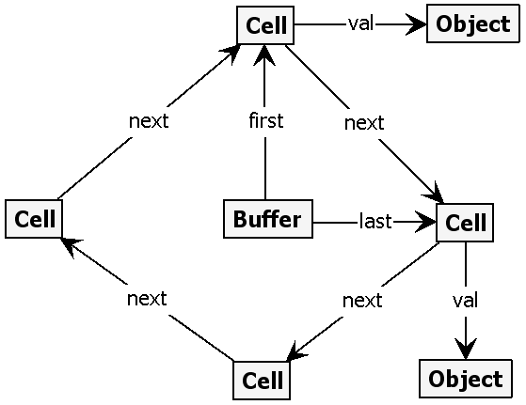
Graphs as Models
Example state graph
  Nodes represents objects
  Edges represent fields or relations between objects
Here: Circular buffer
  Objects inserted at the tail (last element)
  Objects removed from the head (first element)

Slide 4
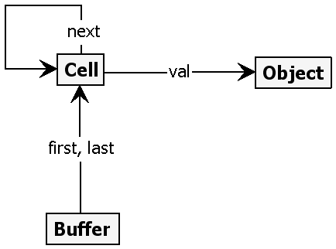
Type graphs as Metamodels
Compare with (UML) class diagrams
Nodes stand for object types
  Also supported: Node inheritance
Edges stand for field/relation types
  Not supported (in our approach): Multiplicities

Slide 5
Graph formalism
Graphs in this presentation (simple graphs):
  Flat (i.e., not hierarchical)
  Directed, edge-labelled, no parallel edges
  Self-edges depicted as node labels
Formally: G = (V,E) with
  Global set L of labels
    Fixed subsets of type labels and flags (= nodel labels)
  V finite set of nodes
  E ⊆ V × L × V finite set of labelled edges
Partial morphisms
  Structure-preserving node mappings
  Isomorphism: bijective (total) morphism
    Used to abstract from node identities

Slide 6
Example morphism
State graph
Type graph
Typing is a (weak) structuring mechanism
  Limits node and edge labels and their interconnection
  Does not enforce presence or absence of edges

Slide 7
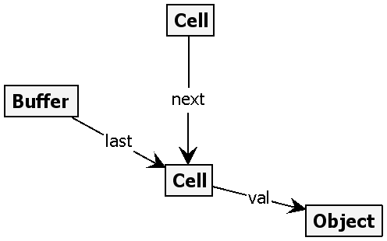
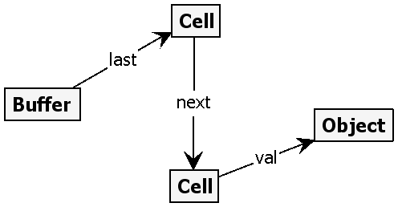
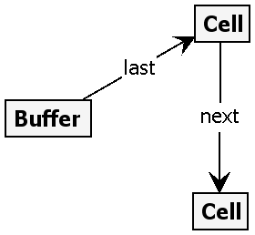
Graph Rewrite Rules
Putting an element into a circular buffer:
RHS
NAC
LHS
A rule embodies a particular change to a graph
  Left Hand Side (LHS): should be matched in the host (source) graph
  Difference of Right Hand Side (RHS) and LHS defines change
  Negative Application Condition (NAC): should not occur in host graph
Compare to string rewriting
  Graph rewrite rules are context sensitive
Graph Production System: Set of rewrite rules

Slide 8
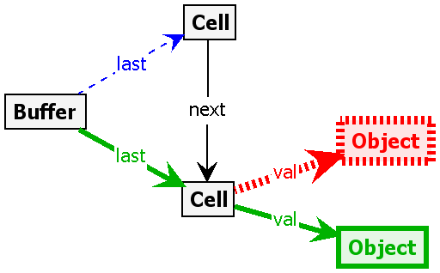
Single-graph representation
black = reader:
LHS and RHS
to be matched and preserved
blue = eraser:
LHS, not RHS
to be matched and deleted
red = embargo:
NAC, not LHS
forbidden
green = creator:
RHS, not LHS
to be added

Slide 9
Graph Productions
Rewrite rule
LHS
rule morphism
RHS
NAC
NAC
NACs
forbidden
matching
source graph
graph morphism
target graph
Graph transition
(labelled by rule and underlying morphism
pushout

Slide 10
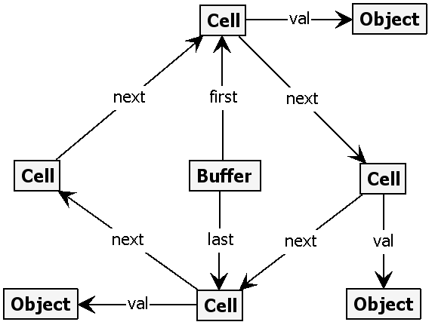
Example production
RHS
NAC
LHS
2
1
3
4
1
2
1
2
3
4
3

Slide 11
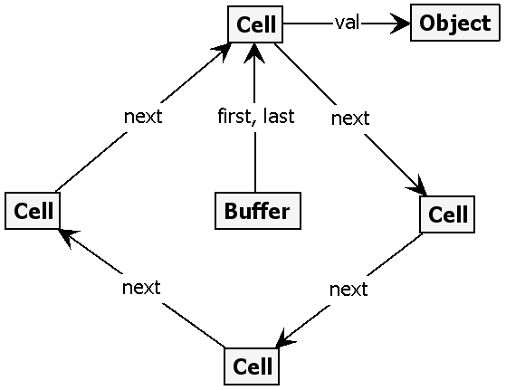
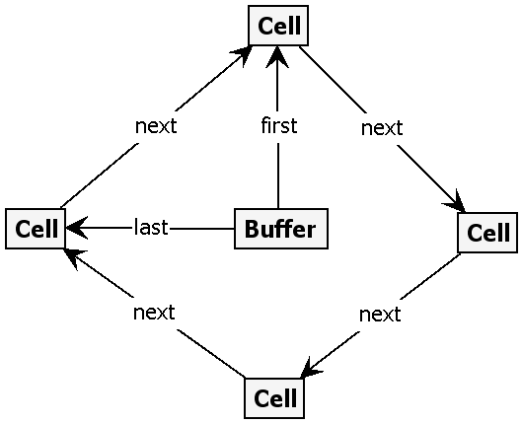
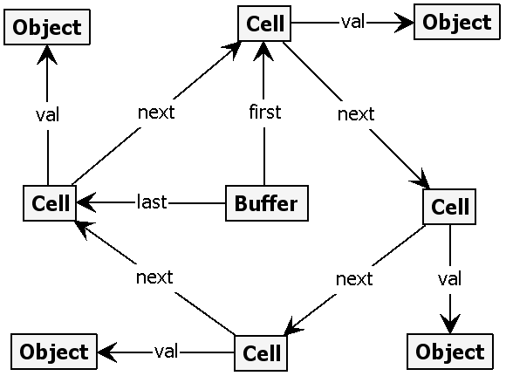
Graph Transition Systems
put
put
get
get
Isomorphic state graphs
are collapsed together
get
get
put
put

Slide 12
Aim: software model checking
Construct graph production system from
  UML diagrams / other specifications
  Programs to be checked
Generate state space
  States = graphs
  Transitions = transformations
Formulate properties
  invariants/reachability (safety)
  liveness
  full temporal logic
Check properties on the model

Slide 13
Personal CaMPaM preview
Questions I am asking myself
Is semantic preservation achievable?
How well does graph-based model checking fit into model transformation?
When will I be happy?
Get answers for the above questions
Find nails for the GROOVE hammer
Meet new people, write papers

