Slide 1
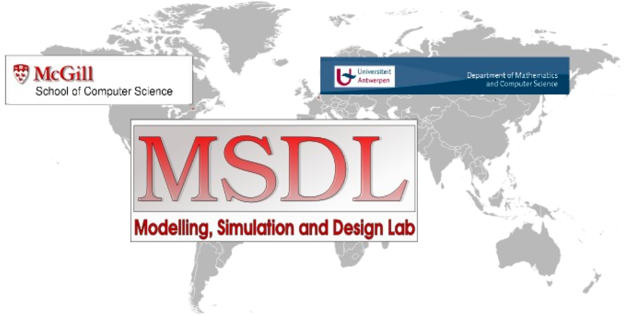
Levi Lúcio
School of Computer Science
McGill University
Canada
(with Joachim Denil, Sadaf Mustafiz, Hans Vangheluwe,
Bart Meyers, Maris Jukss and Raphael Manadiar)

Slide 2
Levi Lúcio
Undergrad, Software Engineering ( - 2000)
(Instituto Superior Técnico, Portugal)
Software Engineer, MSc. Student (2000 - 2003)
(CERN, Switzerland and Sunderland University, England)
  Software Engineering / Databases
PhD. student (2003 - 2009)
(SMV, U. Geneva, Switzerland)
  Model Based Testing
  Language Syntax and Semantics
  Formal modeling
  Concurrency (Algebraic Petri Nets)

Slide 3
Levi Lúcio
Post-Doc (2009-2010)
(SOLAR, U. Nova de Lisboa, Portugal)
  Model Transformation Languages (DSLTrans)
  Model Transformation Verification
  DSL and MDD fundaments
    Precise definition of a DSL
    Precise definition of the MDD process
Post-Doc (2010-2011)
(LASSY, U. Luxembourg, Luxembourg)
  Resilience in software / software evolution (AHL based)
  Verification of Model Transformations

Slide 4
Levi Lúcio
Post-Doc (2011-2012)
(McGill University, Canada)
  Model Transformation Verification for the automotive industry

Slide 5
Main interests
(Formal) Modeling
Verification
Syntax and semantics of computing languages
DSL and MDD fundaments
  Precise definition of a DSL
  Precise definition of the MDD process
Globally intersection between software engineering and formal methods

Slide 6

The NECSIS Project
“NECSIS is focused on the advancement of a software methodology,
called Model-Driven Engineering (MDE), that can yield dramatic
improvements in software-developer productivity and product quality. “
Collaboration between:
McMaster University, University of Waterloo, University of British Columbia,
CRIM (Centre de recherche informatique de Montréal), McGill University,
Queen’s University, University of Toronto, University of Victoria and
General Motors of Canada, IBM Canada and Malina Software.

Slide 7

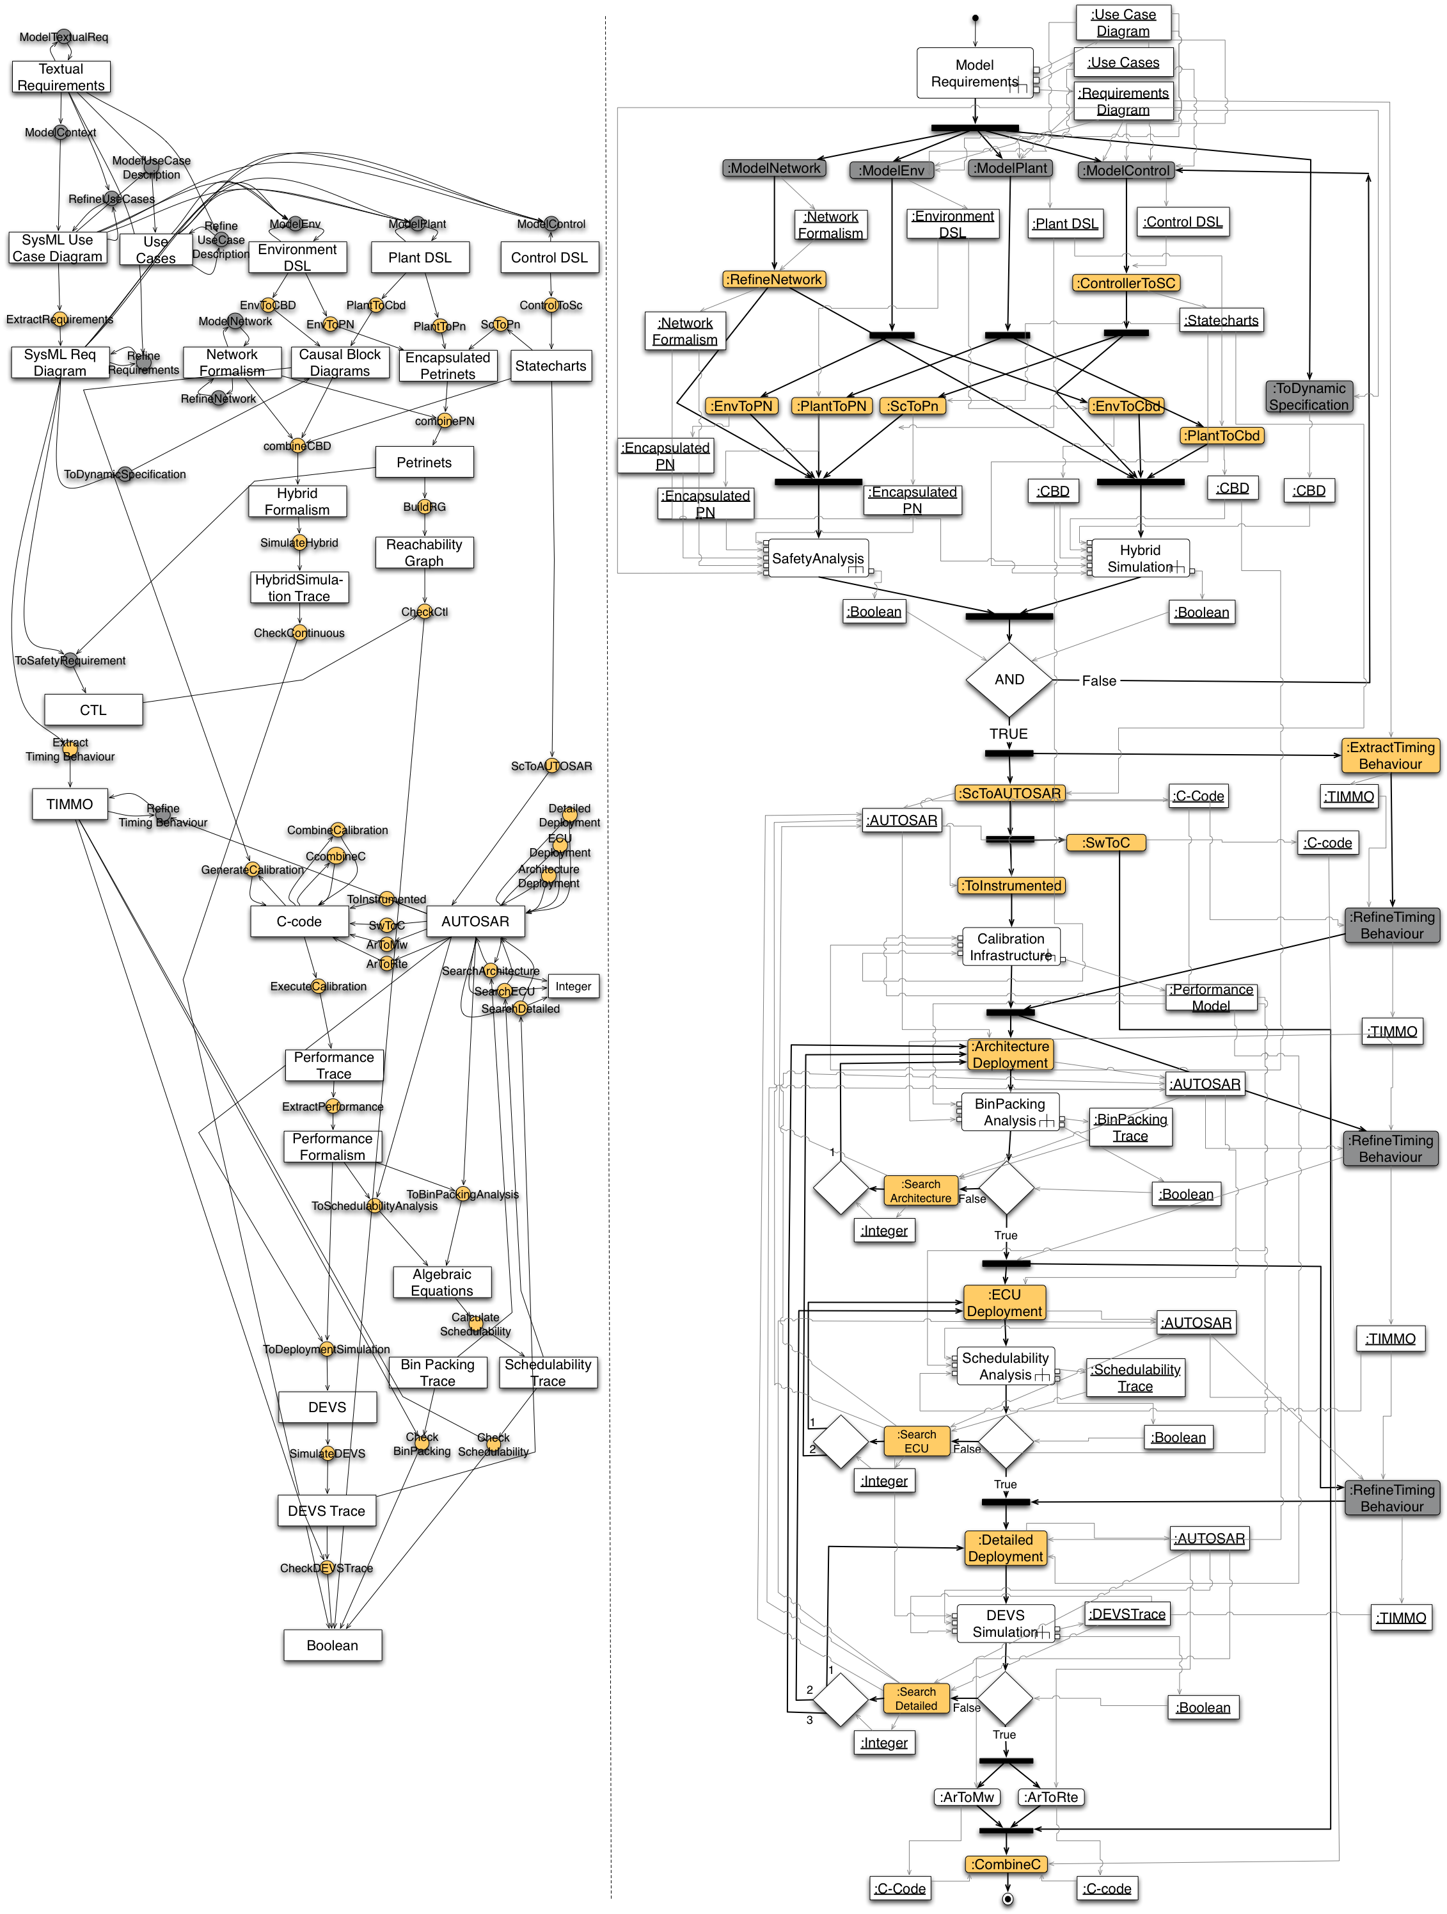
Case Study: MDE based development of control software for Automobiles’ Power Windows

Slide 8
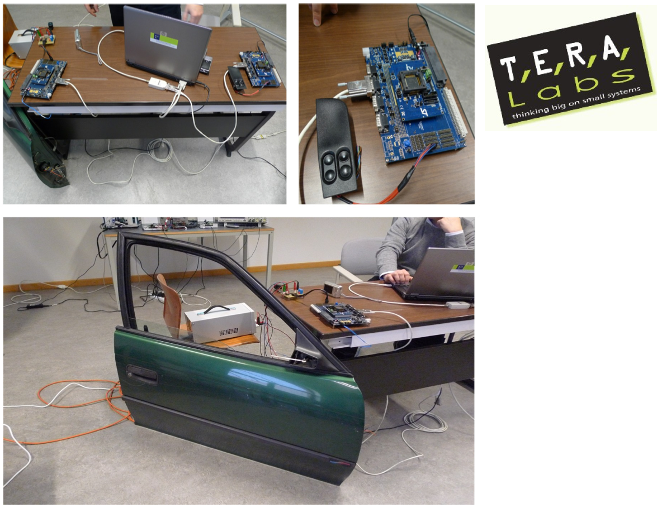

Slide 9
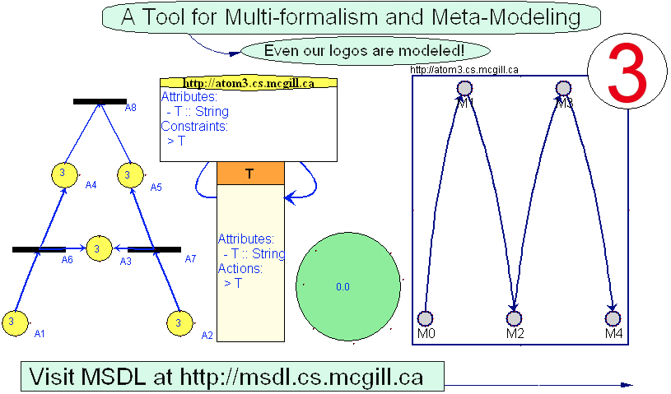
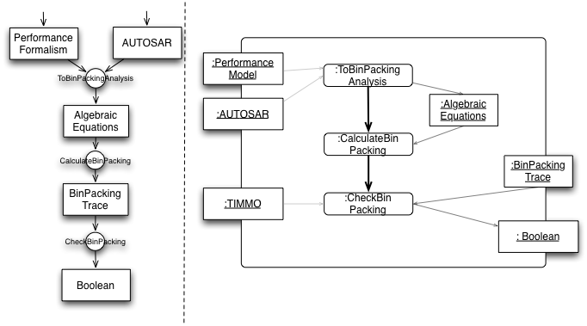
Languages and Transformations
Are the transformations correct?

Slide 10
Questions
What are the properties we want to to ensure for a set of transformations?
How do we prove them?
and… what about domain specificity?

Slide 11
How do we carry on from here?
Need to understand what is the state of the art in Model Transformation Verification
See our paper “A Tridimensional Approach for Studying the Formal Verification of Model Transformations”
  (Moussa AMRANI, Levi LÚCIO, Gehan SELIM,
  Benoit COMBEMALE, Juergen DINGEL, Hans VANGHELUWE, Yves LE TRAON, and James R. CORDY)
The solution seems to be to use the most appropriate techniques for each situation

Slide 12
Transformation
Property (kind)
Formal Verification (Fv) Technique

Slide 13
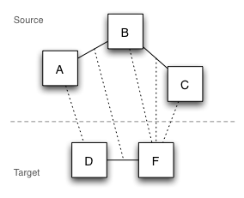
Model Syntax Relations
The fact that certain relations exist between the elements of the source (meta)models
and their counterparts in the target (meta)models implies a correct transformation
[1] D. Akehurst, S. Kent, and O. Patrascoiu, “A Relational Approach to Defining and Implementing Transformations in Metamodels,” SOSYM,
vol. 2(4), pp. 215–239, 2003.
[2] A. Narayanan and G. Karsai, “Verifying Model Transformation By Structural Correspondence,” ECEASST, vol. 10, pp. 15–29, 2008.
[3] A. Schürr and F. Klar, “15 Years of Triple Graph Grammars,” in ICGT, 2008, pp. 411–425.
[4] L. Lúcio, B. Barroca, and V. Amaral, “A Technique for Automatic Validation of Model Transformations,” in MODELS, 2010.

Slide 14
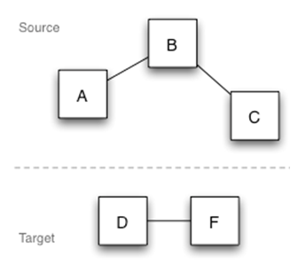
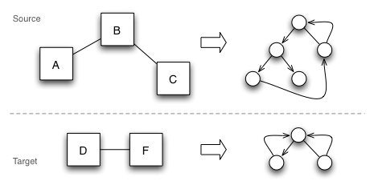
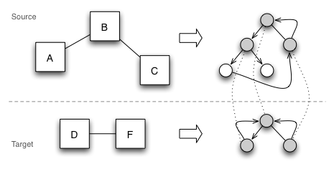
Model Semantics Relations
If certain relations can be established between the semantic domains
of the source and target (meta)models, then the transformation is correct
[1] A. Narayanan and G. Karsai, “Towards Verifying Model Transformations,” ENTCS, vol. 211, pp. 191–200, April 2008.
[2] D. Varro ́ and A. Pataricza, “Automated Formal Verification of Model Transformations,” in CSDUML, 2003, pp. 63–78.
[3] B.Becker, D.Beyer, H.Giese, F.Klein and D.Schilling, “Symbolic Invariant Verification For Systems With Dynamic Structural Adaptation,” in ICSE, 2006.
[4] J.Padberg,M.Gajewsky andC.Ermel,“Refinement versus Verification: Compatibility of Net Invariants and Stepwise Development of High-Level Petri Nets,” Technische Universita ̈t Berlin, Tech. Rep., 1997.
[5] T.Massoni,R.Gheyi,andP.Borba,“Formal Refactoring for UMLClass Diagrams,” in BSSE, 2005, pp. 152–167.

Slide 15
Model Semantics Relations
If certain relations can be established between the semantic domains
of the source and target (meta)models, then the transformation is correct

Slide 16
Model Semantics Relations
Bisimulation / simulation [1]
Preservation of temporal logic formulas [2]
(in particular) preservation of safety properties [3,4]
Preservation of structural semantics [5]
[1] A. Narayanan and G. Karsai, “Towards Verifying Model Transformations,” ENTCS, vol. 211, pp. 191–200, April 2008.
[2] D. Varro ́ and A. Pataricza, “Automated Formal Verification of Model Transformations,” in CSDUML, 2003, pp. 63–78.
[3] B.Becker, D.Beyer, H.Giese, F.Klein and D.Schilling, “Symbolic Invariant Verification For Systems With Dynamic Structural Adaptation,” in ICSE, 2006.
[4] J.Padberg,M.Gajewsky andC.Ermel,“Refinement versus Verification: Compatibility of Net Invariants and Stepwise Development of High-Level Petri Nets,” Technische Universita ̈t Berlin, Tech. Rep., 1997.
[5] T.Massoni,R.Gheyi,andP.Borba,“Formal Refactoring for UMLClass Diagrams,” in BSSE, 2005, pp. 152–167.

Slide 17
Success Criteria
Better understanding of the nature of the verification of Model Transformations according to the three dimensions (and their relations):
  Transformations
  Properties
  Proof techniques
Conceive a better (larger) experimental approach to its study
Study some particular techniques for doing so (c.f. Joachim)

