Slide 1
Rick Salay
Modeling management group at University of Toronto
  Marsha Chechik
My interests:
  Conceptual and formal foundations of modeling that have practical applications
Recent/Current work:
  Model roles/intent (PhD)
  Model uncertainty
  Model Management Tool Framework (MMTF)
  Ontology of model relationships

Slide 2
The Model Role Level
… But modelers always have intentions about the roles of the models they create …
TollPrice should show all and only toll pricing information
BuyTollTicket should show ticket purchase process and should use attributes in TollPrice
Toll should show the objects and links of BuyTollTicket
So they also work at the role level – where the modeler intent exists
Role Level
uses
objectsOf
Toll:OD
TollPrice:CD
show only toll pricing info
BuyTollTicket:SD
show toll ticket purchase process
Modelers seem to work exclusively at the model level – creating the content of models
plays
plays
plays
constrains
TollPriceV22: CD
BuyTollTicketV5:SD
TollV3:OD
Model Level

Slide 3
Discussion Topic
MPM - collections of related model roles
  Model role should identify the level of abstraction of model relative to the system being modeled
    Metamodel is not enough: many different levels of abstraction can be captured with the same metamodel
Topic
  What constraints can be used to characterize the intended level of abstraction of a model?
  Can be used to check for over/under modeling

Slide 4
Expressing Model Uncertainty
P1:MAVO(ClassDiagram)
Not sure which security attributes - but know some will be needed.
?
Not sure what other vehicle types there will be
?
?
?
?
?
?
Not sure if we will have Hovercraft or which class it specializes.
Not sure which class will hold the numOfDoors attribute

Slide 5
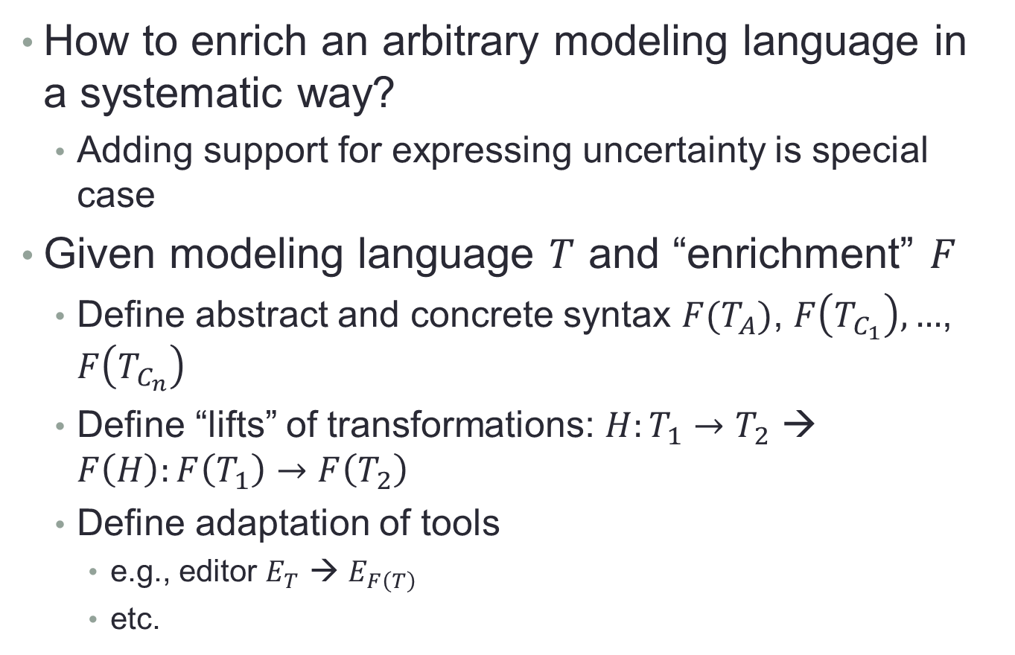
Discussion Topic
How to enrich an arbitrary modeling language in a systematic way?
  Adding support for expressing uncertainty is special case
Given modeling language $T$ and “enrichment” $F$
  Define abstract and concrete syntax $F(T_{A})$, $F\left(T_{C_{1}}\right), …$, $F\left(T_{C_{n}}\right)$
  Define “lifts” of transformations: $H:T_{1}→T_{2}$ → $F\left(H\right):F\left(T_{1}\right)→F\left(T_{2}\right)$
  Define adaptation of tools
    e.g., editor $E_{T}$ → $E_{F\left(T\right)}$
    etc.

Slide 6
Topics and success criteria
Formally characterizing levels of abstraction in models
In a systematic way, enriching a modeling language and associated transformations, tools, etc.
Defining an “upper ontology” of modeling
  specifically: classifying model relationships/transformations
Criteria for success
  Find connections between teams
  Defining theory
  Publish joint papers

