Slide 1
Modular design of domain-specific languages
Bart Meyers
Notes:
This talk is in the research area of domain-specific modeling. These days, we build complex and heterogeneous systems.
In DSM, the goal is to model your system at the most appropriate level of abstraction, using the most appropriate formalism. This way, accidental complexity of the system is minimized.
Therefore, customized languages are created. The enablers are meta-modeling and model transformation. The structure of these languages is defined by meta-modeling, and the meaning is given by a model transformation mapping to a semantic domain.

Slide 2
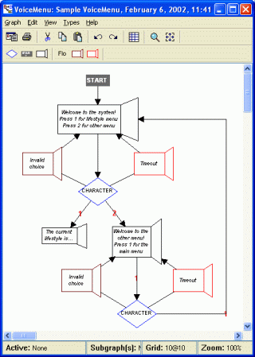
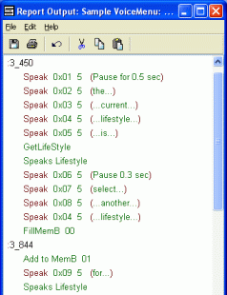
MenuItem
1
next
*
MenuItem
1
next
*
Choice
Choice
+choice: Integer
+choice: Integer
RecordedAudio
UserInput
Start
RecordedAudio
UserInput
Start
Menu
Error
Timeout
Menu
Error
Timeout
Notes:
When meta-modeling, we start from a clean sheet. Let us take into account an example from the MetaCase tool implementing a DSL for a voice menu for an 8-bit microcontroller. The system would enable the user to control devices at home remotely over the phone. For example, while driving home from work, you could call in and order the system to turn on the air conditioning and garage lights.
The menu consists of MenuItems. We can step through the menu according to Choices, with an integer attribute. A MenuItem can be recorded audio, waiting for user input or the start of the menu. Recorded audio can either be a menu message, an error message or a timeout message.
From this meta-model, a tool such as MetaCase can generate a modeling environment. Voice menus can now be modeled easily at the right level of abstraction in the most appropriate formalism. The modeler does not have to take issues such as networks or memory restrictions into account. The modeling environment can create executable code from the model. In this generated code, all complex issues are been taken care of.
two examples ("random" as they were simply the first two examples of MetaCase):
- voice menu for 8-bit microcontroller: http://www.dsmforum.org/voicemenu.html
smart phone application: http://www.dsmforum.org/phone.html
Similarities:
- state-based (state - transition)
- constrained environment (battery life, limited memory)
- user interaction
complex because distributed system
Why not language for "interactive applications for embedded systems"? Because of the differences (we want to maximally constrain a language, and use the most appropriate language):
- notion of voice vs no notion of voice
- notion of menu layout vs voice menu recording (2-dimensional vs 1-dimensional)

Slide 3
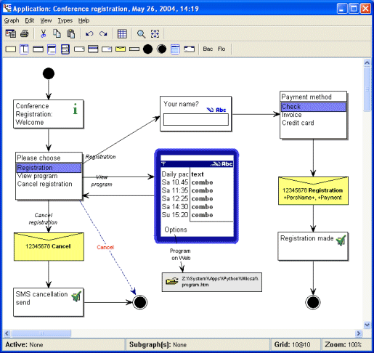
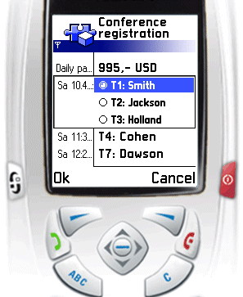
*
*
followedBy
followedBy
1
Event
1
Event
Action
Action
+ID: String
+event: String
+ID: String
+event: String
+ID: String
+ID: String
SendMessage
SendMessage
ViewWebPage
ViewWebPage
Exit
Exit
Start
Start
Display
Display
+dest: String
+message: String
+dest: String
+message: String
+url: String
+url: String
*
*
VisualElement
VisualElement
1
1
shows
shows
+ID: String
+height: String
+width: String
+ID: String
+height: String
+width: String
*
*
contains
contains
Widget
Widget
Container
Container
0..1
0..1
+code: Text
+code: Text
+layout: ENUM
+layout: ENUM
Notes:
Let us take a look into a second example. This DSL enables the modeling of smartphone applications. An example of such an applications is a conference registration system, which allows users to register by phone, and pay by SMS.
There are certain Events that can happen such as clicking, with ID and event description. These events are followed by an Action. Such an Action can be sending a text message, viewing a web page, quitting and starting the application, or displaying a screen. When displaying, a VisualElement is shown, which can be a Widget (such as a text box, label or list – not visualized) or a Container, containing multiple VisualElements.
Again, applications can be built on the most appropriate level of abstraction, using the most appropriate formalism. Code can be fully generated and executed on a smartphone.

Slide 4
Event
*
followedBy
1
Action
+ID: String
+event: String
+ID: String
MenuItem
1
next
*
Choice
SendMessage
ViewWebPage
Exit
+choice: Integer
Start
Display
+dest: String
+message: String
+url: String
*
RecordedAudio
UserInput
VisualElement
Start
1
shows
+ID: String
+height: String
+width: String
*
contains
Menu
Error
Timeout
1
Widget
Container
State
transitionsTo
*
Transition
0..1
+code: Text
+layout: ENUM
Notes:
Both DSLs have some things in common. They both transition from one state to another, depending on user interaction. In other words, they both model state based behavior.
When defining these languages, we can reuse a simplified version of a formalism which models this, e.g., statecharts. As a benefit, we can use the well-known statechart formalism for analysis.
Other parts of the language for smartphone applications can be reused, such as the use of IDs. This is a generic language feature, which might be as well the use of e.g., authorization.
Another example is the modeling of the layout. Such layouts can be independent of a domain, and can thus be reused.

Slide 5
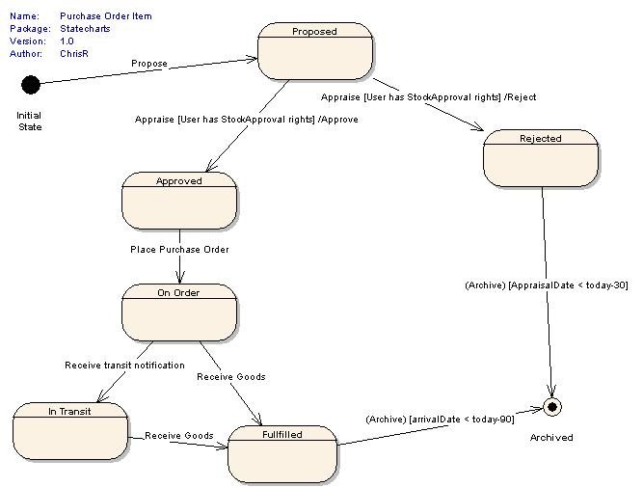
Notes:
Up to now, we only talked about abstract syntax. The concrete syntax can also be reused: for the state based behavior, we can reuse the well-known rounded rectangles as states, and arrows with guard labels as transitions.
In order to preserve the meaning of this part of the DSL, we can use the statechart formalism as a semantic domain and automatically map to states and transitions. This way, our newly defined language gets a part of its meaning for free.
The difficulty will of course be the composition of these DSLs and their parts.

Slide 6
Event
*
followedBy
1
Action
Breakpoint
0..1
interrupts
1
+ID: String
+event: String
+ID: String
SendMessage
ViewWebPage
Exit
Start
Display
+dest: String
+message: String
+url: String
*
VisualElement
1
shows
+ID: String
+height: String
+width: String
*
contains
Widget
Container
0..1
+code: Text
+layout: ENUM
Notes:
When the modular composition of DSLs is enabled, we believe this can be used for addressing a number of problems in DSM.
First, reuse can lower the initial cost of building the DSL. For this, we need to classify the reusable components. We might think in terms of reusable languages (statecharts, differential equations), but it seems that a better way is to think in terms of language features or properties (behavior, discrete, nondeterminism, hierarchy, …).
Second, debugging is an interesting use of this technique. We can add for example breakpoints to the language. If a breakpoint can be set on an Event, we can interrupt the application. The meaning of the breakpoint would be to pause the system and pass the current state to the user.
There are some other possibilities, like bridging the gap between requirements and design, traceability, and evolution of languages.

