Slide 1
Hybrid Rule Scheduling in Story Driven Modeling a tool-independent approach
by Bart Meyers
Principal Adviser: prof. dr. Dirk Janssens
Principal Co-Adviser: dr. Pieter Van Gorp

Slide 2
Goal
“Bart, what have you done?”
Master’s thesis
Fujaba Days 2008 (Dresden)
GraBaTs 2009 (Zürich)
Option entrepreneurship (off topic, yet interesting)

Slide 3
Outline
Graph transformation
Graph transformation in general
Graph transformation in MoTMoT
Higher order transformation
Case study
BPMN to BPEL (GraBaTs 2009)
Implicit rule scheduling (Fujaba Days 2009)
Negative application conditions
Conclusion and future

Slide 4
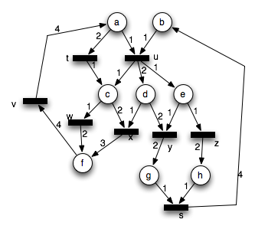
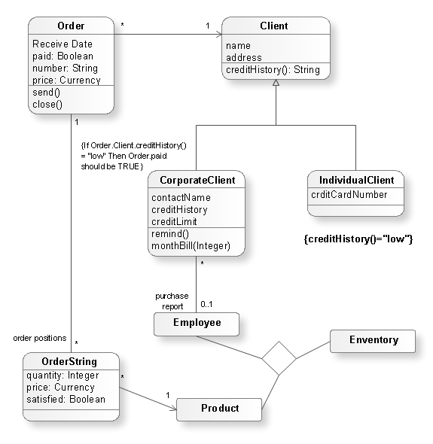
Graph transformation
Transforms models
Models as graphs
graph transformation
Set of transformation rules
CRUD operations

Slide 5
Graph transformation
Rule selection
nondeterministic
controlled
Location selection
one-point
concurrent
user input
Rule application
Transformation rule 1
LHS
RHS
Transformation rule 2
Transformation rule 2
LHS
LHS
RHS
RHS
Input model
Output model
Rule application

Slide 6
Graph transformation with MoTMoT
Story Driven Modeling (SDM)
Story Diagrams and Story Patterns
UML compliant
Story Diagrams as Activity Diagrams
Rules as states
Control flow as transitions
Story Patterns as Class Diagrams
Rewrite nodes as classes
Links as associations
UML profile for model transformation
UML extension mechanisms: stereotypes and tagged values

Slide 7
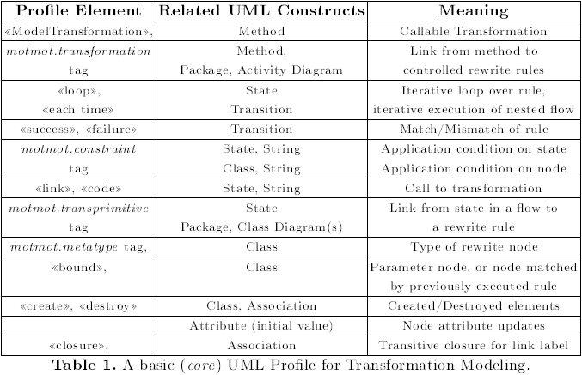
Graph transformation with MoTMoT
“SDM Core language”
Pieter Van Gorp, Anne Keller, Dirk Janssens, Transformation language integration based on profiles and higher order transformations, Toulouse, France. Sept. 29-30, 2008

Slide 8
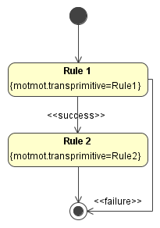
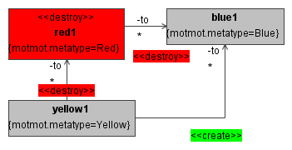
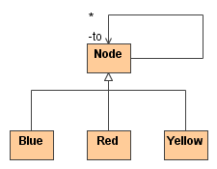
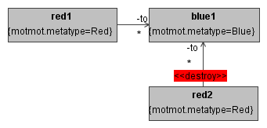
Graph transformation with MoTMoT
Abstract syntax in rules
(follows metamodel)
Rule selection:
controlled
Location selection:
one-point
Abstract syntax in rules
(follows metamodel)
Rule selection:
controlled
Location selection:
one-point
Story Diagram
Story Diagram
Metamodel
Metamodel
Rule 1
Rule 2
Input model
Input model
Output model
Rule application

Slide 9
Higher order transformation
transformation
language model
transformation
language model
conforms to
conforms to
Input
meta-
model
Output meta-
model
transformation
model
transformation
model
HOT
conforms to
instance of
conforms to
Input
model
Output
model
transforms to

Slide 10
BPMN to BPEL
Business processes
Business Process Modeling Notation (BPMN)
Focus on clarification
Used by domain analysts
Based on flow-charts
Graph-oriented
Business Process Execution Language (BPEL)
Focus on execution
Used by experts
Based on XML (no graphical notation)
Tree-oriented

Slide 11
BPMN to BPEL example
s
<?xml version="1.0" encoding="UTF-8"?>
<process xmlns="http://docs.oasis-open.org/wsbpel/2.0/process/abstract" name="smallStructured.bpmn">
<partnerLinks />
<variables>
<variable name="request_nok" />
<variable name="request_ok" />
<variable name="stock_ok" />
<variable name="stock_nok" />
</variables>
<sequence>
<receive name="ProcessInstantiation" />
<switch>
<case condition="request_nok">
<invoke name="returnFeedback" />
</case>
<case condition="request_ok">
<sequence>
<invoke name="checkStock" />
<switch>
<case condition="stock_ok">
<invoke name="rejectOrder" />
</case>
<case condition="stock_nok">
<sequence>
<invoke name="confirmOrder" />
<flow>
<invoke name="sendInvoice" />
<invoke name="shipGoods" />
</flow>
</sequence>
</case>
</switch>
</sequence>
</case>
</sequence>
</process>
request_ok
request_nok
checkStock
returnFeedback
stock_nok
stock_ok
BPMN2BPEL
confirmOrder
rejectOrder
sendInvoice
shipGoods
e

Slide 12
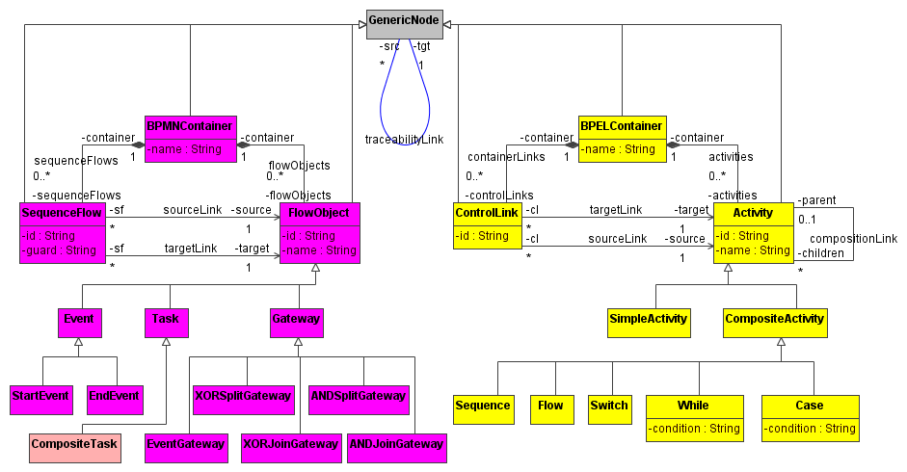
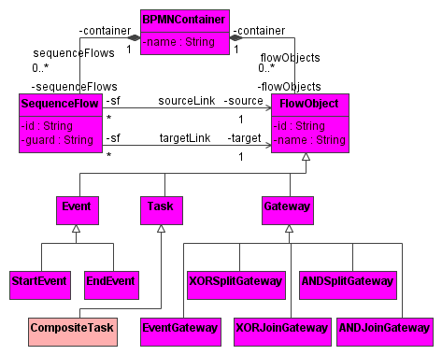
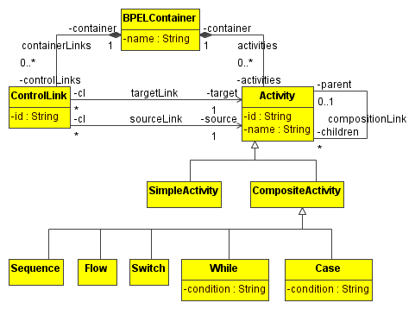
BPMN to BPEL metamodel
BPMN
BPEL

Slide 13
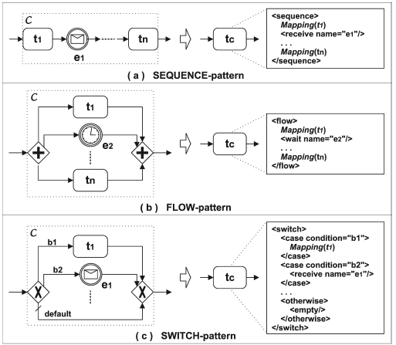
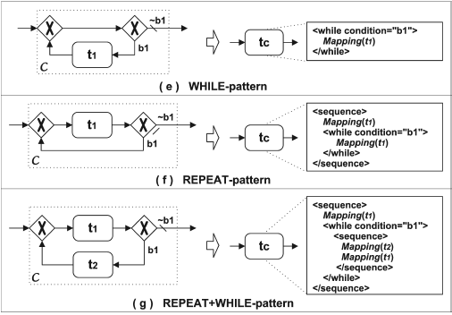
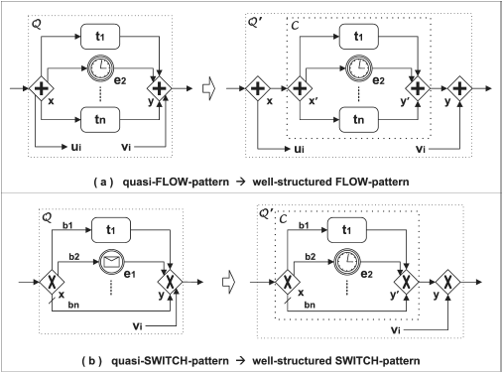
BPMN to BPEL folding algorithm
Well-structured patterns
Quasi-structured patterns

Slide 14
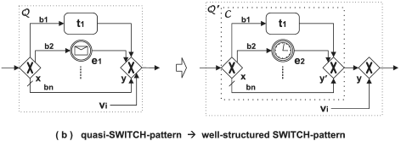
Folding algorithm example
s
s
s
s
s
s
s
s
s
s
s
s
s
s
request_ok
request_ok
request_ok
request_ok
request_nok
request_ok
request_nok
request_nok
request_nok
request_nok
checkStock
checkStock
request_ok
request_ok
request_ok
checkStock
checkStock
checkStock
request_ok
request_ok
s
request_ok
s
request_nok
s
request_nok
request_nok
request_nok
request_nok
request_nok
request_ok
request_ok
returnFeedback
request_ok
returnFeedback
checkStock
checkStock
checkStock
checkStock
checkStock
request_nok
checkStock
request_nok
request_nok
returnFeedback
returnFeedback
returnFeedback
checkStock
checkStock
checkStock
s
s
stock_nok
returnFeedback
stock_nok
returnFeedback
returnFeedback
returnFeedback
returnFeedback
returnFeedback
stock_nok
stock_nok
request_nok
stock_nok
request_nok
request_nok
request_ok
request_ok
stock_ok
request_ok
stock_ok
confirmOrder
confirmOrder
stock_ok
stock_ok
Success!
stock_ok
stock_nok
stock_nok
stock_nok
stock_nok
stock_nok
returnFeedback
stock_nok
returnFeedback
returnFeedback
compTask5
compTask5
returnFeedback
returnFeedback
returnFeedback
compTask4
compTask4
stock_ok
compTask4
stock_ok
stock_ok
stock_ok
stock_ok
rejectOrder
stock_ok
rejectOrder
confirmOrder
confirmOrder
rejectOrder
confirmOrder
rejectOrder
rejectOrder
compTask2
compTask2
compTask2
compTask3
compTask3
compTask3
e
e
rejectOrder
rejectOrder
rejectOrder
compTask2
compTask2
compTask2
rejectOrder
rejectOrder
rejectOrder
sendInvoice
sendInvoice
shipGoods
shipGoods
compTask1
compTask1
compTask1
e
e
e
e
flow
e
e
sequence
switch
sequence
switch
map(confirmOrder)
map(shipGoods)
map(rejectOrder)
map(returnFeedback)
e
map(checkStock)
e
e
e
e
e
map(sendInvoice)
e
e
e
e
e
map(compTask1)
map(compTask2)
map(compTask4)
map(compTask3)

Slide 15
BPMN to BPEL transformation
Create new BPEL container
Perform patterns (first try the well-structured patterns)
Is the remaining BPMN trivial?
no: quit
Reconstruct mappings to build structure of BPEL model

Slide 16
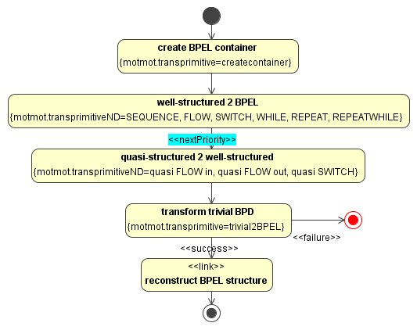
BPMN to BPEL Story Diagram
New language constructs for nondeterministic scheduling
Keep folding using all patterns until they all fail
But the well-structured have priority over the quasi-structured
CLEAR
READABLE
MODULAR

Slide 17
Implicit rule scheduling in SDM
At the level of Story Diagrams
Syntax: how does the reader know what we mean?
Additional language constructs for nondeterminism
motmot.transprimitiveND tag
nextPriority stereotype
Semantics: how does MoTMoT know what we mean?
Convert the Story Diagram to SDM Core language
preserve the behavior!
Higher order transformation

Slide 18
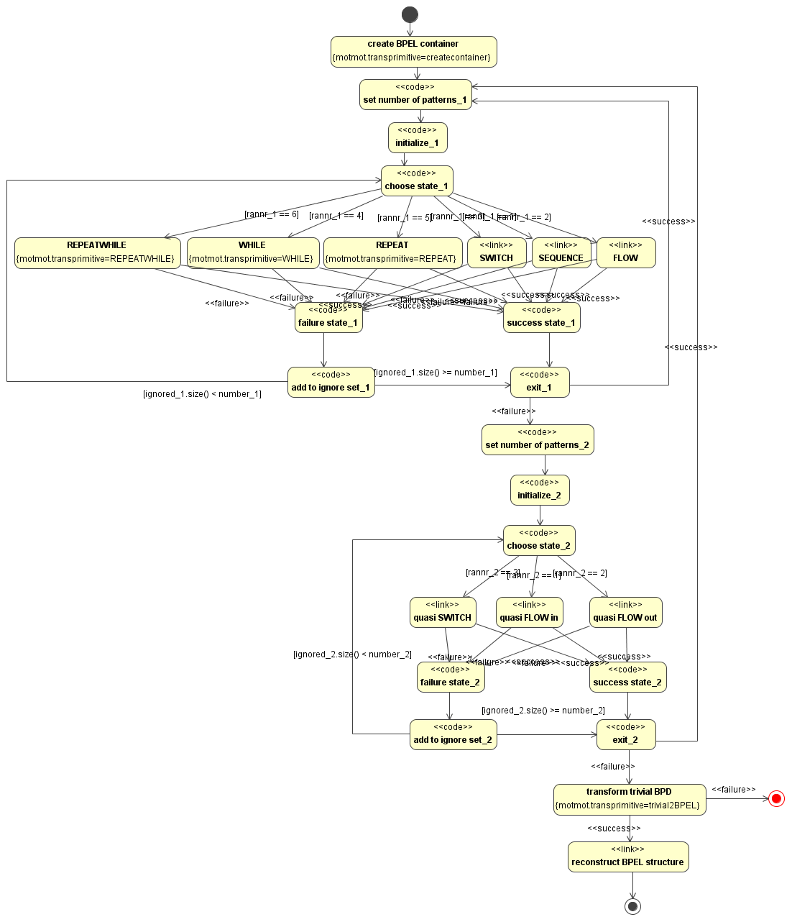
Transforming BPMN2BPEL
HOT
Conform to the SDM Core language

Slide 19
Implicit rule scheduling in SDM
What exactly does nondeterminism mean?
Choose random, but how?
Evaluate rules until one matches
Try one rule and return whether it matched
Keep matching until all the rules fail to match
Keep matching until one rule fails to match
... (depends on the context)
variants are analyzed and categorized according termination criteria and repetition criteria
Variants can be added by creating a prototype

Slide 20
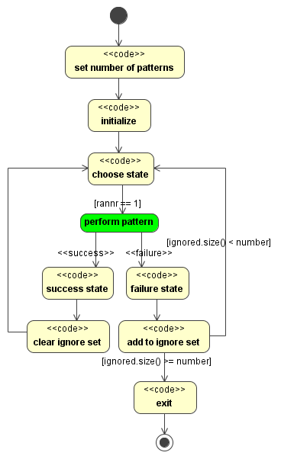
Prototypes
Follows some conventions
Application Condition
Example
“Keep matching until all rules failed”

Slide 21
Higher order transformation
Load all available prototypes
Transform nextPriority transitions
Transform motmot.transprimitiveND states
Choose the right prototype according to the application conditions
Copy the prototype into the Story Diagram
Create a state and transitions for each reference
For a Story Pattern: create a motmot.transprimitive state
For a Story Diagram: create a link state with a method call

Slide 22
Negative application conditions
At the level of Story Patterns
Match the pattern and fail to match the NAC
A NAC is an additional constraint for matching a rule
New language construct: NAC package
Will be converted to SDM Core language using a HOT

Slide 23
NAC example
BPMN2BPEL: merge activity into sequence
s
<?xml version="1.0" encoding="UTF-8"?>
<process xmlns="http://docs.oasis-open.org/wsbpel/2.0/process/abstract" name="sequence.bpmn">
<partnerLinks />
<variables />
<sequence>
<receive name="ProcessInstantiation" />
<sequence>
<invoke name=“task 1" />
<sequence>
<invoke name=“task 2" />
<invoke name=“task 3" />
</sequence>
</sequence>
</sequence>
</process>
<?xml version="1.0" encoding="UTF-8"?>
<process xmlns="http://docs.oasis-open.org/wsbpel/2.0/process/abstract" name="sequence.bpmn">
<partnerLinks />
<variables />
<sequence>
<receive name="ProcessInstantiation" />
<invoke name=“task 1" />
<invoke name=“task 2" />
<invoke name=“task 3" />
</sequence>
</process>
task 1
BPMN2BPEL
task 2
task 3
e
Add activities to surrounding sequences
Correct, but not very readable

Slide 24
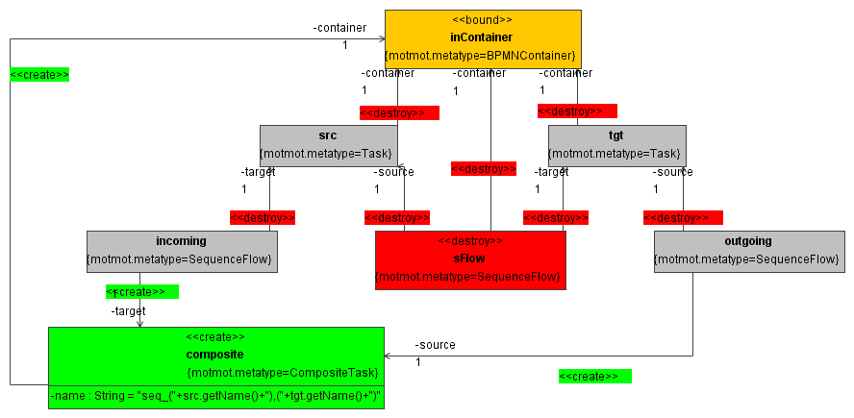
NAC example
Match a sequence

Slide 25
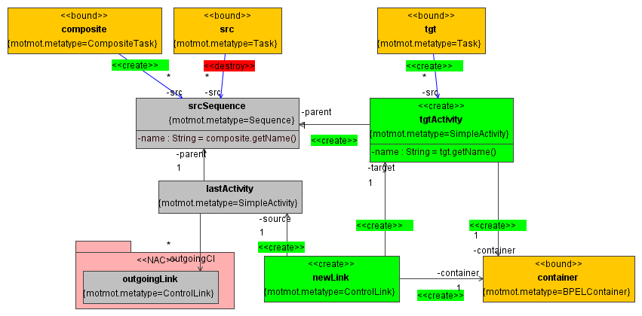
NAC example
If one of the tasks src or tgt is a sequence, merge
Add control link to last activity (the one without an outgoing link)

Slide 26
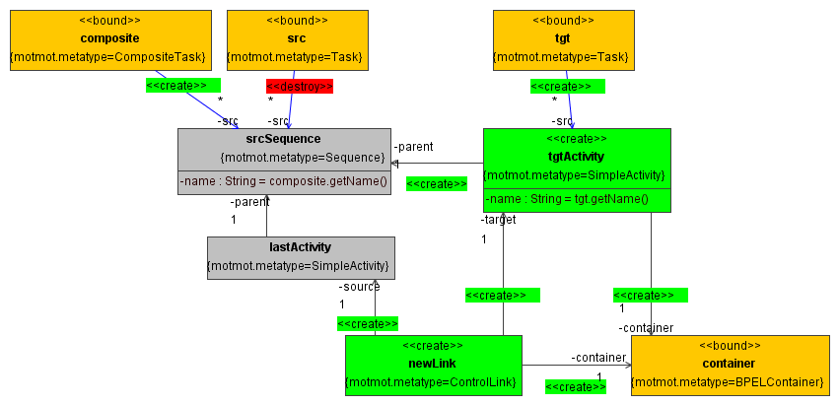
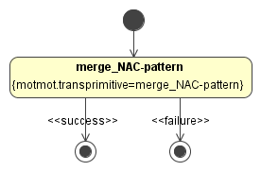
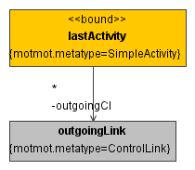
NAC example
{motmot.constraint=!merge_NAC(lastActivity)}
HOT
merge_NAC Story Diagram
merge_NAC-pattern Story Pattern

Slide 27
Conclusion
Two new useful language constructs
Implicit rule scheduling
Negative application conditions
2nd place award in the GraBaTs 2009 offline contest
Two techniques
Higher order transformation
Prototypes
Tool independence
Modularity

Slide 28
Conclusion
Lots of other language extensions possible
Multi objects
Optional graph elements
Maybe clauses
Transitive closure

Slide 29
Future
“Bart, what are you going to do?”
IWT research proposal
Preparation of courses
MODELS 2009 workshop paper (with Eugene)
BPMN to BPEL paper (with Pieter)

