Slide 1
Chaotic Behavior - Cellular automata
COMP 522 Modeling and Simulation Research Project
Andrey Paunov

Slide 2
What is Cellular automata?
C.A. is a collection of cells on a grid which evolve over discrete time with a set of rules
These rules depend on the state of the neighbors in the previous time step.
Discovered by von Neumann in study of biological systems (early 1950s).
Wolfram (starting 1980s) – more in depth study in “A New Kind of Science” book.
http://en.wikipedia.org/wiki/Cellular_automaton

Slide 3
Conway’s simplified model
Von Neumann – Self replicating hypothetical machine – complicated rectangular grid
Conway simplified von Neumann mathematical model
Conway’s Game of Life – Scientific American 1970
New field for scientific research

Slide 4
Conway's Game of Life
Rules for the game of life:
< 2 alive neighbors -> cell dies of under-population.
2 or 3 live neighbors -> cell lives on to the next generation.
> 3 live neighbors -> cell dies of overcrowding.
== 3 live neighbors -> dead cell becomes a live cell by reproduction.

Slide 5
Many varieties
Type of grid:
1D – line (each state == one row)
2D – square, triangular, and hexagonal
Cartesian grids over the natural numbers (most common)

Slide 6
Cell State
The new cell state depends on the states of the previous neighbor cells and its own
Each of the three parents can have 2 possible states
Example: rule 30
http://www.stilldreamer.com/mathematics/1d_cellular_automaton/

Slide 7
States of the cell
Each cell can have two possible values: 0 or 1
Depending on that value, the cell could be either in “off” == 0 or “on” == 1.
2x2x2 = 2^3 = 8 possible binary states
=> 2^8 = 256 in total of elementary cellular automata, index by 8 – bit binary number
For example: rule 30 is (00011110)
http://www.ba.infn.it/~zito/automachaos.html

Slide 8
Notation
Wolfram code – binary representation
Mirek's Cellebration – string “dx/dy”, d is number of alive neighbors, x, y are from 0 - 8.
Golly (open-source cellular automaton package) – Bx/Sy, where B == birth and S == servival.
http://en.wikipedia.org/wiki/Life-like_cellular_automaton#Notation_for_rules
http://en.wikipedia.org/wiki/Mirek%27s_Cellebration

Slide 9
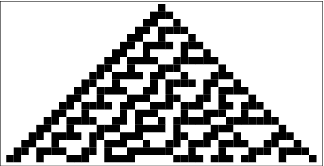
Generations
N number of generations produces:
Rule 30
http://mathworld.wolfram.com/CellularAutomaton.html

Slide 10
More rules

Slide 11
Chaos in cellular automata
Very useful in image cryptography
For example rule 30 – chaotic
Unable to predict the formula from generation n, without knowing the formula at generation n – 1
Message superimpose it on a chaotic signal
http://www.technologyreview.com/blog/arxiv/27460/

Slide 12
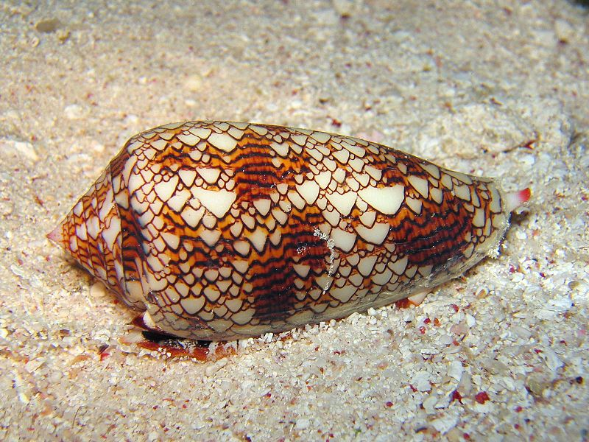
Biological Appearance
Rule 30 - Conus textile

Slide 13
Simulation Examples
Conway’s Game of Life
Diffusion of solution in medium
Rule 30
Rule 90
http://en.wikipedia.org/wiki/Conway%27s_Game_of_Life

