Slide 1
Internal DSLs: Scala

Slide 2
Overview
Scala
Traffic DSL in Scala
Comparison AToM3
Conclusion & Future work

Slide 3
1. Scala
“scalable language”
grow with the demands of its users
Runs on the standard Java platform
Interoperates with all Java libraries
Scala = OO + functional programming
Eg. List(1, 2, 3, 4, 5) map { _ * 2 } => List[Int] = List(2, 4, 6, 8, 10)

Slide 4
2. Traffic DSL in Scala

Slide 5
2.1 Road
Concrete syntax
Abstract syntax
val r1 = new Road(5 m)
val r2 = new Road("e17")
val r3 = new Road(10 km, "a12" )
val r4 = new Road()
r1 > r2 > r3 > r4
class Road extends InOutSegment {
var in: Segment = null
var out: Segment = null
[..]
}

Slide 6
2.1 Road: abstract syntax
Multiple constructors
class Road() extends InOutSegment {
TrafficSim.+(this)
var length: Int = Default.roadlength
var name: String = NextName.road
[..]
def this (l : Int, n : String = NextName.road) = {
this()
length = l
name = n
}
def this(n: String) = {
this()
name = n
}
[..]
}

Slide 7
2.1 Road: abstract syntax
Infix Operator Notation
r1 > r2 > r3
r1.>(r2).>(r3)
r1.>(r2)
r2.>(r3)

Slide 8
2.1 Road: abstract syntax
Implicit Conversion
Integer doesn’t have km() method!
Implicit conversion: Int => Measure
val r1 = new Road(5 km) 5.km()
protected case class Measure(val amount: Int){
def km: Int = amount*1000
def m: Int = amount
}
Measure(5).km() => 5000 meters
implicit def int2Measure(i: Int) = new Measure(i)

Slide 9
2.2 Merge & Split
Concrete syntax
// create roads
val r1 = new Road()
val r2 = new Road()
val bigRoad = new Road()
//merge
(r1,r2) > bigRoad
//split
bigRoad > (r1,r2)

Slide 10
2.2 Merge: abstract syntax
Implicit Conversion
(r1,r2).>(bigRoad)
Tuple2[Road, Road] doesn’t have >(r : Road) method!
implicit def tuple2DualRoad(t: Tuple2[Road, Road]) = new DualRoad(t._1, t._2)

Slide 11
2.3 Car
Concrete syntax
Create own cars!
val e313 = new Road()
// add Tractor to the road e313
new Car("Tractor") at e313
// add Ferrari to the road e313 with speed = 180kmh
new Car(180 kmh,"Ferrari") at e313
// add car with default parameters to e313
new Car() at e313
class LeftCar(s: Int, name : String) extends Car(s,name){
override def getDirection(left : Road, right : Road): Direction = Left
}
}

Slide 12
2.3 Car: abstract syntax
Multiple constructors
class Car(val speed: Int = Default.speed, val name: String = NextName.car) {
def this(n: String) = this(Default.speed, n)
[..]
def at(r: Road) { .. }
def getDirection(left: Road, right: Road): Direction = {
if (Random.nextBoolean) {
return Left
} else {
return Right
}
}

Slide 13
2.4 Generator, Sink & Capacity
Generator & Sink
//generate 6 cars and each car has a tracker
new Generator(6,true) > e313 > new Sink()
//generate 11 cars, speed of car = 6kmh and name = jos
new Generator(11,false,6 kmh, "jos") > new Road() > new Sink(“hey“)
Capacity
val c = new Capacity(4)
val r1 = new Road() + c
val r2 = new Road() + c

Slide 14
2.5 TrafficLight
// define a trafficlightcontrol that starts on Green
val tlc = new TrafficLightControl(Green)
new Road() + TrafficLight(tlc)
// trafficlight with opposite = true // this means the trafficlight will start red
new Road() + TrafficLight(tlc,true)

Slide 15
2.6 Tracker
A road/car can have tracker
Save all events of that car/road during a simulation in a xml file
Event: eg. when a car enters a new road.
The generated XML could be loaded in the DEVS Trace Plotter

Slide 16
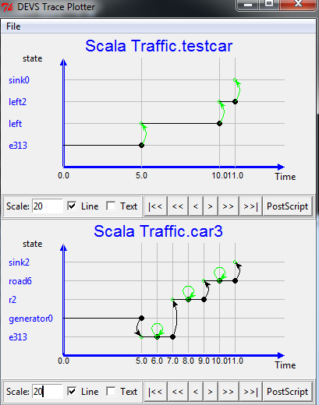
2.6 Tracker
new Car + Tracker()
new Road + Tracker()

Slide 17
2.7 Simulate

Slide 18
3. Comparison AToM3
Abstract Syntax
AToM3: Class Diagram Formalism
Create classes (actions(python), constraints(python), attributes)
Create associations (multiplicities)
Inherit from other classes
Scala Language
Create classes (methods, exceptions, attributes)
Associations as class attributes
Inherit from other classes + traits

Slide 19
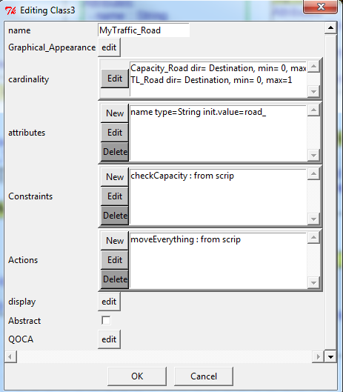
3. Comparison AToM3

Slide 20
3. Comparison AToM3
Concrete Syntax
AToM3: Class Diagram Formalism
Instances of classes => graphical
Load multiple formalisms
Scala Language
Instances of classes => textual
More freedom:
Write scala code in internal DSL or interop with Java

Slide 21
3. Comparison AToM3
Operational Semantics
AToM3: Class Diagram Formalism
Coded model transformation
Rule-based model transformation
View the simulation step by step (moving cars, ..)
Scala Language
Just execute the code
Output = textual
Make a Scala or Java package
-> to visualize traffic
-> .. do sth else with data

Slide 22
3. Conclusion future work
AToM3: Class Diagram Formalism
Good overview
Better for modelling traffic
Scala
More freedom
Useful if you want to do something with the data
Interop with Java or Scala code
Future work: Scala also supports external DSLs

