Slide 1
AUTOMATICALLY GENERATING CONSISTENT USER INTERFACES
By using AToM3- Ahmet Can BUYUKDEMIR

Slide 2
Who am I?
Ahmet Can BUYUKDEMIR
Graduated from Sabanci University/ISTANBUL
Erasmus in Chalmers University Sweden/Gothenburg

Slide 3
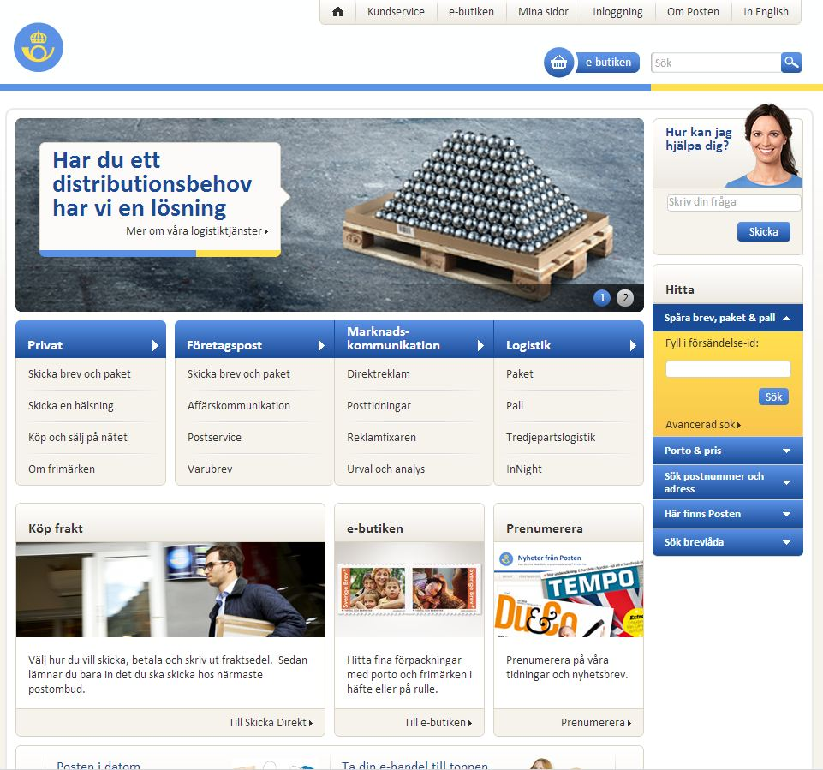
What is my motivation?
Human-Computer Interaction Studies in 2011-2012
Evaluation of www.posten.se

Slide 4
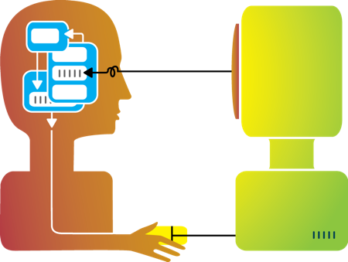
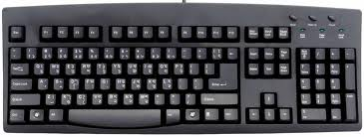
Human-Computer Interaction
Communication between Users-Computers
One of the fields: Graphical User Interface

Slide 5
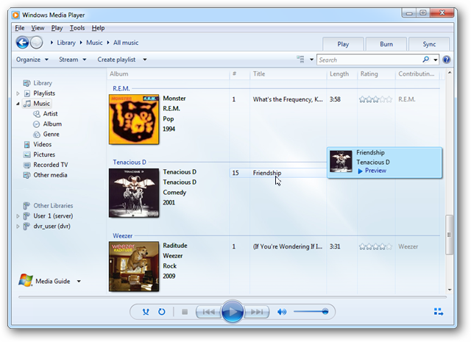
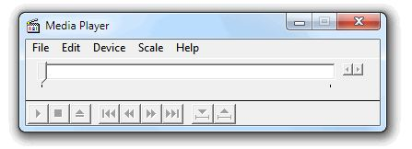
Technology Advances...
So Graphical User Interfaces become more and more complex...
WMP 5.1
WMP 12.0

Slide 6
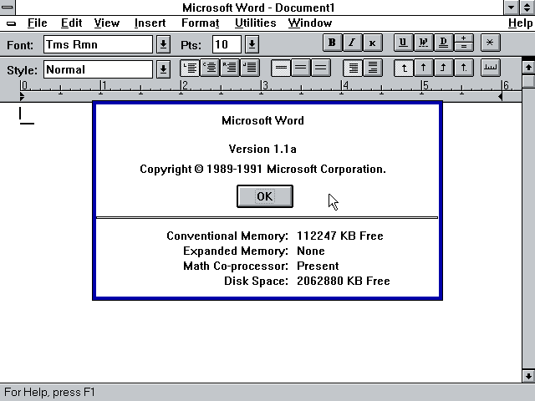
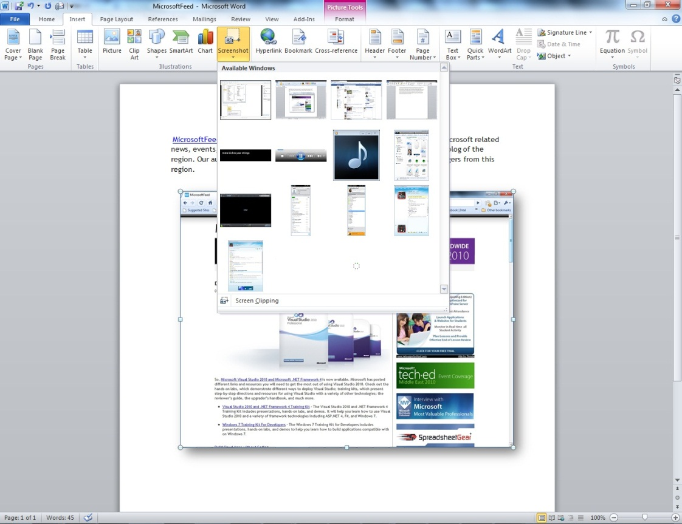
Microsoft Word 1.1
Microsoft Word 2010

Slide 7
But It brings a challange
Learning how to use
Discovering every feature can be...

Slide 8
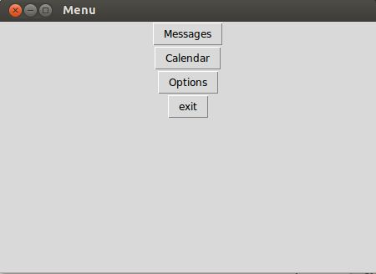
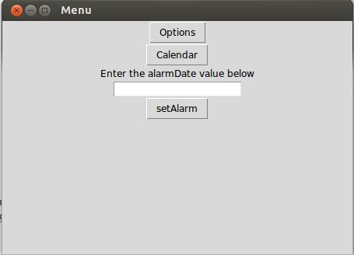
What About The Project?
Addressing the issue of potential unconsistency.
Different versions of the applications
Personally consistent graphical user interfaces.
Version 1
Version 2

Slide 9
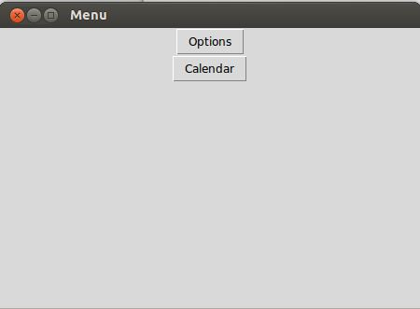
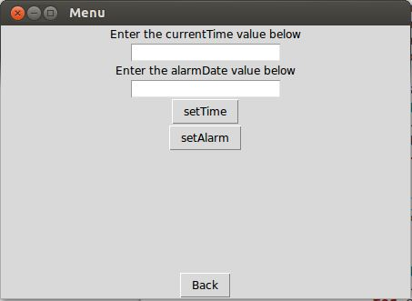
Version 1
Version 2
Menu
Menu.Options

Slide 10
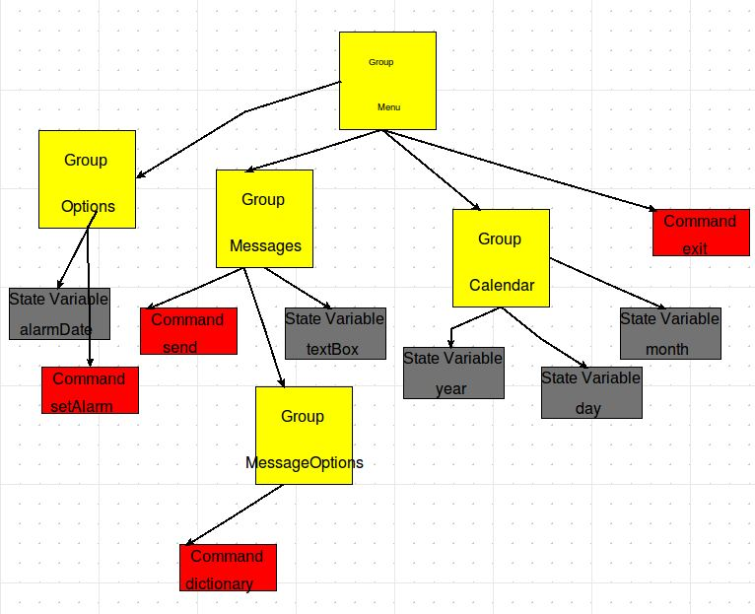
How was it done?
AToM3
Domain-Specific Language For Specifications
Reresenting them in Tree-Structure

Slide 11
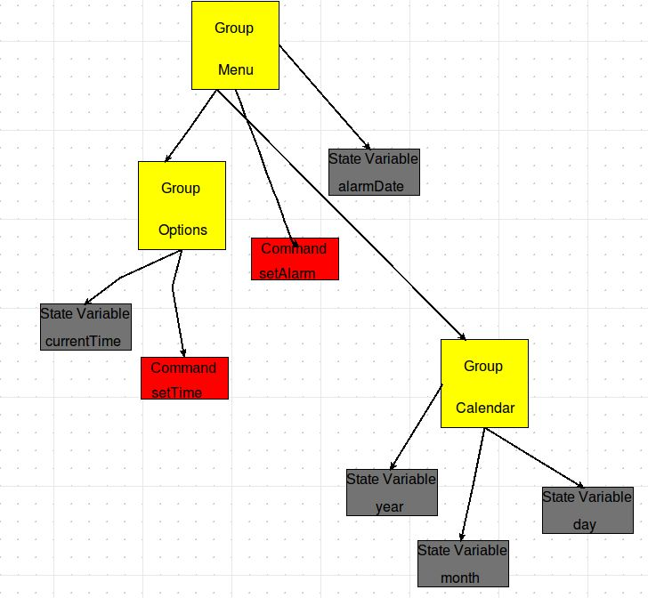
Groups, Command and State Variables
Groups : Yellow Box
Commands : Red Box
State Variables: Grey Box
Describing the layout of the tree

Slide 12
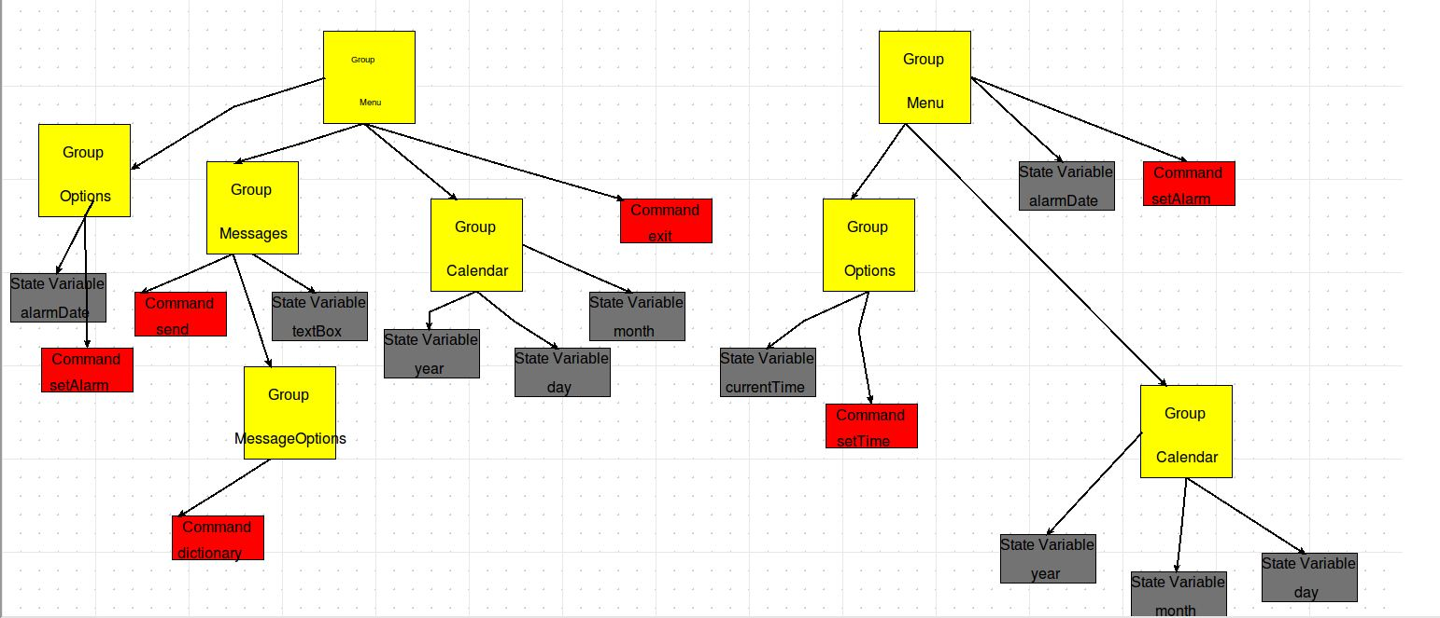
Working on 2 Different Trees
Comparison of the specifications

Slide 13
Future Work
However this language has to be more complicated as well
Trade-off ☹
Can be applied on any device which has a GUI
Mobile Phone ( Smart Phones )
Operating Systems
Media Players
Chat Applications
.
.
.
.

Slide 14
References
Nichols, J.,Myers Brad A.,Rothrock B. 2006. UNIFORM: Automatically Generating Consistent Remote Control User Interfaces, Carnegie Mellon
University
AToM3, AToM3 AToM3Programming WebSite,http://atom3.cs.mcgill.ca/people/jlara/AToM3Programming/index.dtml
Wiecha, C., Bennett, W., Boies, S., Gould, J., and Greene, S., 1990. ITS: A Tool for Rapidly Developing Interactive Applications. ACM Transactions on Information Systems

Slide 15
THANK YOU

