Slide 1
AGENTS IN ANYLOGIC RPGAME
Oriol Pla

Slide 2
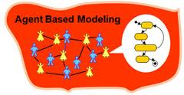
Agent-based modeling
Agent-based modeling is a computational method that enables a researcher to create, analyze, and experiment with models composed of agents that interact within an environment (Gilbert, 2007)
Gilbert, N. (2007) Agent-Based Models. SAGE Publications, num 153, p.1

Slide 3
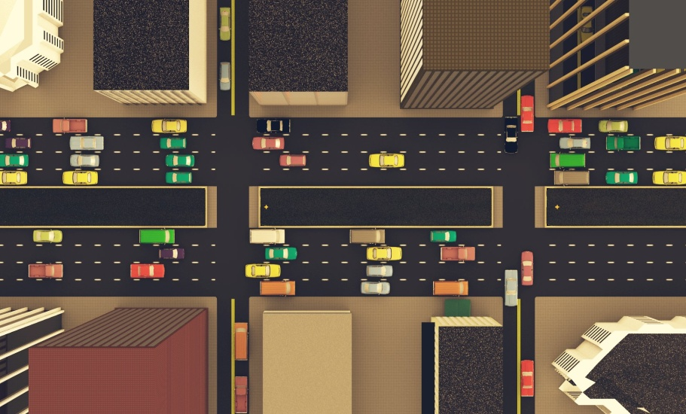
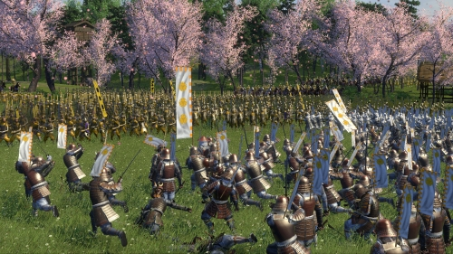
Agent-based modeling

Slide 4
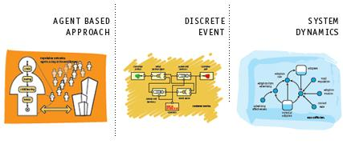
Anylogic
Simulation modeling tool
Supports System Dynamics, Discrete Event, and Agent-Based modeling

Slide 5
Anylogic

Slide 6
Anylogic
2D or 3D simulation
User friendly
Enterprise, Pedestrian and Rail libraries
Text and video tutorials
Several examples
Useful help
Continously improving

Slide 7
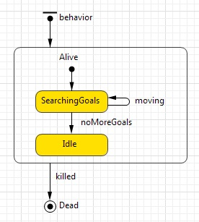
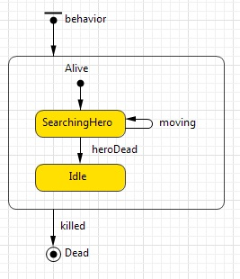
RPGame in Anylogic

Slide 8
RPGame in Anylogic
Let’s try it

Slide 9
THE END Questions?

