Slide 1
RPG modeling with Henshin
Stijn Van der Wee
University of Antwerp
An assigment of the Model Driven Engineering course
Notes:
Good afternoon everybody, today I will present my project for the Model Driven Engineering course.
The title says it all: Role Playing Game modeling by using Henshin.

Slide 2
Contents
Introduction
Role Playing Game modeling with Henshin
Role Playing Game to PetriNet modeling with Henshin
Comparison with AToMPM and conclusion
Notes:
Here is a small slide with the contents of this presentation.
First I will give a small introduction of the two tools I’ll be discussing, secondly I continue with the role playing game or RPG modeling with the Henshin tool.
The third section wil give a closer look at the RPG to petrinet modeling.
Finally I will compare the two tools and give a small conlusion.

Slide 3
Contents
Introduction
Role Playing Game modeling with Henshin
Role Playing Game to PetriNet modeling with Henshin
Comparison with AToMPM and conclusion
Notes:
First we will start with the introduction of the two tools we will compare in the end.

Slide 4
AToMPM*
A Tool for Multi-Paradigm Modeling
Research framework
Domain-specific modeling tools
Web-based
Model Driven Engineering
*Prof. Dr. Eugene Syriani, Prof. Dr. Hans Vangheluwe, 2013. A tool for multi-paradigm
modeling (AToMPM). http://syriani.cs.ua.edu/ atompm/atompm.htm.
Notes:
First I will give a small and quick introduction ot AToMPM, which is a tool all of you know and have used during the Model Driven Engineering course.
AToMPM stands for a tool for multi paradigm modeling. It is a research framework used to generate domain specific modeling tools.
These tools are web-based as atompm itself.

Slide 5
Henshin*
Model transformation language
Built on the Eclipse Modeling Framework
Endogenous and exogenous transformations
* The Eclipse Foundation, 2014b. Henshin. http://www.eclipse.org/ henshin/
Notes:
The second tool, and the main tool used in this presentation, is Henshin.
Henshin is a model transformation language that is built on the eclipse modeling framework.
It supports endogenous, exogenous, and high-order transformations, also space state analysis and giraph code generation.
In our case we only look at the endogenous and exogenous transformations.
Endogenous transformations are transformations on a single model, like the Role Playing Model we are going to discuss.
Exogenous transformations are transformations that are executed on multiple models.
It is mostly used to translate one language into another, like the Role playing game and the petrinet.

Slide 6
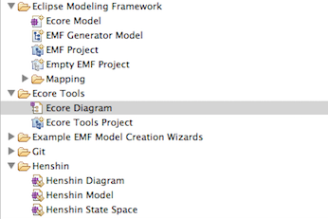
Notes:
Here we see an example of the the supported files and two palettes I used for creating my models and metamodels.
The supported files, on the right of the screen, consists out of an ecore model and diagram to create the metamodels via the eclipse modeling framework.
The henshin files, like the diagram and the model, are used to create the transformation rules for our Role playing game.
The one on the left is the palette to create a metamodel, like the Role playing game and the petrinet, from which we can create an instance model.
The right palette contains the objects to create transformation rules.

Slide 7
Contents
Introduction
Role Playing Game modeling with Henshin
Role Playing Game to PetriNet modeling with Henshin
Comparison with AToMPM and conclusion
Notes:
We will continue with the Role playinga game modeling with the Ecore metamodel and the transformationrules with the aid of henshin.

Slide 8
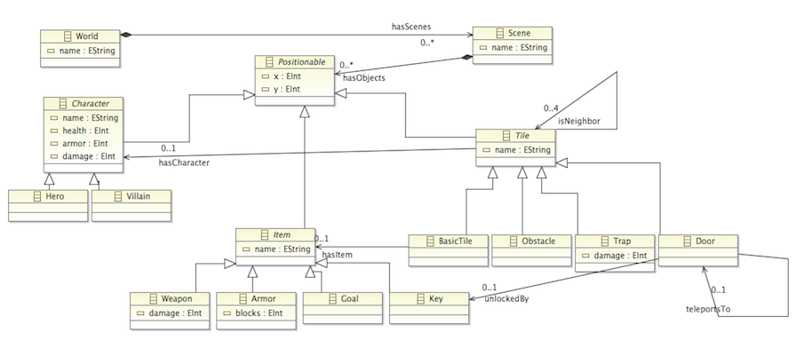
Notes:
This picture represents the Role playing game metamodel created with the ecore diagram editor.
EXPLAIN!

Slide 9
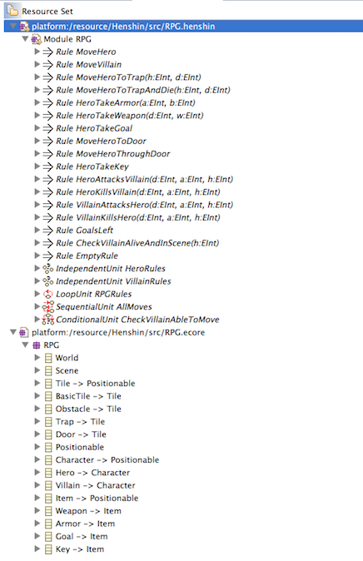
Notes:
All the differen rules in our RPG.

Slide 10
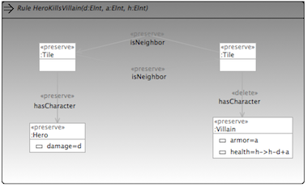
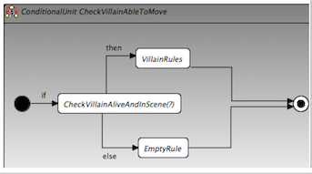
Notes:
An example of a normal rule and of a conditional unit (if then else)

Slide 11
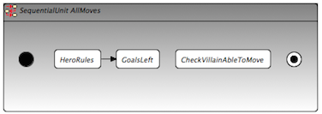
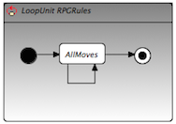
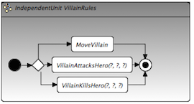
Notes:
Sequential unit, loopunit and independent unit (randomize)

Slide 12
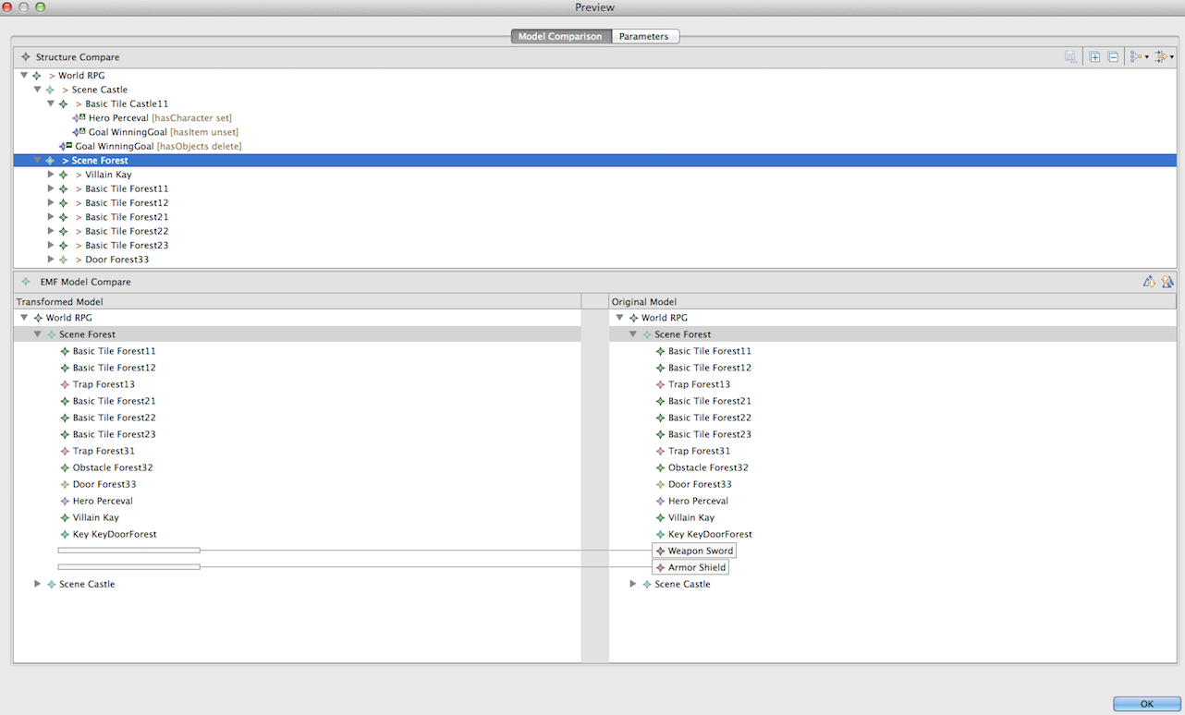
Notes:
Transformation preview

Slide 13
Contents
Introduction
Role Playing Game modeling with Henshin
Role Playing Game to PetriNet modeling with Henshin
Comparison with AToMPM and conclusion
Notes:
We now continue with the RPG to PetriNet modeling.

Slide 14
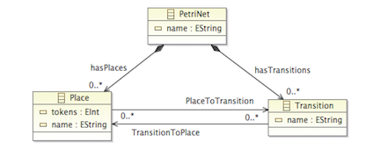
Notes:
PetriNet ecore model

Slide 15
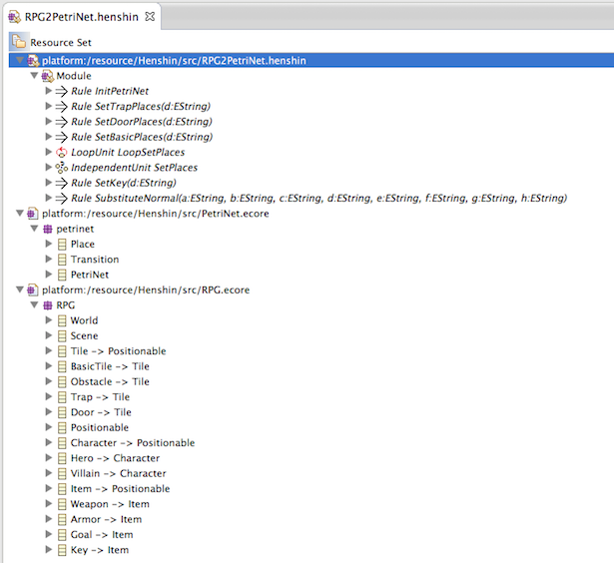
Notes:
Rpg to petrinet rules

Slide 16
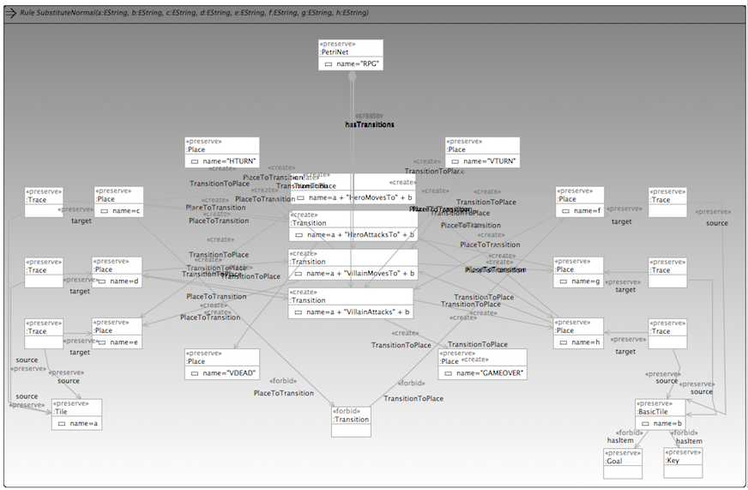
Notes:
Example of a rpg to petrinet rule, explain !!!

Slide 17
Contents
Introduction
Role Playing Game modeling with Henshin
Role Playing Game to PetriNet modeling with Henshin
Comparison with AToMPM and conclusion
Notes:
Last we will compare atompm with henshin and draw some conclusions

Slide 18
My comparison
Transformations in AToMPM are visual, while Henshin has textual-based transformations
4
Deterministic (AToMPM) <-> Non deterministic (Henshin)
2
1
AToMPM has a more appealing visual approach
AToMPM has NAC, while Henshin only has forbid keyword
3

Slide 19
My conclusion
AToMPM has more visual capabilities than Henshin.
AToMPM is more user friendly and uses more visual objects for modeling.
Henshin is non deterministic, while AToMPM is deterministic.

Slide 20
Questions?

