Slide 1
Analysis of BPMN Models
Model Driven Engineering
Addis Gebremichael
19 December 2014

Slide 2
Business Process Modeling Notations
Overview
Information systems handle work flow of organizations
Increase in Complexity of Business Processes
Common Standard Notation- supported by many tools:
IBM Websphere Business Modeler
ARIS
Oracle BPA
Business Process Visual Architect (Visual Paradigm)
Enable Process Analysis, and*1
Facilitate Process Enactment*2
*1 R. M. Dijkman, M. Dumas, C. Ouyang, Semantics and analysis of business process models in BPMN, Information and Software Technology 50 (12) (2008) 1281--1294.
*2 W. P. van der Aalst, Business process management: A comprehensive survey, ISRN Software Engineering 2013 (2012) 37.

Slide 3
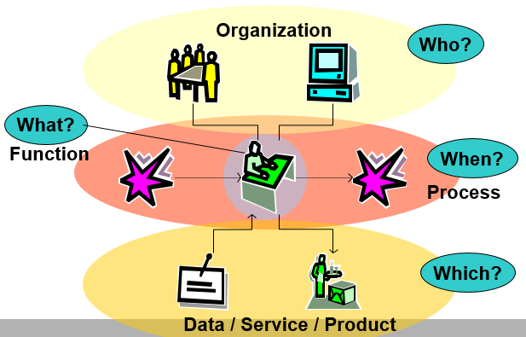
BPMN Basic Constructs
Process Modelling Perspectives

Slide 4
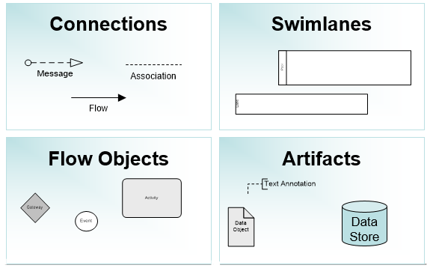
BPMN Basic Constructs
Main Elements

Slide 5
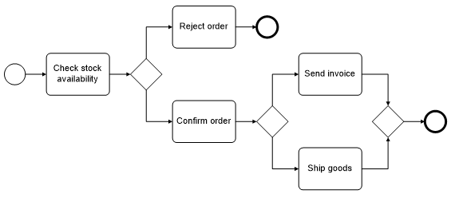
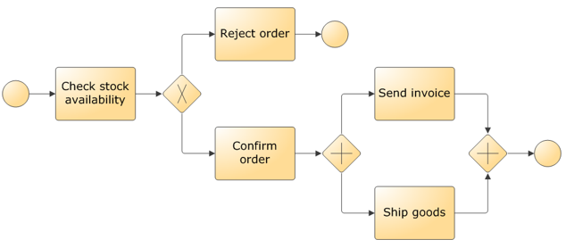
BPMN Basic Constructs
Simple Examples in Use

Slide 6
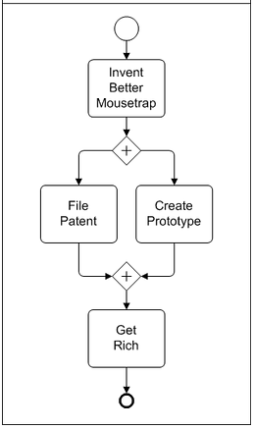
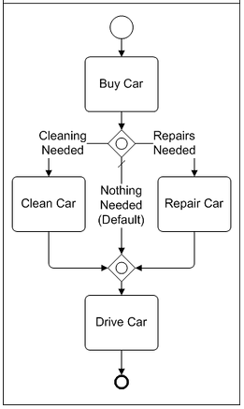
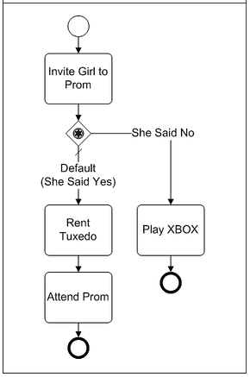
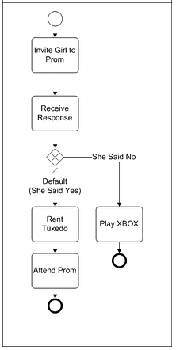
BPMN Basic Constructs
Simple Examples in Use (cont’d)

Slide 7
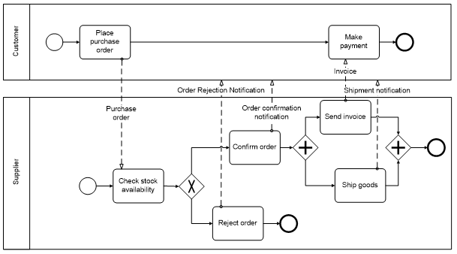
BPMN Basic Constructs
Example: Pools

Slide 8
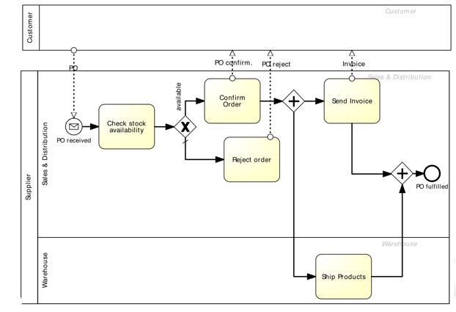
BPMN Basic Constructs
Example: Lanes

Slide 9
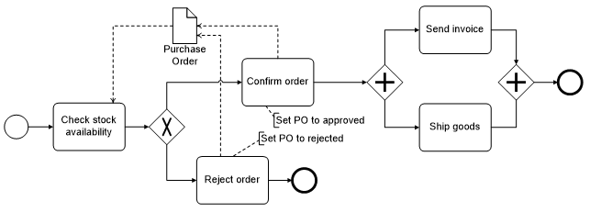
BPMN Basic Constructs
Data and Artifacts

Slide 10
Model Analysis
The Problem (Semantic Errors)
Designer errors
Lack of unambiguous definition

Slide 11
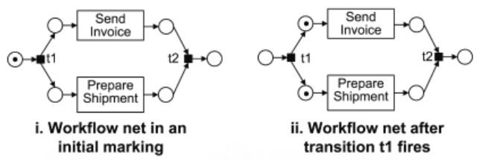
Model Analysis
Why Petri nets
Flow oriented
Similar properties supporting sequences, synchronization, concurrency, conflict/decision etc.
Constraints on PN, i.e. Work flow nets
Distinguished start place and end place
Analysis Criterion
Dead tasks
Proper completion

Slide 12
Model Driven Engineering Approach
Work Plan
Build a visual modeling formalism for a subset of BPMN in AToMPM
Provide semantic definition by mapping on to PN
Collect selected “Test Cases”, i.e. BPMN Models
Conduct Analysis and construct a report

Slide 13
END

