Slide 1
Optimization and Parallelization of CBD models
Konstantinos Theodorakos
January 2015
Notes:
This template can be used as a starter file for presenting training materials in a group setting.
Sections
Sections can help to organize your slides or facilitate collaboration between multiple authors. On the Home tab under Slides, click Section, and then click Add Section.
Notes
Use the Notes pane for delivery notes or to provide additional details for the audience. You can see these notes in Presenter View during your presentation.
Keep in mind the font size (important for accessibility, visibility, videotaping, and online production)
Coordinated colors
Pay particular attention to the graphs, charts, and text boxes.
Consider that attendees will print in black and white or grayscale. Run a test print to make sure your colors work when printed in pure black and white and grayscale.
Graphics, tables, and graphs
Keep it simple: If possible, use consistent, non-distracting styles and colors.
Label all graphs and tables.

Slide 2
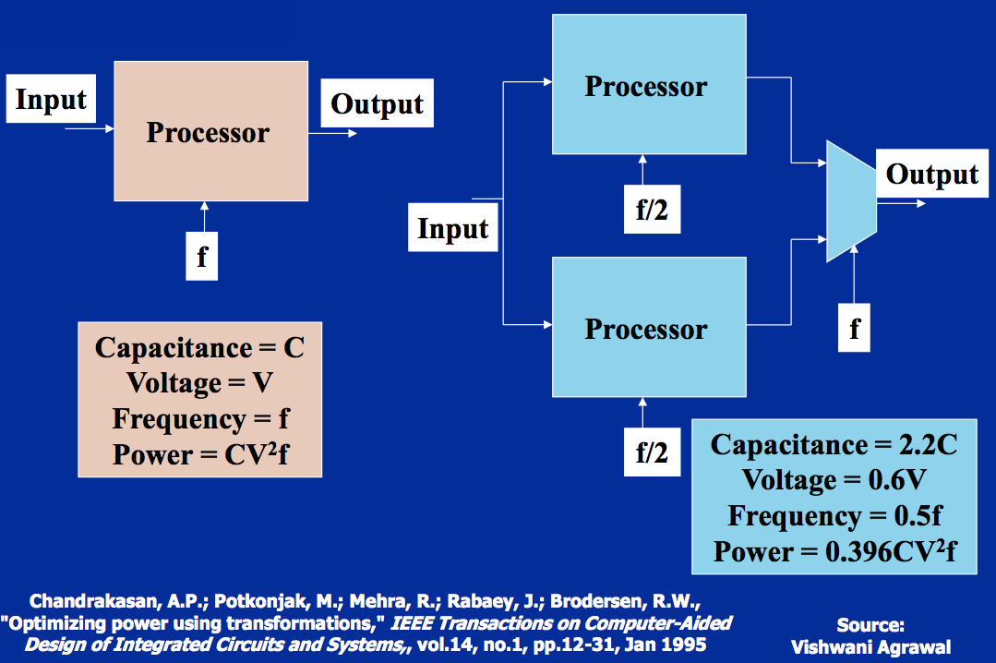
Modern Processor Design
“Free lunch is over”
Lower Power consumption is favored on multi-core/processor architectures
Notes:
What will the audience be able to do after this training is complete? Briefly describe each objective and how the audience will benefit from this presentation.

Slide 3
CBD Parallelization intention
Why Parallelize CBD models?
As fast as possible simulation of large CBD models.
Design Space Exploration (acquiring parameters for optimal CBD model execution)
Shooting Problems (i.e find(a, b, c) when output = 2.5).
Real time simulation.
Real-time ”brute force” calculations on live sensory data with high samples per second rate.
Notes:
What will the audience be able to do after this training is complete? Briefly describe each objective and how the audience will benefit from this presentation.

Slide 4
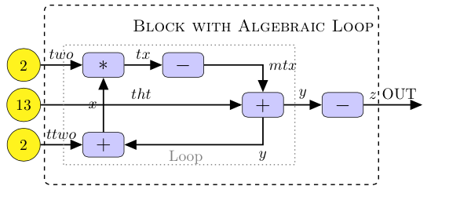
CBD Parallelization methods
Causal Block Diagrams
Parallelization patterns for CBD models examined:
Data (or Domain) decomposition
Task (or Functional) decomposition
Parallel Pipelines
Notes:
What will the audience be able to do after this training is complete? Briefly describe each objective and how the audience will benefit from this presentation.

Slide 5
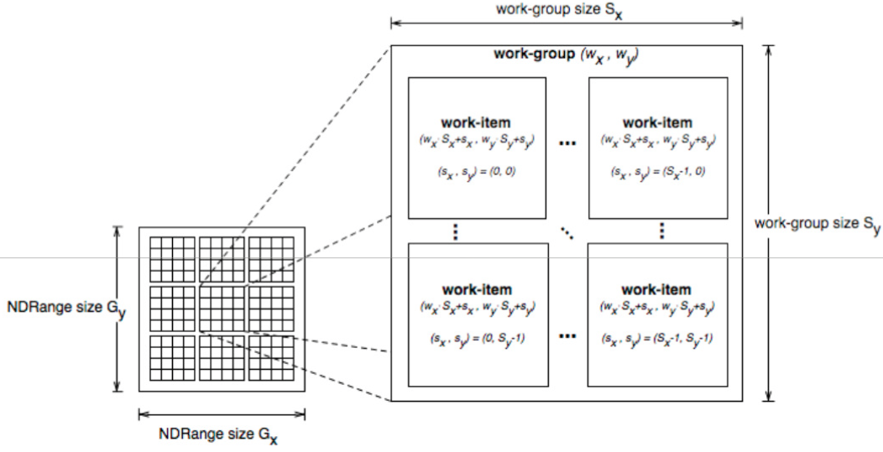
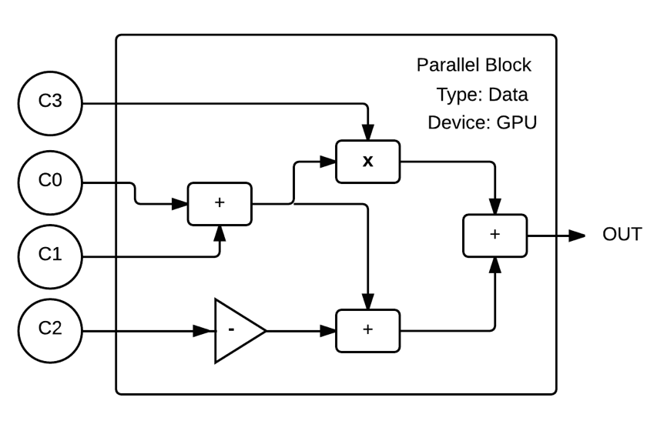
Data Decomposition
NDRange calculations - GPU
One Full CBD Model Iteration
per Work Item. No Algebraic
Loops or Delay blocks are
allowed
Notes:
What will the audience be able to do after this training is complete? Briefly describe each objective and how the audience will benefit from this presentation.

Slide 6
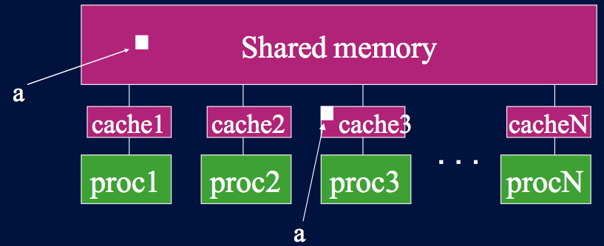
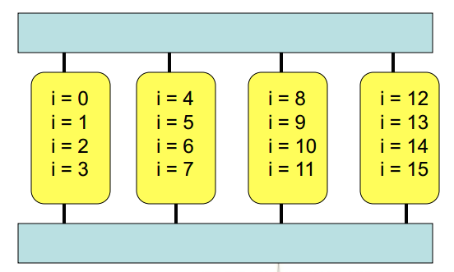
Data Decomposition
Parallel For calculations - CPU
Iteration-Job chunks
are assigned to each
Processor/Core
Notes:
What will the audience be able to do after this training is complete? Briefly describe each objective and how the audience will benefit from this presentation.

Slide 7
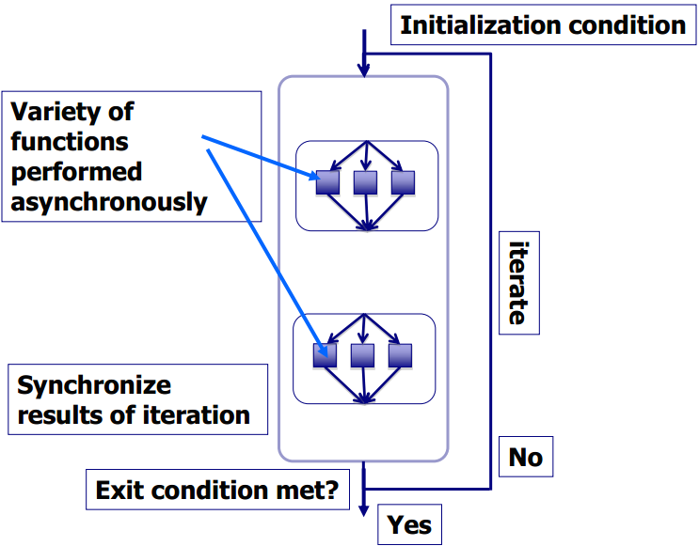
Data Decomposition
Iterator Pattern for scaling up
In case the input data are too large,
we can split them up into manageable chunks
Notes:
What will the audience be able to do after this training is complete? Briefly describe each objective and how the audience will benefit from this presentation.

Slide 8
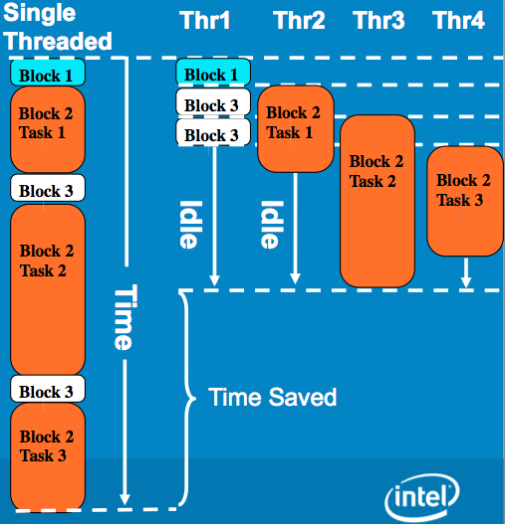
Task Decomposition
Why not Task Decomposition?
Because:
Individual tasks aren’t 100% efficient due to execution “gaps”
Irregular patterns emerge in model transformations
Notes:
What will the audience be able to do after this training is complete? Briefly describe each objective and how the audience will benefit from this presentation.

Slide 9
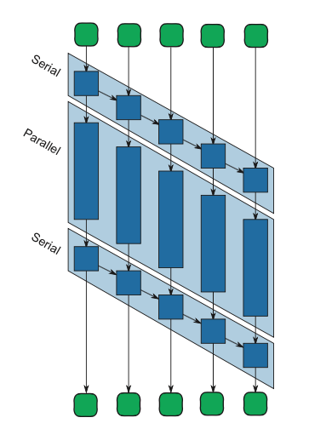
Parallel Pipeline
Pipelines for Loops and Delay blocks
Main Advantage: “Serial in Line” stages maintain the sequence of iterations
Main Disadvantage: Performance is limited by the slowest stage
Notes:
What will the audience be able to do after this training is complete? Briefly describe each objective and how the audience will benefit from this presentation.

Slide 10
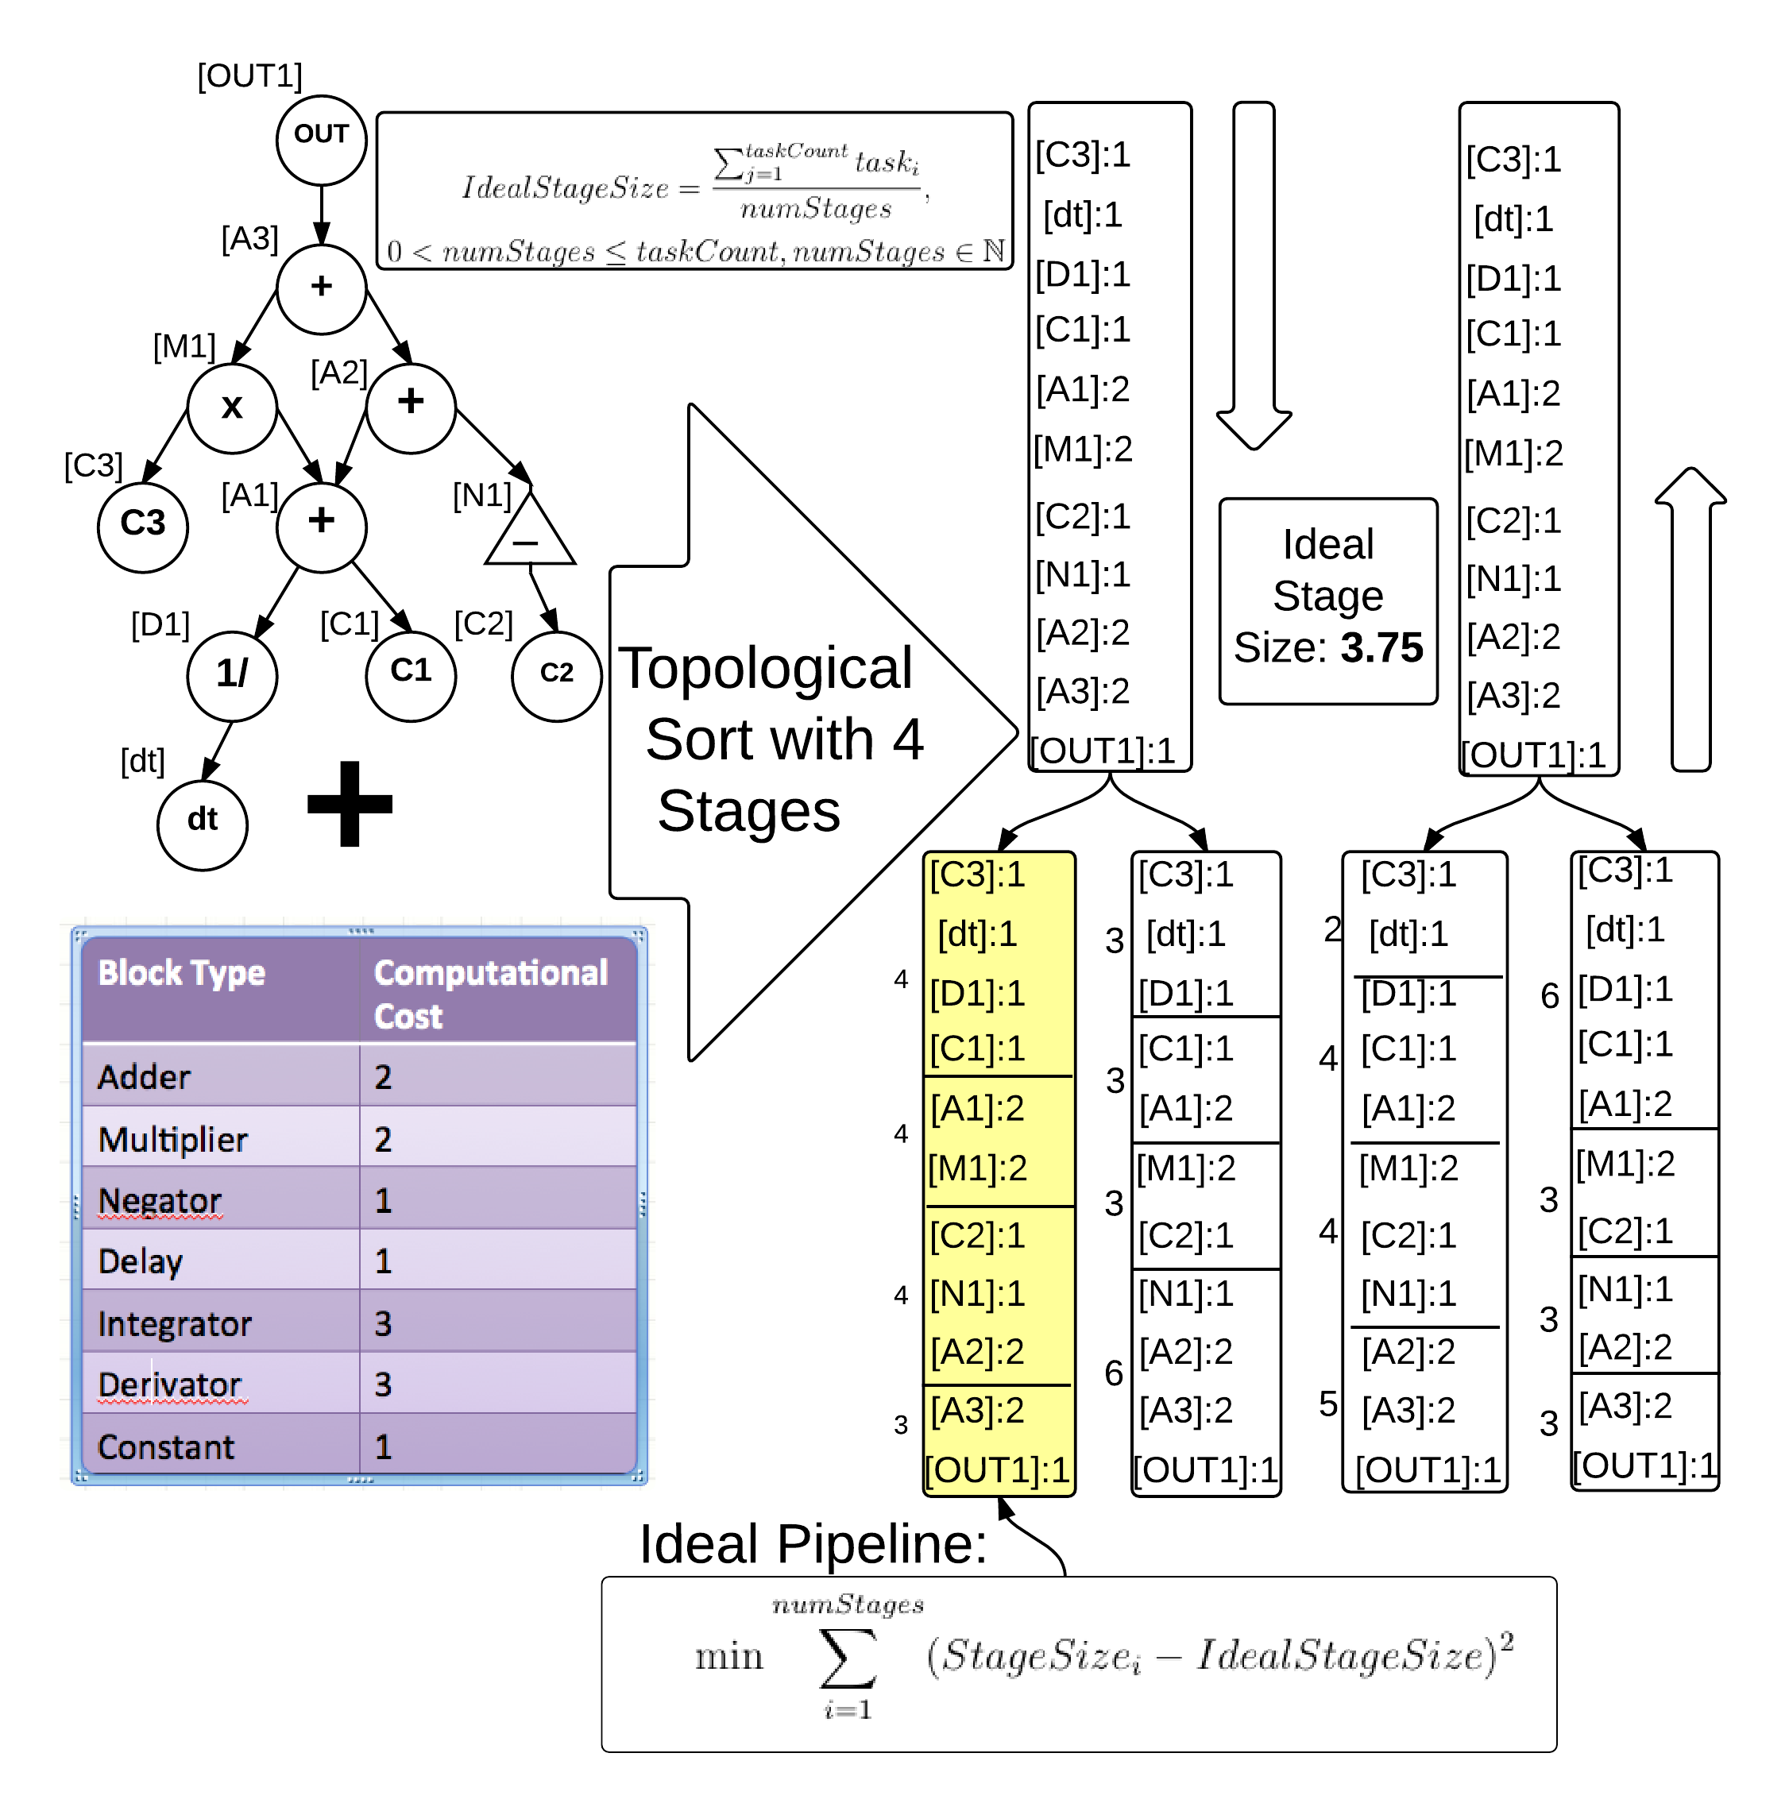
Pipeline Stage Generation
Notes:
What will the audience be able to do after this training is complete? Briefly describe each objective and how the audience will benefit from this presentation.

Slide 11
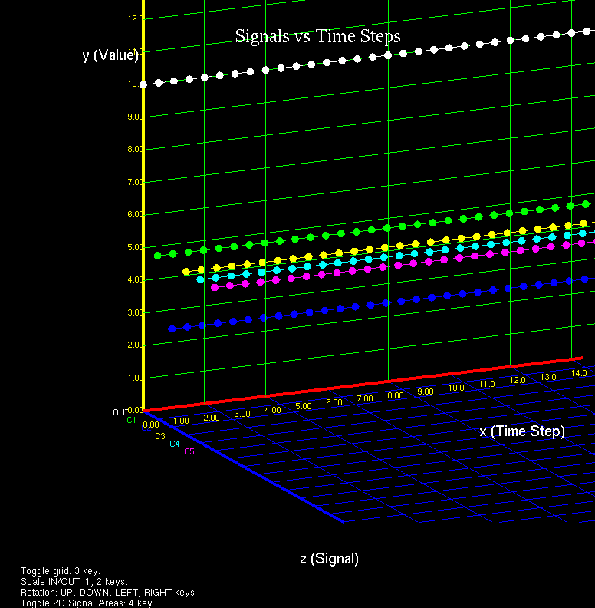
3D Graph Generation
Notes:
What will the audience be able to do after this training is complete? Briefly describe each objective and how the audience will benefit from this presentation.

Slide 12
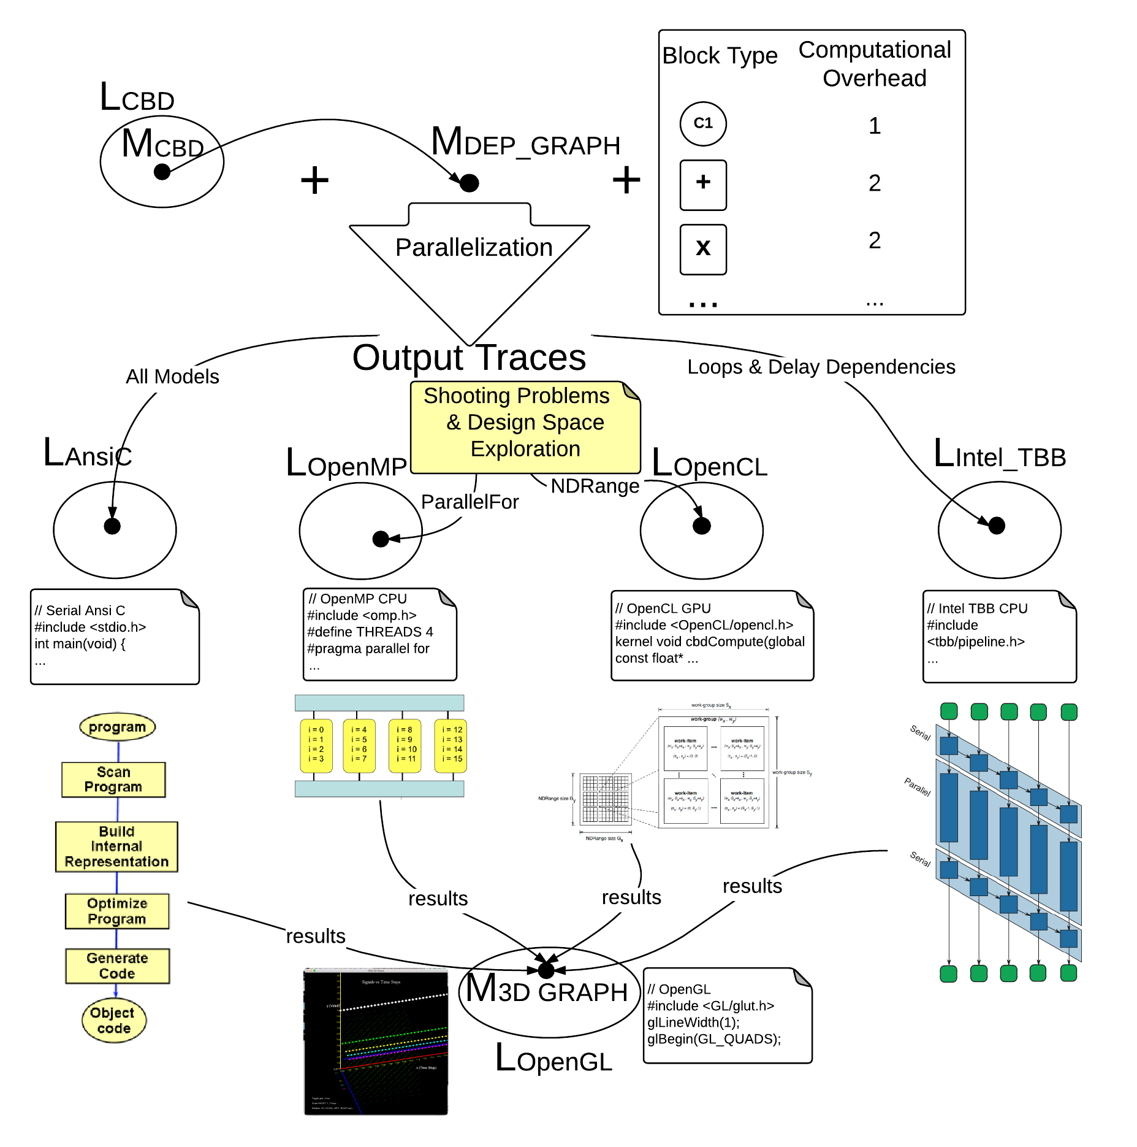
The “complete” picture
Notes:
What will the audience be able to do after this training is complete? Briefly describe each objective and how the audience will benefit from this presentation.

Slide 13
Simulation Performance
Test Machine
Mac Book Pro Mid 2012
Processor: 2.6 GHz Intel Core i7
Memory 8GB DDR3
Internal GPU: Intel HD Graphics 4000 1024MB
Discrete GPU: Nvidia GTX 650M 1024MB
Notes:
What will the audience be able to do after this training is complete? Briefly describe each objective and how the audience will benefit from this presentation.

Slide 14
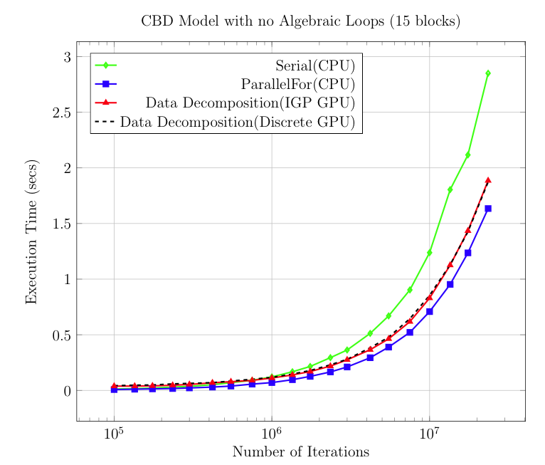
Simulation Performance
Notes:
What will the audience be able to do after this training is complete? Briefly describe each objective and how the audience will benefit from this presentation.

Slide 15
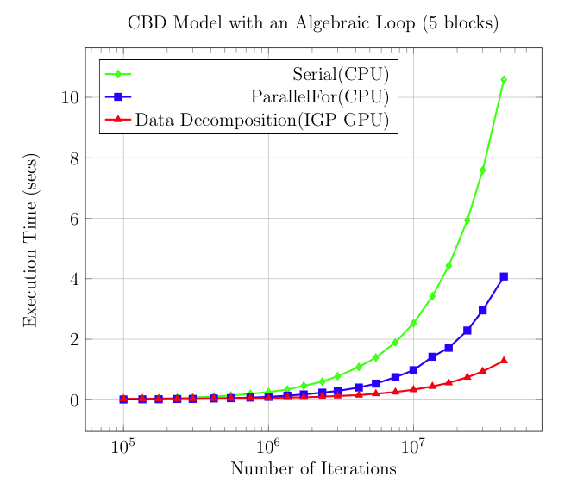
Simulation Performance
Notes:
What will the audience be able to do after this training is complete? Briefly describe each objective and how the audience will benefit from this presentation.

