Slide 1
Optimization and Parallelization of CBD models
Konstantinos Theodorakos
December 2014
Notes:
This template can be used as a starter file for presenting training materials in a group setting.
Sections
Sections can help to organize your slides or facilitate collaboration between multiple authors. On the Home tab under Slides, click Section, and then click Add Section.
Notes
Use the Notes pane for delivery notes or to provide additional details for the audience. You can see these notes in Presenter View during your presentation.
Keep in mind the font size (important for accessibility, visibility, videotaping, and online production)
Coordinated colors
Pay particular attention to the graphs, charts, and text boxes.
Consider that attendees will print in black and white or grayscale. Run a test print to make sure your colors work when printed in pure black and white and grayscale.
Graphics, tables, and graphs
Keep it simple: If possible, use consistent, non-distracting styles and colors.
Label all graphs and tables.

Slide 2
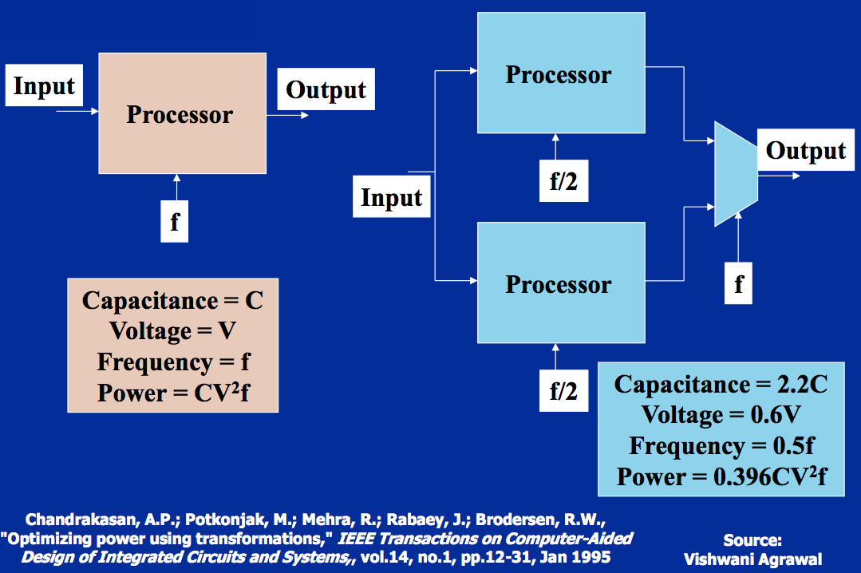
Modern Processor Design
“Free lunch is over”
Notes:
What will the audience be able to do after this training is complete? Briefly describe each objective and how the audience will benefit from this presentation.

Slide 3
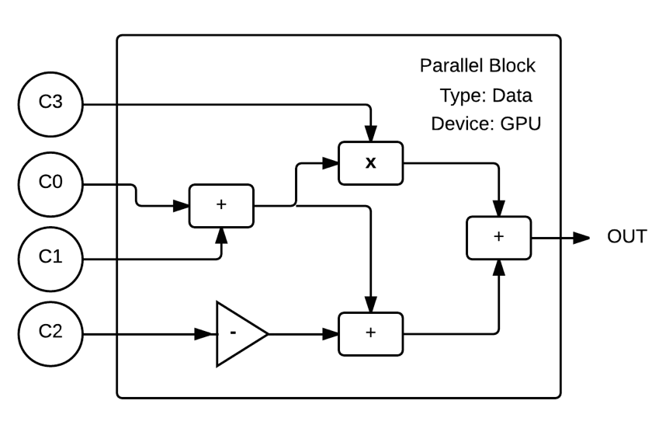
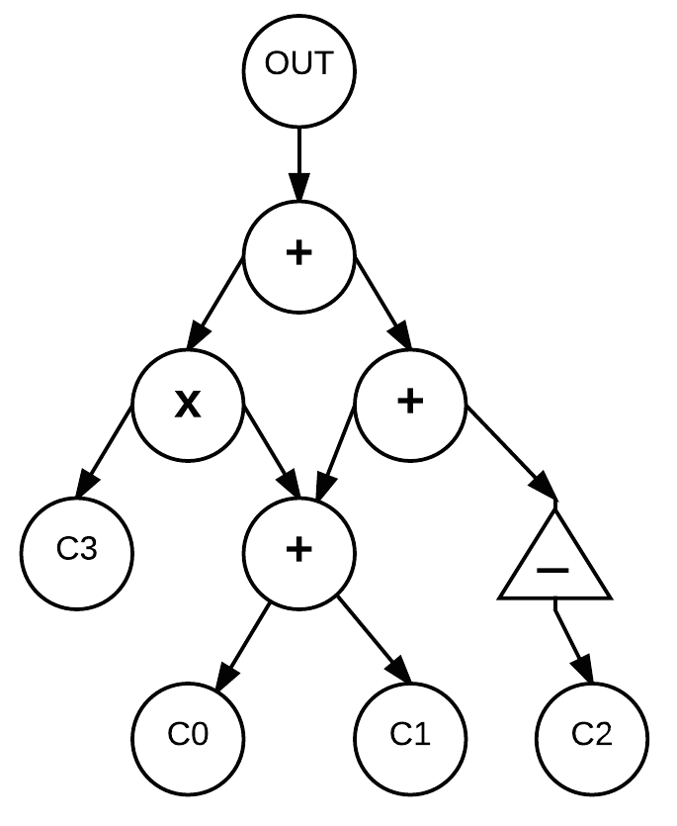
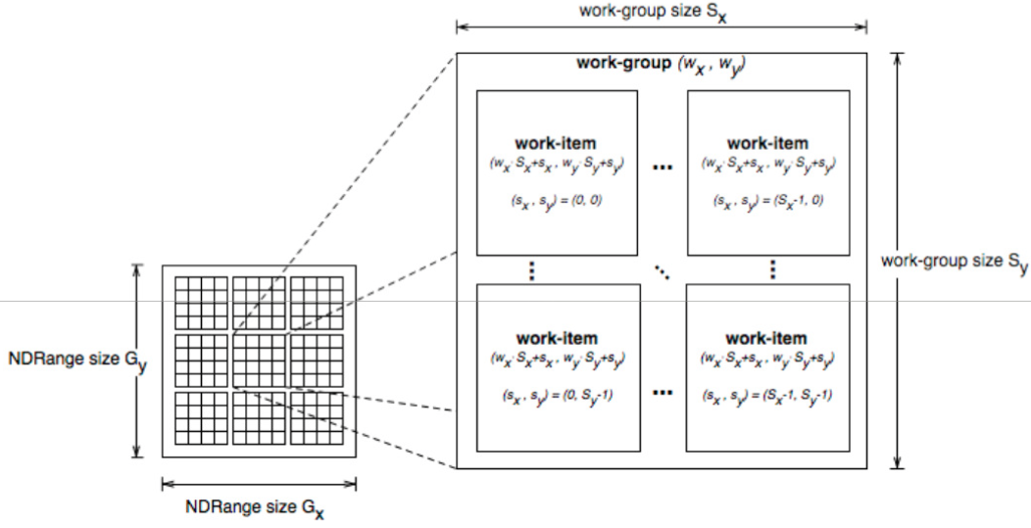
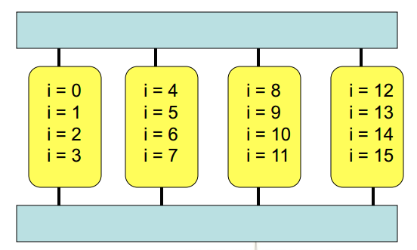
Data Decomposition
Raw Iterations calculation - GPU
Notes:
What will the audience be able to do after this training is complete? Briefly describe each objective and how the audience will benefit from this presentation.

Slide 4
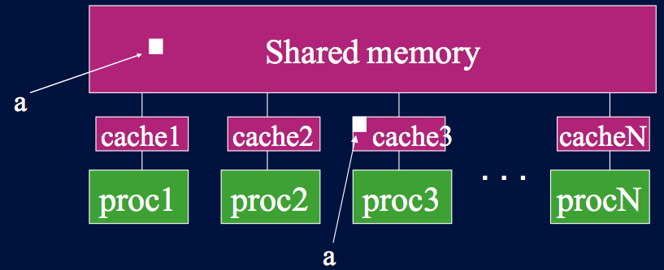
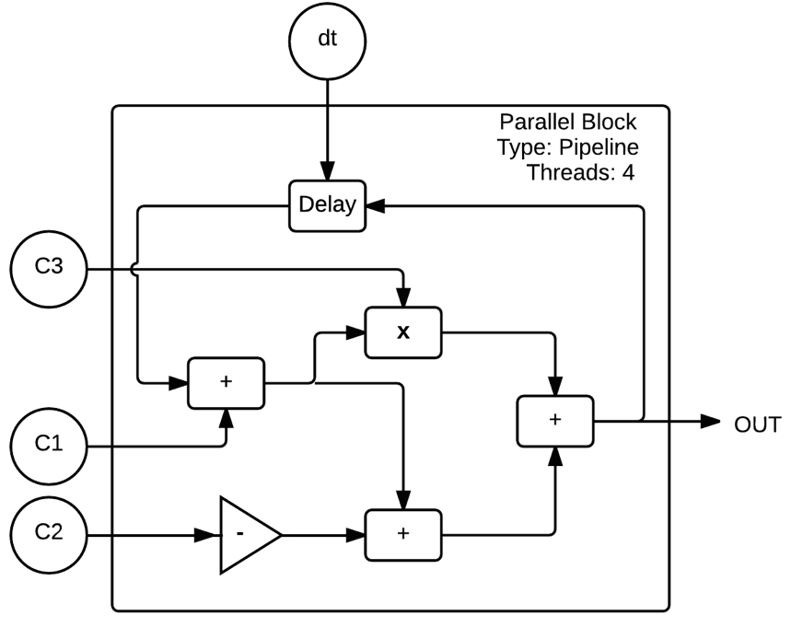
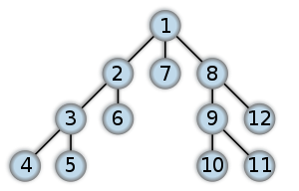
Task Decomposition
Loops & Delay blocks - CPU
Notes:
What will the audience be able to do after this training is complete? Briefly describe each objective and how the audience will benefit from this presentation.

Slide 5
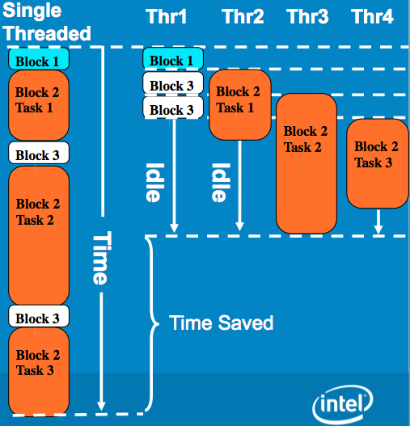
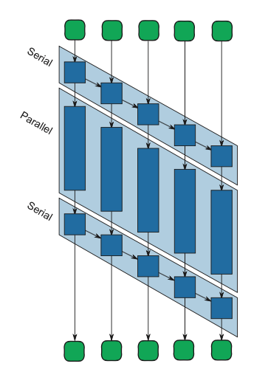
Task Decomposition
The advantage of Pipelines
Notes:
What will the audience be able to do after this training is complete? Briefly describe each objective and how the audience will benefit from this presentation.

Slide 6
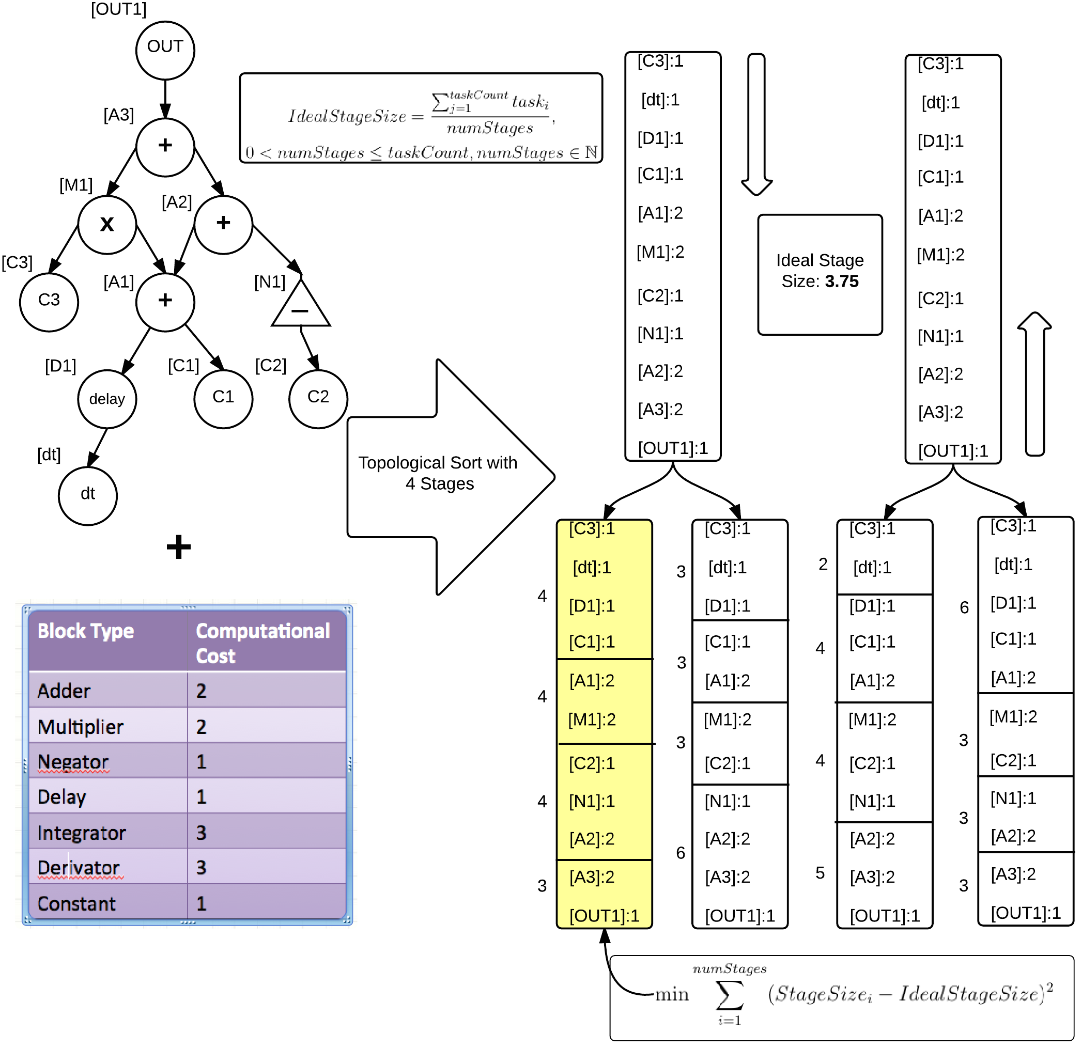
Pipeline Stage Generation
Notes:
What will the audience be able to do after this training is complete? Briefly describe each objective and how the audience will benefit from this presentation.

Slide 7
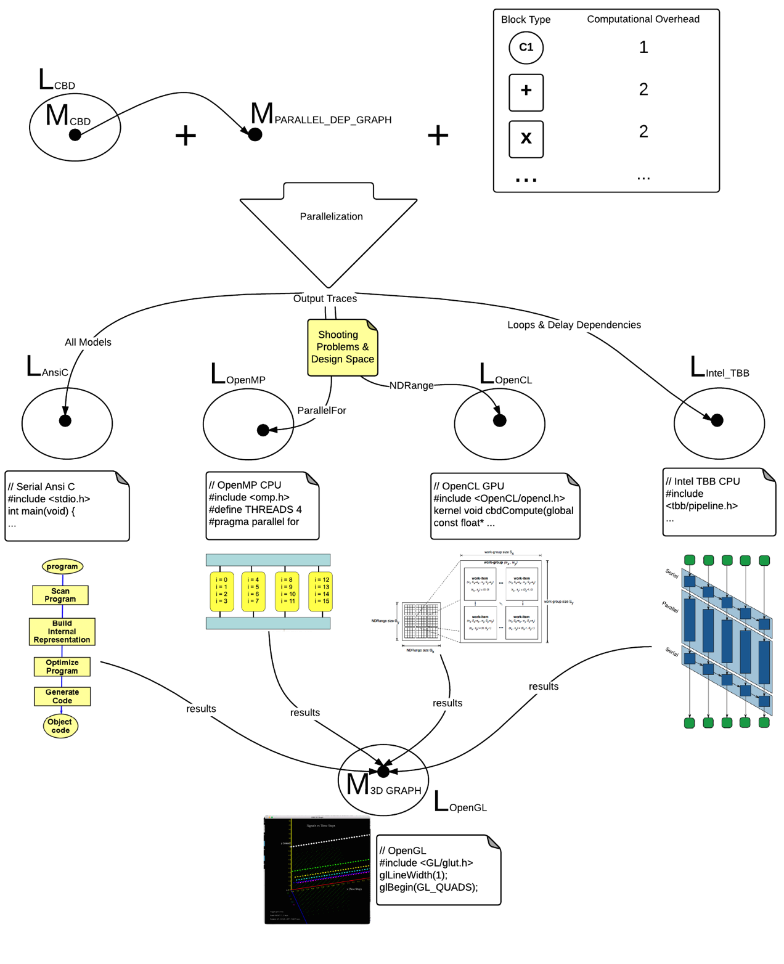
The “complete” picture
Notes:
What will the audience be able to do after this training is complete? Briefly describe each objective and how the audience will benefit from this presentation.

Slide 8
Data Decomposition
Time Steps vs 6 CBD blocks
Notes:
What will the audience be able to do after this training is complete? Briefly describe each objective and how the audience will benefit from this presentation.

Slide 9
Data Decomposition
Time Steps vs 6 CBD blocks
Notes:
What will the audience be able to do after this training is complete? Briefly describe each objective and how the audience will benefit from this presentation.

Slide 10
Data Decomposition
Time Steps vs 15 CBD blocks
Notes:
What will the audience be able to do after this training is complete? Briefly describe each objective and how the audience will benefit from this presentation.

Slide 11
Data Decomposition
Time Steps vs 15 CBD blocks
Notes:
What will the audience be able to do after this training is complete? Briefly describe each objective and how the audience will benefit from this presentation.

