Slide 1

15 December 2017

Slide 2
Domain Specific Language for Indoor Air Quality Analysis in Museums
By Björn de Nijs
Notes:
Introduce yourself

Slide 3

Who guidelines for indoor air quality: selected pollutants
Notes:
The construction materials used in our homes can have an effect on the air quality, just as combustion of fuels, think about cooking or heating our home, release gasses that infleunce the air quality. All these factors and many more can cause health issues or even endanger us. The World Health Organisation (WHO) has released a report on the dangers of indoor air quality for human health, which can be publicly viewed

Slide 4
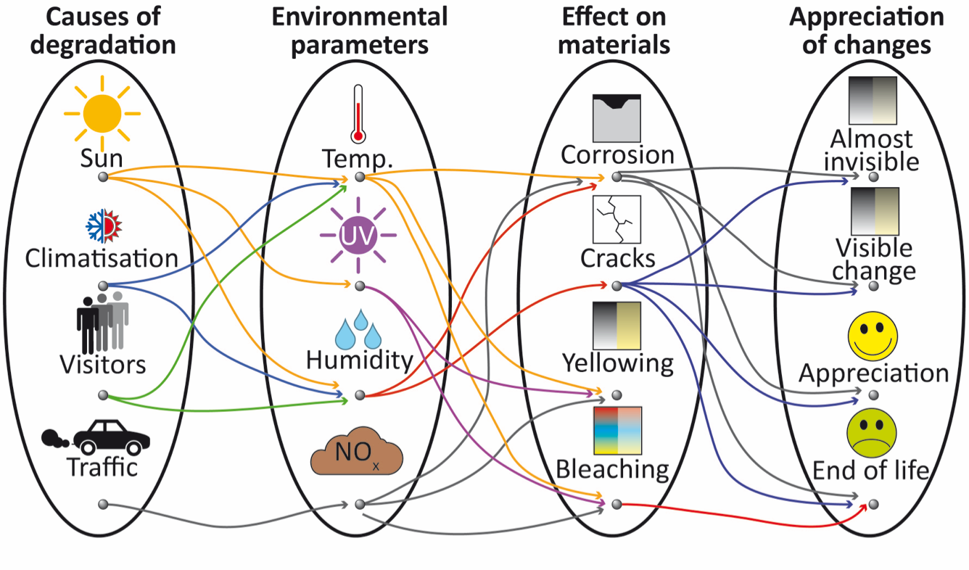
https://www.uantwerpen.be/en/projects/airchecq/
Notes:
In the previous section the effect of Indoor Air Quality on humans was discussed, but why wouldn't the Indoor Air Quality influence other materials as well? It has been proven that the Indoor Air Quality does have an effect on cultural heritage, mainly due to the degradation proces of materials. Materials degradade naturally but the quality of the air can speed up this process. The main difference between materials and humans is that humans can repair themselves, but materials do not possess such abilities. Restauration is possible, but if will always differ from the original work, and it will never be as good as the original work. That's why it's important to preserve our cultural heritage.

Slide 5
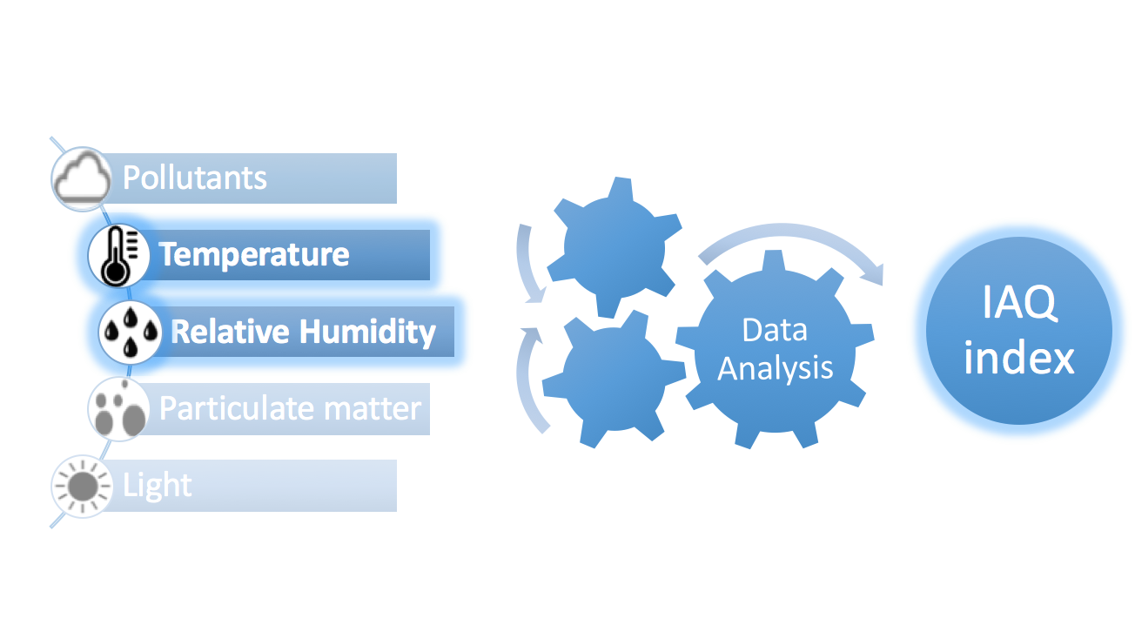
My Work
https://www.uantwerpen.be/en/projects/airchecq/

Slide 6
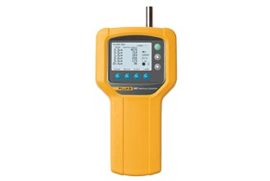
Fluke
http://www.fluke.com
Notes:
Measurement device

Slide 7
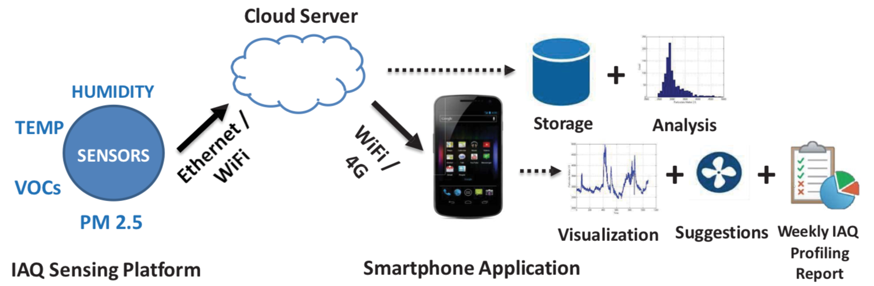
AirSense
B. F. Q. X. T. P. M. Zhang, Airsense: An intelligent home-based sensing system for indoor air quality analytics, UbiComp september 2016

Slide 8
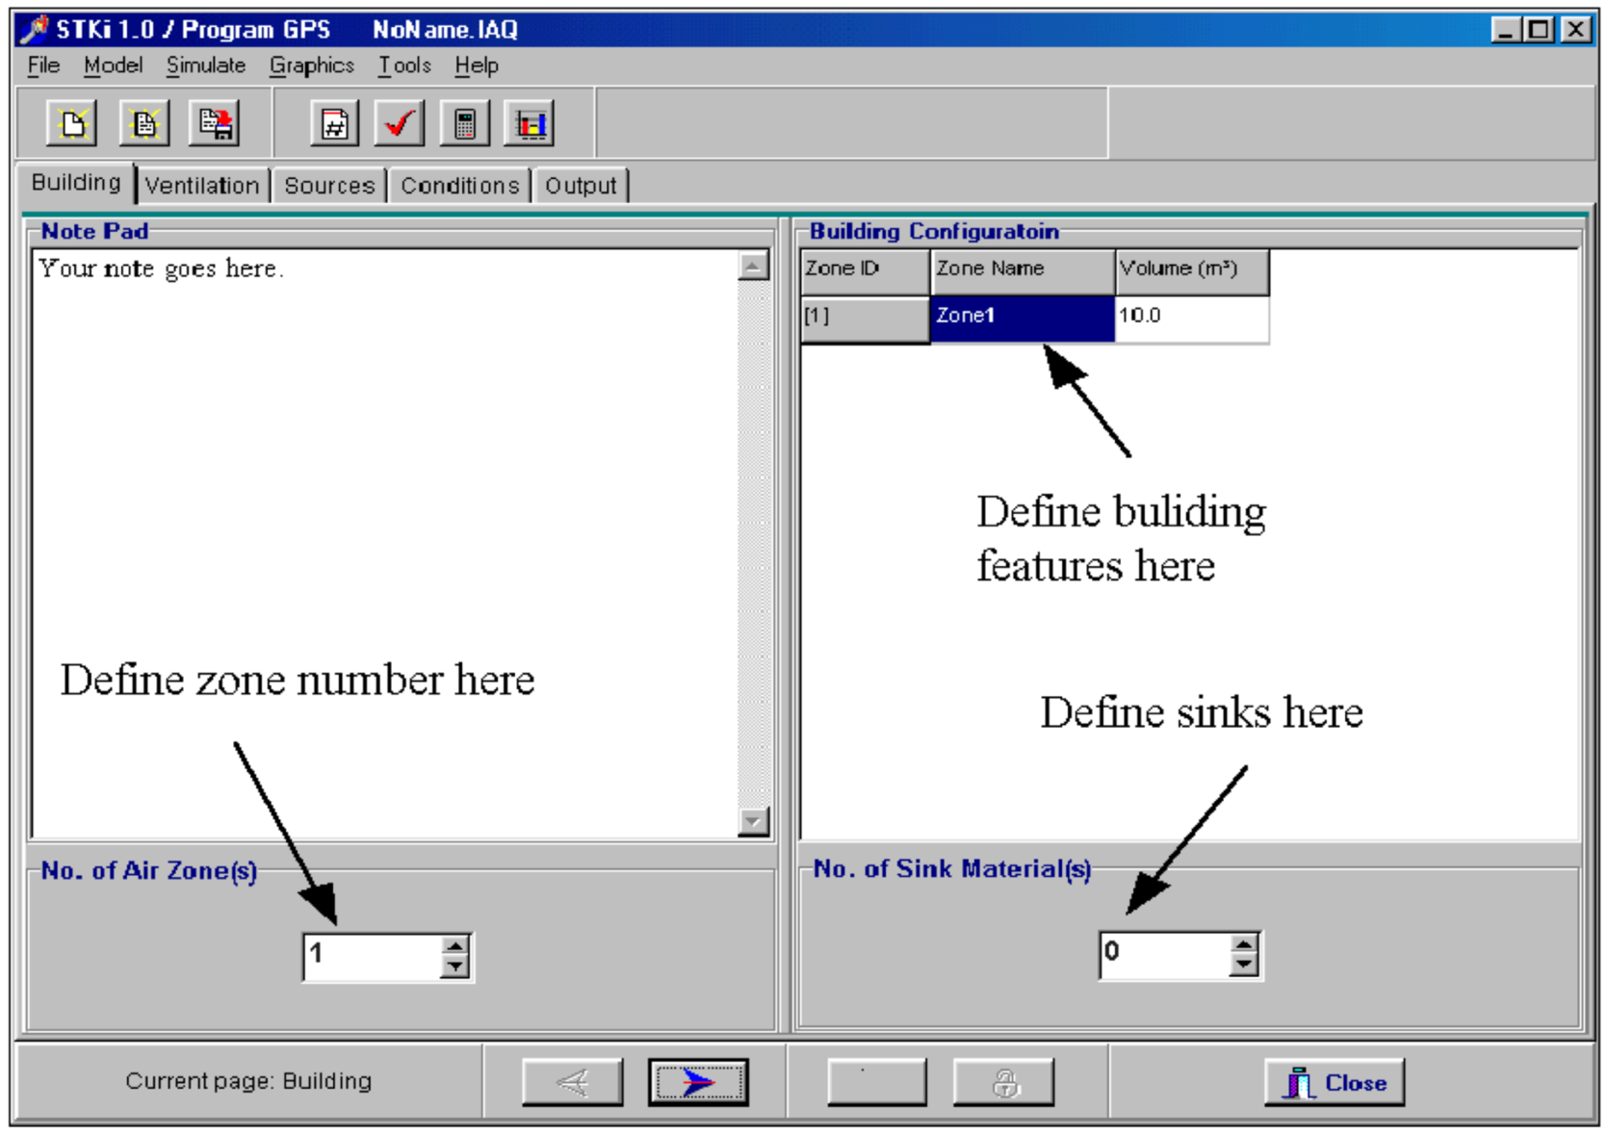
IAQX
Z. Guo*, Development of a windows-based indoor air quality simulation software package. environmental modelling and soft- ware
Notes:
Different zones

Slide 9
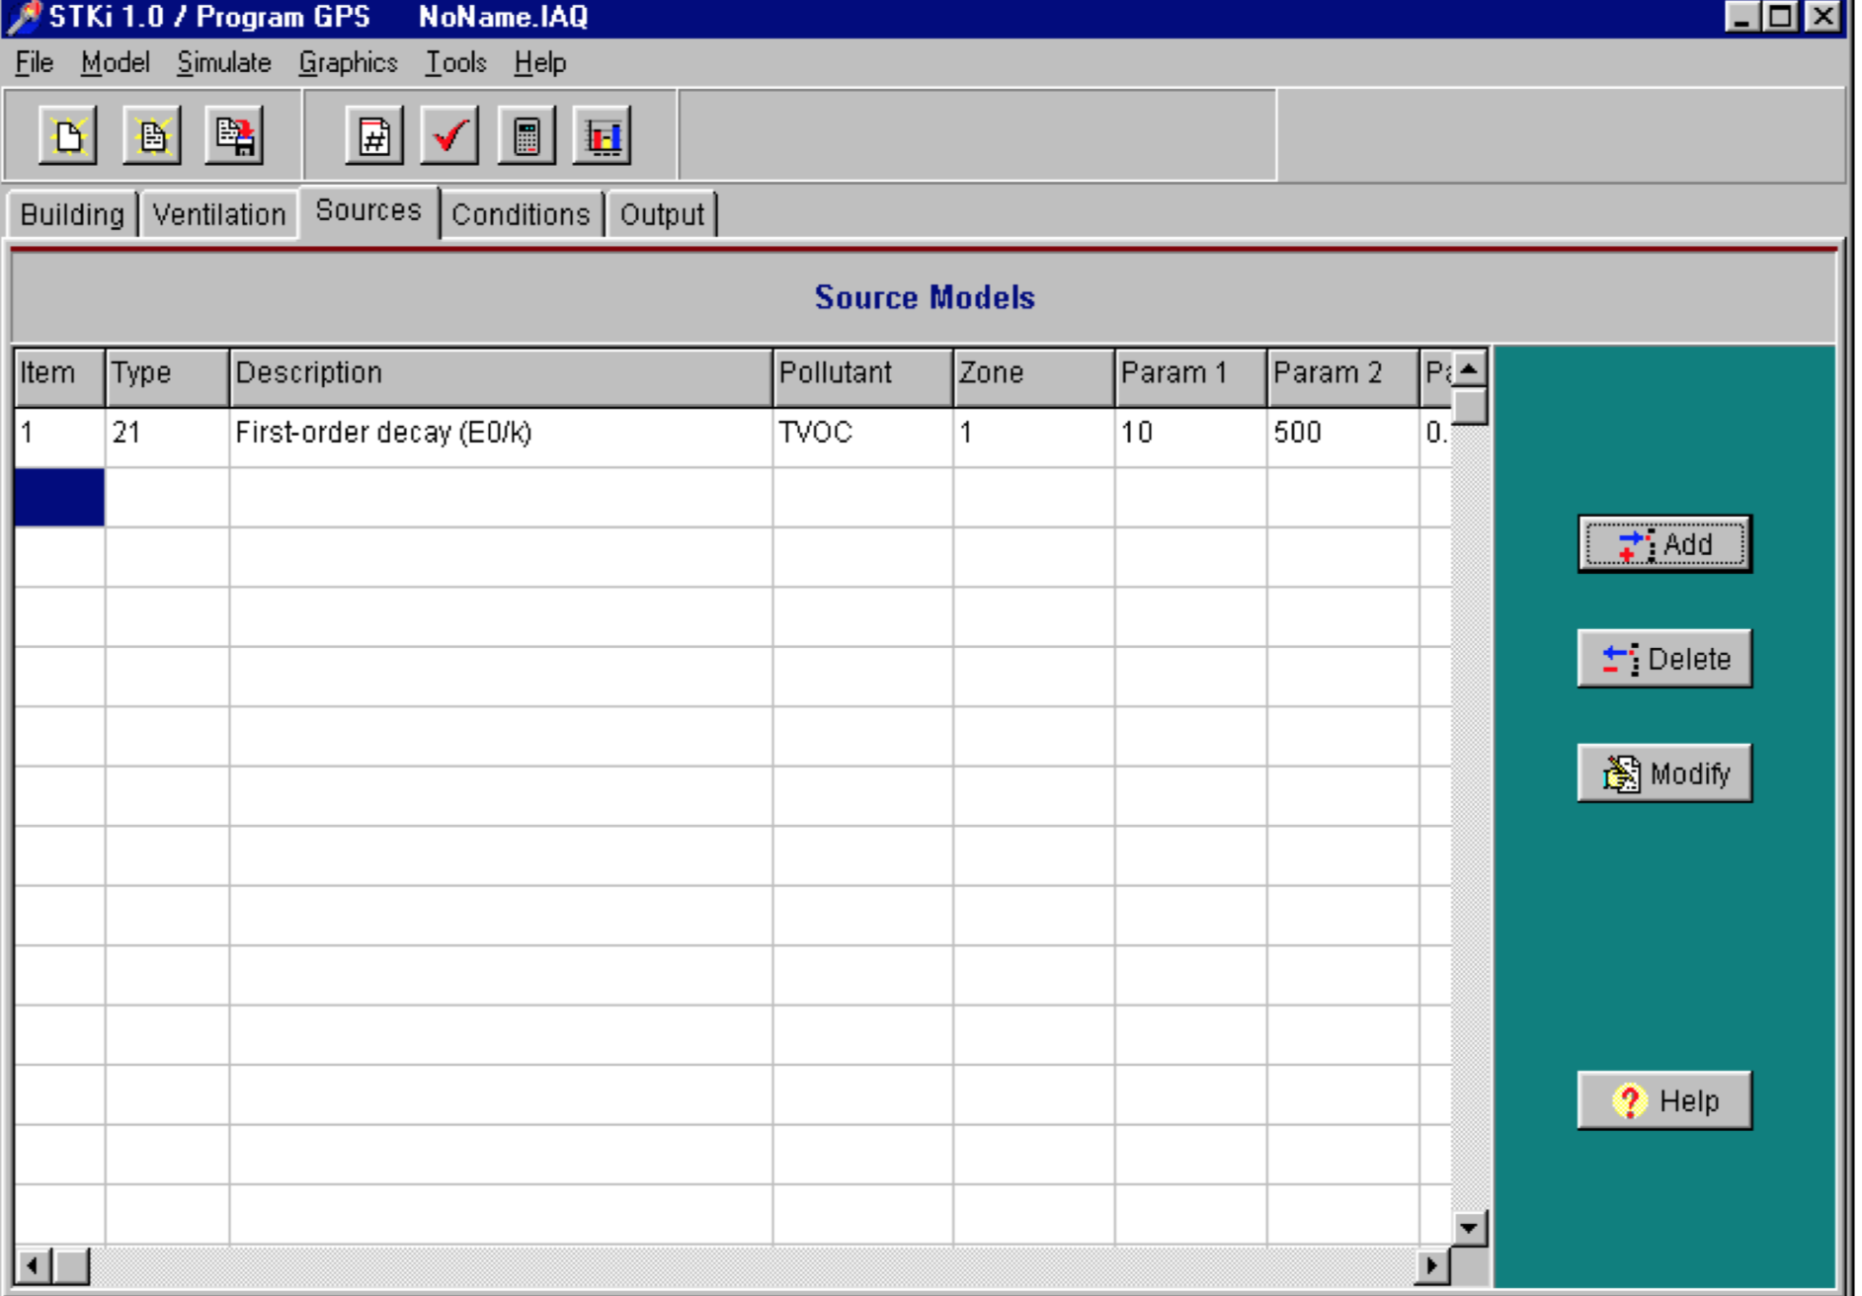
IAQX
Z. Guo*, Development of a windows-based indoor air quality simulation software package. environmental modelling and soft- ware
Notes:
Different emission sources

Slide 10
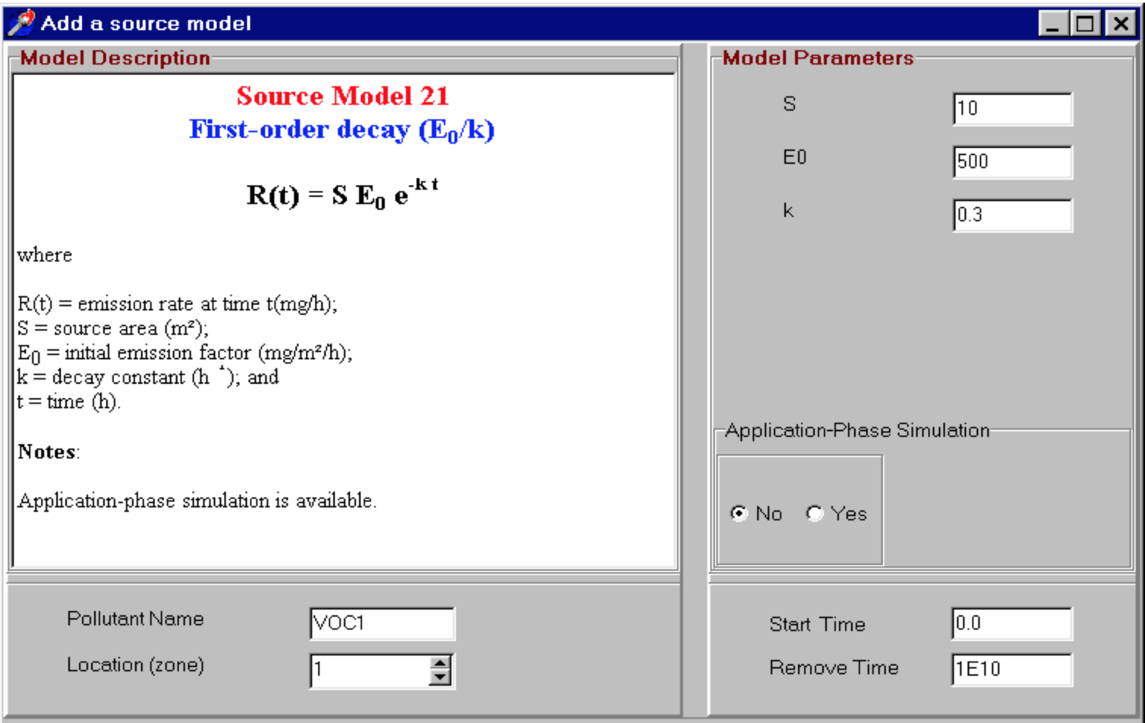
IAQX
Z. Guo*, Development of a windows-based indoor air quality simulation software package. environmental modelling and soft- ware
Notes:
Emission source model

Slide 11
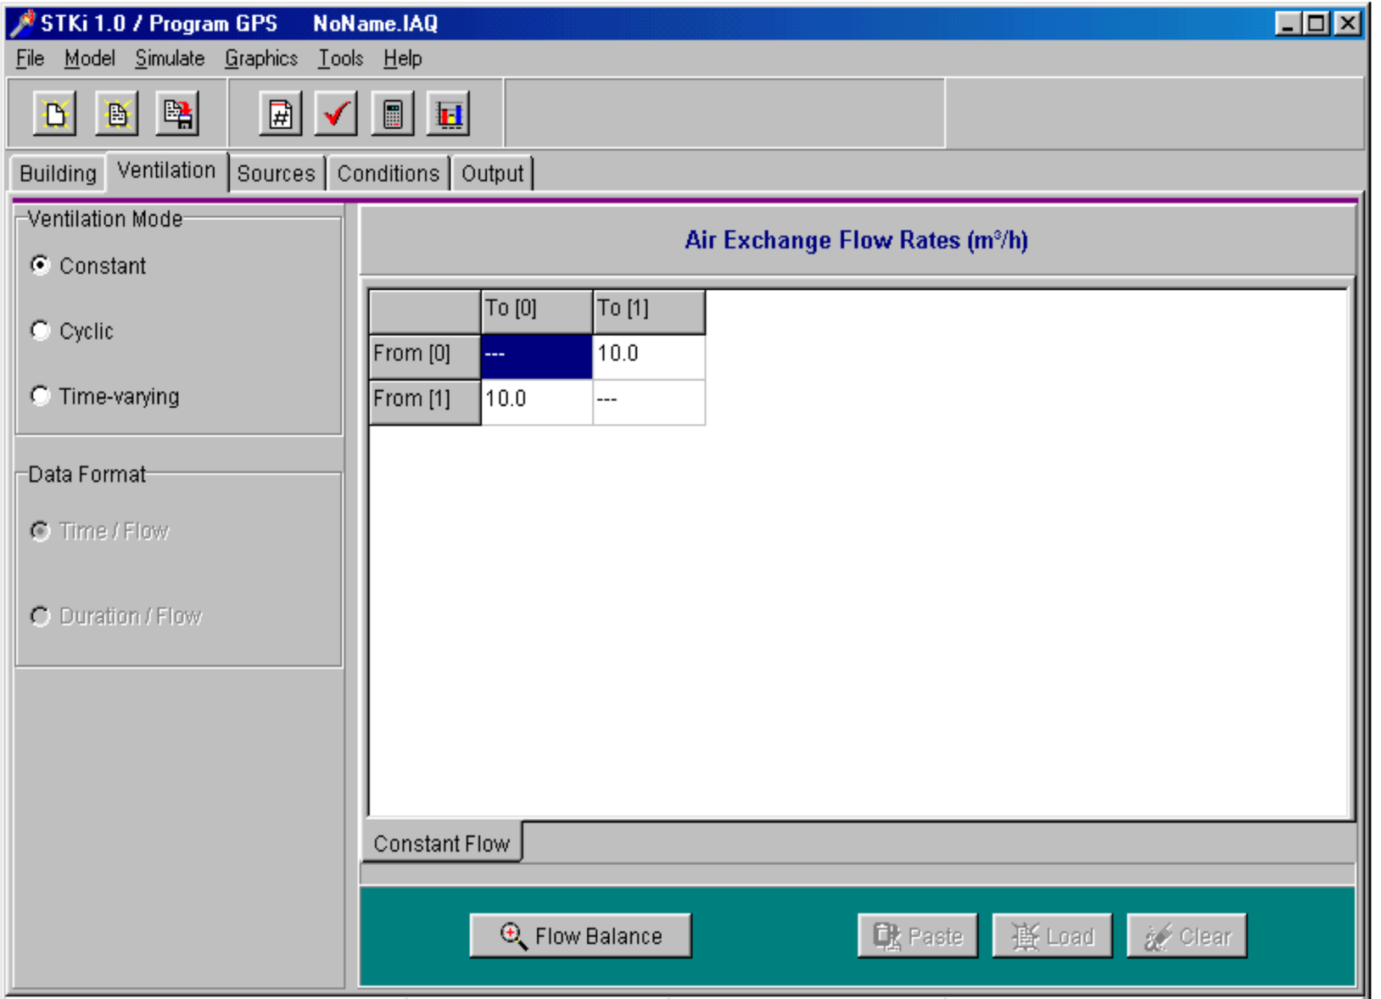
IAQX
Z. Guo*, Development of a windows-based indoor air quality simulation software package. environmental modelling and soft- ware
Notes:
Ventilation with airflow

Slide 12
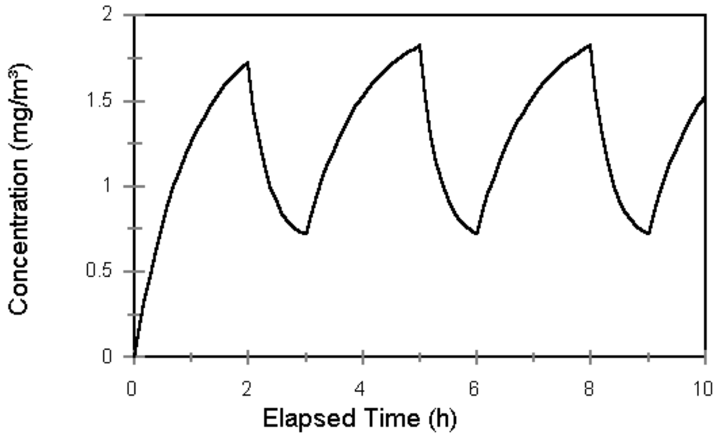
IAQX
Z. Guo*, Development of a windows-based indoor air quality simulation software package. environmental modelling and soft- ware
Notes:
Example of a graph that contains the concentration of a gas over time

Slide 13

Indoor Air Quality Simulation Tool
demo

