Slide 1



21/01/2021

Slide 2
Epsilon Generation Language (Model to Text)
Joanna Kisaakye

Slide 3
Why do we need M2T?
Model Serialisation
Code and documentation generation
Model visualisation and exploration
Notes:
1.Enabling model interchange
2.

Slide 4
What constitutes effective M2T transformations?
Repeatability
Traceability
Readability
Flexibility
Notes:
Repeatability - changes made to models should be able to be detected in generated text
Traceability - after generation of the text model, one should be able to tell from which part of the source it was produced.
Readability - the text model should be readable, this can be achieved by adding indentation, different layouts..
Flexibility - can be achieved by supporting parameterised transformation definitions

Slide 5
The Epsilon Platform
Extensible Platform for Specification of Integrated Languages for mOdel maNagement.
A suite of tools and domain specific languages for model driven development.
Epsilon is metamodel-agnostic.
Notes:
Epsilon comprises a number of integrated model management languages, based upon a common infrastructure, for performing tasks such as model merging, model transformation and inter-model consistency checking
The design of Epsilon promotes reuse when building task-specific model management languages and tools. Each individual Epsilon language (e.g., ETL, ECL,EGL) can be reused wholesale in the production of new languages
Ideally, the developer of a new language only has to design language concepts and logic that do not already exist in the Epsilon languages.

Slide 6
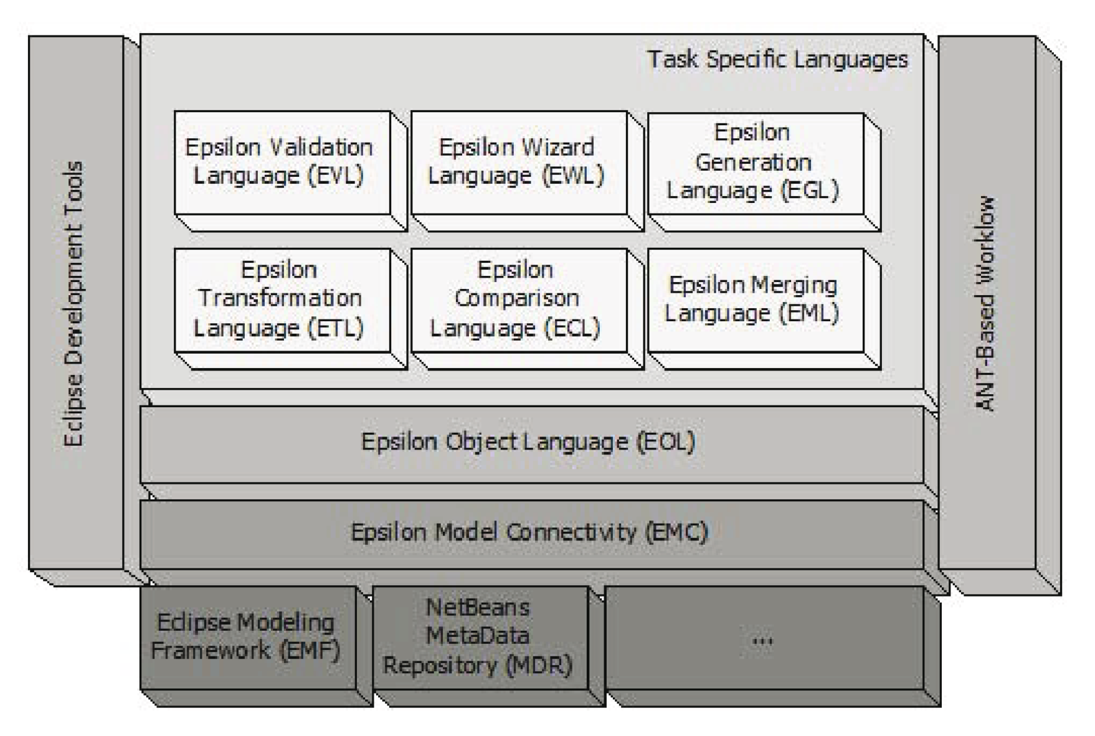
The Epsilon Platform

Slide 7
The Epsilon Object Language
The core of Epsilon, comes packaged with the following features:
The ability to update models
Conditional and loop statements
Statement sequencing
Access to standard output and error streams
Profiling constructs
Task Delegation
An improvement to EOL improves the entire platform.
Notes:
Delegation of computationally extensive tasks to extension points authored in Java, for example, opens up the possibility for developers of Epsilon languages to monitor and finetune performance.

Slide 8
The Epsilon Generation Language
A language for specifying and performing M2T transformations.
EGL is a model-driven template- based code generator, built atop Epsilon, and re-using all of EOL.

Slide 9
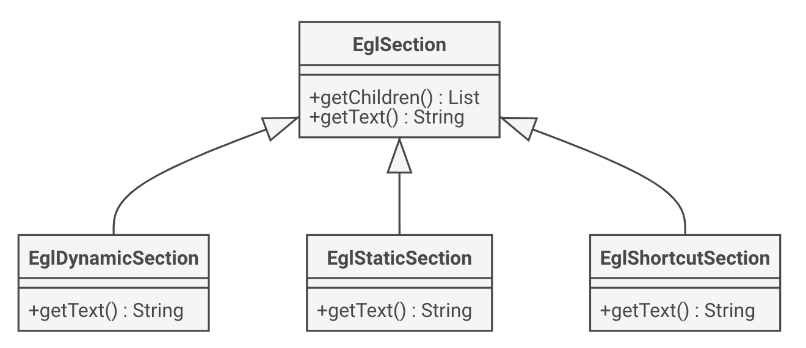
The EGL Abstract Syntax
Notes:
EGL defines sections, from which templates may be constructed.
Static sections delimit sections whose contents appear verbatim in the generated text.
Dynamic sections contain executable code that can be used to control the generated text. In its dynamic sections, EGL re-uses EOL’s mechanisms for structuring program control flow, performing model inspection and navigation, and defining custom operations.
EGL provides an EOL object, out, for use within dynamic sections.
EGL also provides syntax for defining dynamic output sections, which provide a convenient shorthand for outputting text from within dynamic sections.

Slide 10
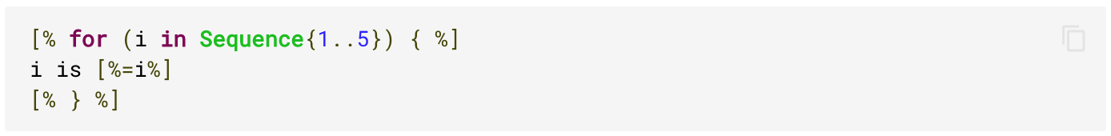
The EGL Concrete Syntax
The tag pair [% %] is used to delimit a dynamic section.
Any text not enclosed in such a tag pair is contained in a static section.
The [%=expr%] construct (line 2) is shorthand for [% out.print(expr); %], which appends expr to the output generated by the transformation.

Slide 11
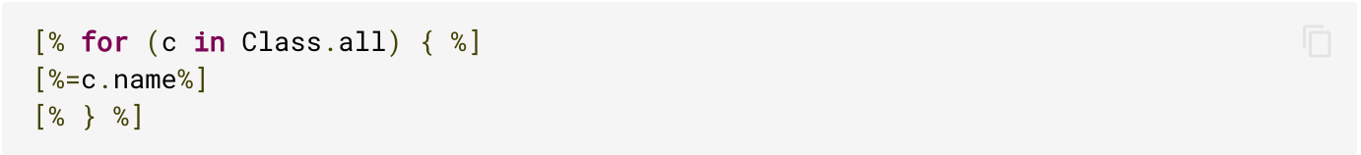
The EGL Concrete Syntax
Any EOL statement can be contained in the dynamic sections of an EGL template.
The out keyword also provides several methods for appending text to and removing text from the output buffer, and for merging generated text with existing text such as println(Object) and chop(Integer).
Notes:
The EGL template shown generates text from a model that conforms to a metamodel that describes an object-oriented system.

Slide 12
Parsing and Preprocessing
EGL provides a parser which generates an abstract syntax tree comprising static, dynamic and dynamic output nodes for a given template.
A preprocessor then translates each section into corresponding EOL.
static
Preprocessor
EOL
dynamic output
dynamic

Slide 13
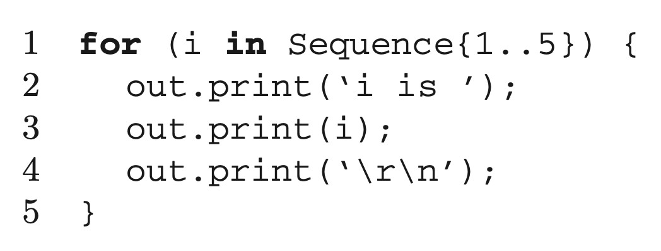
Parsing and Preprocessing
Notes:
The template-based syntax is more concise, while the preprocessed syntax is arguably more readable.
For templates where there is more dynamic than static text, a template-based syntax is often less readable.

Slide 14
Deriving EGL from EOL
A minimal syntax for EGL.
EGL execution engine is a preprocessor for EOL.
Two additional global variables:
  out
  TemplateFactory
Notes:
The out object defines methods for performing operations specific to M2T translation.
The TemplateFactory object provides methods for loading other templates, even from the file system.

Slide 15
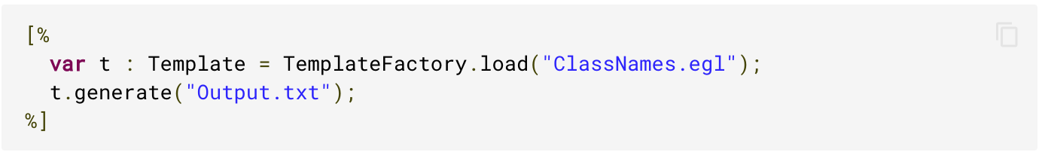
Coordination
The EGL co-ordination engine supplies mechanisms for generating text directly to files.
The design encourages decoupling of generated text from output destinations.
The Template data-type is provided to allow nested execution of M2T transformations, and operations on instances of this data-type facilitate the generation of text directly to file.
Notes:
In the large, M2T transformations need to be able to not only generate text, but also files, which are then used downstream as development artefacts.
Firstly, a Template can invoke other Templates, and hence can be shared and re-used between EGL programs.
Secondly, the Template type has been implemented in an extensible manner: users can define their own types of Template that generate text to any destination (e.g. a database or a network socket).
Finally, the Template type provides a set of operations that are used to control the destination of generated text.
EGL’s co-ordination engine facilitates the specification of platform-specific details (the destination of any files being generated) separately from the platform-independent details (the contents of any files being generated).

Slide 16
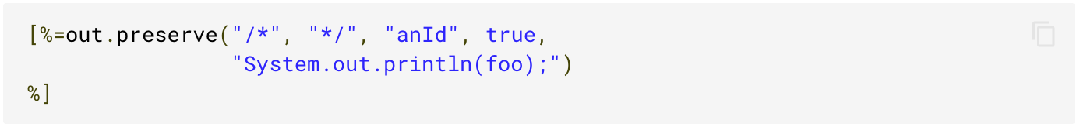
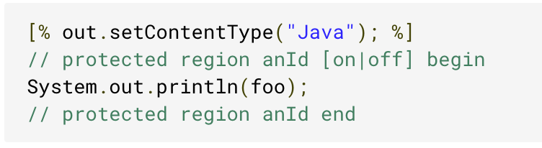
Merge Engine
EGL provides language constructs that allow M2T transformations to designate regions of generated text as protected.
Specified using the preserve keyword.
Other related methods include; startPreserve, stopPreserve, setContentType.
Notes:
Whenever an EGL program attempts to generate text, any protected regions that are encountered in the specified destination are preserved.
To enhance readability, EGL provides two additional methods on the out keyword: startPreserve and stopPreserve to demarcate the start and end of a protected region.
EGL also provides a separate method to set the target language generated by the current template, setContentType(String).
Once a content type has been specified, a protected region may be declared entirely from a static section.

Slide 17
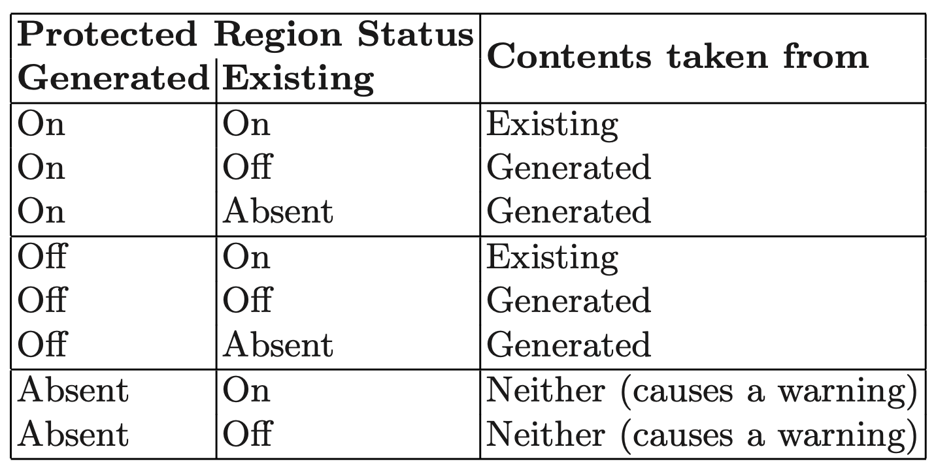
Merge Engine
Notes:
When a template that defines one or more protected regions is processed by the EGL execution engine, the target output destinations are examined and existing contents of any protected regions are preserved.
If either the output generated from the template or the existing contents of the target output destination contains protected regions, a merging process is invoked.
The table shows the default behaviour of EGL's merge engine.

Slide 18
Readability and Traceability
EGL provides a number of text post-processors – or beautifiers – that can be executed on output of transformations to improve readability.
Invoked via Epsilon’s extensions to Apache Ant.
EGL also provides a traceability API, as a debugging aid, and to support auditing of the M2T transformation process.
Notes:
This API facilitates exploration of the templates executed, files affected and protected regions processed during a transformation.

Slide 19
Tool Support
The Epsilon platform provides development tools for the Eclipse development environment
EGL provides an Eclipse workbench configuration that is tailored for use with Epsilon’s development tools.
EGL also provides an Apache Ant task definition, to facilitate invocation of model-management activities from within a build script.
Notes:
Re-use of Eclipse APIs allows Epsilon’s development tooling to incorporate a large number of features with minimal effort.

Slide 20
Thank you for listening. Questions?

