Slide 1
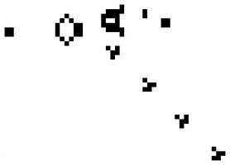
Cellular Automata
By Andrei Bondarenko
Paper:
Cellular Automata, Wolfram, S. Los Alamos Science 9 (1983): 2 - 21.
Animation by Lucas Vieira under CC BY-SA 3.0
Notes:
Hello, my name is Andrei Bondarenko
And I’m going to give you an introduction to cellular automata
Based on the paper: Cellular automata by Stephen Wolfram

Slide 2



About Me
2nd year Master student in computer science
specializing in
Data Science and Artificial Intelligence
Image via Stockio.com
Notes:
This is me
2nd year master student in CS at the UA
Specializing in DS and AI
However, my passion for CS isn’t limited to my specialization
Hence my interest in software engineering topics and participation in this course
Besides CS and technology in general, I also love travelling and experiencing new cultures, so you can imagine how I’ve been feeling these past couple of months.
End

Slide 3
Overview
What is a cellular automaton?
  Basic structure and properties
  Elementary cellular automata
Why are they interesting to us?
Practical examples
Notes:
Let’s have a look at what I’m going to talk about
I’ll explain what cellular automata are
Look at the basics
Focus on elementary cellular automata (focus of Stephen Wolfram’s research and the paper I read)
Then we’ll talk about why they’re of interest to us, members of the modelling / model driven engineering community
Finally, we’ll close of the presentation with two practical application examples where CA’s were applied

Slide 4
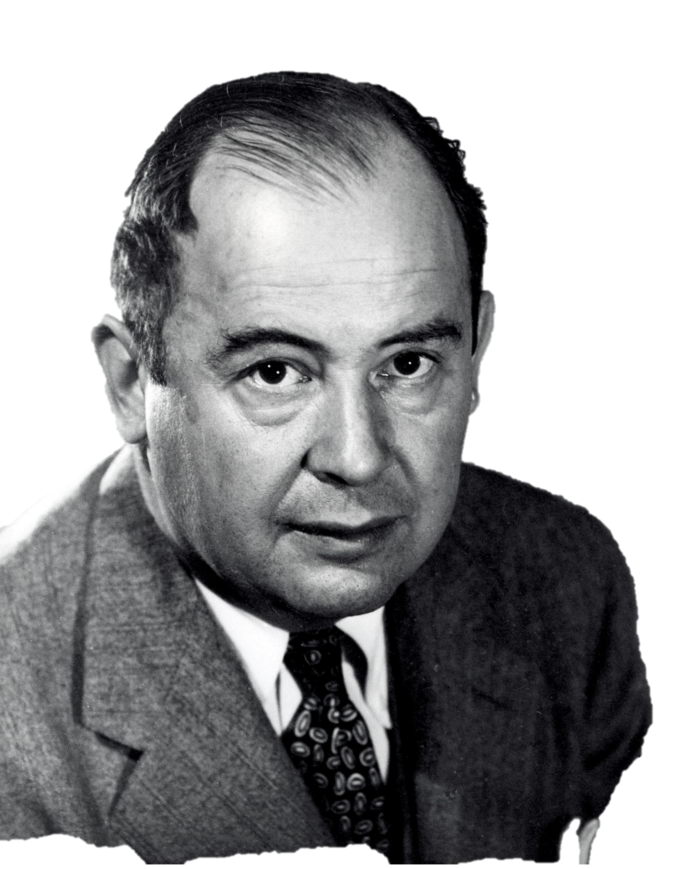
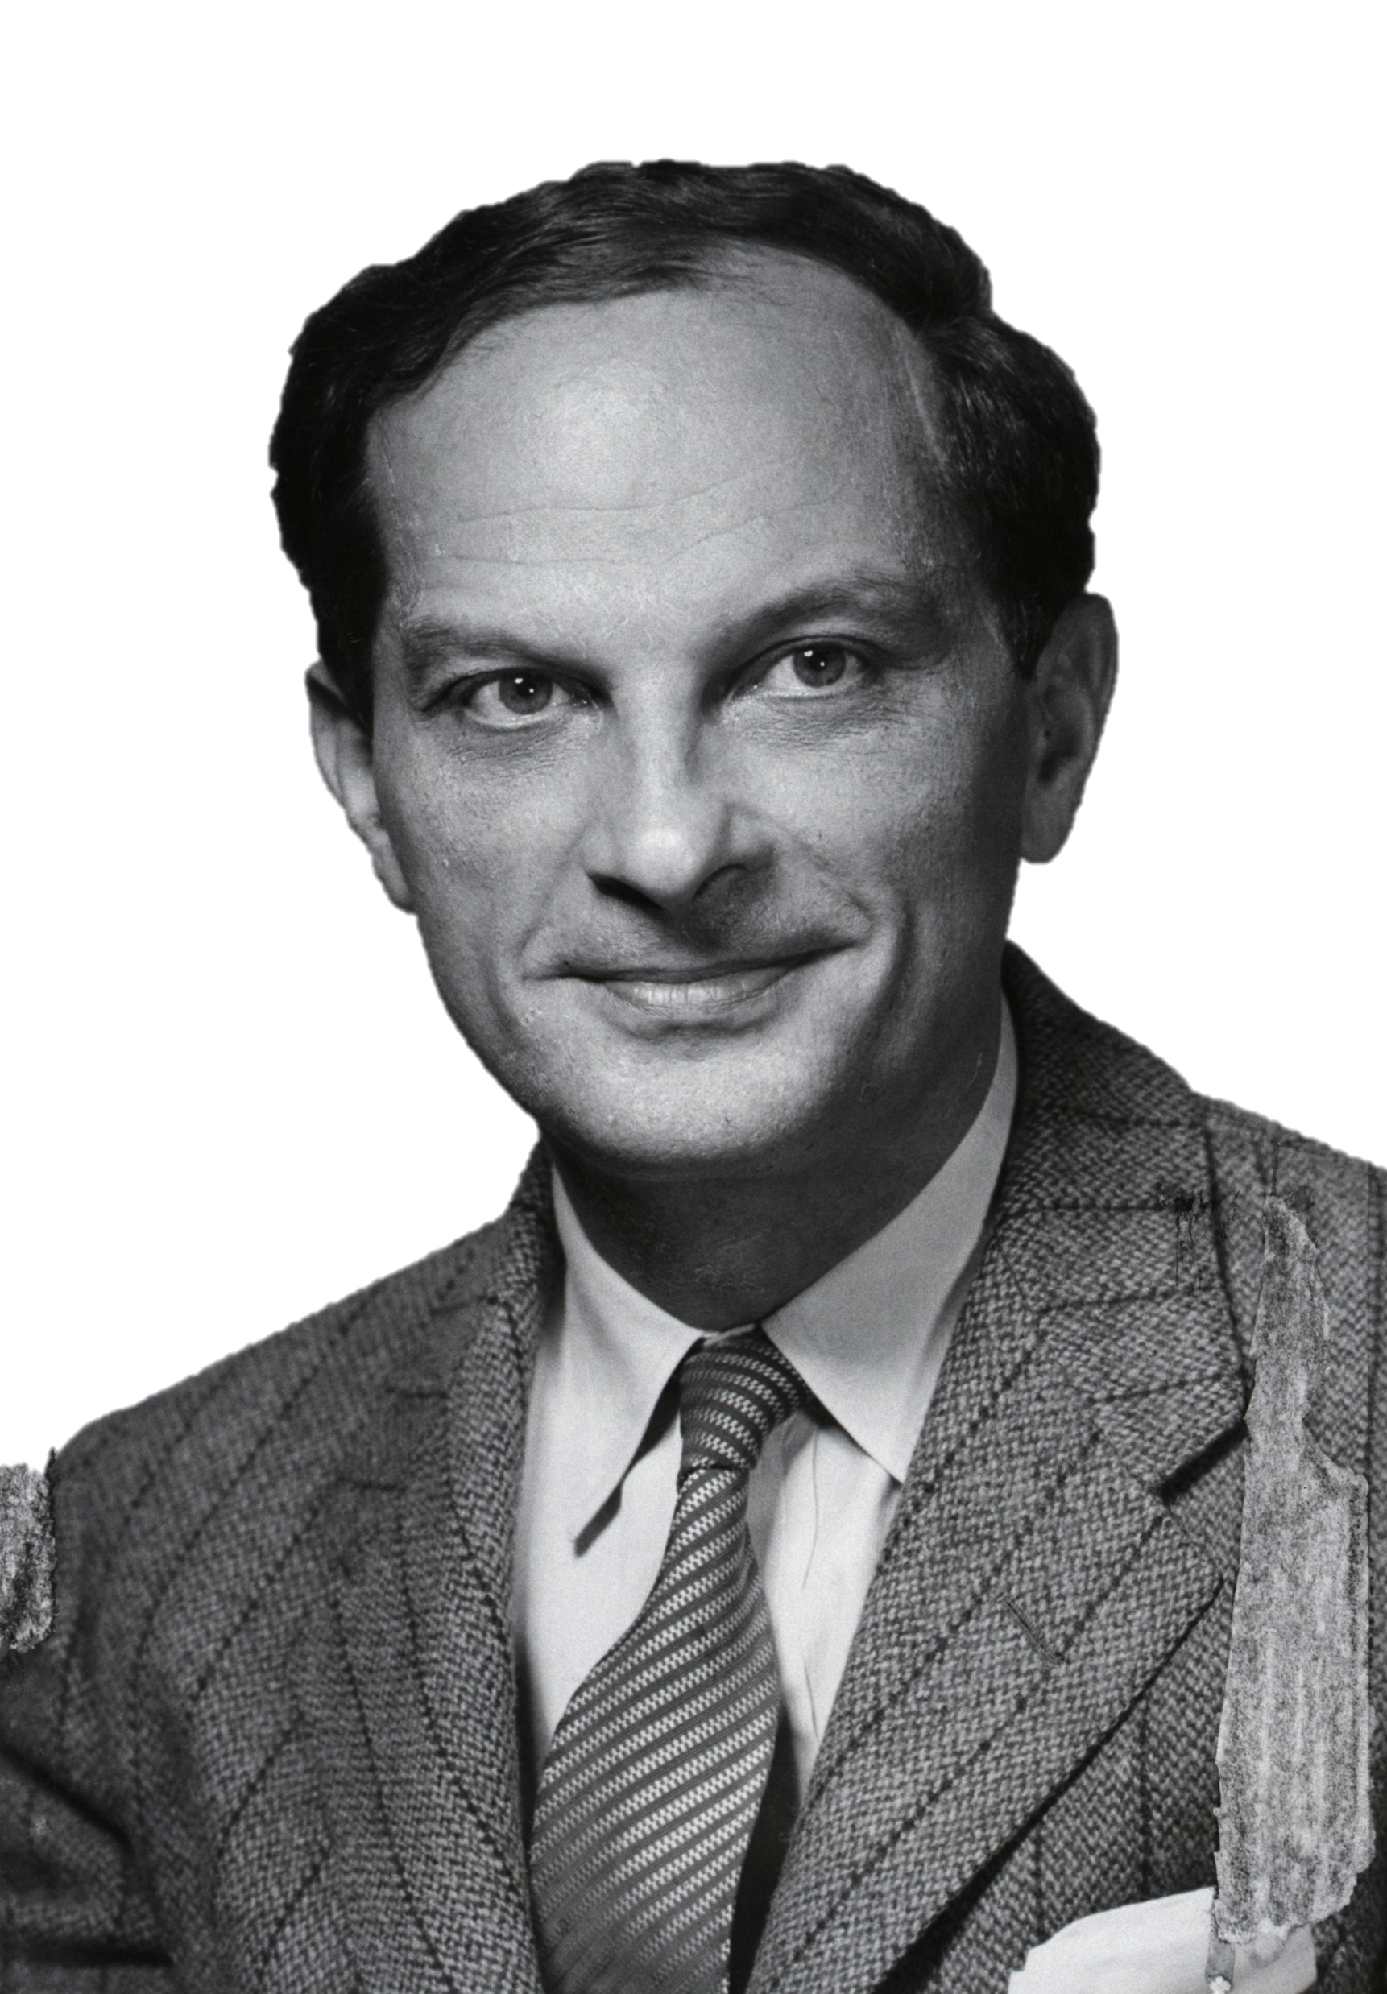
Cellular automaton?
1940’s
Grid of Cells (n-dimensional)
Finite number of (cell) states
Cell states evolve in discrete time (generations)
Based on the state of neighboring cells
According to a fixed set of update rules
ALL cells are updated synchronously
Bettmann/Getty Images
Notes:
Grid of cells (finite number of dimensions)
Each cell has a finite number of states that it can have
Extensions of CA’s where states are continuous exist, but out of scope for this presentation
Cell states evolve in discrete time steps
Each global state of the grid is called a generation
A cell’s state is updated based on the states of its neighbors
Different neighborhoods exist: Von Neumann, Moore, extended Moore
All cells are updated simultaneously
Asynchronous CA’s exist, but are out of scope
According to a fixed set of rules
Stochastic CA’s exist, but are also out of scope
This concept was first studied in the 1940’s by Stanislaw Ulam and John von Neumann
Subject didn't gain much traction until…

Slide 5
Conway’s game of life
1970’s
Animation by Lucas Vieira under CC BY-SA 3.0
Notes:
The 1970’s when John Conway published his “Game of life” CA
This CA was proven to be capable of universal computation, i.e. Turing complete
Then…

Slide 6
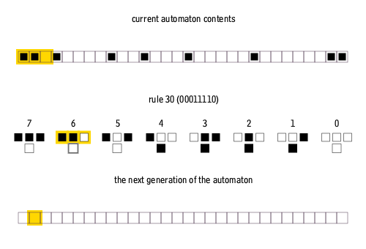
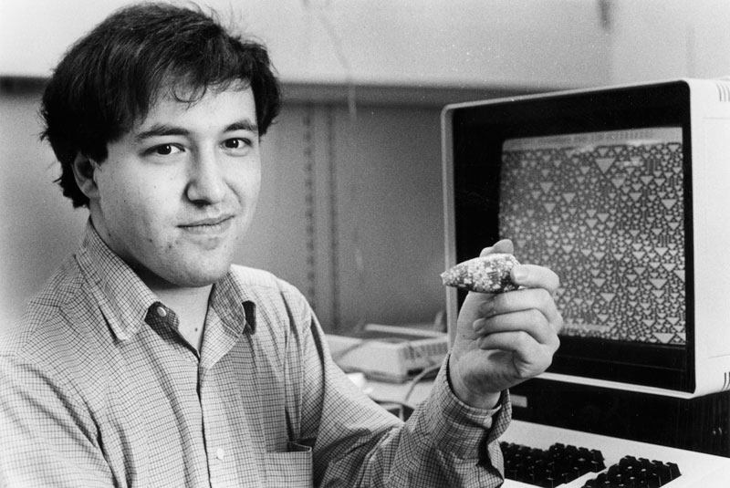
Elementary cellular automata
1980’s
Animation by CORMULLION under CC BY-SA 4.0
© Stephen Wolfram
Notes:
In the 1980’s engaged in a systematic study of 1-dimensional CA’s
ELEMENTARY CELLULAR AUTOMATA, also called the simplest CA’s possible by Wolfram
Let us now zoom in on one of these ECA’s

Slide 7
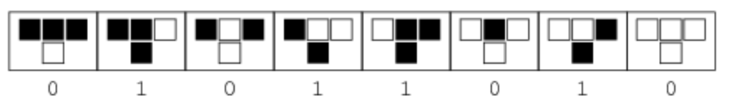

Rule 90
$a_{i}^{(t+1)}=a_{i−1}^{(t)}$+ $a_{i+1}^{(t)} mod 2$
OBSERVATION?
Self-similarity
Image from: Weisstein, Eric W. "Rule 90." From MathWorld--A Wolfram Web Resource. https://mathworld.wolfram.com/Rule90.html
Notes:
Rule 90
Mathematical notation in the top right
Visual representation of the rule
Semantics of this rule: next state of a cell is the XOR of its nieghbours
So, if exactly one of the neighbours of the cell being updated is black, then it becomes black
Even if we start at an initial state with one black cell
And keep applying this very simple rule
(and print each generation below the previous one)
We get quite complicated behavior
It is here that Wolfram made his first observation
The structures generated by these simple rules were self-similar/ fractal like in

Slide 8
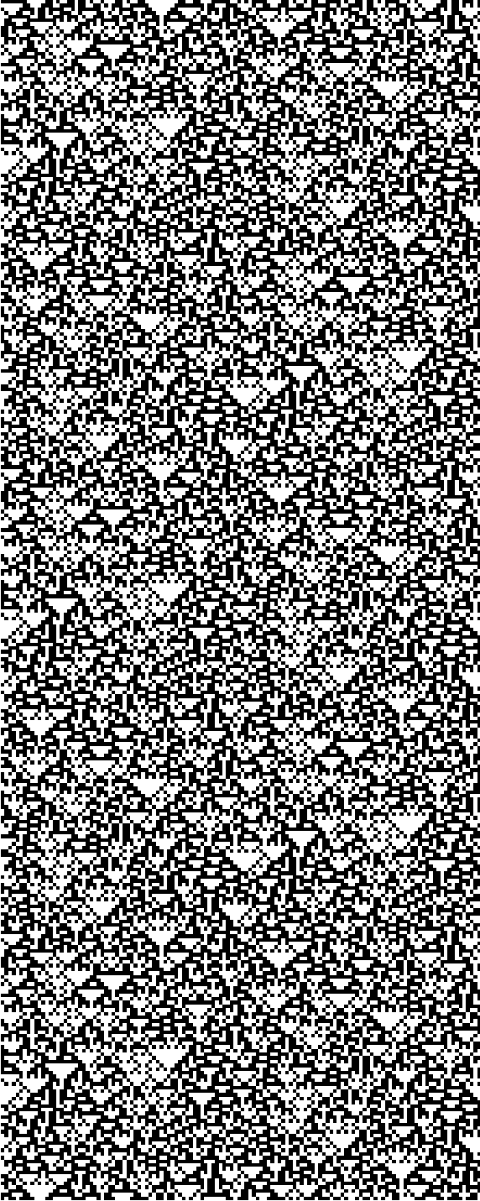
RULE 90 – disordered initial state
OBSERVATION?
Self-organization
Notes:
If we randomize the initial state
We get the following pattern
This is where Wolfram made his second observation
Namely, that there was some form of organization present in the chaotic patterns generated by this rule

Slide 9
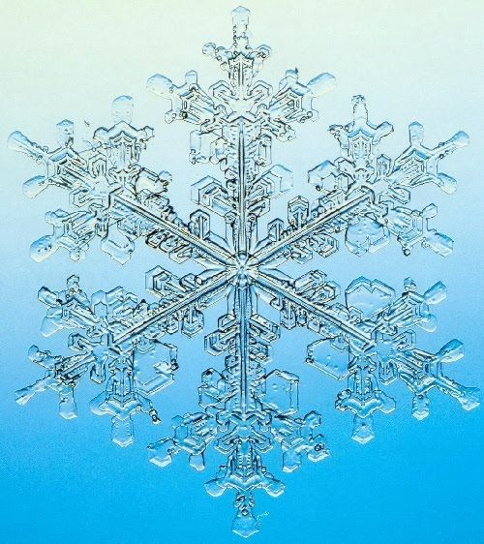
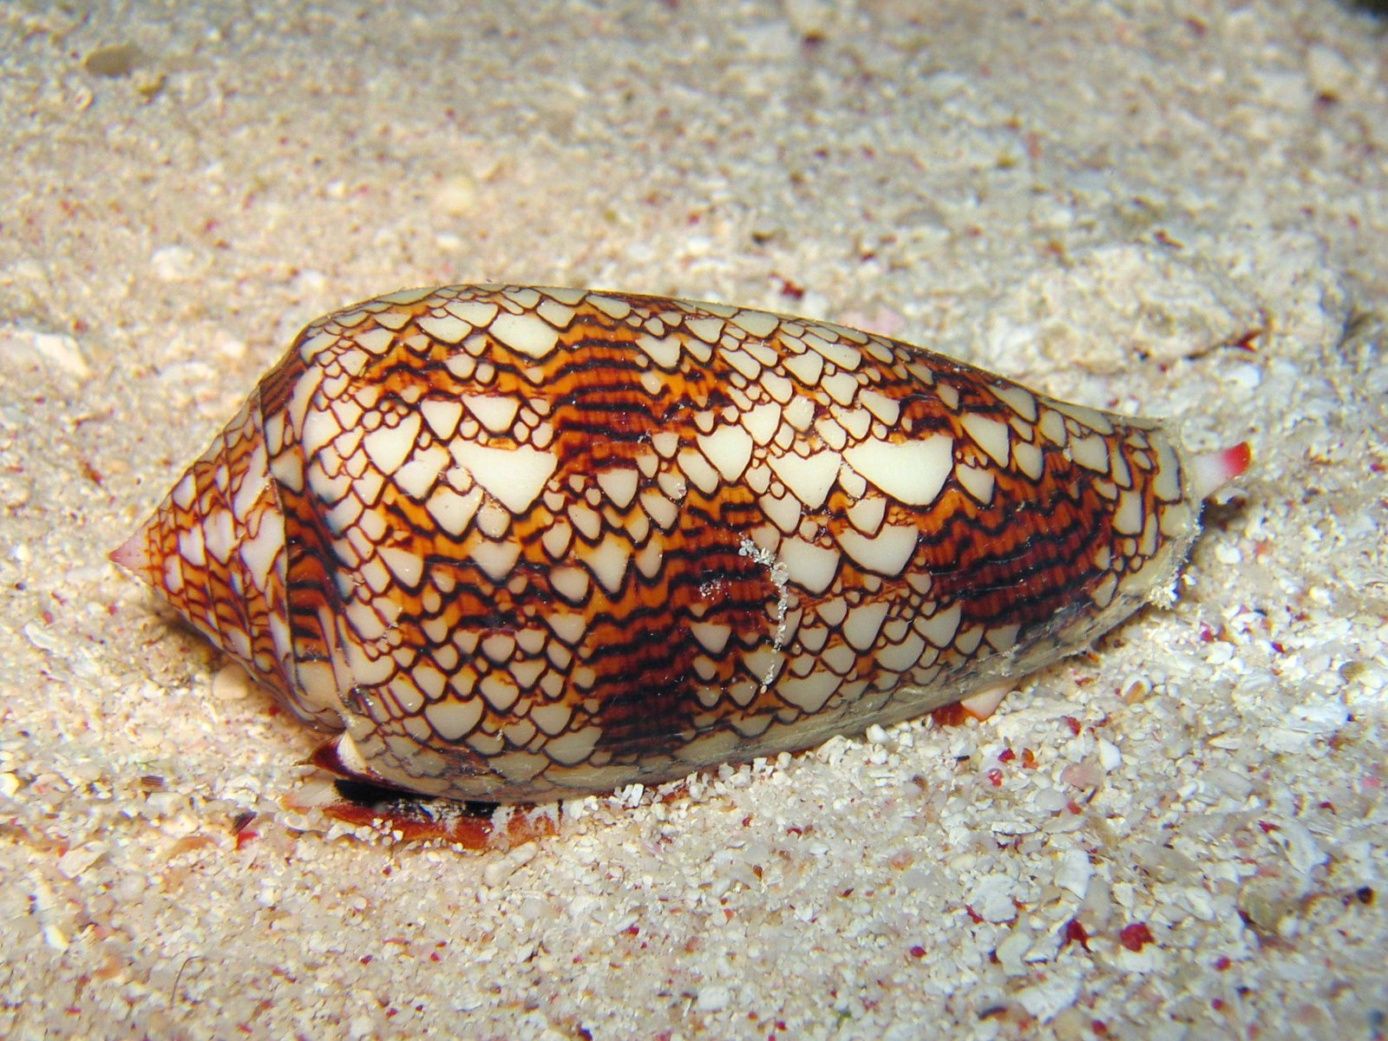
in natural systems
Self-similarity
Self-organization
Notes:
Stephen Wolfram argues that these self-similar and self-organized patterns
Are reminiscent of patterns found in natural systems
Could have been generated by processes analogous to cellular automata

Slide 10
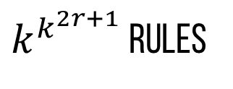




Generalizing from rule 90
$a_{i}^{(t+1)}=a_{i−1}^{(t)}$+ $a_{i+1}^{(t)} mod 2$
Arbitrary function of cell state and its two neighbors
256 rules
$a_{i}^{(t+1)}=F(a_{i−1}^{\left(t\right)},a_{i}^{\left(t\right)},$ $a_{i+1}^{(t)})$
$k=2$, $r=1$
$k$ discrete states, consider neighbors up to distance $r$ on both sides
$k^{k^{2r+1}}$ rules
$$a_{i}^{(t+1)}=F(a_{i−r}^{\left(t\right)}, {…,a}_{i+r}^{(t)})$$
Notes:
He then goes on to generalize from rule 90 to more general rules
By allowing arbitrary functions of a cell’s current state and the state of its neighbors to determine a cell’s next state
This results in an additional 256
Explain where 256 comes from
This can be generalized even further by allowing cells to have k discrete states
And consider neighbors up to distance r (on both sides) from the cell
This results in k^k^(2r+1) rules depending on the value for k and r that are chosen

Slide 11
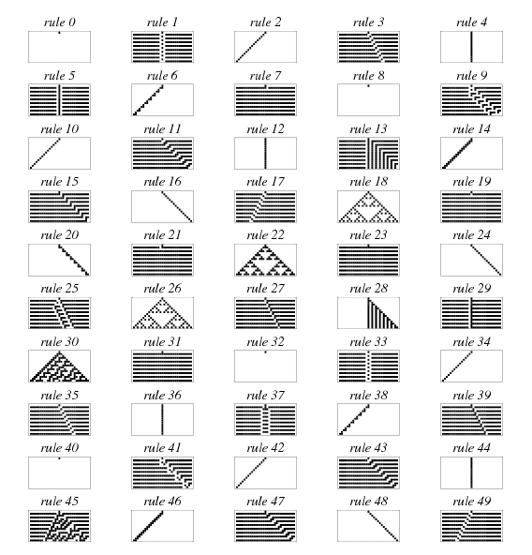
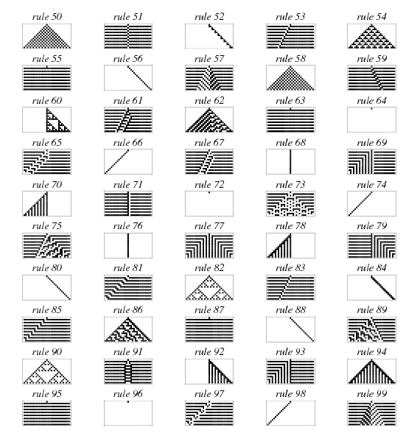
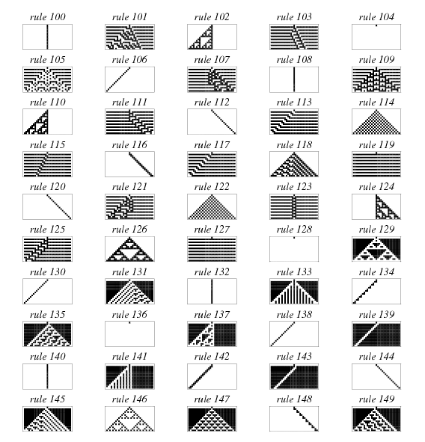
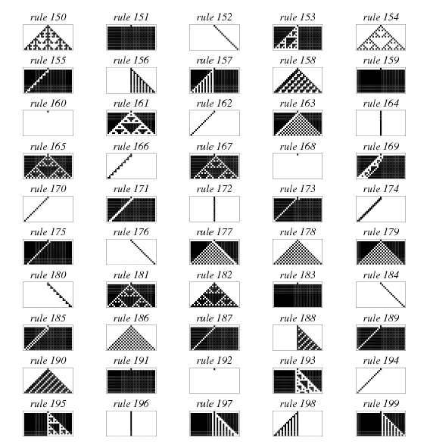
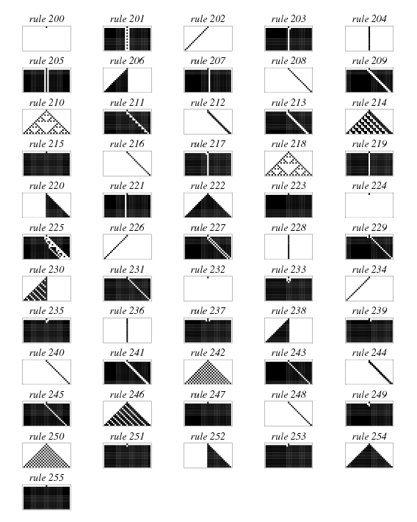
IMaGEs FROM: Weisstein, Eric W. "Cellular Automaton." From MathWorld--A Wolfram Web Resource. https://mathworld.wolfram.com/CellularAutomaton.html
Notes:
So, Stephen Wolfram studied these 256 rules with r=1
and others with different k and r values

Slide 12
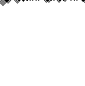
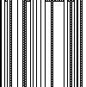
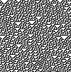
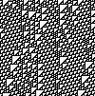
Four Qualitative classes
Given a random initial state . . .
CLASS 1
CLASS 2
CLASS 3
CLASS 4
Evolution leads to a homogeneous state
Evolution leads to a set of stable or periodic structures
Evolution leads to a chaotic pattern
Evolution leads to complex structures, sometimes long-lived
(partial) differential equations → continuous dynamical systems
Universal computation
Notes:
What he observed was, is that given a random initial state
The patterns that are generated by these elementary cellular automata
Can be categorized into 4 qualitative classes
Class 1 CA’s evolve into a homogenous state
Class 2 CA’s evolve into stable or periodic structures
Class 3 CA’s evolve into chaotic, although not completely random, patterns
May exhibit self-organizing behavior
Class 4 CA’s evolve into complex structures that are sometimes long lived
Stephen Wolfram then goes on to point out that the behavior exhibited by the first three classes is analogous to the three types of behavior found in solutions to (partial) differential equations used to represent continuous dynamic systems
1) approach a fixed point over time 2) cycle in which the parameters vary periodically 3) complicated, apparently chaotic behavior depending on initial conditions
While arguing that the 4th class may be capable of universal computation, i.e. be Turing complete.
Later it was proved by his colleague Matthew Cook that one of the class 4 rules, rule 110, is capable of universal computation
This is where we can neatly transition into …

Slide 13
Why is this interesting to us?
Formalism we’ve studied in MOSIS:
  Causal block diagrams
  Petri nets
  . . .
Lack sense of LOCALITY
cellular automata to the rescue
  Spatial structure
  Local interaction (neighborhood)
Notes:
Why these cellular automata are interesting to us, model driven engineers
During the course on modelling software intensive systems, taught by Prof. Vangheluwe, we saw many different formalisms
CBD’s
Petri nets
State charts
DEVS
All lack a sense of locality
In order to model some complex systems, this sense of locality is essential
Biological ecosystems, social networks, telecommunications

Slide 14

Example – Nagel–Schreckenberg model

Slide 15
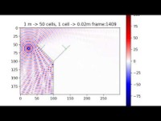
Example – sound wave propagation
Komatsuzaki, Toshihiko, Yoshio Iwata, and Shin Morishita. "Modelling of incident sound wave propagation around sound barriers using cellular automata." International Conference on Cellular Automata. Springer, Berlin, Heidelberg, 2012.

Slide 16
Questions?

