Slide 1
Model Transformation By-Example:
A Survey of the First Wave
By Igor Schittekat
Paper: Langer, Philip & Retschitzegger, Werner & Schwinger, Wieland & Wimmer, Manuel. (2012). Model Transformation By-Example: A Survey of the First Wave. Conceptual Modelling and Its Theoretical Foundations, LNCS. 7260. 197-215. 10.1007/978-3-642-28279-9_15.
https://www.researchgate.net/publication/221350031_Model_Transformation_By-Example_A_Survey_of_the_First_Wave

Slide 2
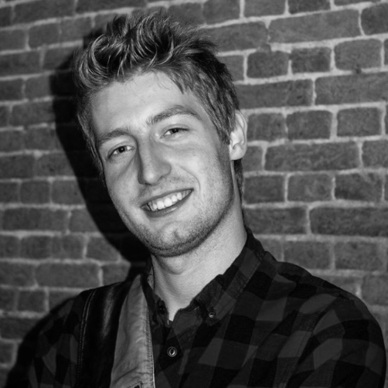
About Me
Master Student Computer Science
  Specializing in Software Engineering

Slide 3
Introduction
Demonstration Based
Correspondence Based
Conclusion

Slide 4
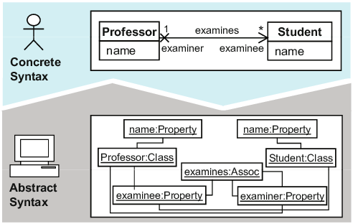
https://www.researchgate.net/publication/221350031_Model_Transformation_By-Example_A_Survey_of_the_First_Wave

Slide 5
MDE in a Nutshell
Endogenous Transformation
  Rewrite input model to produce output model
  Operational Semantics
  Demonstration Based approach
Exogenous Transformation
  Create new output model from input model
  Transformational Semantics
  Correspondence or Demonstration Based approach

Slide 6
Introduction
Demonstration Based
Correspondence Based
Conclusion

Slide 7
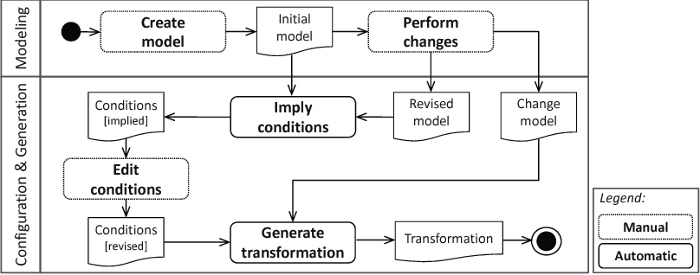
https://www.researchgate.net/publication/221350031_Model_Transformation_By-Example_A_Survey_of_the_First_Wave

Slide 8
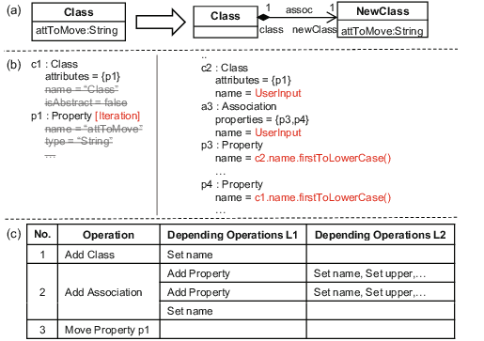
https://www.researchgate.net/publication/221350031_Model_Transformation_By-Example_A_Survey_of_the_First_Wave

Slide 9
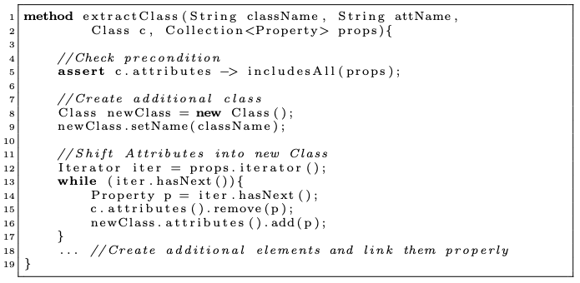
https://www.researchgate.net/publication/221350031_Model_Transformation_By-Example_A_Survey_of_the_First_Wave

Slide 10
Introduction
Demonstration Based
Correspondence Based
Conclusion

Slide 11
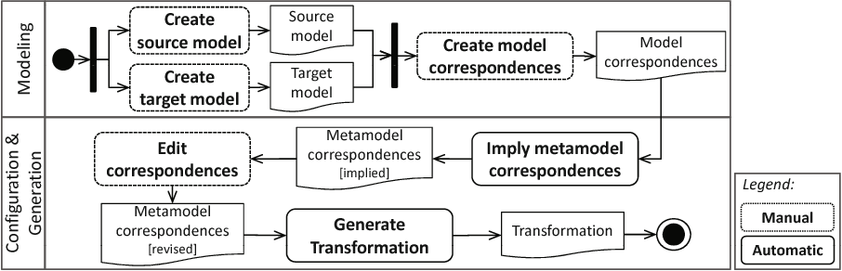
https://www.researchgate.net/publication/221350031_Model_Transformation_By-Example_A_Survey_of_the_First_Wave

Slide 12
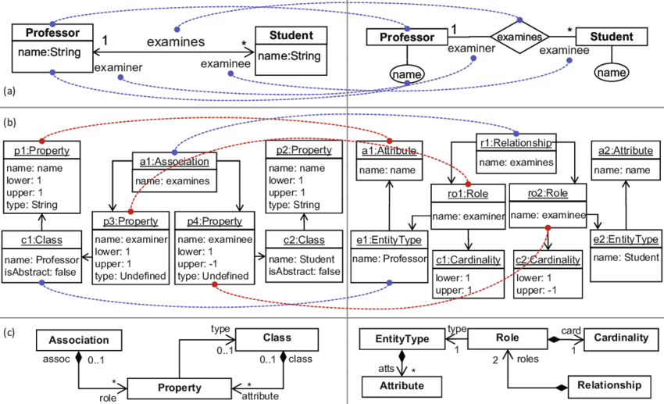
https://www.researchgate.net/publication/221350031_Model_Transformation_By-Example_A_Survey_of_the_First_Wave

Slide 13
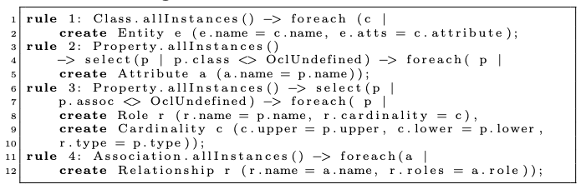
https://www.researchgate.net/publication/221350031_Model_Transformation_By-Example_A_Survey_of_the_First_Wave

Slide 14
Introduction
Demonstration Based
Correspondence Based
Conclusion

Slide 15
Lessons learned and Future Challenges
Different scenario’s and different techniques
  6 papers on exogenous-correspondence
  1 paper on exogenous-demonstration
  0 papers on endogenous-correspondence
  2 papers on endogenous-demonstration
Test-driven Transformation development
MTBE outperforms Metamodel matching
Multifaceted usage of Exmples

Slide 16
Conclusion

Slide 17


