Slide 1
A study and implementation of semantic variation in statecharts
Joeri Exelmans
3 September 2020

Slide 2
Outline
Background:
  Why statecharts are useful?
  The semantics of statecharts
  How the big-step modeling languages framework describes semantic variation
Solution:
  What is the Statecharts + Class Diagrams (SCCD) formalism?
  Implementation overview
  Demo
Comparison (with another tool)
Conclusions

Slide 3
Caution
For this presentation, I will assume that the audience is familiar with
  the statecharts formalism
  big-step modeling languages

Slide 4
Background

Slide 5
Statecharts are a formalism for modeling...
Reactive
Autonomous, timed
Complex
Concurrent
...systems!
at a discrete-event level of abstraction

Slide 6
Example statechart – Requirements
Interface:
  Suppose we want to model the behavior of a microwave oven with 3 buttons. A button press generates an input event:
    start
    stop
    increase_time
  The statechart controls the microwave’s power (running / not running) through the output events:
    micro_on
    micro_off
  The statechart also controls the “remaining time” on the display through the output variable:
    time: int (amount of seconds, initially 0)
Requirements:
  at any time, when the increase_time button is pressed, the time is increased by 10 seconds
  when the microwave is running, every second, the time is decreased by 1
  if the time becomes 0 while running, the microwave stops running
  when the stop button is pressed:
    if running, it stops running
    if not running, the time is reset to 0
  when not running, pressing the start button starts the microwave.
  if, at the moment the microwave is started, the time == 0, the time is set to 30.

Slide 7

Example statechart – Mental picture

Slide 8
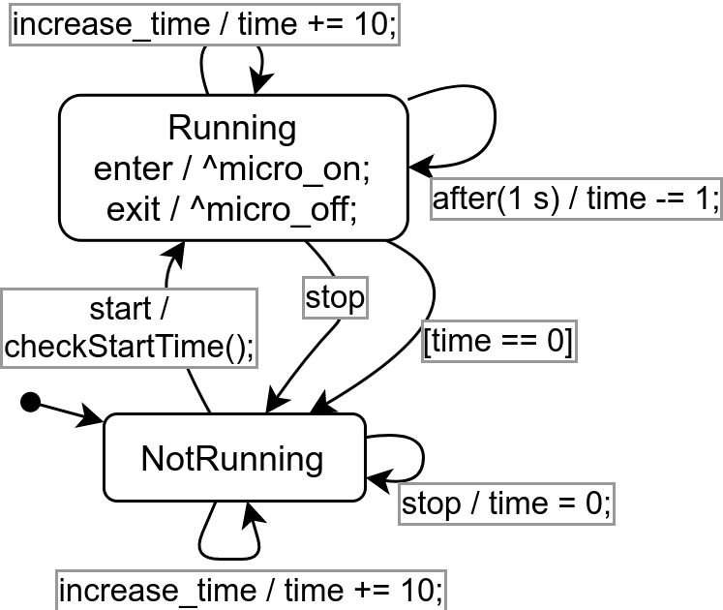
Microwave – Solution #1
implementation of checkStartTime():
if (time == 0) {
time = 30;
}

Slide 9
A new requirement
Safety regulations demand that:
  opening the door of the microwave should stop the microwave if it is running
  while the door is opened, the microwave cannot be started
2 new input events:
  door_opened
  door_closed

Slide 10
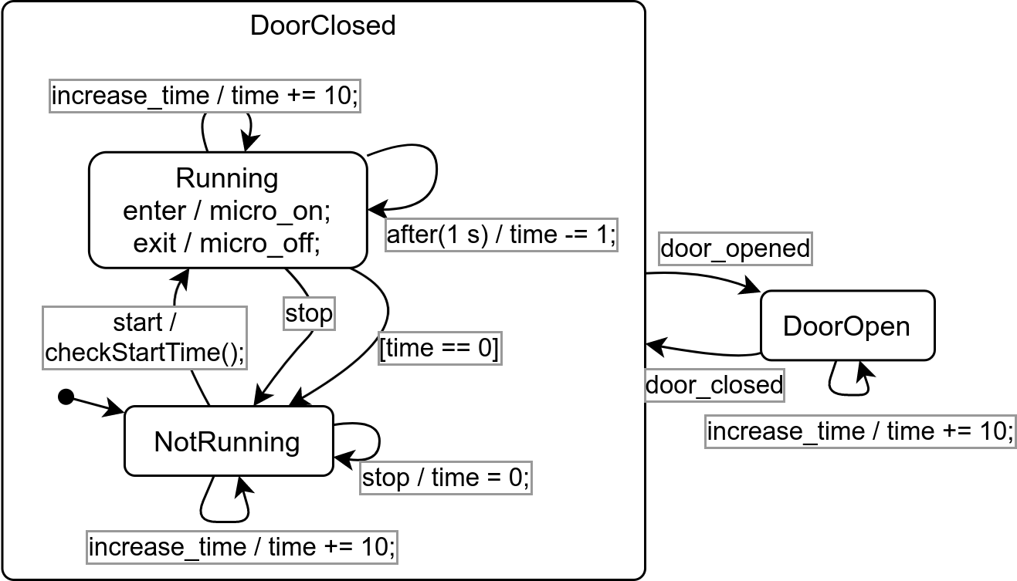
Microwave – Solution #2
Hierarchy allows us to reduce the number of transitions
+ potentially assign a higher priority to “door_opened”

Slide 11
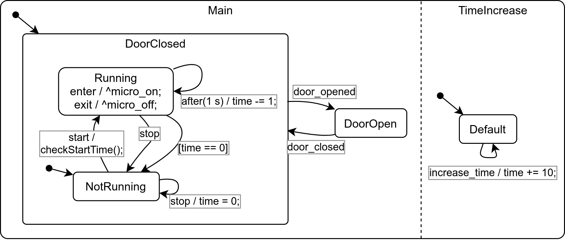
Microwave – Solution #3
Orthogonality further reduces number of transitions
+ “increasing the time” becomes independent from the rest

Slide 12
Semantics of statecharts
Original ‘87 Harel paper (purposefully) underspecified semantics
Followed by discussion of what would be the “best” semantics for statecharts
Current view: No “best” semantics, requirements dictate formalism
de Roever, Willem-Paul, Gerald Lüttgen, and Michael Mendler. "What is in a step: New perspectives on a classical question." Time for verification. Springer, Berlin, Heidelberg, 2010. 370-399.

Slide 13
Example: Tools with different purposes have different semantics
Statemate (‘86) intended for mixed hardware/software systems
Rhapsody (‘96) intended more for software systems, object-oriented
Semantics of these tools differ:
  Priority: SM: “outer first”, R: “inner first”
  Synchronicity: SM: transitions take no time , R: transitions may take time
  Internal events: SM: visible in next step*, R: run-to-completion
* newer Statemate versions can also be configured with run-to-completion semantics

Slide 14
Requirements dictate formalism
Chosen formalism (and its semantics) should satisfy
  Expressiveness: Can a solution be expressed?
  Minimal cognitive gap: Can a human easily understand the solution?
  Performance: Can the solution be efficiently executed?
Caveat: Ideally, every set of requirements its own formalism? No, because:
  Interoperability
  Cognitive effort of learning new formalism

Slide 15
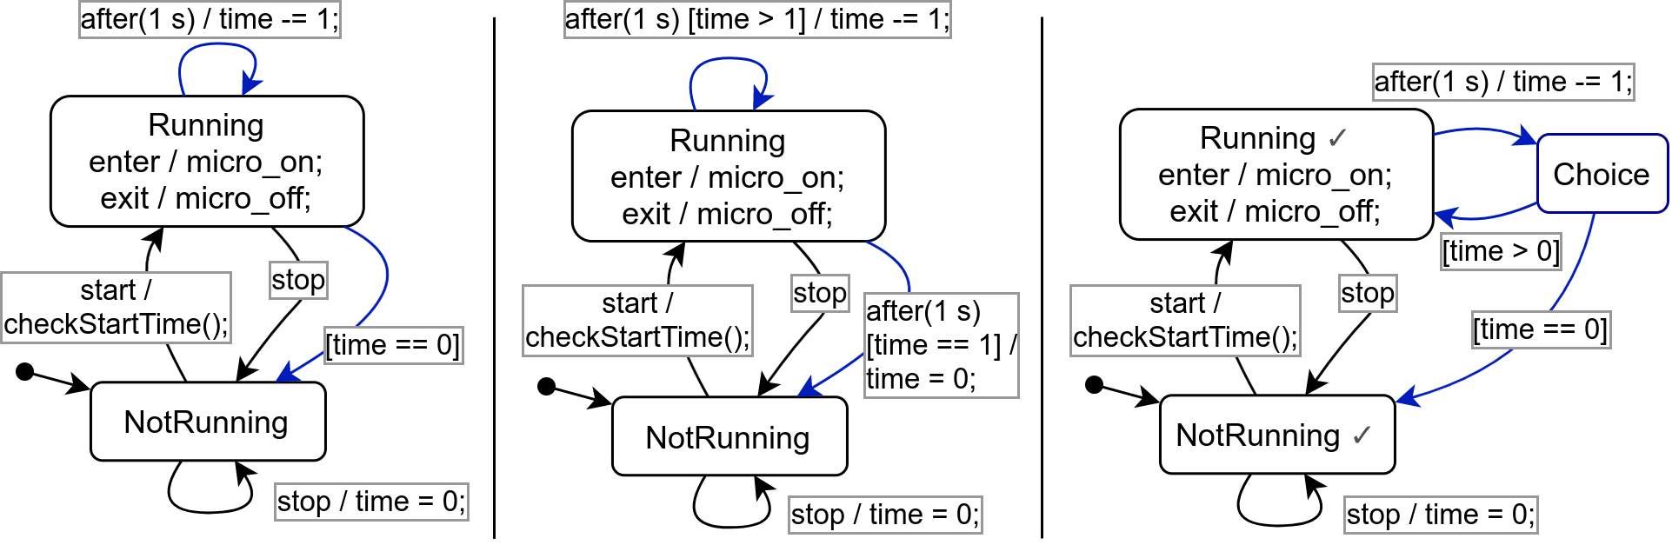
Example: Microwave w/ alternative semantics
original solution
We assumed being able to make the eventless transition [time == 0] after having processed our input events
single transition per step
A solution if, per input event, only a single step can be made
stable states
A solution if, per input event, steps can be made until a stable configuration is obtained

Slide 16
Example: Microwave w/ alternative semantics (2)
original example
Expressiveness: OK
Cognitive gap: Best
Performance: Good (we unnecessarily check
[time == 0] right after starting the microwave
single transition per step
Expressiveness: OK
Cognitive gap: Bad
Performance: Bad (have to schedule 2 timers)
stable states
Expressiveness: OK
Cognitive gap: Good
Performance: Best (only check [time == 0] when necessary)

Slide 17
Example: Microwave semantics (3)
Suppose we are in state NotRunning and we simultaneously receive input events start and door_opened.
⇒ Clearly should make the transition to DoorOpen, not starting the microwave!
Would be very difficult to express this behavior in a semantics that chooses “inner” transitions.
⇒ Requirements demand priority of “outer” transitions

Slide 18
How to describe semantic variation?
Big-Step Modeling Languages (BSML) is a family of languages (incl. statechart variants)
  mapped onto a common syntax
  semantics described in a feature diagram + small set of constraints
Esmaeilsabzali, Shahram, et al. "Deconstructing the semantics of big-step modelling languages." Requirements Engineering 15.2 (2010): 235-265.

Slide 19
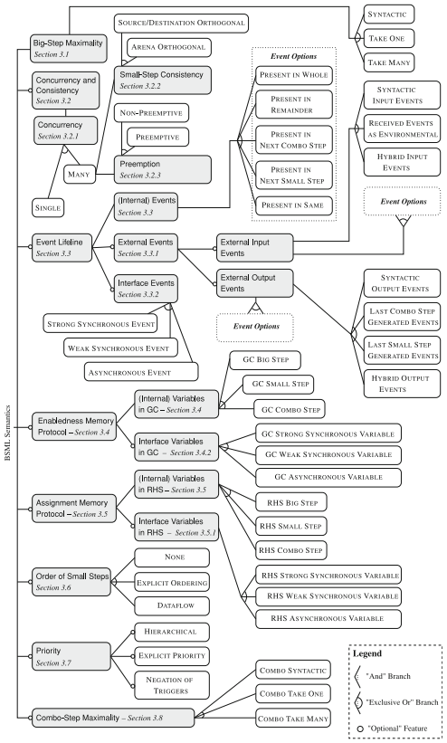
BSML’s semantics feature diagram
Top level: 8 semantic aspects, mostly independent
Modeled this diagram + set of constraints (not shown) in Clafer, instance count is combinatorial explosion
Manually estimated instance count at between 111 and 145 million combinations
Can we prune this space by only considering semantic options that apply to statecharts and are meaningful?
https://www.clafer.org/

Slide 20
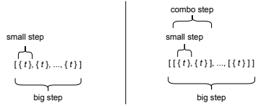
BSML’s fundamental semantics
The execution of a BSML is always a sequence of big-steps
A big step is either
  a sequence of small-steps
  a sequence of combo-steps, which in turn is a sequence of small-steps
A small step is a set of transitions concurrently taken
a BSML without combo-steps a BSML with combo-steps

Slide 21
Examples of semantic aspects
Big-Step Maximality: “under what circumstances can transitions be taken together in a big-step?”
  e.g. “only if they are orthogonal to each other”
  e.g. “no restriction”
Combo-Step Maximality: “under what circumstances can transitions be taken together in a combo-step?”
  e.g. “only if they are orthogonal to each other”
  e.g. “no restriction”
Input Event Lifeline: “for how long does an input event remain present?”
  e.g. “within the first combo step”

Slide 22
Example: Applied to Microwave alternatives
original example
Big-Step Max.: Take Many
Combo-Step-Max.: Take One
Input Event Life: First Combo Step
single transition per step
Big-Step Max.: Take One
Input Event Life: Whole
stable states
Big-Step Max.: Syntactic
Input Event Life: Whole

Slide 23
Solution

Slide 24
Context: What is SCCD?
Modeling language combining
StateCharts and Class Diagrams
At the highest level, an SCCD model is a
class diagram
Behavior of every class’ instances modeled as a statechart
Class diagram adds dynamic structure
(statechart instances created / destroyed at runtime)

Slide 25
Original features of SCCD
Small set of semantic options (already based on BSML). Motivation:
  Reproduce semantics from existing tools (e.g. Statemate, Rhapsody)
  Possibly find new useful semantic combinations
SCCD models could be compiled to different target languages (Python, JavaScript)
  But due to absense of neutral action language, models were usually not portable

Slide 26
My contribution (in a fork of SCCD)
extension of semantic options
added action language
  making models portable
  allowing us to implement Memory Protocol semantic options (from BSML)
interpreter instead of compiler:
  closer to input model than generated code
  (easier to understand what’s going on)
  can still add code generation later on
improved architecture (next slide...)

Slide 27
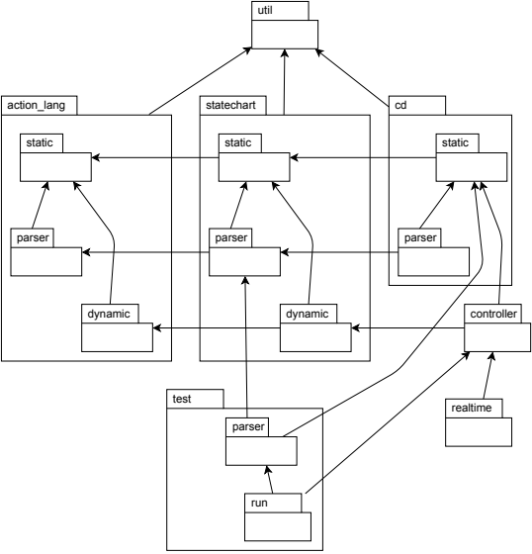
SCCD Architecture
3 languages:
  SCCD language
  statechart language
  action language
Action language / statechart language can be used independently of SCCD language

Slide 28
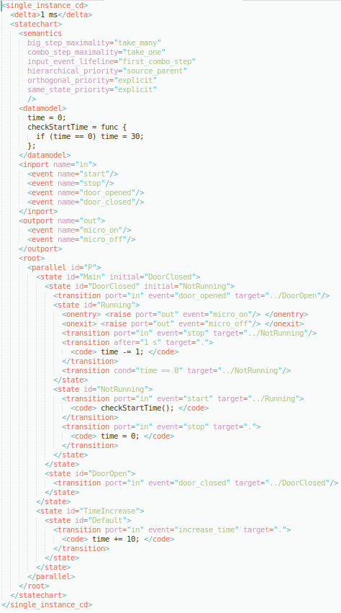
Example SCCD model: Microwave
- Class diagram with only a single statechart
- Statechart model
- Semantic options part of to statechart model
- Action language snippets
- State tree concrete textual syntax loosely based on SCXML
- Input and output events explicitly declared

Slide 29
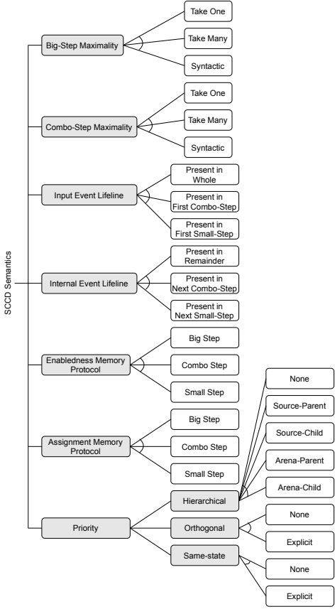
SCCD’s semantic options
Not supported:
  Event lifeline: Present in Whole/Same (non-causal)
  Order of Small-Steps: Dataflow (complex)
  Concurrency (an experimental implementation exists, but usually better to have an (explicit) ordering between transitions)
1944 “raw” (executable) variants in total (not including Arena-priority options, and using Explicit for Same State and Orthogonal Priority)
312 “meaningful” variants, semantically unique (next slide...)

Slide 30
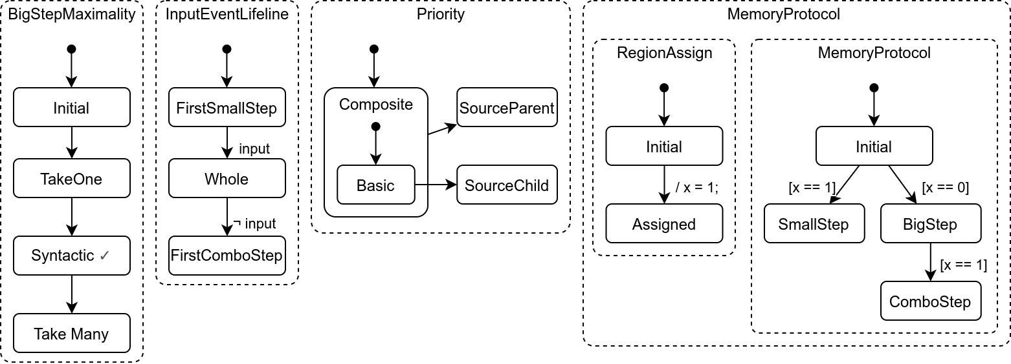
How to find semantically unique variants?
1. Build a statechart that behaves differently for every semantic combination
2. For every semantic combination, run 1 big step, check if statechart’s configuration matches semantic configuration
Regions not shown (too complex): InternalEventLifeline, ComboStepMaximality
Model included in SCCD project (‘examples’ dir)

Slide 31
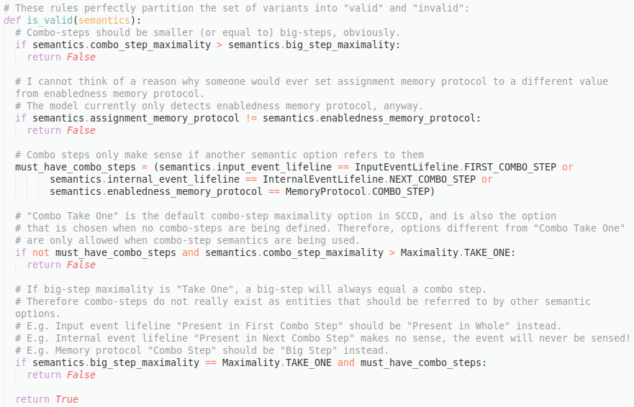
SCCD’s semantically unique variants
Of the 1944 combinations, 312 could be correctly inferred
Constructed simple rules partitioning the set of 1944 into “correct” (312) and “incorrect” (1632)
These rules could be considered SCCD’s constraints on valid semantic combinations

Slide 32
Demo
original example
(SCCD’s default semantics)
Big-Step Max.: Take Many
Combo-Step-Max.: Take One
Input Event Life: First Combo Step
single transition per step
Big-Step Max.: Take One
Input Event Life: Whole
stable states
Big-Step Max.: Syntactic
Input Event Life: Whole

Slide 33
SCCD’s deviations from BSML
Always-on “fairness” (orthogonal regions take turns in executing transitions)
Can only mark a state as “stable”, not “combo stable”
  => States syntactically marked as “stable” are stable wrt. “Syntactic” options for both Big-Step Maximality and Combo-Step Maximality
Order of small-steps considered a priority option (next slide...)

Slide 34
Priority implementation
Individual priority options generate partial orderings between transitions
The partial orderings of individual options are “summed together” into a directed graph:
  vertices are transitions
  edges are “has higher priority than” relations
From this graph, a total ordering is constructed using an algorithm (next slide)

Slide 35
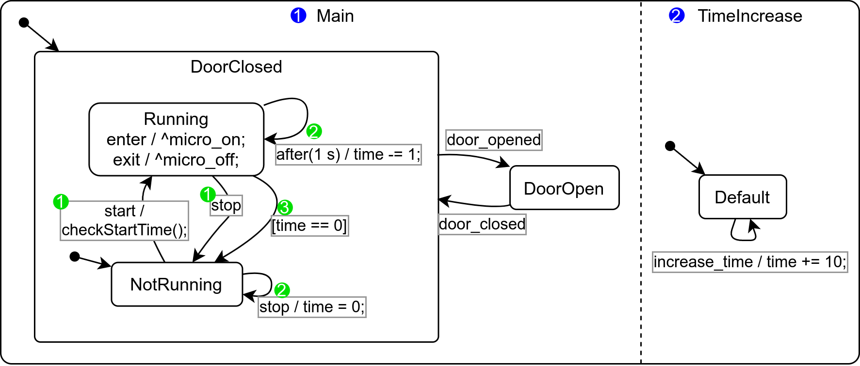
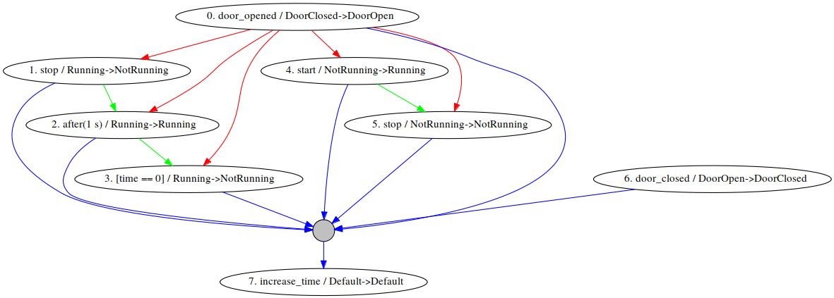
Priority example: Microwave
priorities:
same source: Explicit
hierarchical: Source-Parent
orthogonal: Explicit
graph generated by tool included in SCCD

Slide 36
Priority example: Microwave
priorities:
same source: Explicit
hierarchical: Source-Parent
orthogonal: Explicit
1. select highest-priority transitions
total ordering = []
graph generated by tool included in SCCD

Slide 37
Priority example: Microwave
priorities:
same source: Explicit
hierarchical: Source-Parent
orthogonal: Explicit
1. select highest-priority transitions
2. assure that they cannot be enabled simultaneously (otherwise, ERROR)
total ordering = []
graph generated by tool included in SCCD

Slide 38
Priority example: Microwave
priorities:
same source: Explicit
hierarchical: Source-Parent
orthogonal: Explicit
1. select highest-priority transitions
2. assure that they cannot be enabled simultaneously (otherwise, ERROR)
3. add them to the total ordering, in any order (non-deterministically)
total ordering = [0, 6]
graph generated by tool included in SCCD

Slide 39
Priority example: Microwave
priorities:
same source: Explicit
hierarchical: Source-Parent
orthogonal: Explicit
4. remove them from the graph
total ordering = [0, 6]
graph generated by tool included in SCCD

Slide 40
Priority example: Microwave
priorities:
same source: Explicit
hierarchical: Source-Parent
orthogonal: Explicit
4. remove them from the graph
5. repeat until graph is empty
total ordering = [0, 6]
graph generated by tool included in SCCD

Slide 41
Priority example: Microwave
priorities:
same source: Explicit
hierarchical: Source-Parent
orthogonal: Explicit
total ordering = [0, 6]
graph generated by tool included in SCCD

Slide 42
Priority example: Microwave
priorities:
same source: Explicit
hierarchical: Source-Parent
orthogonal: Explicit
total ordering = [0, 6, 4, 1]
graph generated by tool included in SCCD

Slide 43
Priority example: Microwave
priorities:
same source: Explicit
hierarchical: Source-Parent
orthogonal: Explicit
total ordering = [0, 6, 4, 1]
graph generated by tool included in SCCD

Slide 44
Priority example: Microwave
priorities:
same source: Explicit
hierarchical: Source-Parent
orthogonal: Explicit
total ordering = [0, 6, 4, 1]
graph generated by tool included in SCCD

Slide 45
Priority example: Microwave
priorities:
same source: Explicit
hierarchical: Source-Parent
orthogonal: Explicit
total ordering = [0, 6, 4, 1, 2, 5]
graph generated by tool included in SCCD

Slide 46
Priority example: Microwave
priorities:
same source: Explicit
hierarchical: Source-Parent
orthogonal: Explicit
total ordering = [0, 6, 4, 1, 2, 5]
graph generated by tool included in SCCD

Slide 47
Priority example: Microwave
priorities:
same source: Explicit
hierarchical: Source-Parent
orthogonal: Explicit
total ordering = [0, 6, 4, 1, 2, 5]
graph generated by tool included in SCCD

Slide 48
Priority example: Microwave
priorities:
same source: Explicit
hierarchical: Source-Parent
orthogonal: Explicit
total ordering = [0, 6, 4, 1, 2, 5, 3]
graph generated by tool included in SCCD

Slide 49
Priority example: Microwave
priorities:
same source: Explicit
hierarchical: Source-Parent
orthogonal: Explicit
total ordering = [0, 6, 4, 1, 2, 5, 3]
graph generated by tool included in SCCD

Slide 50
Priority example: Microwave
priorities:
same source: Explicit
hierarchical: Source-Parent
orthogonal: Explicit
total ordering = [0, 6, 4, 1, 2, 5, 3, 7]
graph generated by tool included in SCCD

Slide 51
Stepping algorithm (as simple as possible)
Big-step executes combo-steps until an empty combo-step happens
Combo-step executes small-steps until an empty small-step happens
Small step attempts to generate a transition candidate, execute it, and concludes the small step. If no candidate, small-step is empty.
Candidate generation: from the total priority-ordering of transitions, always pick the first enabled one. Enabledness determined by:
  statechart configuration
  enabled events
  forbidden arenas (-> maximality semantics)
  statechart variables (guard conditions)
(various optimizations mentioned in thesis)

Slide 52
Comparison

Slide 53
Comparison: YAKINDU
YAKINDU is a very popular free, well-supported tool for statechart development
SCCD has more semantic options
Apart from semantic options, YAKINDU’s feature set is much richer than SCCD’s
Attempted to describe YAKINDU’s semantics as a BSML (next slide)

Slide 54
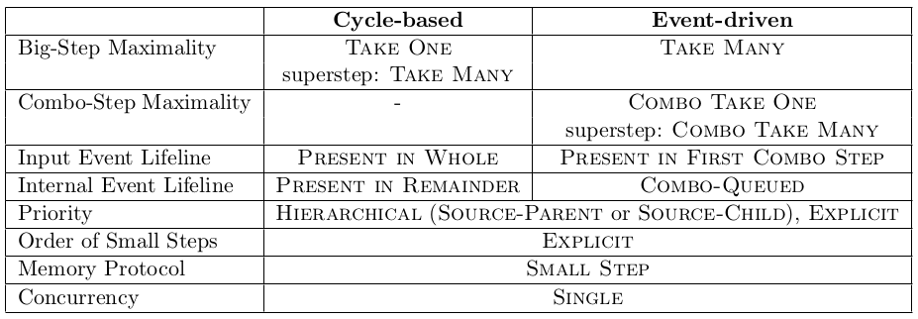
YAKINDU as a BSML
Options are:
- Cycle-based vs. event-driven
- Priority: inner vs. outer
- Superstep: yes / no
Problem: YAKINDU’s event-driven semantics queues internal events and executes one combo-step per internally raised event
Ad-hoc “invented” option:
Queue internally raised events, and execute a combo-step for each of them
Should BSML be extended?

Slide 55
Features of YAKINDU not present in SCCD
code generator
queuing internal events
graphical editor
more advanced (white box) testing framework
syntactical constructs:
  fork and join transitions
  choice-pseudo states

Slide 56
Conclusions

Slide 57
Conclusions
Semantics should be chosen on a per-model basis, wrt. requirements, keeping in mind expressiveness, cognitive gap, performance
Restrictive semantics (few transitions per big-step) still allow complex models, are easy to understand, and can be executed efficiently
  Default semantics of SCCD have worse performance due to combo-steps, but may have greater expressiveness and smaller cognitive gap

Slide 58
Future work
SCCD’s features:
  Restore class diagram functionality
  Code generation
  White-box testing
  ...

Slide 59
Questions?

