Slide 1
Studying Model Transformation Chains for Model Driven Engineering
Levi Lúcio, McGill University

Slide 2
The NECSIS Project
“NECSIS is focused on the advancement of a software methodology,
called Model-Driven Engineering (MDE), that can yield dramatic
improvements in software-developer productivity and product quality. “
Collaboration between:
McMaster University, University of Waterloo, University of British Columbia,
CRIM (Centre de recherche informatique de Montréal), McGill University,
Queen’s University, University of Toronto, University of Victoria and
General Motors of Canada, IBM Canada and Malina Software.

Slide 3
Presentation Structure
The Power Window case study
Work done with: Joachim Denil (Antwerp), Sadaf Mustafiz (McGill), Hans Vangheluwe (McGill / Antwep), Bart Meyers (Antwerp), Maris Jukss (McGill) and Raphael Mannadiar (McGill)
Intents of model transformations
Work done with: Moussa Amrani (Luxembourg), Jürgen Dingel (Queens), Leen Lambers (Potsdam / Hasso Plattner), Rick Salay (Toronto), Gehan Selim (Queens), Eugene Syriani (Alabama) and Manuel Wimmer (Malaga)

Slide 4
Presentation Structure
The Power Window case study
Work done with: Joachim Denil (Antwerp), Sadaf Mustafiz (McGill), Hans Vangheluwe (McGill / Antwep), Bart Meyers (Antwerp), Maris Jukss (McGill) and Raphael Mannadiar (McGill)
Intents of model transformations
Work done with: Moussa Amrani (Luxembourg), Jürgen Dingel (Queens), Leen Lambers (Potsdam / Hasso Plattner), Rick Salay (Toronto), Gehan Selim (Queens), Eugene Syriani (Alabama) and Manuel Wimmer (Malaga)

Slide 5
Case Study: MDE based development of control software for Automobiles’ Power Windows
L. Lúcio, J. Denil, and H. Vangheluwe, “An Overview of Model Transformations for a Simple Automotive
Power Window,” McGill University, Tech. Rep. SOCS-TR-2012.1, 2012.

Slide 6
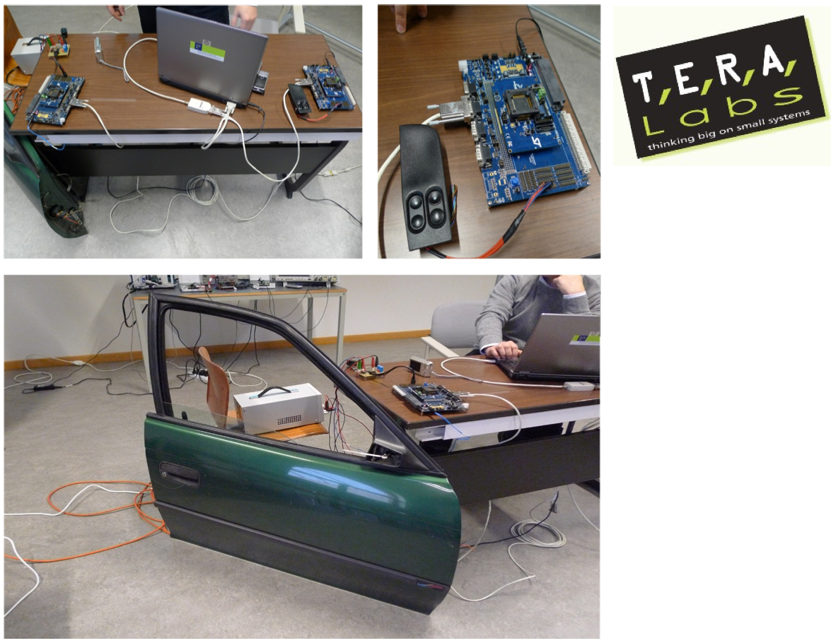

Slide 7
Transformation Chains
28 formalisms 50 transformations

Slide 8
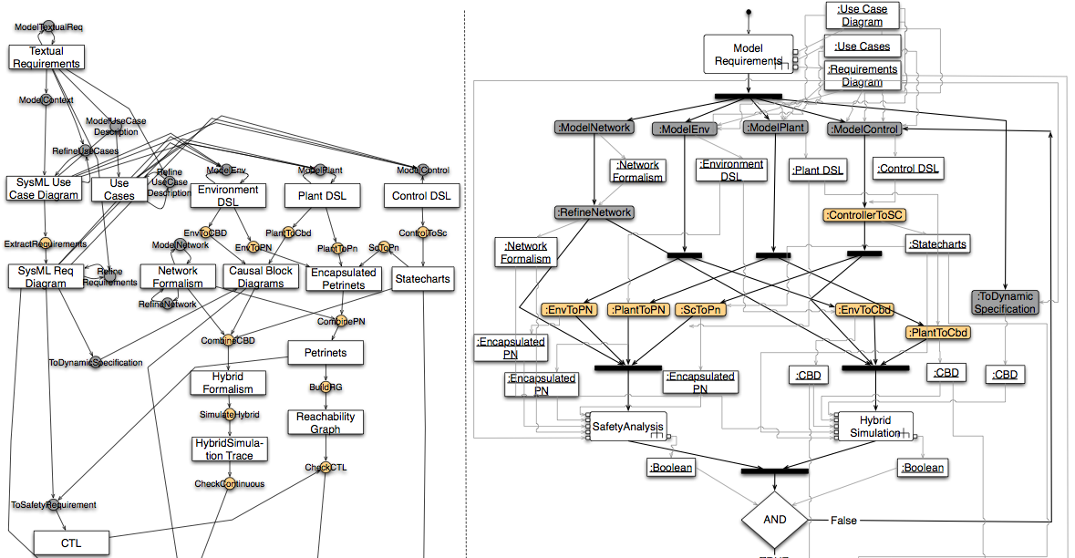
Transformation Chains
FTG (Formalism Transformation Graph)
+
PM (Process Model), UML 2.0 Activity Diagrams

Slide 9
Transformation Chains
Formalism
(Metamodel)
Model

Slide 10
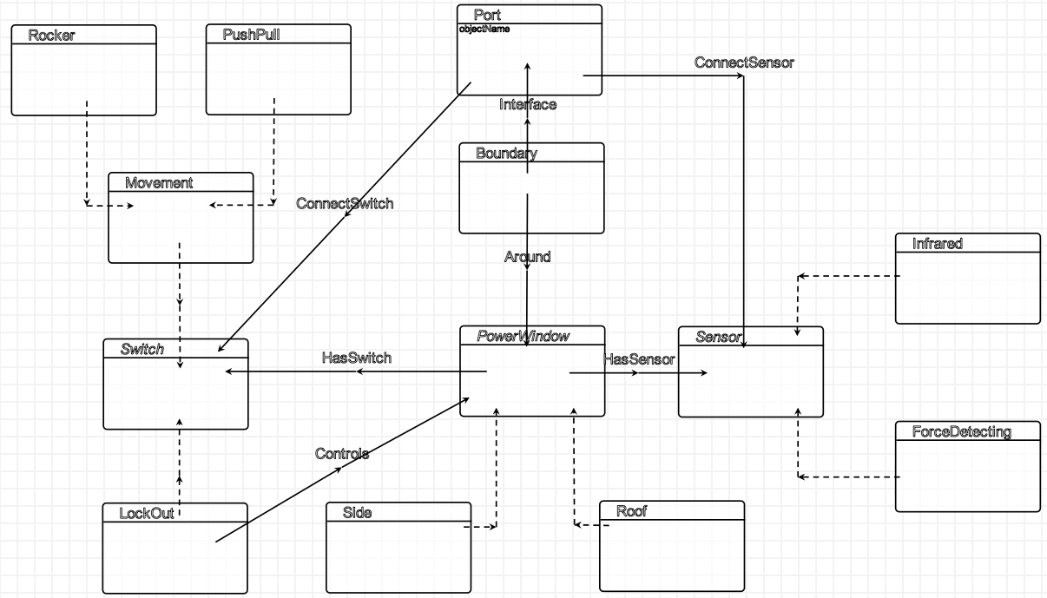
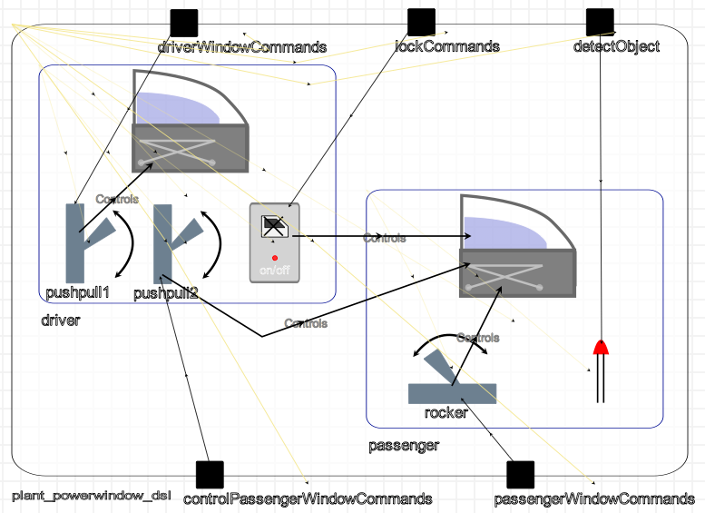
Transformation Chains
Plant DSL Model
Plant DSL Formalism

Slide 11
Transformation Chains
Transformation
Definition
Transformation
Execution
Notes:
3 niveaux / FTG / PM / Instance

Slide 12
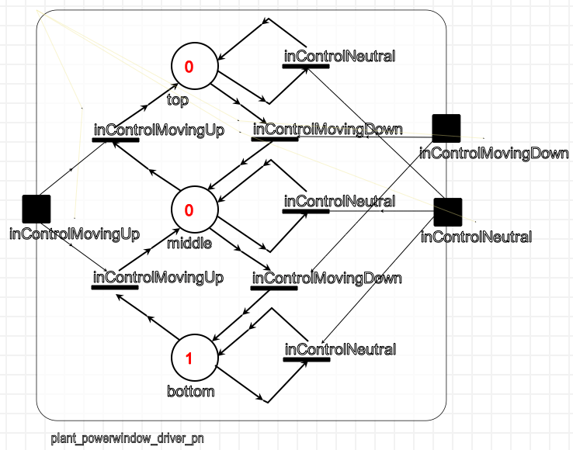
Transformation Chains
Transformation Execution
Transformation Definition (1 rule)

Slide 13
Transformation Chains

Slide 14
Transformation Chains

Slide 15
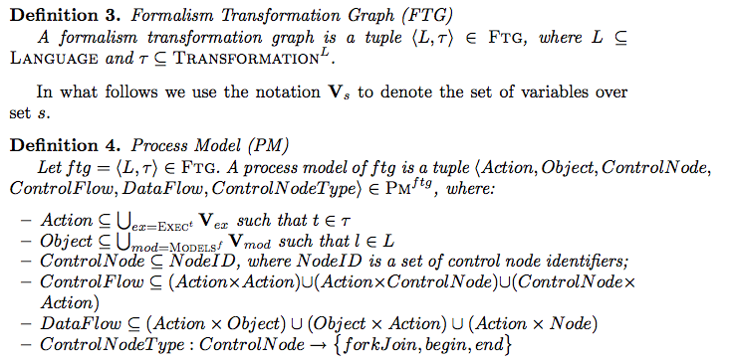
We have formalised the FTG+PM language…
Levi Lúcio, Joachim Denil, Sadaf Mustafiz and Hans Vangheluwe, "The Formalism Transformation Graph as a
Guide to Model Driven Engineering", School of Computer Science, McGill University, March 2012, SOCS-TR-2012.1

Slide 16
… and implemented it in AToMPM
?
AToMPM !
Sadaf Mustafiz, Joachim Denil, Levi Lúcio, Hans Vangheluwe, “The FTG+PM Framework for
Multi-Paradigm Modelling: An Automotive Case Study” Accepted at MPM’2012@MoDELS

Slide 17
Advantages of having an explicit representation of the MDE process
Repository of formalisms
Repository of transformations
Automation
Reuse
Mining of higher order transformation chain data becomes possible…
… among which properties of model transformations and their chains.

Slide 18
Presentation Structure
The Power Window case study
Work done with: Joachim Denil (Antwerp), Sadaf Mustafiz (McGill), Hans Vangheluwe (McGill / Antwep), Bart Meyers (Antwerp), Maris Jukss (McGill) and Raphael Mannadiar (McGill)
Intents of model transformations
Work done with: Moussa Amrani (Luxembourg), Jürgen Dingel (Queens), Leen Lambers (Potsdam / Hasso Plattner), Rick Salay (Toronto), Gehan Selim (Queens), Eugene Syriani (Alabama) and Manuel Wimmer (Malaga)

Slide 19
Verification of Model Transformations
Transformation
Definition What is a transformation?
Language How to express a transformation?
Classification How to categorise transformations?
Language – Related Property
Transformation – Related Property
Property (kind)
Type I: Transformation Independent / Input Independent
Type II: Transformation Dependent / Input Independent
Type II: Transformation Dependent / Input Dependent
Formal Verification (Fv) Technique
Notes:
We propose to follow a tridimensional approach that consists of the following dimensions:
How and for which purpose the transformation is specified;
Which property kind is intended to be verified; and
Which verification technique is used to perform the check.
This approach allows to situate any contribution found in the literature by “projecting” it on each dimension to figure out how it is composed. This also provides a way for comparing existing approaches with precise criteria, as well as following the evolution of this research area. Furthermore, it also helps figuring out which kind of contribution is missing.

Slide 20
Verification of Model Transformations
Transformation
Impact of the transformation’s intention on the properties of interest
Impact of the transformation’s paradigm and form on the Fv technique used
Property (kind)
Formal Verification (Fv) Technique
M. Amrani, L. Lúcio, G. Selim, B. Combemale, J. Dingel, H. Vangheluwe, Y. Le Traon, and J. R. Cordy,
“A Tridimensional Approach for Studying the Formal Verification of Model Transformations,” in VOLT’2012@ICST
Notes:
We propose to follow a tridimensional approach that consists of the following dimensions:
How and for which purpose the transformation is specified;
Which property kind is intended to be verified; and
Which verification technique is used to perform the check.
This approach allows to situate any contribution found in the literature by “projecting” it on each dimension to figure out how it is composed. This also provides a way for comparing existing approaches with precise criteria, as well as following the evolution of this research area. Furthermore, it also helps figuring out which kind of contribution is missing.

Slide 21
Intents of Model Transformations
“A model transformation is an automated manipulation of models
according to a specific intent.“
E. Syriani, “A Multi-Paradigm Foundation for Model Transformation Language Engineering,”
Ph.D. Thesis, McGill University, 2011
Working Definition: A model transformation intent is a description of the
goal behind the model transformation and the reason for using it.
Moussa Amrani, Jürgen Dingel, Leen Lambers, Levi Lúcio, Rick Salay, Gehan Selim, Eugene Syriani and Manuel Wimmer,
“A Tridimensional Approach for Studying the Formal Verification of Model Transformations,” in AMT’2012@MoDELS

Slide 22
Intent Catalog
Intent | Description
Refinement | Refinement produces a lower level specification (e.g., a platform-specific model) from a higher level specification (e.g., a platform-independent model). A model m1 refines another model m2 if m1 can answer all questions that m2 can answer. For example, a non-deterministic finite state automaton (NFA) can be refined into a deterministic finite state automaton (DFA).
Abstraction | Abstraction is the inverse of refinement: if m1 refines m2 then m2 is an abstraction of m1. For example, an NFA is an abstraction of a DFA.
Synthesis | A model is synthesized into a well-defined language format that can be stored, such as in serialization. Model-to-code generation is the case where the target language is source code in a programming language. E.g., Java code can be synthesized from a UML class diagram model.
Translational Semantics | The semantics of a language can be defined in terms of another formalism. In this case, the semantic mapping function of the original language is defined by a model transformation that translates any of its instances to a valid instance of the reference formalism with well-defined semantics. For example, the meaning of a Causal Block Diagram is given by mapping it onto an Ordinary Differential Equation.
Analysis | A model transformation can be used to map a modeling language to a formalism that can be analysed more appropriately than the original language. The target language is typically a formal language with known analysis techniques. For example, a Petri net model is transformed into a reachability graph on which liveness properties can be evaluated.

Slide 23
Intent Catalog
Simulation | A simulation is a model transformation that updates the state of the system modeled. A simulation defines the operational semantics of the modeling language. For example, a model transformation can simulate a Petri net model and produces a trace of the transition firing.
Refactoring | Model refactoring is a restructuring that changes the internal structure of the model to improve certain quality characteristics without changing its observable behavior.
Composition | Model composition integrates models that have been produced in isolation into a compound model. Typically, each isolated model represents a concern which may overlap. On the one hand, model merging creates a new model such that every element from each model is present exactly once in the merged model. On the other hand, model weaving creates correspondence links between overlapping entities.
… | …
T. Mens, K. Czarnecki, and P. Van Gorp, “A Taxonomy Of Model Transformation,”
ENTCS, vol. 152, pp. 125–142, 2006.
K. Czarnecki and S. Helsen, “Feature-Based Survey of Model Transformation Approaches,”
IBM Systems J., vol. 45(3), pp. 621–645, 2006
M. Tisi, F. Jouault, P. Fraternali, S. Ceri, and J. Bézivin, “On the Use of Higher-Order Model Transformations,” in ECMDA-FA, 2009, pp. 18–33

Slide 24
Formalising Intent
True iff it is possible for an endogenous transformation to have this intent
A property that a transformation must have in order to have this intent
True iff it is possible for an exogeneous transformation to have this intent
A description of when to use a transformation with this intent
i.e., what problems can it be used to solve?
An informal description of the underlying goal of the intent
The conditions that must hold before this intent applies
A transformation property that is relevant for this intent.
Another intent that is often associated with this intent
Examples of transformations that have this intent
The name used to identify the intent

Slide 25
The Analysis intent
T. Kühne, G. Mezei, E. Syriani, H. Vangheluwe, and M. Wimmer, “Systematic Transformation Development,” ECEASST, vol. 21, 2009
J. de Lara and G. Taentzer, “Automated Model Transformation and its Validation Using AToM3 and AGG,” in Diagrams, 2004, pp. 182–198
B. König and V. Kozioura, “Augur 2–A New Version of a Tool for the Analysis of Graph Transformation Systems,” Electronic Notes in Theoretical Computer Science (ENTCS), vol. 211, pp. 201–210, 2008
D. Varro , S. Varro-Gyapay, H. Ehrig, U. Prange, and G. Taentzer, “Termination Analysis of Model Transformations by Petri Nets,” Int. Conference on Graph Transformations, pp. 260–274, 2006
A. Narayanan and G. Karsai, “Verifying Model Transformations by Structural Correspondence,” ECEASST, vol. 10, 2008
A. Narayanan and G. Karsai, “Towards Verifying Model Transformations,” ENTCS, vol. 211, pp. 191–200, 2008
J. Rivera, E. Guerra, J. de Lara, and A. Vallecillo, “Analyzing Rule- Based Behavioral Semantics of Visual Modeling Languages with Maude,” Software Language Engineering, pp. 54–73, 2009
B. Schätz, F. Hölzl, and T. Lundkvist, “Design-Space Exploration Through Constraint-Based Model-Transformation,” in Engineering of Computer Based Systems Workshop (ECBS), 2010, pp. 173–182

Slide 26
The Analysis intent: attributes
Name | Analysis

Slide 27
The Analysis intent: attributes
Name | Analysis
Description | To indirectly analyse a property of the input model by running the analysis algorithm on the transformation’s output model

Slide 28
The Analysis intent: attributes
Name | Analysis
Description | To indirectly analyse a property of the input model by running the analysis algorithm on the transformation’s output model
UseContext | Need to analyse models that are not analysable in the transformation’s input language, or are more efficiently analysable in the transformation’s output language

Slide 29
The Analysis intent: attributes
Name | Analysis
Description | To indirectly analyse a property of the input model by running the analysis algorithm on the transformation’s output model
UseContext | Need to analyse models that are not analysable in the transformation’s input language, or are more efficiently analysable in the transformation’s output language
Example | Transforming graph rewriting systems into Petri Nets to analyse them for termination (e.g. Varró et al, ICGT 2006)

Slide 30
The Analysis intent: attributes
Name | Analysis
Description | To indirectly analyse a property of the input model by running the analysis algorithm on the transformation’s output model
UseContext | Need to analyse models that are not analysable in the transformation’s input language, or are more efficiently analysable in the transformation’s output language
Example | Transforming graph rewriting systems into Petri Nets to analyse them for termination (e.g. Varró et al, ICGT 2006)
canBeExogenous | True

Slide 31
The Analysis intent: attributes
Name | Analysis
Description | To indirectly analyse a property of the input model by running the analysis algorithm on the transformation’s output model
UseContext | Need to analyse models that are not analysable in the transformation’s input language, or are more efficiently analysable in the transformation’s output language
Example | Transforming graph rewriting systems into Petri Nets to analyse them for termination (e.g. Varró et al, ICGT 2006)
canBeExogenous | True
canBeEndogenous | True (if transforming to a profile of the original language)

Slide 32
The Analysis intent: attributes
Name | Analysis
Description | To indirectly analyse a property of the input model by running the analysis algorithm on the transformation’s output model
UseContext | Need to analyse models that are not analysable in the transformation’s input language, or are more efficiently analysable in the transformation’s output language
Example | Transforming graph rewriting systems into Petri Nets to analyse them for termination (e.g. Varró et al, ICGT 2006)
canBeExogenous | True
canBeEndogenous | True (if transforming to a profile of the original language)
Preconditions | Access to intended semantics, The property of interest (that should be analysed) is defined A verification method exists for analyzing the property of interest on the target language There exists a method to translate the property of interest onto the transformation’s output language (if the transformation is exogenous)

Slide 33
The Analysis intent: associations
mandatoryProperty | Termination Type correctness Preservation of the property of interest (specialises Property preservation) Analysis result can be mapped back onto the input model (specialises Traceability)

Slide 34
The Analysis intent: associations
mandatoryProperty | Termination Type correctness Preservation of the property of interest (specialises Property preservation) Analysis result can be mapped back onto the input model (specialises Traceability)
optionalProperty | Readability of the transformation’s output for debugging purposes Semantics of the input language is formally defined (specialises Mathematical underpinning)

Slide 35
The Analysis intent: associations
mandatoryProperty | Termination Type correctness Preservation of the property of interest (specialises Property preservation) Analysis result can be mapped back onto the input model (specialises Traceability)
optionalProperty | Readability of the transformation’s output for debugging purposes Semantics of the input language is formally defined (specialises Mathematical underpinning)
relatedIntent | Translational Semantics, Simulation

Slide 36
The Analysis Intent in the Power Window transformation chain

Slide 37
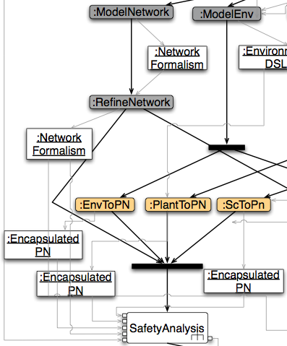
The Analysis Intent in the Power Window transformation chain
Build a Petri net representation of a
specialised model of the passenger’s
interactions with the power window.
Allows checking power window security
requirements.
Satisfies preconditions 1,2,3, missing 4
“There exists a method to translate the property of
Interest onto the transformation’s output language”
Satisfies properties 1,2,3, missing 4
“Analysis result can be mapped back onto the input model”
Satisfies no optional properties
The intent is analysis!

Slide 38
The Analysis Intent in the Power Window transformation chain
Build a Petri net representation of a specialised model of the power window physical configuration. Allows checking power window security requirements.
Satisfies preconditions 1,2,3, missing 4
“There exists a method to translate the property of
Interest onto the transformation’s output language”
Satisfies properties 1,2,3, missing 4
“Analysis result can be mapped back onto the input model”
Satisfies no optional properties
The intent is analysis!

Slide 39
The Analysis Intent in the Power Window transformation chain
Build a Petri net representation of a specialised model of the power window control software. Allows checking power window security requirements.
Satisfies preconditions 1,2,3, missing 4
“There exists a method to translate the property of
Interest onto the transformation’s output language”
Satisfies properties 1,2,3, missing 4
“Analysis result can be mapped back onto the input model”
Satisfies no optional properties
The intent is analysis!

Slide 40
The Analysis Intent in the Power Window transformation chain

Slide 41
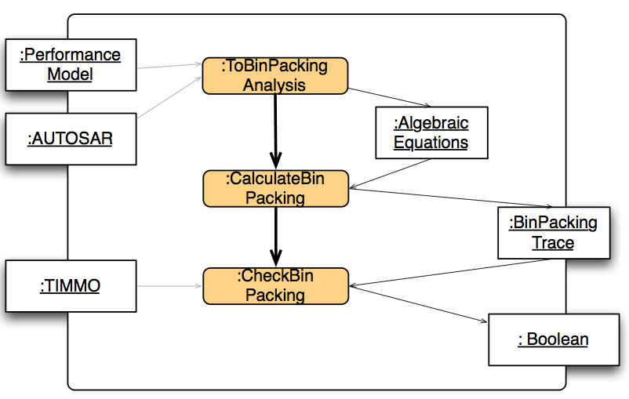
The Analysis Intent in the Power Window transformation chain
Build an equational algebraic representation of the dynamic behavior of the involved hardware components from an AUTOSAR specification. Allows checking processor load distribution.
Satisfies preconditions 1,2,3,4
Satisfies properties 1,2,3,4
Satisfies optional properties 1
The intent is analysis!

Slide 42
The Analysis Intent in the Power Window transformation chain

Slide 43
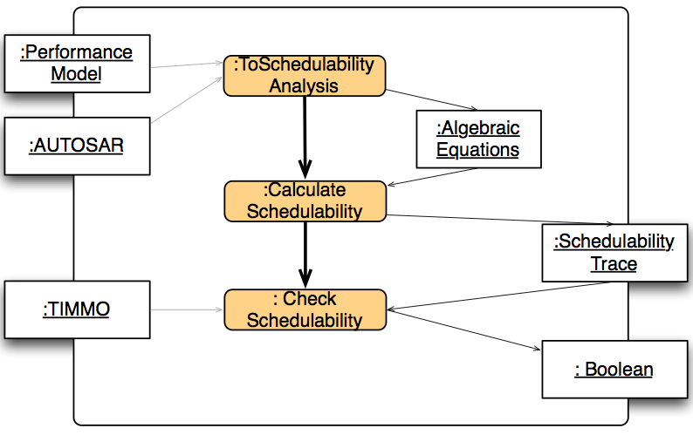
The Analysis Intent in the Power Window transformation chain
Build an equational algebraic representation of the dynamic behavior of the involved hardware and software components from an AUTOSAR specification. Allows checking software response times.
Satisfies preconditions 1,2,3,4
Satisfies properties 1,2,3,4
Satisfies optional properties 1
The intent is analysis!

Slide 44
The Analysis Intent in the Power Window transformation chain

Slide 45
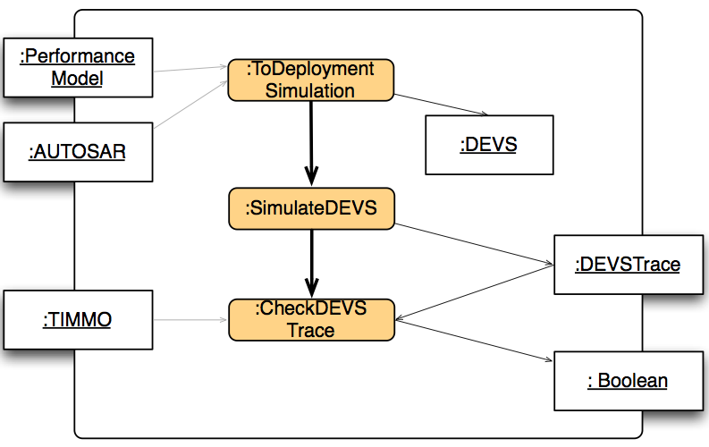
The Analysis Intent in the Power Window transformation chain
Build a DEVS representation of the deployment solution to check for latency times, deadlocks and lost messages.
Satisfies preconditions 1,2,4 (missing 3)
“A verification method exists for analyzing the property
of interest on the target language”
Satisfies properties 1,2,3,4
Satisfies optional properties 1
The intent is NOT analysis!

Slide 46
Other intentions: Query

Slide 47
Other intentions: Synthesis

Slide 48
Other intentions: Refinement

Slide 49
Other intentions: Abstraction

Slide 50
Other intentions: Translational Semantics

Slide 51
Other intentions: Simulation

Slide 52
Other intentions: Composition

Slide 53
Future Work
Describe other intents according to our metamodel
Complete the power window case study with transformation intention information
Understand the usefulness of our catalog:
Are intents “requirement patterns” for transformations?
Can we go one step further and mathematically formalise intents?
Reasoning over transformation chains

Slide 54
Future Work
Transformation
?
Impact of the transformation’s intention on the properties of interest
Impact of the transformation’s paradigm and form on the Fv technique used
Property (kind)
Formal Verification (Fv) Technique
Notes:
We propose to follow a tridimensional approach that consists of the following dimensions:
How and for which purpose the transformation is specified;
Which property kind is intended to be verified; and
Which verification technique is used to perform the check.
This approach allows to situate any contribution found in the literature by “projecting” it on each dimension to figure out how it is composed. This also provides a way for comparing existing approaches with precise criteria, as well as following the evolution of this research area. Furthermore, it also helps figuring out which kind of contribution is missing.

