Slide 1
A Technique for Automatic Validation of Model Transformations
Levi Lúcio and Bruno Barroca
Universidade Nova de Lisboa

Slide 2
Presentation Overview
Context: DSLTrans transformation language
How do we verify a transformation?
Building a proof
Results and future work
Notes:
Transformations are at the center of MDD
We delegate a lot of computing power to transformations
Transformations need to be verified, by test or tranformations

Slide 3
Presentation Overview
Context: DSLTrans transformation language
How do we verify a transformation?
Building a proof
Results and future work

Slide 4
DSLTrans – Motivation
Started out as a visual transformation language for semantics by translation
Developed into a complete transformation language, with interesting properties

Slide 5
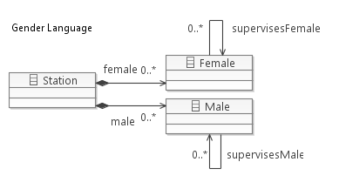
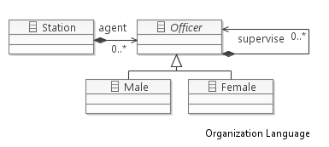
DSLTrans – Running Example
Source Metamodel
Target Metamodel
“… to flatten a chain of command (…) into two independent sets of male
and female officers. (…) command relations are kept…

Slide 6
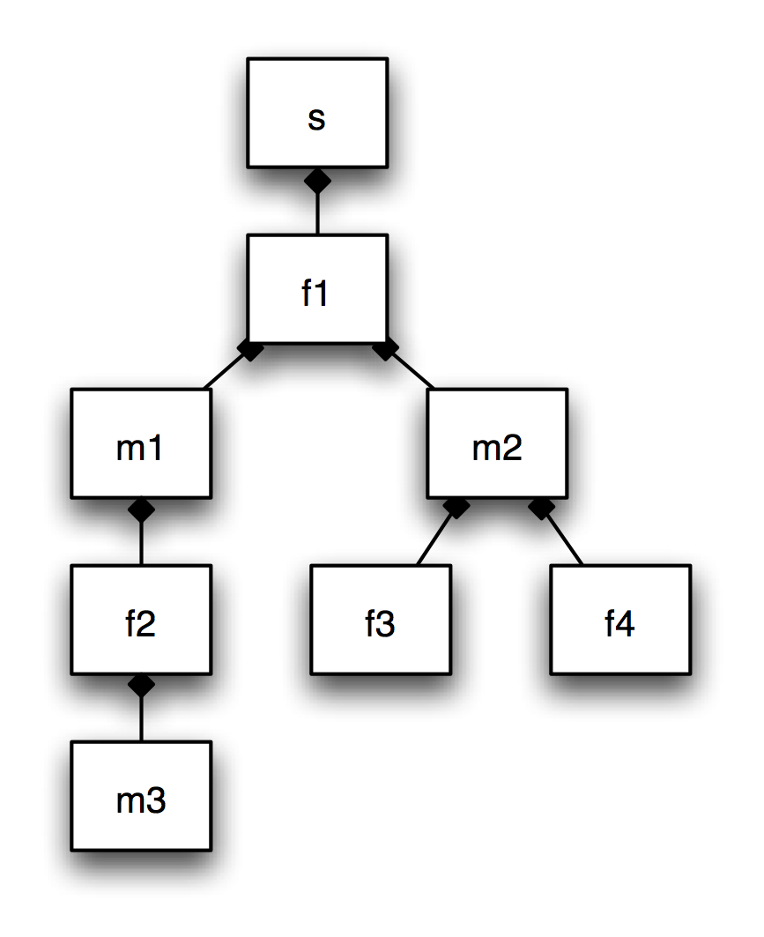
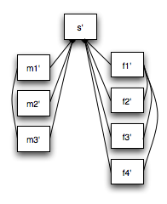
DSLTrans – Running Example
Source Metamodel
Target Metamodel

Slide 7
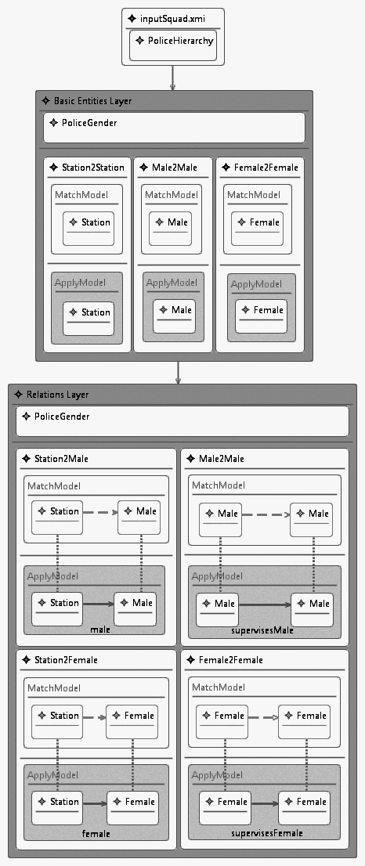
DSLTrans Transformations
Layer 1
A DSLTrans tranformation is defined
as a list of Layers, each Layer
holding a set of transformations
Layers are executed sequentially
Layer 2
The Input Model is immutable
(outplace transformation language)
Eclipse plugin at:
http://solar.di.fct.unl.pt/twiki/pub/BATICCCS/ReleaseFiles/dsltrans.october.2010.zip

Slide 8
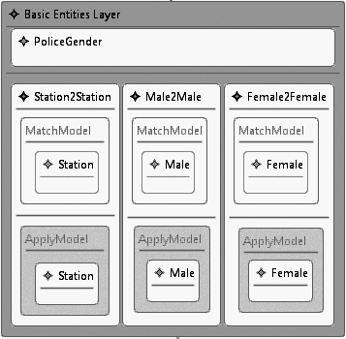
DSLTrans in Action – Layer 1
Match Models/Elements
Apply Models/Elements

Slide 9
DSLTrans in Action – Layer 1

Slide 10
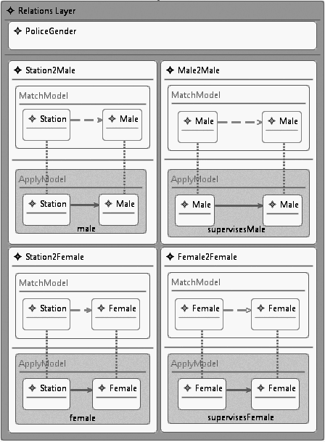
DSLTrans in Action – Layer 2

Slide 11
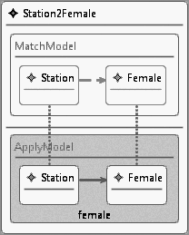
DSLTrans in Action – Layer 2
Match Model
Indirect Match Links
Match Elements
Backward Links
Apply Links
Apply Model
Apply Elements

Slide 12
DSLTrans in Action – Layer 2

Slide 13
DSLTrans in Action – Layer 2

Slide 14
DSLTrans in Action – Layer 2

Slide 15
DSLTrans in Action – Layer 2

Slide 16
DSLTrans’ Theory¹
DSLTrans is turing incomplete:
no loops or recursivity allowed
Set theoretical, graph based formalization
Termination:
Theorem: every model transformation terminates
Confluence:
Theorem: every model transformation is confluent
¹Barroca, Lucio, Amaral, Felix, Sousa “DSLTrans – A Turing Incomplete Transformation Language”.
Proceedings of SLE 2010

Slide 17
Presentation Overview
Context: DSLTrans transformation language
How do we verify a transformation?
Building a proof
Results and future work

Slide 18
Presentation Overview
Context: DSLTrans transformation language
How do we verify a transformation?
Building a proof
Results and future work

Slide 19
How do we verify a transformation?
What properties can we verify in DSLTrans transformations?
‘if a certain pattern of elements and their relations exists in the source model, then another pattern of elements and their relations necessarily exists in the produced target model’

Slide 20
How do we verify a transformation?
For all instances of a transformation… our contribution!
How?
Using exhaustive techniques (similar to model checking / theorem proving) for building the symbolic execution space of a transformation and proving the properties on that space.
Notes:
For example, if you would like to certify that a UML translation in Java is correct, you might want to certify that classes are transformed correctly, or certain corner cases, or certain combinations of UML elements

Slide 21
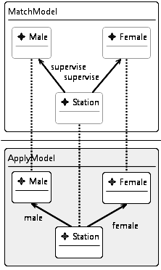
How do we verify a transformation?
‘Any model which includes a police station that has both a male and female chief officers will be transformed into a model where the male chief officer will exist in the male set and the female chief officer will exist in the female set’

Slide 22
Presentation Overview
Context: DSLTrans transformation language
How do we verify a transformation?
Building a proof
Results and future work

Slide 23
Presentation Overview
Context: DSLTrans transformation language
How do we verify a transformation?
Building a proof
Results and future work

Slide 24
Building the set of Symbolic Executions for a Transformation
1₁
2₁
3₁
1₂
2₂
3₂
4₂

Slide 25
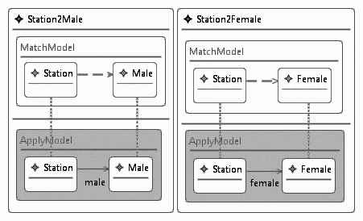
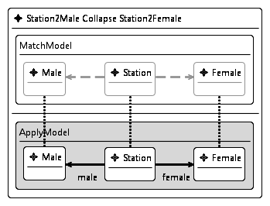
Building the set of Symbolic Executions for a Transformation
Because in DSLTrans two transformation rules may match the same model element,
we need more resolution in states to distinguish more symbolic executions…
Collapse

Slide 26
Building the set of Symbolic Executions for a Transformation
1₁
2₁
3₁
1₂
2₂
3₂
4₂

Slide 27
Proving Properties
True property
False property
Non Provable
Notes:
Counterexample

Slide 28
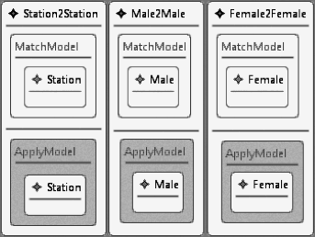
Proving Properties – True Property
‘For all paths belonging to the transformation’s state space, if the property’s match model
is found in a given state, then a subsequent state in that path is model of the property.’
?

Slide 29
Proving Properties – True Property
Collapse

Slide 30
Proving Properties – True Property
‘For all paths belonging to the transformation’s state space, if the property’s match model
is found in a given state, then a subsequent state in that path is model of the property.’
Match model
is found!
State is model of
the property!

Slide 31
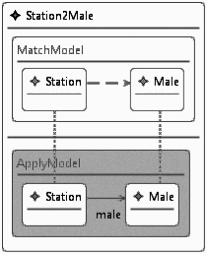
Proving Properties – False Property
‘There exists a path belonging to the transformation’s state space where the property’s match
model is found in a given state, but no subsequent state in that path is model of the property.’
Counterexample!
?
Match model is found!
Final state is not model
of the property!

Slide 32
Proving Properties – Non Provable
‘The match model of the property can never be found in any state of the construction
of the symbolic executions of the transformation.’
Can’t find the match model of the property in any state!

Slide 33
Presentation Overview
Context: DSLTrans transformation language
Intuition: what properties can we verify?
Building a proof
Results and future work

Slide 34
Presentation Overview
Context: DSLTrans transformation language
Intuition: what properties can we verify?
Building a proof
Results and future work

Slide 35
Theoretical Results
Set theoretical, graph based formalization
Finiteness (theorem)
The state space for any transformation is finite
Preliminary experimental validation
http://solar.di.fct.unl.pt/twiki/pub/BATICCCS/ReleaseFiles/transmc.zip

Slide 36
Related Work
The literature on verifying transformations is
preliminary and quite recent…
Rensink et al (2004)
Model Checking Graph Transformations: A Comparison of Two Approaches
Mens at al (2006)
“A taxonomy of model transformation”
Anastasakis at al (2007)
“Analysis of Model Transformations via Alloy”
Narayanan et al (2008)
“Verifying Model Transformations by Structural Correspondence”
Asztalos et al (2009)
”Towards Automated, Formal Verification of Model Transformations”
Notes:
Rensink: worries about systems that have graph rewriting semantics. Verifies safety properties.
Anastasakis: expresses transformation as a system in Alloy, shows all possible instances of a transformation. Can produce instance counterexamples for conditions over the target metamodel, but no traceability links
Narayanan: close to our approach, but verifies instance per instance (online method)
Asztalos: uses a logic based approach by producing assertions from a basic set of axioms about a transformation

Slide 37
Future Work
Validation of the verification technique – is the symbolic execution space complete?
Build a complete prototype for automatic proofs;
Evaluate the usefulness of our properties on larger case study transformations;
Can this verification approach be applied to other transformation languages?

