Slide 1
Operational Resilience Theory and Experimentation
Levi Lúcio

Slide 2
MOVERE Project
Model-Driven Validation and Verification of Resilient Software Systems
Team: Levi Lúcio, Jackin Zhang, Yasir Khan, Nicolas Guelfi
3 year Lux. FNR CORE funding + 2 AFR PhD.

Slide 3
Natural Evolving System
Birds want to be able to feed properly!

Slide 4
Natural Evolving System

Slide 5
Natural Evolving System

Slide 6
Natural Evolving System

Slide 7
Natural Evolving System

Slide 8
Natural Evolution Concepts
System
bird
Objective
be able to feed
Events
temperature change, location change,…
Evolution strategy: mutations
make feathers impermeable, grow stronger muscles,…
Satisfaction of the objective
population stability or increase

Slide 9
Resilient Evolving Process

Slide 10
Non-Resilient Evolving Process

Slide 11
Can we build (autonomous) Resilient Evolving Processes?
The context of fully autonomous resilient evolving processes can provide insights into automation of resilience in general;
Formalize the concepts related to evolution and resilience;
Applications will follow…

Slide 12
Natural Evolution Concepts (in the Computing World)
System: machine, computing model, program;
Objective: decidable property about the system;
Events: problems satisfying the objective;
Evolution strategy: operation mode change, structural change,…
Satisfaction of the objective: computable quantification of the property on a system.

Slide 13
Resilient Evolving Process in the Modeling World
{o1, o2, o3}
Objective
{o2, o3}
System
{o2}
Objective
System
Evolution Strategy
Events
Satisfaction of the Objective
Evolution Strategy
Events
Model Check {o1,o2,o3}
Model Check {o2,o3}
Model Check {o2}
{o1} is satisfied
{o2,o3} are not satisfied
{o3} is satisfied
{o2} is not satisfied
{o2} is satisfied
Satisfaction of the Objective

Slide 14
Main Research Problems
{o1, o2, o3}
{o2, o3}
Model Check {o1,o2,o3}
Model Check {o2,o3}
{o1} is satisfied
{o2,o3} are not satisfied
{o3} is satisfied
{o2} is not satisfied
How to preserve already achieved objectives?
How to achieve new objectives?

Slide 15
How to preserve already achieved objectives in Algebraic Petri Nets?
Objectives can be described by temporal properties about the semantics of APN;
Use particular types of transformations…
… such that the structure of net N (places + arcs + transitions) is preserved in net N+1;
Like this the properties about net N still make sense in net N+1;

Slide 16
We studied two kinds of properties
Safety “something always happens” (AG) Using High-Level Replacement Systems to Preserve Safety Properties in Place/Transition Net Transformations” J. Padberg, M. Gajewsky
Reachability something will eventually happen (EF) Our own results

Slide 17
Safety preservation
Property: “any token in place P3 is always inferior to 12”

Slide 18
Reachability Preservation
“Something will eventually happen”;
Everything is allowed except adding input arcs into transition and guards to transitions;
Kind of “opposite” to safety preservation;
Proof done by us, new result in APN.

Slide 19
Issues
Conservative approach to change, do not allow satisfying “less” properties;
Nets grow monotonically;
Other approaches possible, but much harder mathematically!

Slide 20
Main Research Problems
{o1, o2, o3}
{o2, o3}
Model Check {o1,o2,o3}
Model Check {o2,o3}
{o1} is satisfied
{o2,o3} are not satisfied
{o3} is satisfied
{o2} is not satisfied
How to achieve new objectives?

Slide 21
How to achieve new objectives in Algebraic Petri Nets?
Much more difficult…
Look at the counterexample data, at the part of the net impacted by the unsatisfied properties;
We are in the modeling world… simulate the evolution and find the best transformation set.

Slide 22
OK… but we want to apply this!
Experimentation: study the applicability of the conditions for property (safety/reachability) preservation in a real evolving system
Case study: Development of models with Access Control concerns

Slide 23
Incremental implementation of Access Control in Software Systems

Slide 24
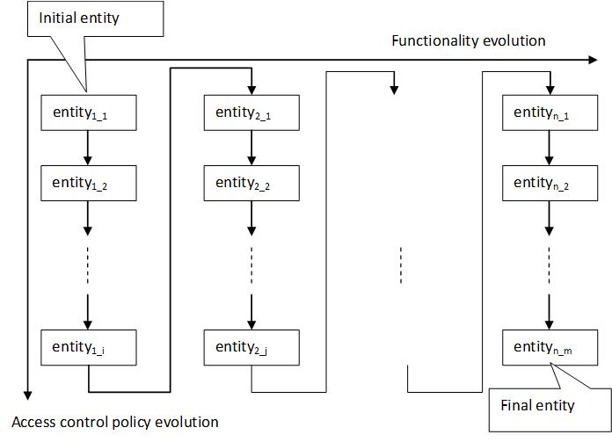
Co-evolution Framework
The first row: evolution by adding new functions and probable related access control policies.
The same column: sub-evolution without any new function, but satisfies more access control policies until the model holds all of them.

Slide 25
Future Work
Preservation of other temporal properties in Algebraic Petri Nets (theoretical/mathematical);
Finding evolution strategies using model checkers;
Bring the APN co-evolution of model and access control policies to the statechart world;
More case studies, more applications…

