Slide 1

19/10/2018

Slide 2
Valid deployment of Models-of-the-physics using Validity Frames
Bert Van Acker

Slide 3
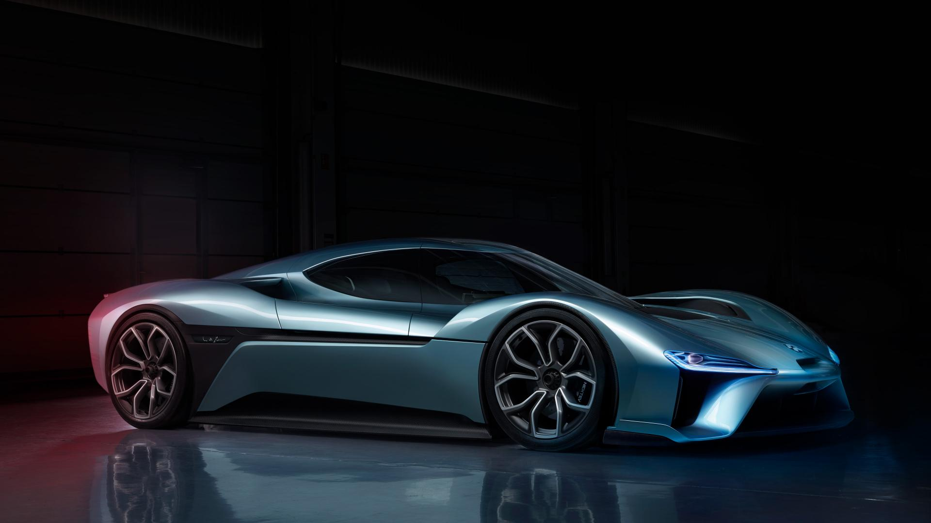
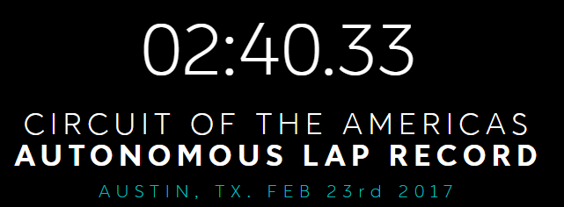

Why?(What is the need)
Pushing the boundaries of Cyber-physical systems
Notes:
Engineers are pushing the boundries of Cyber-physical systems. Nice example is the fastest electric car, performing the nurnurgring in 6:45.900 and going around the Circuit of Americas fully autonomous in 2:40.33
This seems an extreme example but propagates to current state-of-the art where the engineers try to reduce fuel-consumption, reduce vibrations,

Slide 4
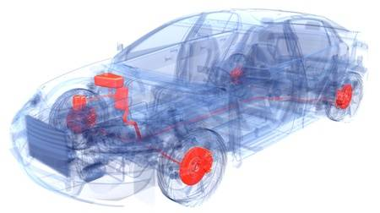
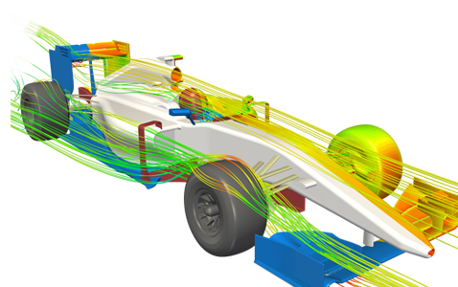
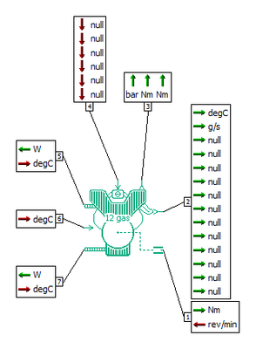
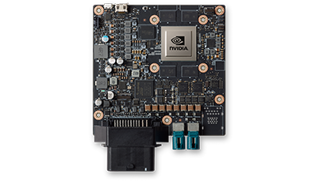
Why?(What is the need)
Embedded target
Notes:
In order to optimize the control of cyber-physical systems, more knowledge about the behavior of the system is needed. By modelling the physics, we have a high fidelity approximation of the system, or parts of the system and somehow we need to integrate this in our control algorithms, controlling or systems

Slide 5


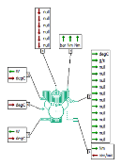
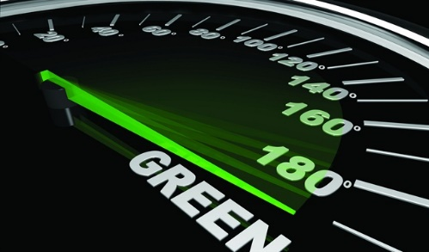
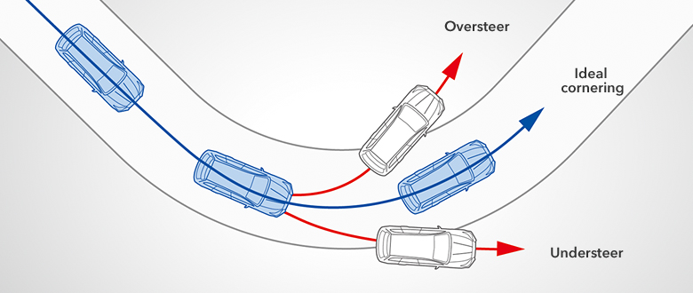

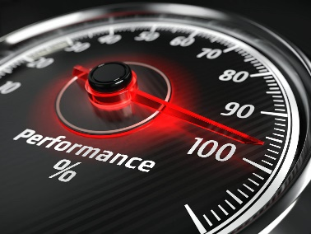
Why?(What is the need)
Utopia
Reality
Embedded target
Notes:
In order to optimize the control of cyber-physical systems, more knowledge about the behavior of the system is needed. By modelling the physics, we have a high fidelity approximation of the system, or parts of the system and somehow we need to integrate this in our control algorithms, controlling or systems

Slide 6
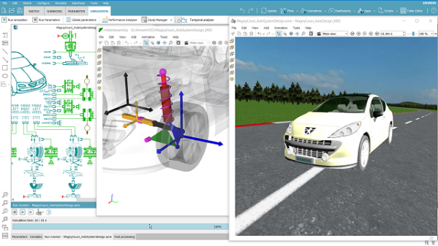
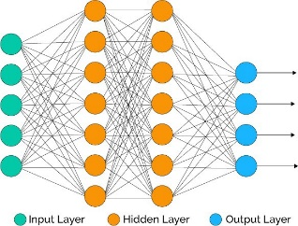
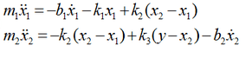
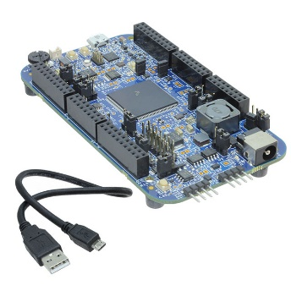
Why?(What is the need)
High-fidelity model
Utopia
Reductions/approximations
Reality
or
or
Or …
Constraint system
-> [MEMmin,MEMmax]
-> [COMPmin,COMPmax]
-> Hard real-time!
-> …
Notes:
In order to optimize the control of cyber-physical systems, more knowledge about the behavior of the system is needed. By modelling the physics, we have a high fidelity approximation of the system, or parts of the system and somehow we need to integrate this in our control algorithms, controlling or systems
Surrogat model!!

Slide 7
Why?(What is the need)
High-fidelity model
Utopia
Reductions/approximations
Reality
Discretization/fixed-pointing/…
Constraint system
-> [MEMmin,MEMmax]
-> [COMPmin,COMPmax]
-> Hard real-time!
-> …
Notes:
In order to optimize the control of cyber-physical systems, more knowledge about the behavior of the system is needed. By modelling the physics, we have a high fidelity approximation of the system, or parts of the system and somehow we need to integrate this in our control algorithms, controlling or systems

Slide 8
Why?(What is the need)
High-fidelity model
Properties?
Valid range?
Verify?
Utopia
Reductions/approximations
Reality
Discretization/fixed-pointing/…
Properties?
Valid range?
Verify?
Constraint system
-> [MEMmin,MEMmax]
-> [COMPmin,COMPmax]
-> Hard real-time!
-> …
Notes:
Neural network -> does not have a physical meaning of the high-fidelity plant!

Slide 9
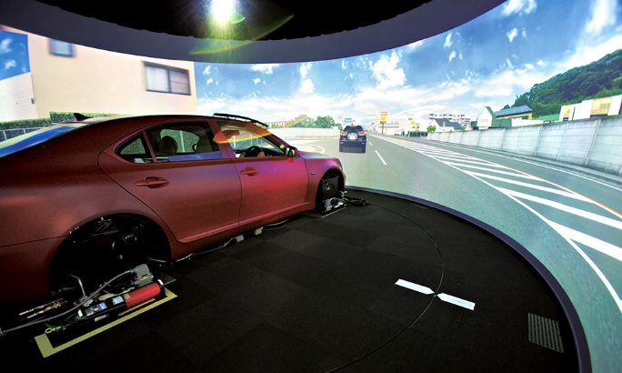
What? (oplossing)
…
Properties
Optimizer
Accuracy
Model-of-the physics
Interface
Calibration
Reductions
Solver
…
WCET
Memory

Slide 10
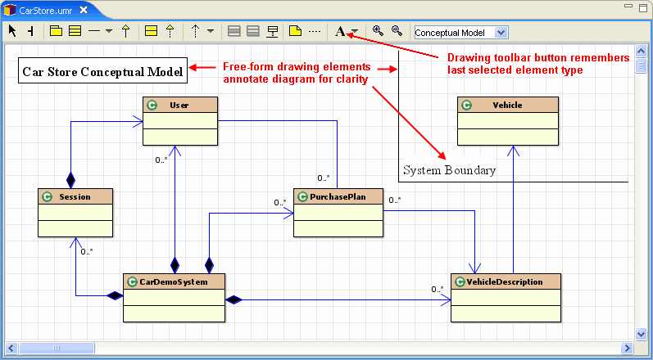
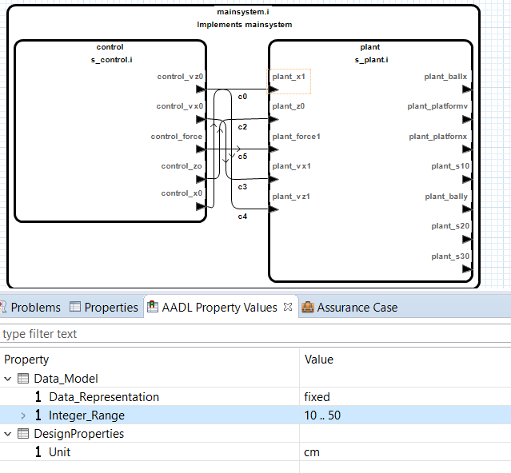
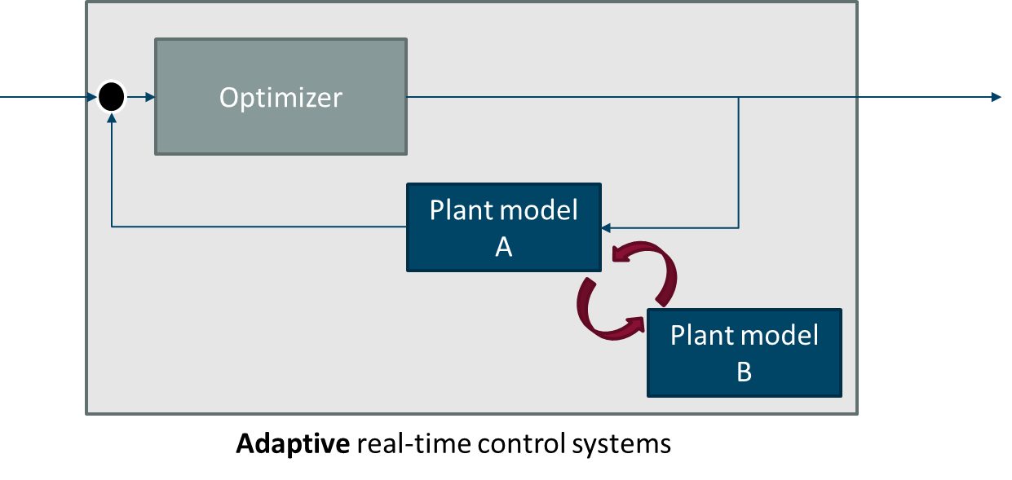
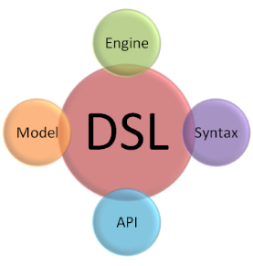
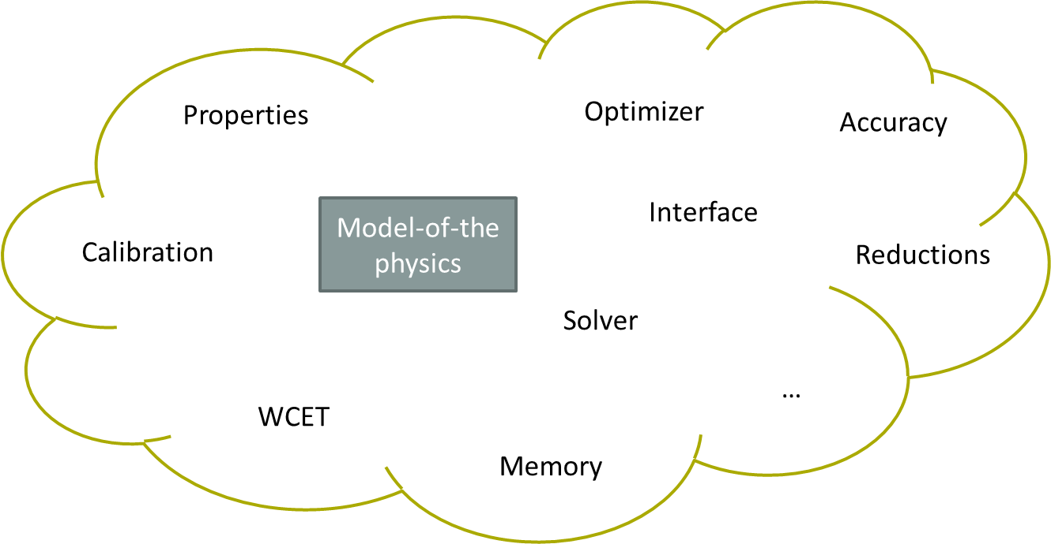
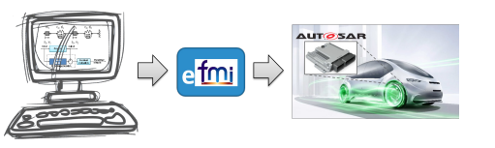

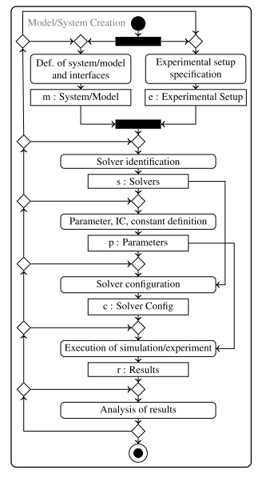
Capture
Validity frame
Usage
Calibration processes
Verify
Experimenter processes
Integration processes
Component (re-)usability

Slide 11
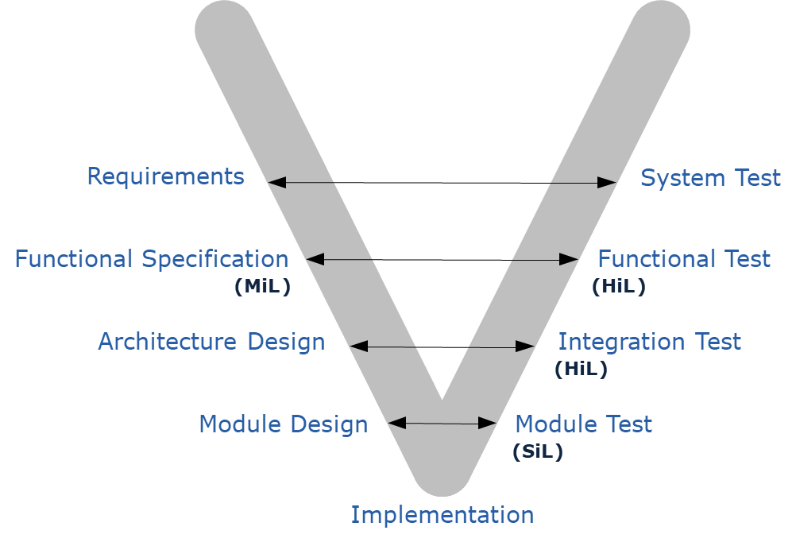
Roadmap (evolution 5j.)
Future focus
Current focus

