Slide 1
Co-simulation
Cláudio Gomes

Slide 2
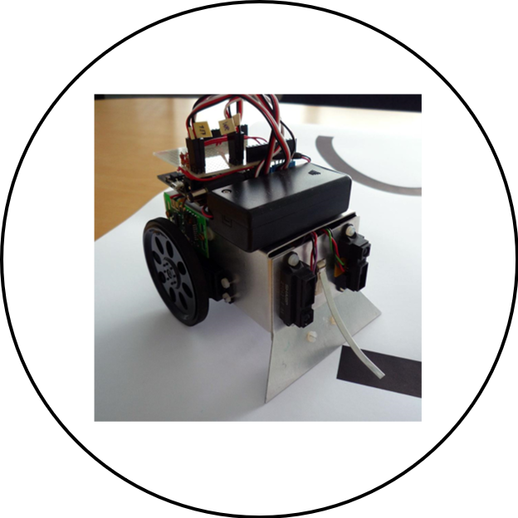
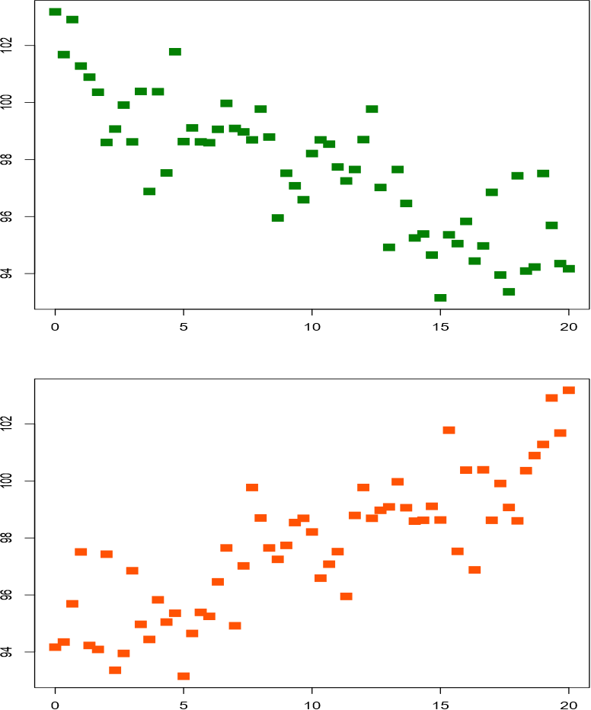
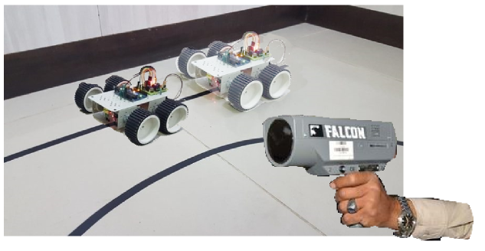
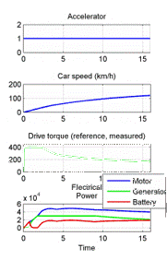
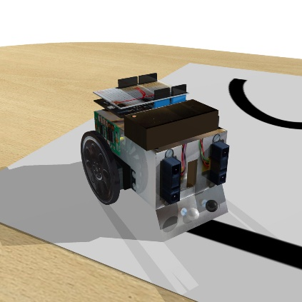
Simulation
Experimentation
Simulation

Slide 3
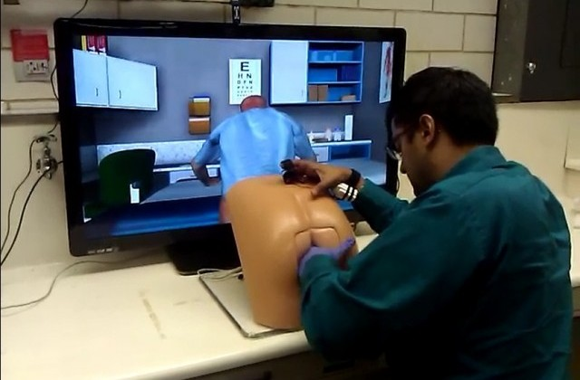
Simulation is useful
https://www.slashgear.com/virtual-simulation-and-robotic-butt-named-patrick-offers-med-students-hands-on-practice-13305334/

Slide 4
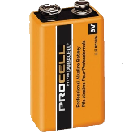
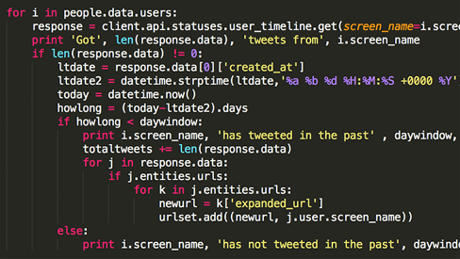
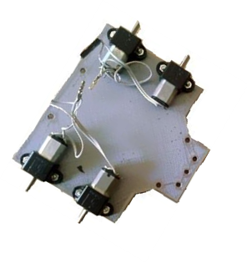
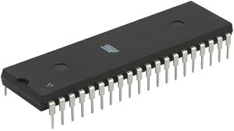
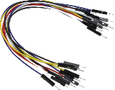
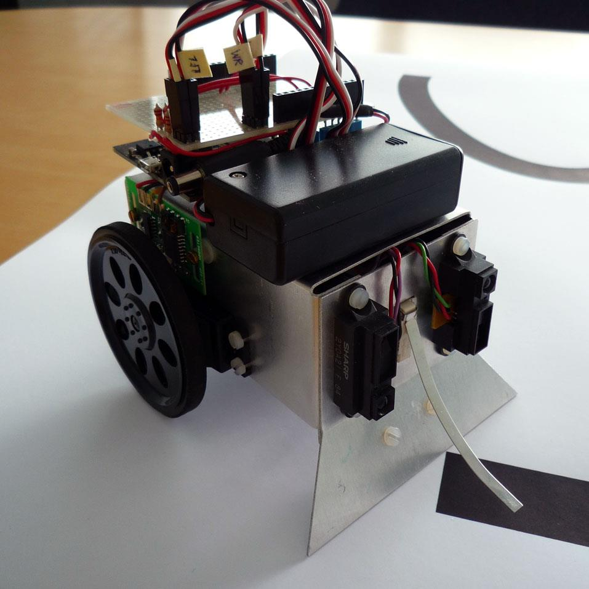
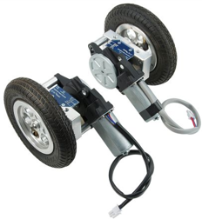
Co-Simulation

Slide 5
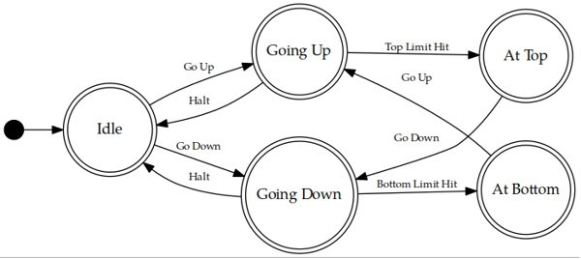
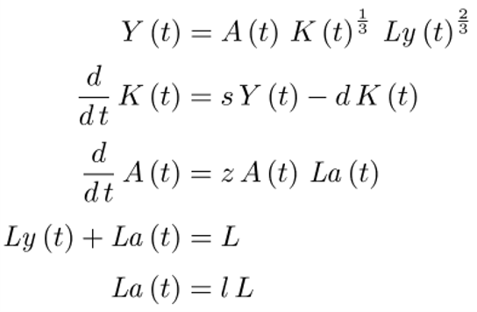
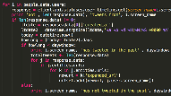
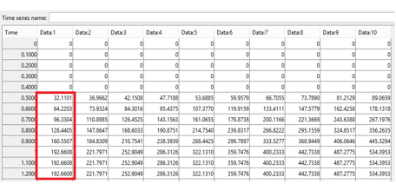
Co-Simulation

Slide 6
Co-Simulation

Slide 7
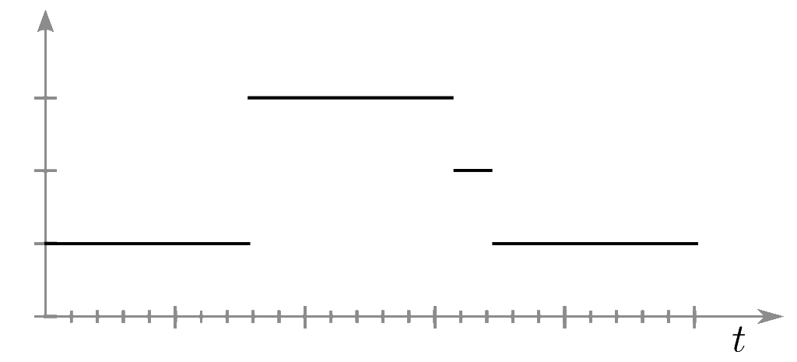
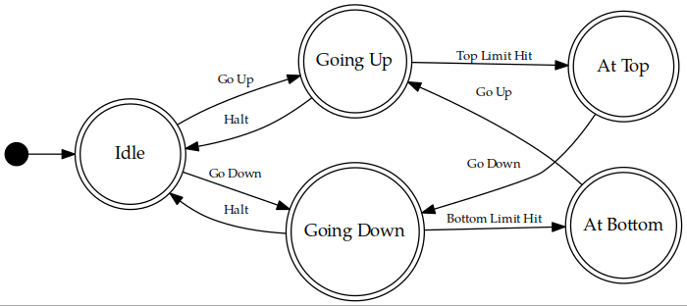
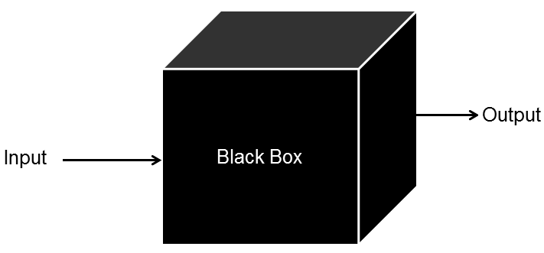
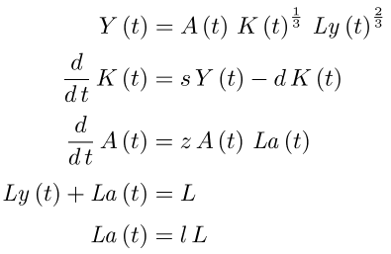
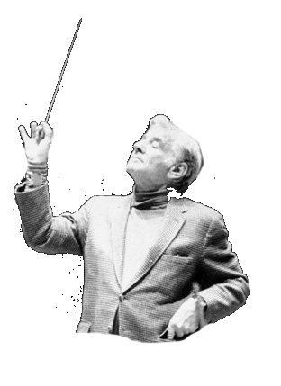
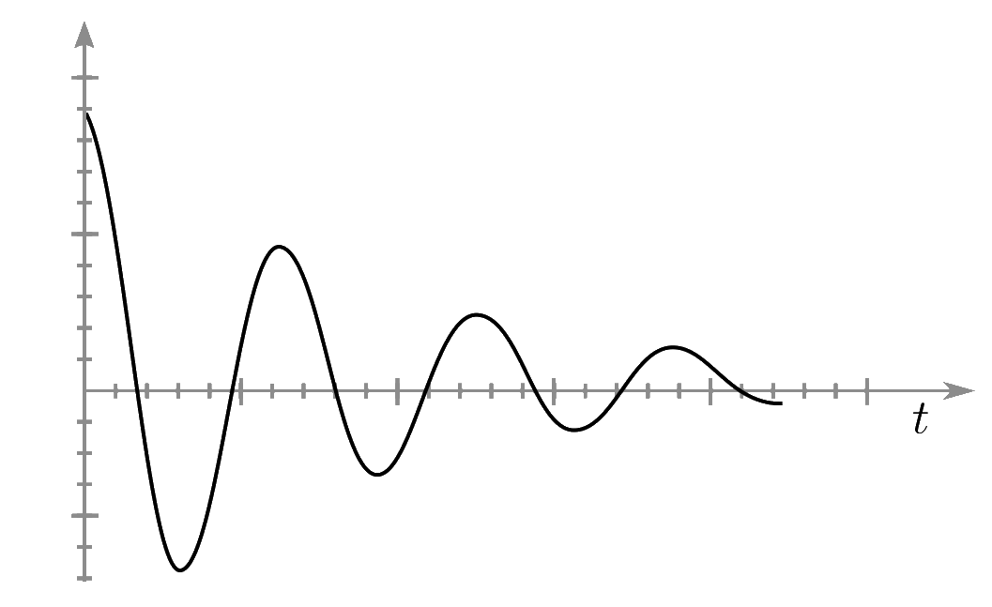
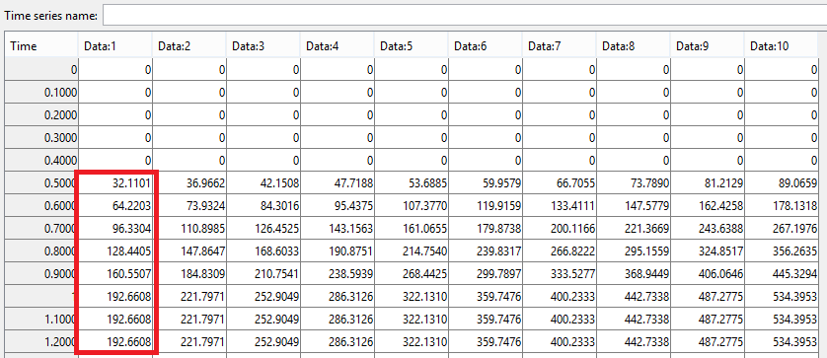
Co-Simulation
https://www.npr.org/sections/deceptivecadence/2012/11/27/165677915/do-orchestras-really-need-conductors?t=1540147152130

Slide 8
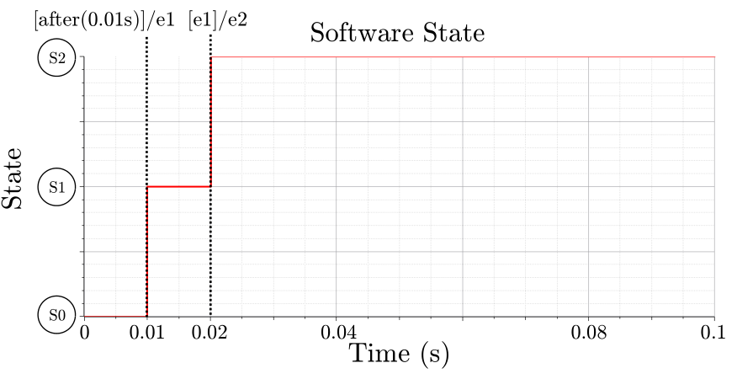
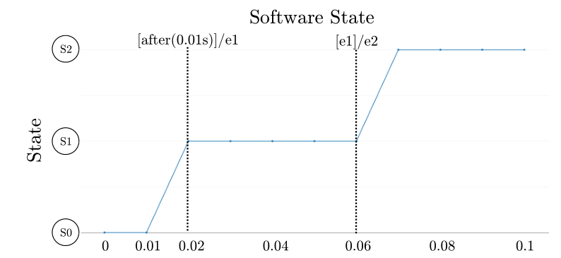
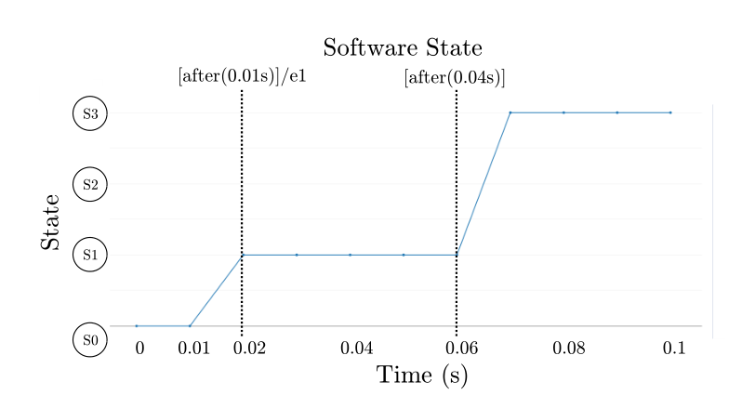
Challenge
Thule, Casper, Cláudio Gomes, Julien Deantoni, Peter Gorm Larsen, Jörg Brauer, and Hans Vangheluwe. “Towards Verification of Hybrid Co-Simulation Algorithms.” In 2nd Workshop on Formal Co-Simulation of Cyber-Physical Systems, to be published. Toulouse, France: Springer, Cham, 2018.

Slide 9
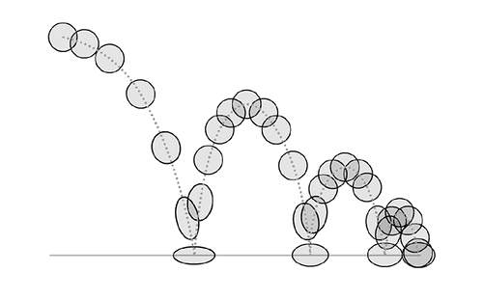
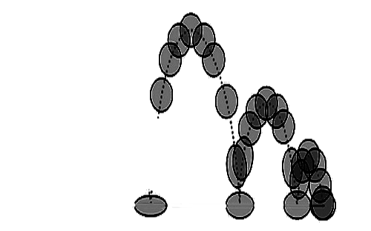
Challenge
Gomes, Cláudio, Paschalis Karalis, Eva M. Navarro-López, and Hans Vangheluwe. “Approximated Stability Analysis of Bi-Modal Hybrid Co-Simulation Scenarios.” In 1st Workshop on Formal Co-Simulation of Cyber-Physical Systems, 345–60. Trento, Italy: Springer, Cham, 2017. https://doi.org/10.1007/978-3-319-74781-1_24.

Slide 10
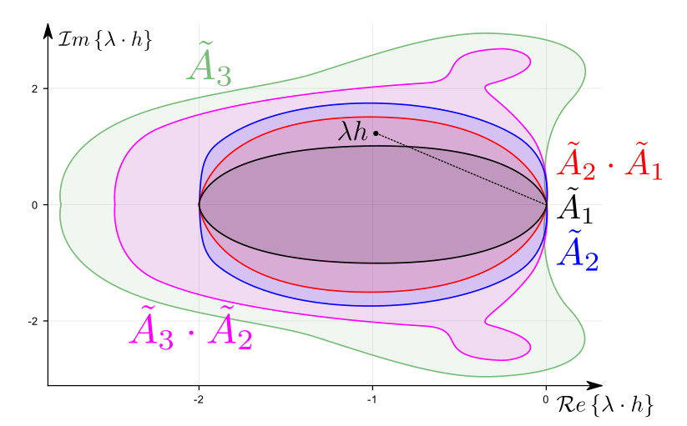
Challenge
Gomes, Cláudio, Benoît Legat, Raphaël Jungers, and Hans Vangheluwe. “Minimally Constrained Stable Switched Systems and Application to Co-Simulation.” In IEEE Conference on Decision and Control, to be published. Miami Beach, FL, USA, 2018.

Slide 11
Thank you!
Questions?
Cláudio Gomes
claudio.gomes@uantwerp.be
http://msdl.cs.mcgill.ca/people/claudio
Notes:
Disclaimer: your experience may vary.

