Slide 1




http://msdl.cs.mcgill.ca/
Pieter Mosterman Hans Vangheluwe Joachim Denil (CoSysLab)
Bart Meyers
Bentley Oakes, Maris Jukss Simon Van Mierlo, Yentl Van Tendeloo, István Dávid, Cláudio Gomes
Ken Vanherpen (CoSysLab)
Addis Gebremichael, Lucas Heer

Slide 2
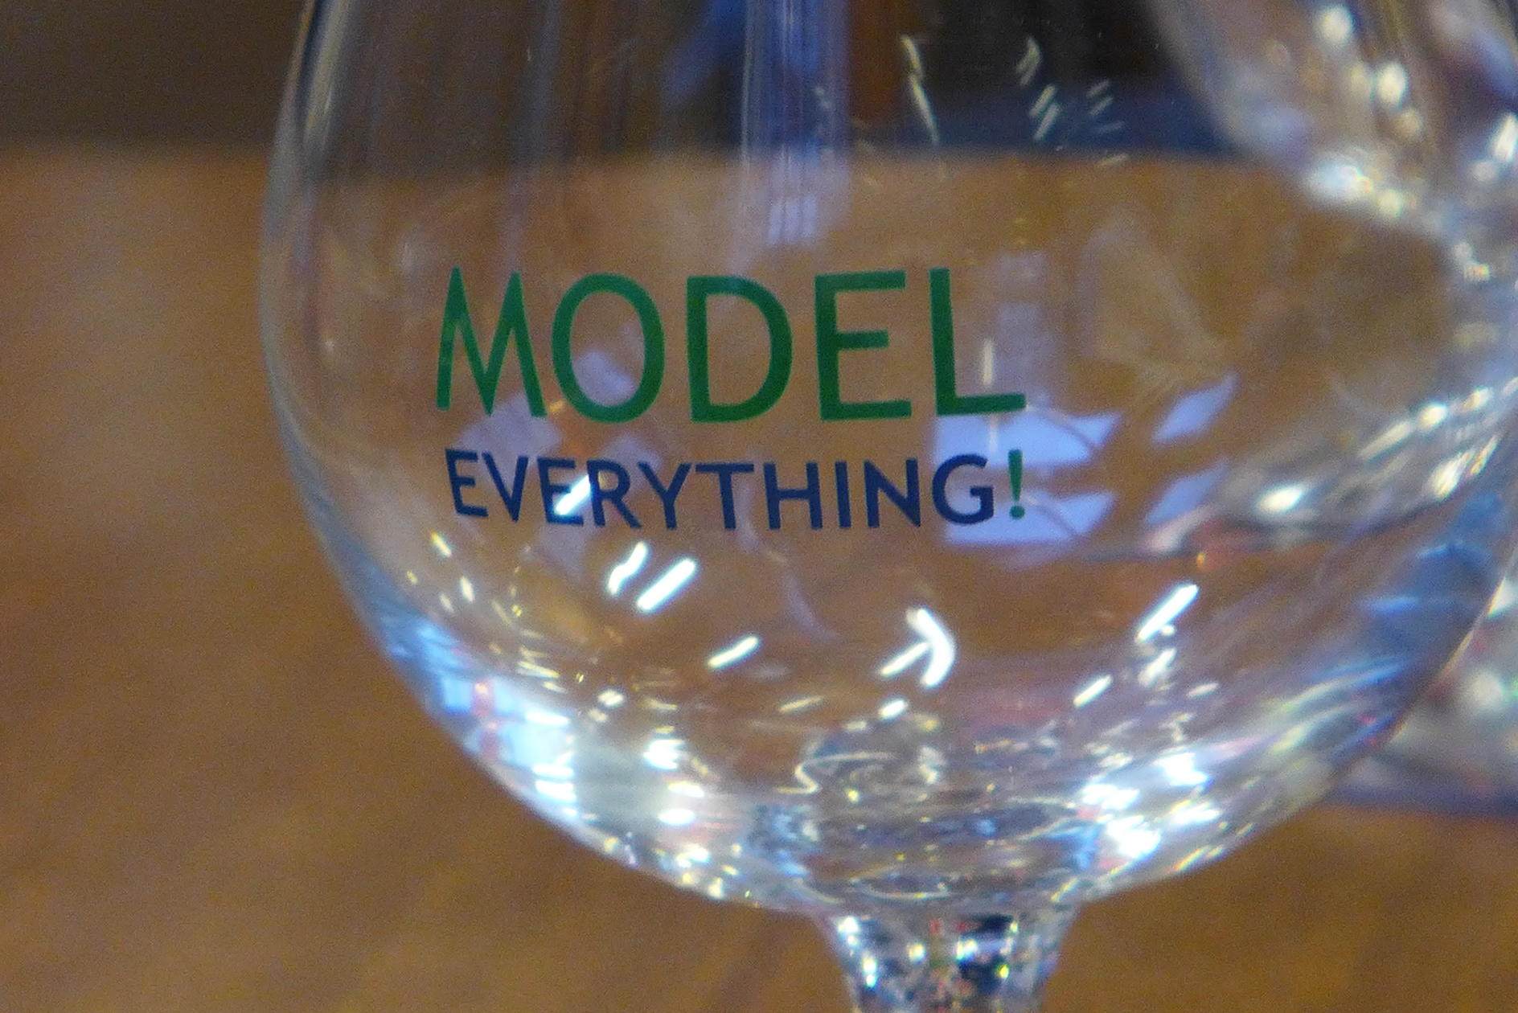
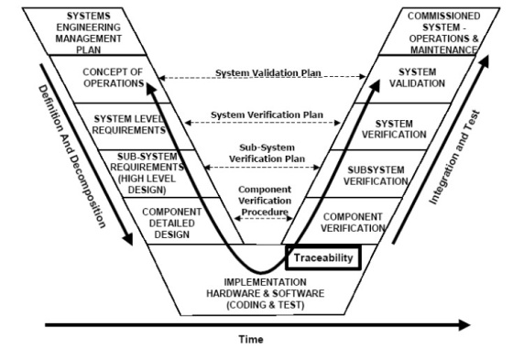
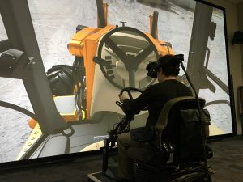
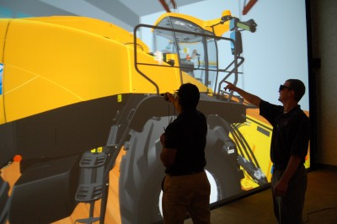



Virtual Product
at the most appropriate level(s) of abstraction
using the most appropriate formalism(s)
explicitly modelling processes
Enabler: (domain-specific) modelling language engineering,
including model transformation
Pieter J. Mosterman and Hans Vangheluwe. Computer Automated Multi-Paradigm Modeling: An Introduction. Simulation: Transactions of the Society for Modeling and Simulation International , 80(9):433- 450, September 2004. Special Issue: Grand Challenges for Modeling and Simulation.

Slide 3
Validation, Verification, Testing and Accreditation
Analysis and Verification of Model Transformations, Debugging, Instrumentation, Tracing, etc.
Language Engineering
Domain-Specific Languages, Model Transformation, (web-based) Visual and Textual Modelling Environments, etc.
Model Management & Process
FTG+PM, Safety (ISO 26262, Railway, etc,), Agile Modelling, Consistency management, Experimental frames, etc.
Simulation
Co-Simulation, Discrete-event, DEVS, continuous time, acausal, Modelica, etc.
Deployment & Resource-optimized Execution
Platforms (e.g. AUTOSAR, CAN, etc.), Design-Space Exploration, Virtualization, Models@run-time, Efficient execution of model transformations, etc.

Slide 4
The Modelverse:
A Foundation for Multi-Paradigm Modelling
Yentl Van Tendeloo
Yentl.VanTendeloo@uantwerpen.be

Slide 5
Summary
What? Multi-Paradigm Modelling kernel and repository
Why? Support the use of Multi-Paradigm Modelling
How? Using Multi-Paradigm Modelling techniques
Maturity? Academic tool
[1] Y. Van Tendeloo and H. Vangheluwe. The Modelverse: a Tool for Multi-Paradigm Modelling and Simulation. In Proceedings of the 2017 Winter Simulation Conference, 2017 (accepted).
[2] Y. Van Tendeloo. Foundations of a Multi-Paradigm Modelling Tool. In ACM Student Research Competition at MoDELS, 2015.

Slide 6
What?
Multi-Paradigm Modelling kernel and repository
[3] L. Lucio, S. Mustafiz, J. Denil, H. Vangheluwe, and M. Jukss. FTG+PM: An Integrated Framework for Investigating Model Transformation Chains. In SDL 2013: Model-Driven Dependability Engineering, Volume 7916 of Lecture Notes in Computer Science, 182–202, 2013.
[4] P. Mosterman and H. Vangheluwe. Computer Automated Multi-Paradigm Modeling: An Introduction. SIMULATION 80(9): 433–450, 2004.

Slide 7


What?
Multi-Paradigm Modelling kernel and repository
Modelverse
[5] E. Syriani, H. Vangheluwe, R. Mannadiar, C. Hansen, S. Van Mierlo, and H. Ergin. AToMPM: A Web-based Modeling Environment. In Proceedings of MODELS’13 Demonstration Session, 21–25, 2013.
[6] K. Schmidt. LoLA: a low level analyser. In Proceedings of the 21st international conference on Application and theory of petri nets, 465-474, 2000.

Slide 8


What?
Multi-Paradigm Modelling kernel and repository
Models
Transformations
Modelverse
Integer function fib (n : Integer):
if (n <= 2):
return 1!
else:
return fib(n–1) + fib(n–2)!
Metamodels
Operations

Slide 9

Why?
Flexibility

Slide 10

Why?
ClassDiagrams
PetriNets
PetriNets2
my_pn
my_pn_2

Slide 11
Why?
ClassDiagrams
Bottom
PetriNets
PetriNets2
my_pn
my_pn_2

Slide 12
Why?

Slide 13
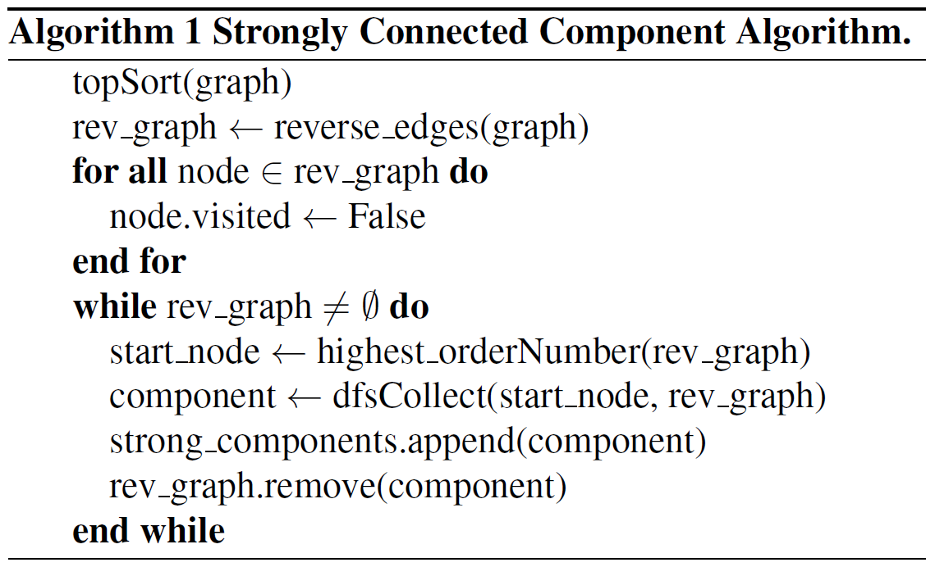
Why?

Slide 14

Why?
“I need to hack the transformation server for that.”

Slide 15


Why?
Storage
Manipulation
[7] R. France, J. Biemand, and B. H. C. Cheng. Repository for Model Driven Development. In Proceedings of the International Conference on Model Driven Engineering Languages and Systems (MoDELS), 311-317, 2006.
[8] F. Basciani, J. Di Rocco, D. Di Ruscio, A. Di Salle, L. Iovino, and A. Pierantonio. MDEForge: an extensible web-based modeling platform. In Proceedings of the Workshop on Model-Driven Engineering on and for the Cloud (CloudMDE), 66-75, 2014.

Slide 16
How?
Complex systems are best modelled using Multi-Paradigm Modelling!

Slide 17
How?
I should code the MPM kernel and repository, which is a complex system!

Slide 18
How?
I should code the MPM kernel and repository, which is a complex system!

Slide 19
How?
Protocols
Performance
Task management
Action Language
Conformance
Services
Concrete syntax
Data
Transformations

Slide 20
Roadmap
Modelling
Performance
Client-side code
Coupling
Interfaces (graphical?)
Usability
Performance
Action language syntax
Conformance bottom (applications)
Services
Compiler
Multi-conformance (applications)

Slide 21
SCCD: A Statecharts and Class Diagrams Hybrid
Simon Van Mierlo
Universiteit Antwerpen
simon.vanmierlo@uantwerpen.be

Slide 22
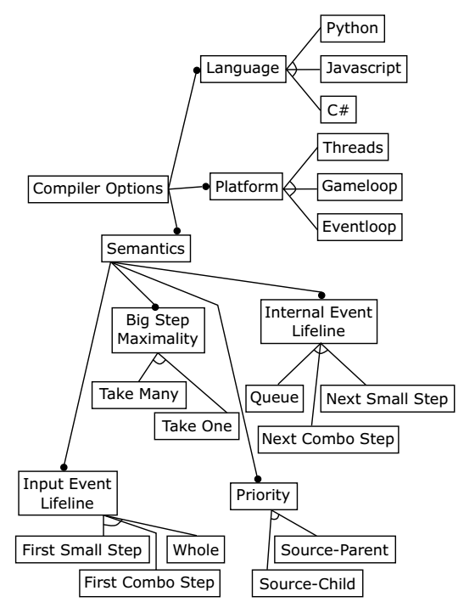
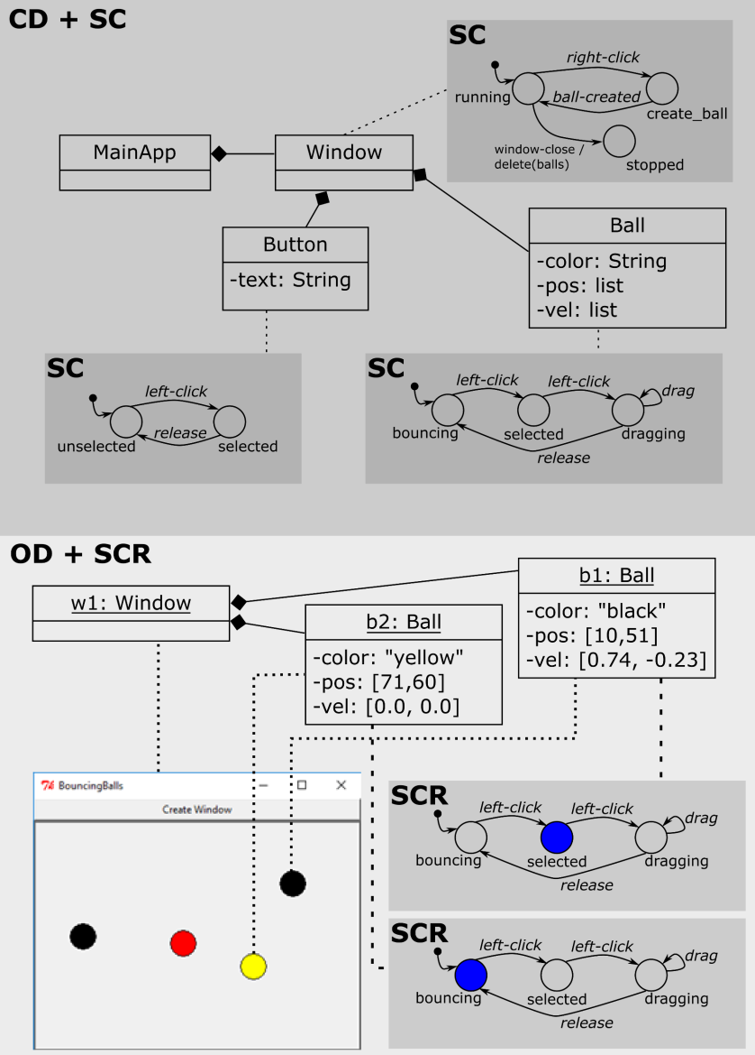
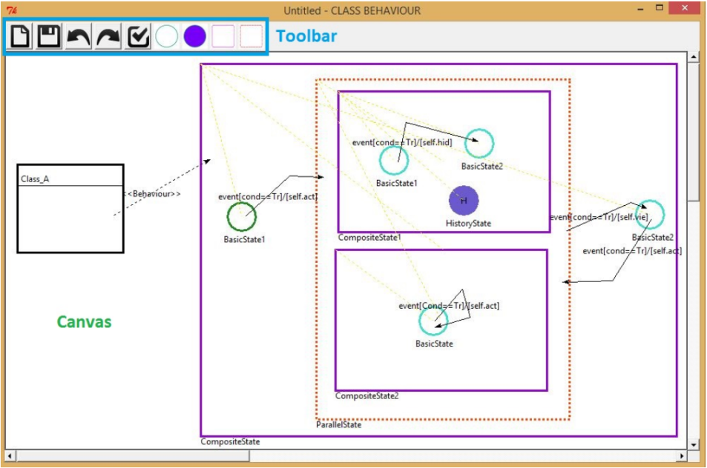
Summary
Simon Van Mierlo, Yentl Van Tendeloo, Bart Meyers, Joeri Exelmans, and Hans Vangheluwe.
SCCD: SCXML extended with class diagrams. In 3rd Workshop on Engineering Interactive Systems with SCXML, part of EICS 2016, 2016

Slide 23

Motivation
Behavior
Timed
Autonomous
Interactive
Hierarchical
Structure
Dynamic
Hierarchical
Design?
Statecharts
+ Class Diagrams
= SCCD(XML)
Notes:
Why

Slide 24

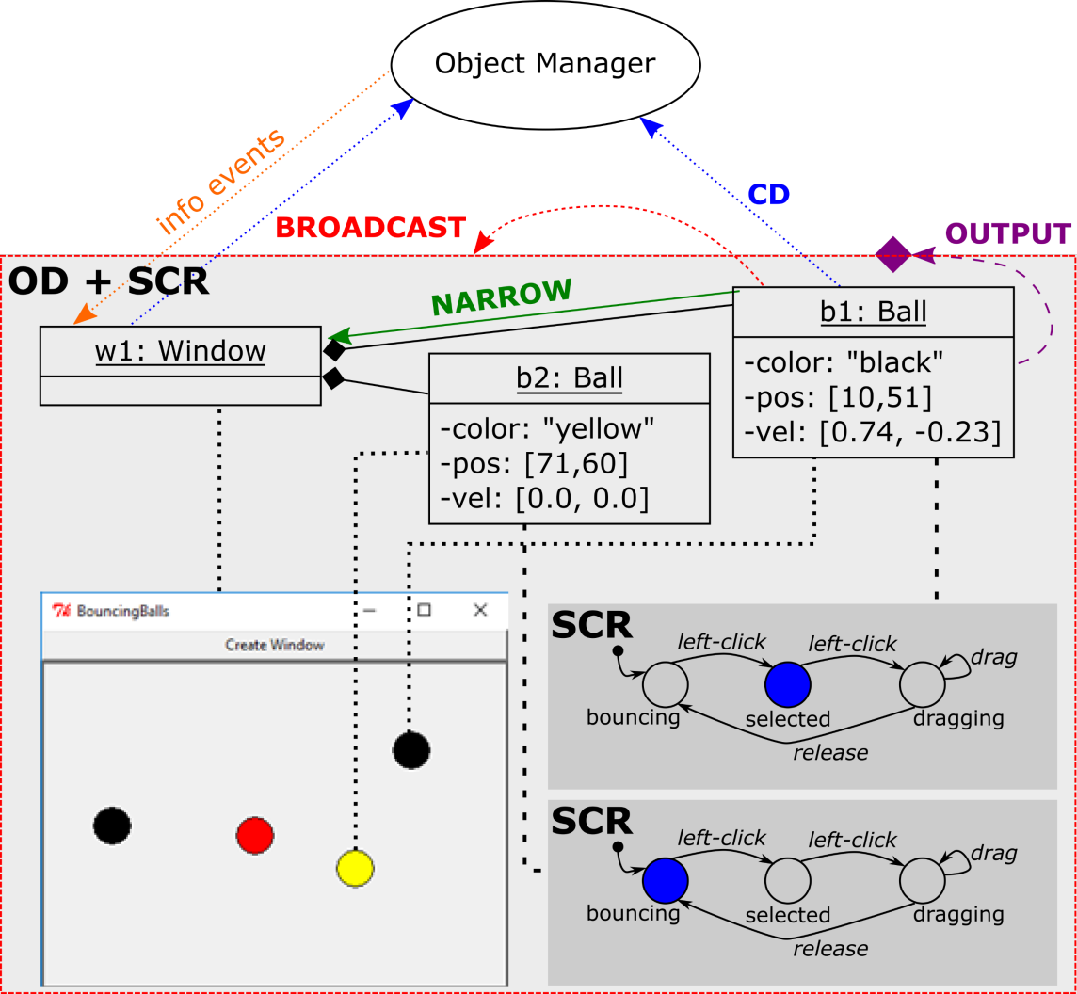
Modelling Complex, Timed, Autonomous,
Dynamic-Structure Systems
Notes:
What

Slide 25
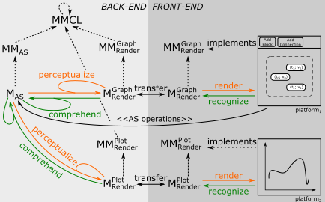
Visual Modelling Interface Behaviour: Concrete Syntax
Notes:
What
Concrete syntax: modelling in the Modelverse, implementation in SCCD

Slide 26
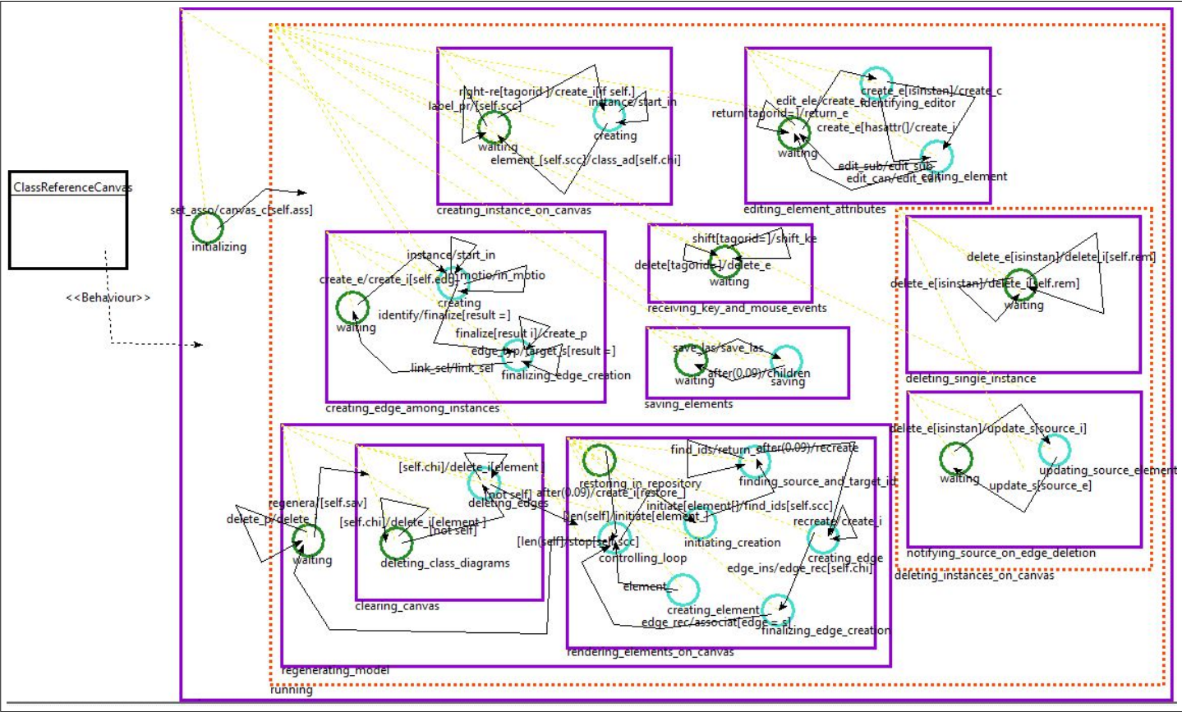
Visual Modelling Interface Behaviour: User Interaction
Notes:
What
User interaction with the canvas/toolbar/etc. using SCCD. (Addis)
-> link with Vasco S.

Slide 27
Roadmap
SCCD Language: Syntax and Semantics
  Conformance
    Initialization/Destruction
    Exceptions
  Dynamic Loading of SCCD Models
  Interfaces/Contracts: Protocol Machine
  Subtyping
    Events as Objects
    Behavior
  Object Creation Decoupled from Associations
Model user interaction in DSL
  (see Vasco Sousa’s work)
Concrete Syntax: separation of AS/CS modification operations
Notes:
Future

Slide 28
Verification of Domain-Specific Models with ProMoBox
Bart Meyers
Universiteit Antwerpen
bart.meyers@uantwerpen.be

Slide 29
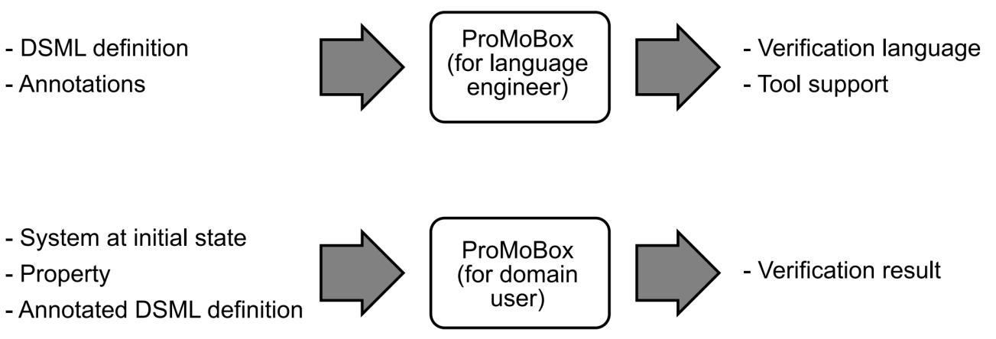
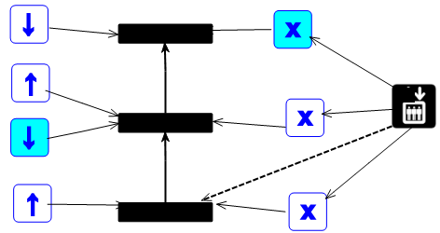
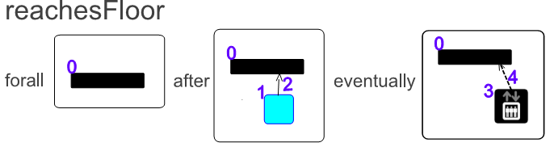
Summary
Design
⊨
Property
specification of properties at DS level
fully automatic generation of languages from annotated metamodel
fully automatic verification of properties
application to model checking, testing, DSE, …
Bart Meyers, Romuald Deshayes, Levi Lucio, Eugene Syriani, Manuel Wimmer and Hans Vangheluwe. ProMoBox: A Framework for Generating Domain-Specific Property Languages. In "Proceedings of the 7th International Conference on Software Languages Engineering (SLE 2014)", Lecture Notes on Computer Science, vol. 8706, p. 1-20, 2014.
Bart Meyers, Joachim Denil, István Dávid, and Hans Vangheluwe. Automated Testing Support for Reactive Domain-Specific Modelling Languages. In "Proceedings of the 2016 ACM SIGPLAN International Conference on Software Language Engineering". ACM digital library, p. 181-194, 2016.

Slide 30
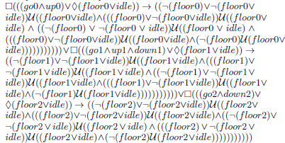
Properties for DSMLs: State of the Art
Design
⊨
Property
Notes:
We always focus on design.
Explain elevator language.
But is the model according to requirements?
We see requirements as properties.
Temporal property, LTL
Transformation of model to a semantic domain

Slide 31
Properties for DSMLs: Property DSML
Design
⊨
Property
Bart Meyers, Romuald Deshayes, Levi Lucio, Eugene Syriani, Manuel Wimmer and Hans Vangheluwe. ProMoBox: A Framework for Generating Domain-Specific Property Languages. In "Proceedings of the 7th International Conference on Software Languages Engineering (SLE 2014)", Lecture Notes on Computer Science, vol. 8706, p. 1-20, 2014.
Notes:
They might look the same but are different languages.
Temporal operators are used, and patterns
In fact we need five languages (next slide, explain already on this slide)
A distinction can be made between dynamic and static structure in the model, for example whether the elevator is going up and whether its doors are open, at which floor it is, and what buttons are pressed
We want to be able to translate to a formal model that can be evaluated with model checking
We use the operational semantics of the model for this, but we need additional information
Some elements model input to the system, in this case button presses
In case of a counter example, an output trace is expected
Everything at the domain-specific layer, sharing the same syntax

Slide 32
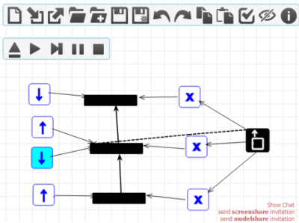
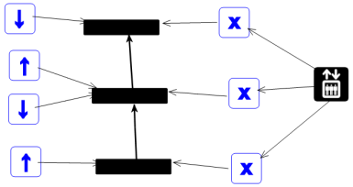
Properties for DSMLs: Consistency
Annotations
Annotations
MM’
Consistency by construction
[[.]]’
Property
Design
Input
Runtime
Trace
DSM
4
Formal Methods
1
1
.txt
3
.ltl
1
.pml
2
Spin
.trail
2
Notes:
We apply the MPM principles to the engineering of DSMLs
We pull up everything to the DSM layer, even transformations going to formal methods layer are generic
Problem: 5 languages to keep consistent

Slide 33
Evaluation (TSE paper)
Modelling effort
  comparison LOC and complexity
Correctness + Usability study
  6 participants, qualitative study + SUS
Model checking performance
  better than adapted Elevator example from literature
Expressiveness
  Exhaustive comparison with Promela language constructs
Customisability
  added patterns to property language and replaced Spin backbone with Groove

Slide 34
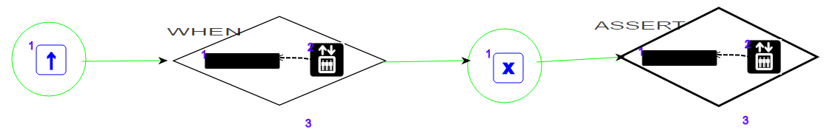
Properties for DSMLs: Testing
Design
⊨
Test Case
Test DSML
Bart Meyers, Joachim Denil, István Dávid, and Hans Vangheluwe. Automated Testing Support for Reactive Domain-Specific Modelling Languages. In "Proceedings of the 2016 ACM SIGPLAN International Conference on Software Language Engineering". ACM digital library, p. 181-194, 2016.

Slide 35
Roadmap
ProMoBox
- Annotations
- DSML generation
- Generic semantics
Model Checking
Property Template
+
Generic Promela compiler
Testing
Test Template
+
Generic operational semantics
DSE
Rules Template
+
Generic solver
Generation of test cases from properties

Slide 36
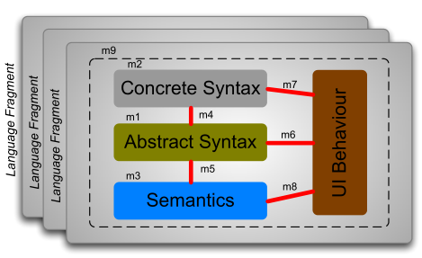
Modular Language Environment Engineering (L+E)Spec
Reusable components of a language environment specification
  Syntax (Concrete/Abstract)
  Operational semantics
  Interaction (UI) Behaviour
Combine fragments to create environments for hybrid languages
Notes:
At the core of our approach lies the concept of Language Specification Fragments:
Reusable components of a language comprising syntax, operational semantics and user interface behavior components.
We will focus on the composition of the operational semantics, as it is, from our experience, the most difficult task.
Possible questions from audience:
Why did you include the UI-Behavior in the language specification fragment? It seems to be something orthogonal to language design (as one can have multiple syntaxes for the same semantics).

Slide 37
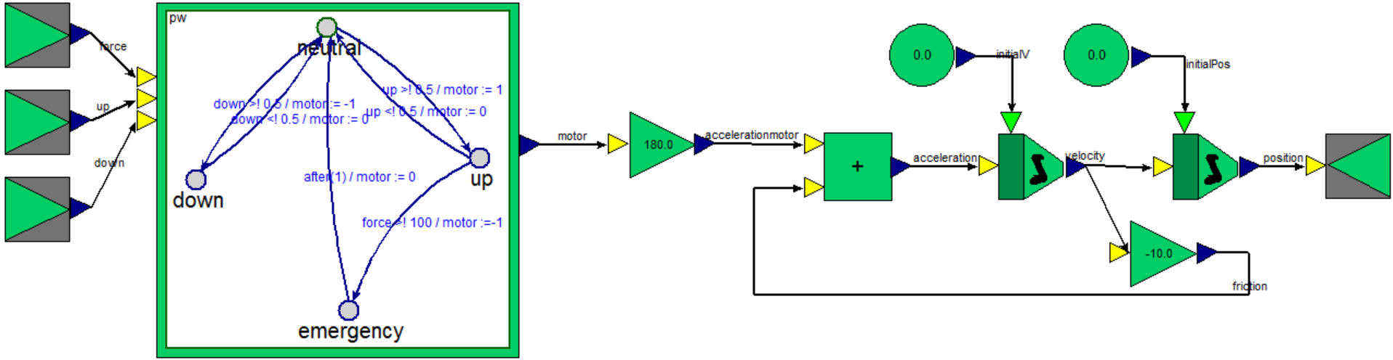
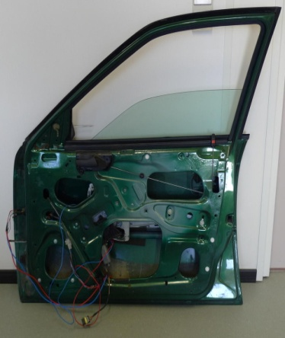
Example 1: CBD (host) + TFSA (embedded)
Bart Meyers, Joachim Denil, Frederic Boulanger, Cecile Hardebolle, Christophe Jacquet, Hans Vangheluwe. A DSL for Explicit Semantic Adaptation. MPM@MoDELS 2013:47-56.
Joachim Denil, Bart Meyers, Paul De Meulenaere, and Hans Vangheluwe. Explicit semantic adaptation of hybrid formalisms for FMI co-simulation. In Proceedings of the 2015 Spring Simulation Multi-Conference, pages 852 - 859. SCS, April 2015.

Slide 38
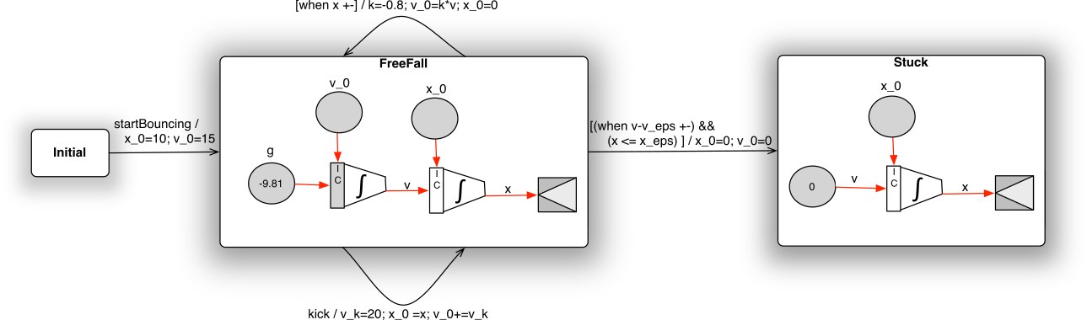
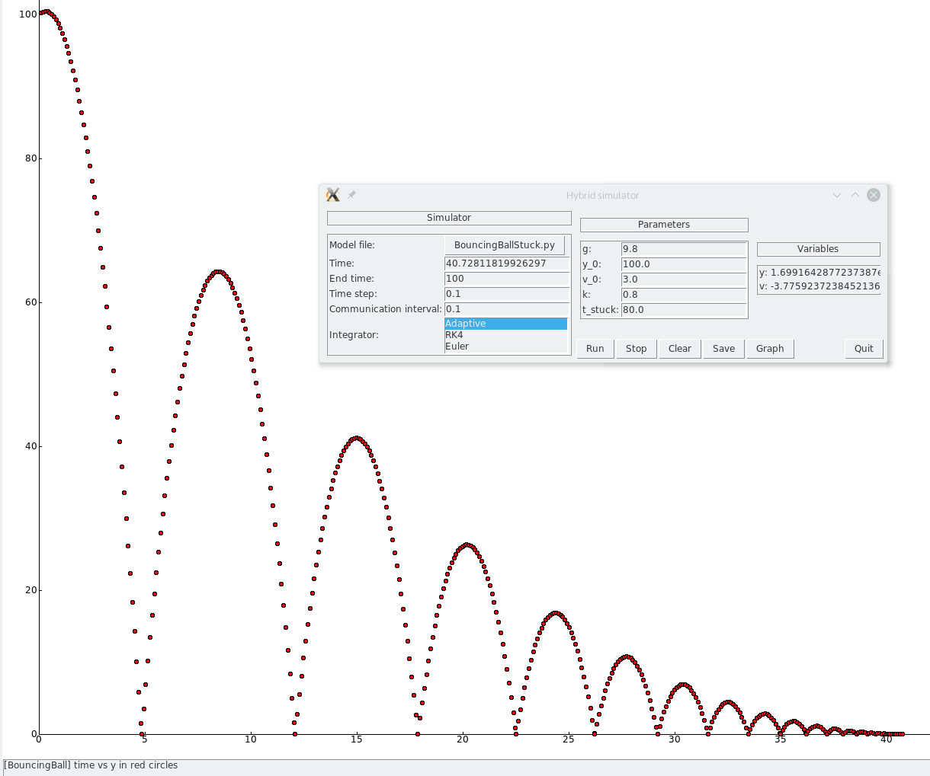

Example 2: TFSA (host) +CBD (embedded)
Simon Lacoste-Julien, Hans Vangheluwe, Juan de Lara, and Pieter J. Mosterman. Meta-modelling hybrid
formalisms. In Pieter J. Mosterman and Jin-Shyan Lee, editors, IEEE International Symposium on Computer-
Aided Control System Design , pages 65 - 70. IEEE Computer Society Press, September 2004. Taipei, Taiwan.

Slide 39
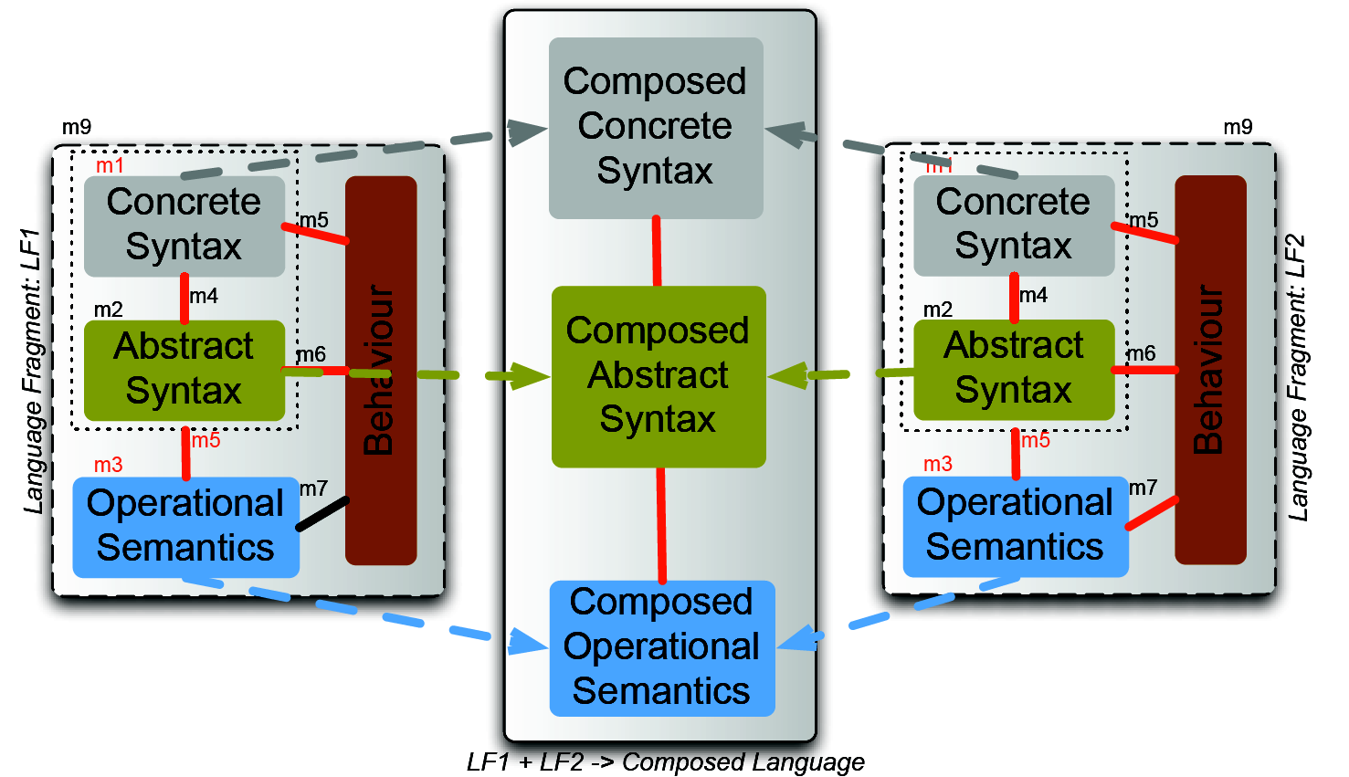
Composition of Language Specification Fragments
Notes:
39

Slide 41
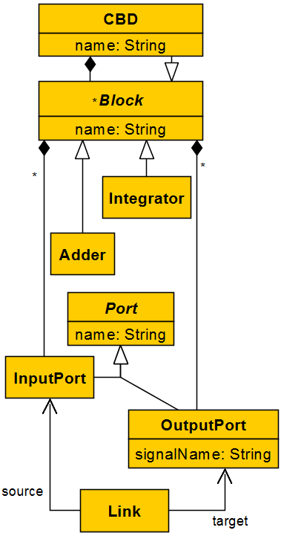
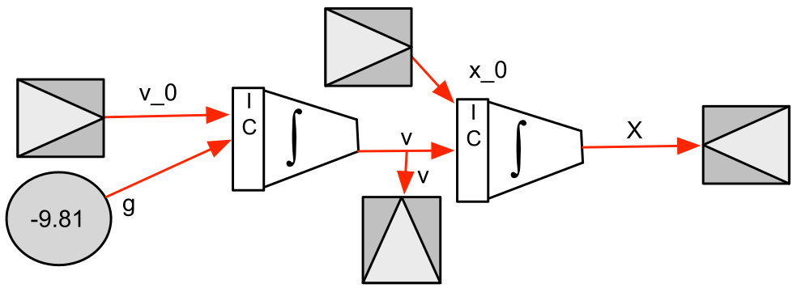





Background: CBD* Syntax
*Causal Block Diagram (such as Simulink®), aka Synchronous Data Flow
Notes:
Use the example to explain how the simulation of the CBD works.

Slide 42
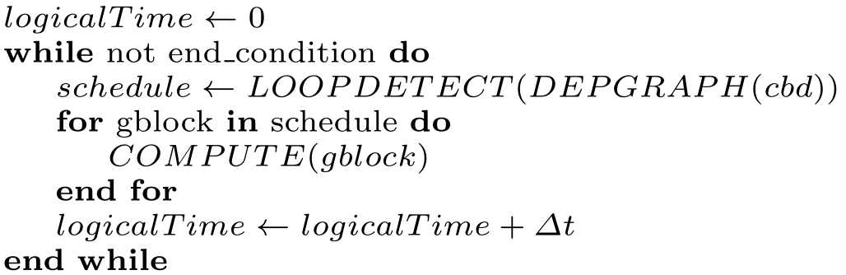
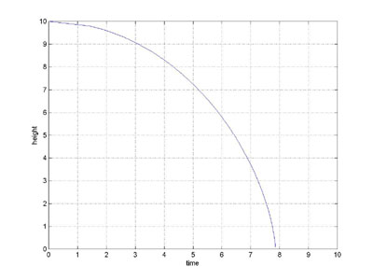
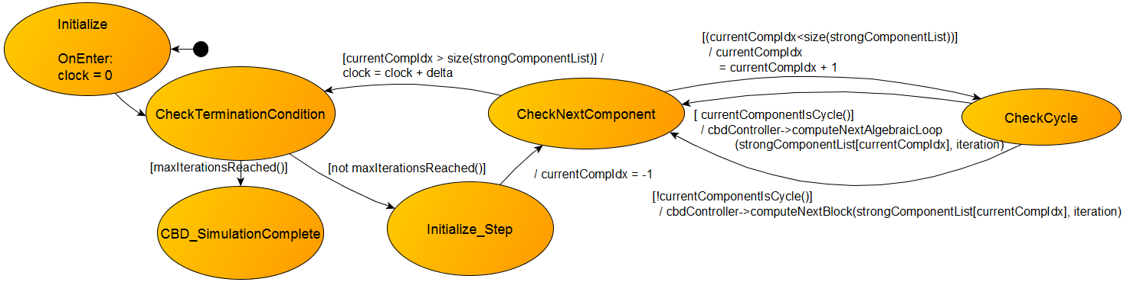
CBD Semantics
at appropriate abstraction level (for specific intent): automaton vs. action code
Notes:
Use the example to explain how a simulator of TFSAs works.

Slide 43
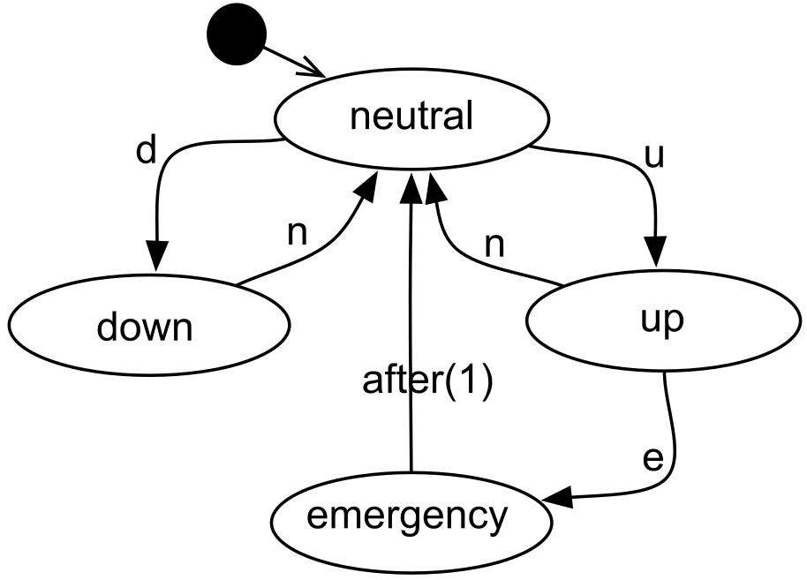
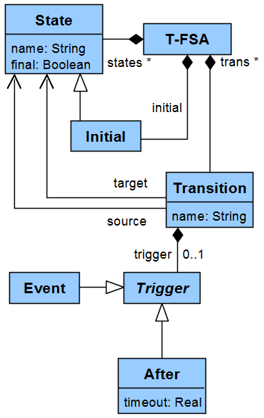



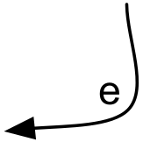
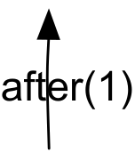
Background: TFSA* Syntax
*Timed Finite State Automata
Notes:
Use the example to explain how a simulator of TFSAs works.

Slide 44
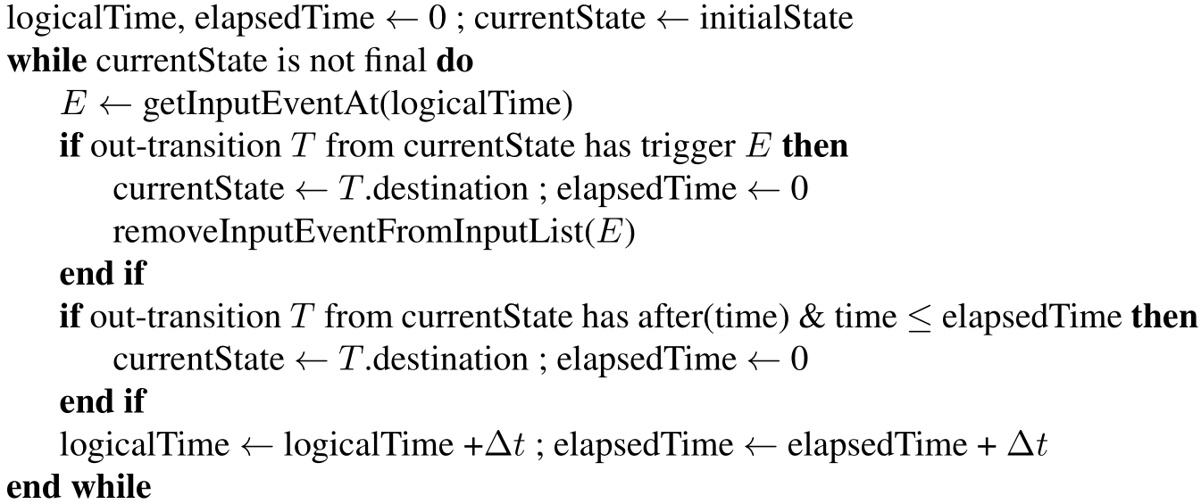
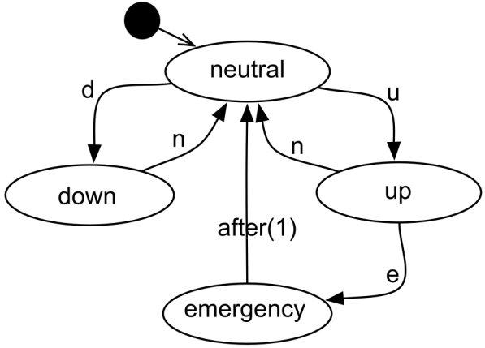
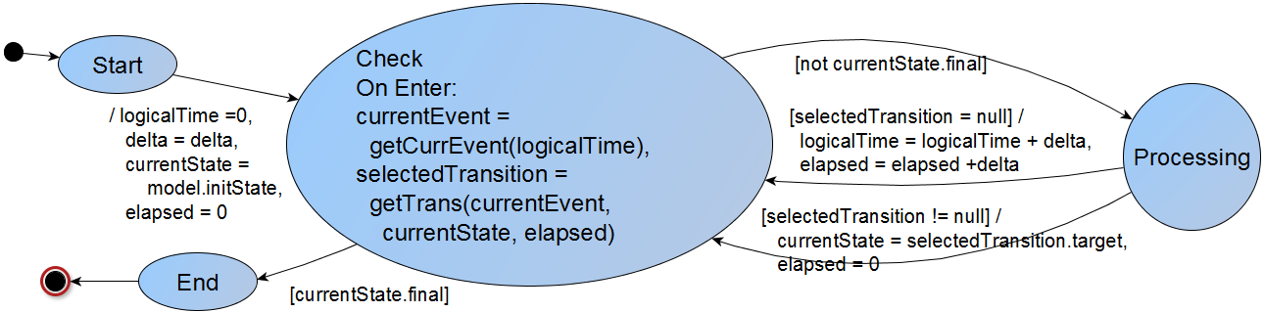
Background: TFSA Semantics
Notes:
Use the example to explain how a simulator of TFSAs works.

Slide 45
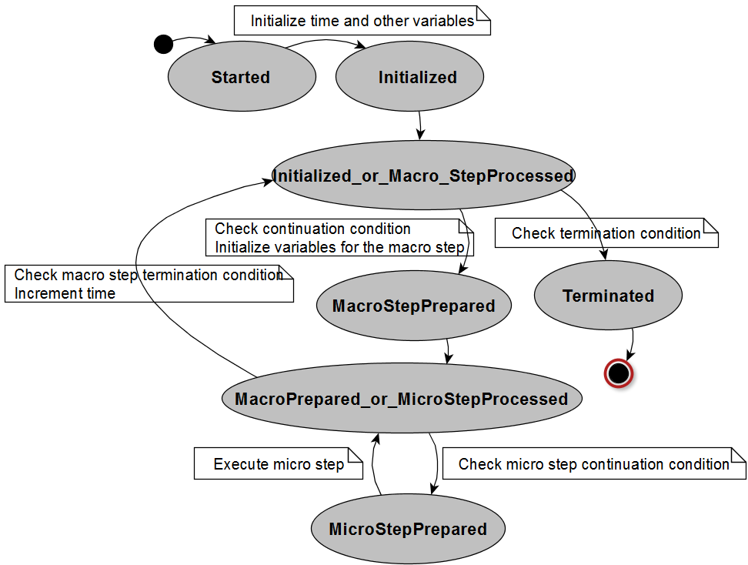
Canonical Operational Semantics
Common pattern in simulators
  Main simulation loop
  Macro-steps
  Micro-steps
Notes:
In order to meaningfully compose the operational semantics of the two languages, we have to have those semantics expressed in some well defined formalism.
The formalism that we used is the state charts.
The operational semantics models must be in this canonical form, with macro and micro-steps because it makes possible the identification of valid breaking points.

Slide 46
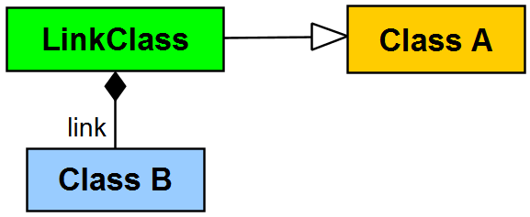
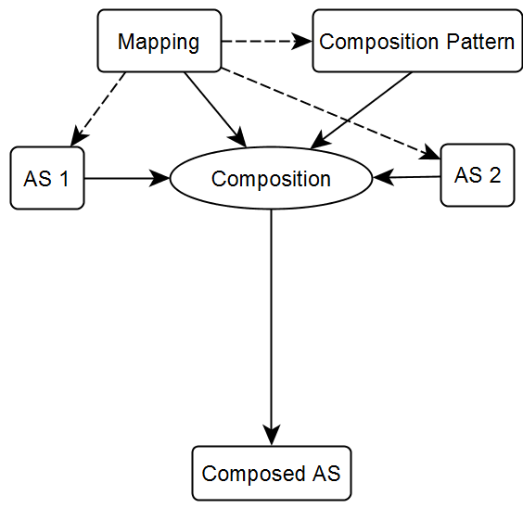
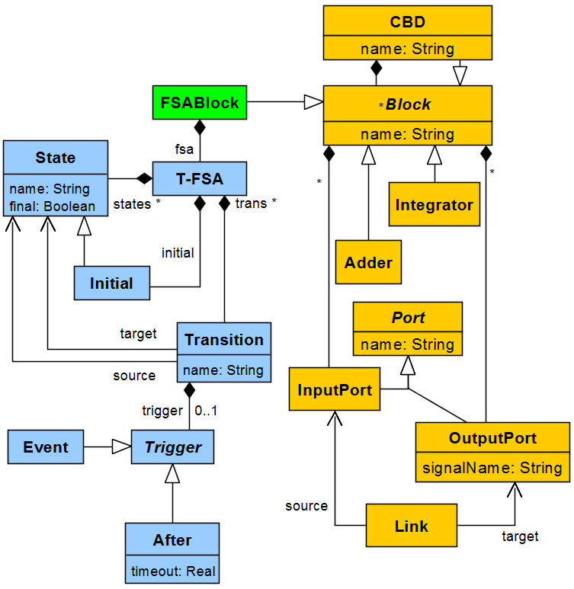
Workflow: Combine AS
Caveat: need “formalism transition” language too!
“when”

Slide 47
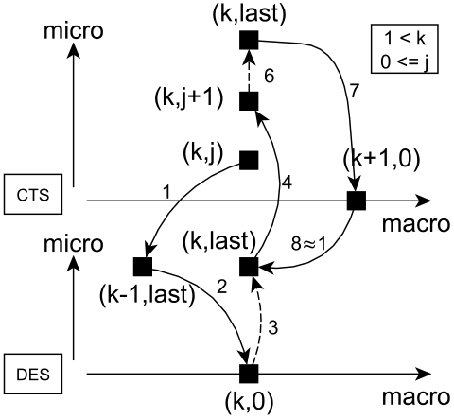
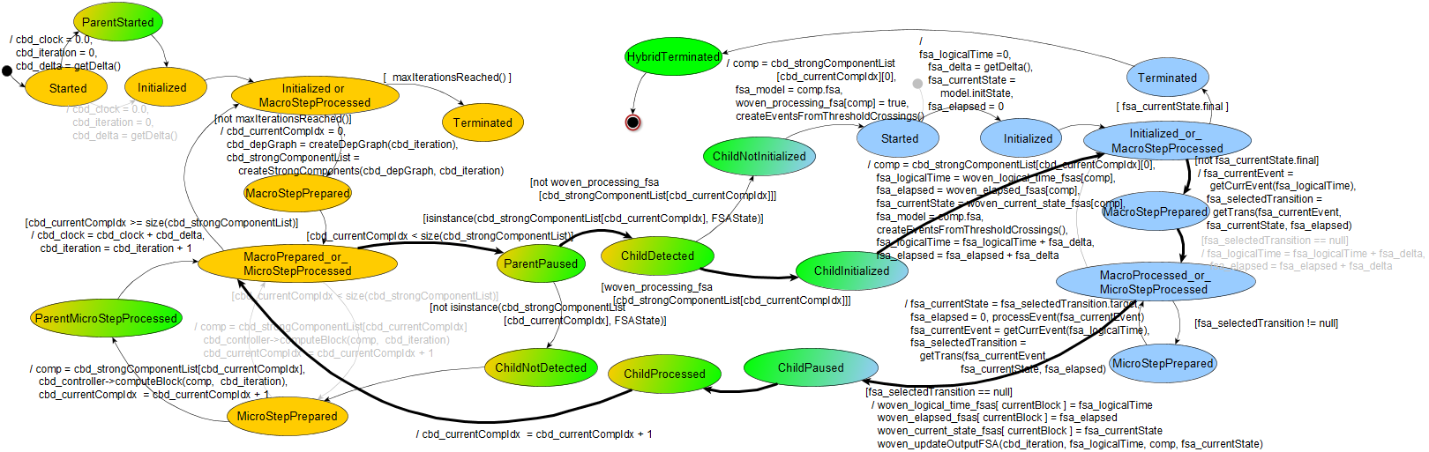
Hybrid CBD (host) operational semantics
need “orchestration” language
(to specify how to interleave OS)
Gheorghe, L., Bouchhima, F.,
Nicolescu, G., and Boucheneb, H.
Semantics for Model-based Validation of
Continuous/Discrete Systems.
In DATE ’08, pages 498–503.
Notes:
There is no point in going over the details of the composition.
I’ m not even sure we should include that picture.
We can show the overall route in a normal execution (the papers contains the transitions that execute in that route).
The pictures can be tweaked to highlight this.

Slide 48
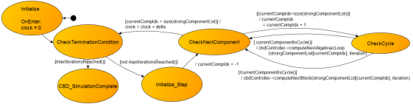

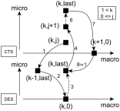
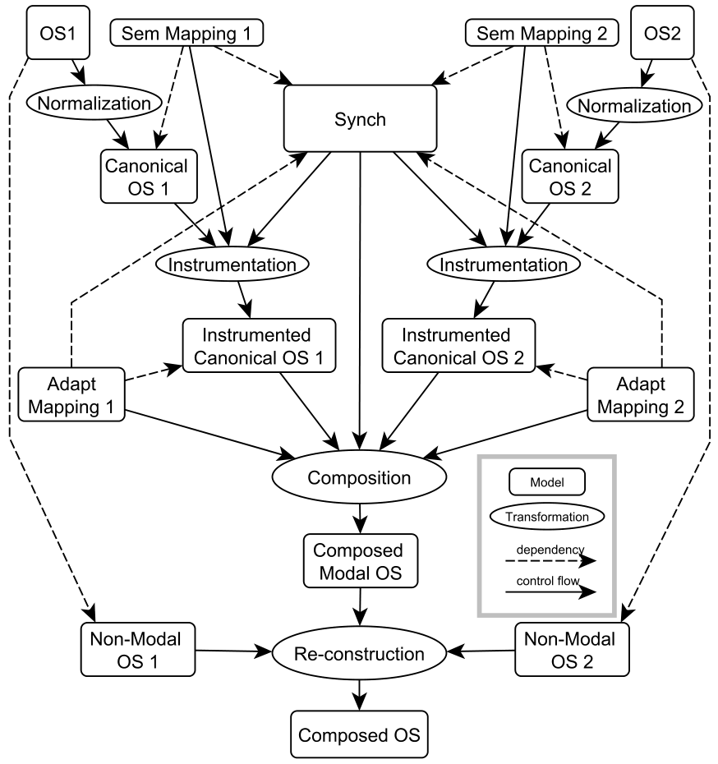
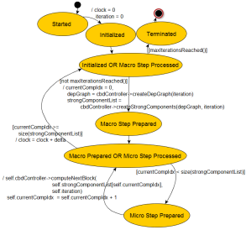
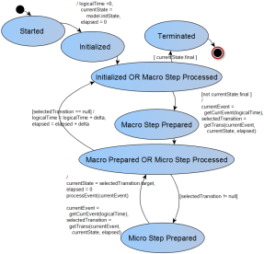
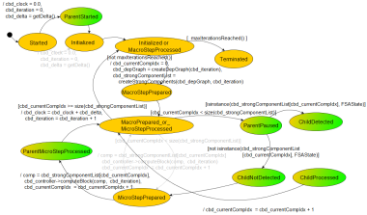
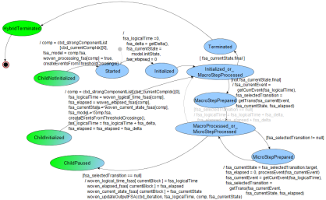
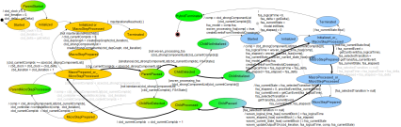
Workflow: Combine OS
Notes:
Go over the general methodology, explain what can be done automatically and what is harder to automate.

Slide 49


Slide 50


Slide 52

Workflow: Combine AS
Caveat: need “formalism transition” language too!

Slide 53


Hybrid TFSA (host) operational semantics
need “orchestration” language (to specify how to interleave OS)

Slide 54
Workflow: Combine OS
Notes:
Go over the general methodology, explain what can be done automatically and what is harder to automate.

Slide 55
Semantic Adaptation for FMI Co-simulation*
Cláudio Gomes, Bart Meyers, Joachim Denil,
Casper Thule, Kenneth Lausdahl,
Hans Vangheluwe, Paul De Meulenaere
* Journal paper submitted to SIMULATION

Slide 56
Summary
Why? There is a need for quick (but sound) changes to the behavior of simulators.
What? We developed a DSL for that…
How? …using hierarchical co-simulation principles.
Maturity: Set of techniques and tool, applied to academic cases.

Slide 57

Motivation
Quick and sound way of adapting the behaviour of an interconnected set of FMUs
  Unit conversion
  Interaction protocol modification
  Enhance accuracy and performance

Slide 58


Semantic Adaptation
Actions by which the behavior of an original set of interconnected FMUs is altered, following the transparency and modularity principles.

Slide 59

Semantic Adaptation
Actions by which the behavior of an original set of interconnected FMUs is altered, following the transparency and modularity principles.

Slide 60

A DSL for Semantic Adaptation

Slide 61

A DSL for Semantic Adaptation

Slide 62

A DSL for Semantic Adaptation

Slide 63




Hierarchical Co-simulation

Slide 64



Roadmap
Industrial Case Study with AgroIntelli
Raise level of abstraction

Slide 65
Stability Analysis for Adaptive Co-simulation*
Cláudio Gomes, Benoît Legat,
Raphaël M. Jungers, Hans Vangheluwe
* Paper accepted in IUTAM Symposium on Co-simulation and solver coupling – Recent developments in theory and application, September, Darmstadt

Slide 66
Summary
Stability of adaptive master algorithms is seldom taken into account, but can increase performance/accuracy tradeoff.
We apply the Joint Spectral Radius theory to study the stability of such orchestration algorithms for linear co-simulation scenarios.

Slide 67





Stability – Non-Adaptive Numerical Solver
Stability:

Slide 68



Stability – Adaptive Numerical Solver
Example in co-simulation: adapt the step size
Stability:

Slide 69




Stability Analysis
Non adaptive solver (spectral radius):
Adaptive solver (joint spectral radius):

Slide 70




Adaptive Co-simulation Master
Given a co-simulation scenario, and a specification of the master algorithm, one can compute Sigma
Example:

Slide 71
Roadmap
Address scalability by using adaptive master specifications based on state machines.
Identify conditions for which JSR can be computed directly. (Example: a repeating sequence of matrices)

Slide 72
Stability Analysis for Hybrid Co-simulation*
Cláudio Gomes, Paschalis Karalis,
Eva M. Navarro-López, Hans Vangheluwe
* Paper accepted in Workshop on Formal Co-Simulation of Cyber-Physical Systems, September, Trento

Slide 73
Summary
A co-simulation of a hybrid system must preserve the stability properties of the later, so that the results can be trustworthy.
We analyze the range of communication frequencies between simulators that ensure those properties are kept.

Slide 74



Example: Hybrid System

Slide 75


Example: Hybrid Co-simulation Scenario

Slide 76

Question: How much delay can be tolerated?
H = 0.05
H = 0.001

Slide 77

(Lyapunov) Stability of Hybrid Systems

Slide 78

(Lyapunov) Stability of Hybrid Co-simulation

Slide 79
Roadmap
Generalize the approach for many modal systems (not just two), and systems with resets.
Use a more relaxed Lyapunov stability theorem, developed by Paschalis and Eva

Slide 80
Hybrid System Simulation with Dirac Deltas*
Cláudio Gomes, Yentl Van Tendeloo,
Joachim Denil, Paul De Meulenaere,
Hans Vangheluwe
* Paper accepted in Symposium on Theory of Modeling and Simulation, April, Virginia Beach

Slide 81
Summary
We compare two different approaches for the simulation of impulsive differential equation, and formulate their differences.

Slide 82





Impulse-based Modeling
Bouncing ball dynamics:
Around a collision:
(Momentum) Conservation dictates:
Hence, whatever the shape of Fc,

Slide 83



Impulse-based Modeling
Bouncing ball dynamics:
Let δ be a function abstraction, such that:
Then:

Slide 84



Symbolic Simulation of Impulses
Manipulate signals with impulses encoded

Slide 85



Numerical Simulation of Impulses
Numerically approximate an impulse as the derivative of a steep ramp.

Slide 86
Example: Bouncing ball

Slide 87


Comparison: Symbolic vs Numerical
Numerical approach shifts the solution n.h time units
Maximum magnitude for a discontinuity D:
Conclusion: Symbolic approach is more accurate for models that manipulate impulse derivatives.

Slide 88
Roadmap
Find models that require impulse derivatives.

Slide 89
Coffee Break

Slide 90
Model Debugging
Simon Van Mierlo
Universiteit Antwerpen
simon.vanmierlo@uantwerpen.be

Slide 91





Summary
→ Causal-Block Diagrams, Parallel DEVS, Statecharts, Petrinets,
Dynamic-Structure DEVS, Hybrid TFSA-CBD, Action Language
Simon Van Mierlo, Yentl Van Tendeloo, and Hans Vangheluwe. Debugging Parallel DEVS. SIMULATION, 93(4):285-306, 2017
Simon Van Mierlo, Cláudio Gomes, and Hans Vangheluwe. Explicit Modelling and Synthesis of Debuggers for Hybrid Simulation Languages. In Proceedings of the 2017 Symposium on Theory of Modeling and Simulation - DEVS (TMS/DEVS), pages 1013-1024, 2017

Slide 92



Motivation
Usable M&S Environments:
  Fidelity (w.r.t. formalism’s syntax and semantics)
  Accuracy (in simulation results)
  Resuse (model libraries)
  Performance
  Debugging
Notes:
Why
What do we need in M&S tools? Refer back to SpringSim presentation on Parallel DEVS debugger.

Slide 93





Building Language-Specific Debugging Environments
Operations:
  Pause/Resume
  Stepping
  Breakpoints
  State Tracing (Visual)
  Manual State Changes
  Omniscient Debugging
+
+
Notes:
What
What are we going to do? Develop techniques for tool builders to enhance their modelling environments with debugging support.
This is difficult because of the simulator’s semantics, debugging operations that can interrupt its execution, and time.

Slide 94


De- and Reconstruction
1.
2.
3.
Notes:
How

Slide 95


Architecture and Workflow
Notes:
How

Slide 96



Examples
Dynamic-Structure DEVS
Parallel DEVS
Petrinets
Notes:
How

Slide 97



Debugging Hybrid Formalisms
Continuous
Breakpoints
Pause/Resume
Stepping
Realtime Simulation
Continuous
Stepping
Event Injection
Continuous
Stepping
Continuous
Stepping
Continuous

Slide 98


Efficient Omniscient Debugging (PDEVS)
$x$s
$x$s
A
A1
A2
A3
A4
A5
A6
A7
Periodic
State Saving
B
B1
B2
B3
B4
B5
B6
B7
C
C1
C2
C3
C4
C5
C6
C7
Simulation Time
Optimizations:
xs -> 2xs
Disk I/O
Compression

Slide 99
Roadmap
Denotational (vs. Operational) Semantics
Language Engineering
  “weaving” debugging language
Simulators
  black- or grey-box (see FMI)
  hybrid: canonical form (moving away from SCCD)
Architecture
  automatic artefact generation/instrumentation
Advanced Breakpoint Conditions
  (see ProMoBox)
Notes:
Future
Mindmap?

Slide 100


Slide 101


Slide 102






Slide 103



Slide 104




Slide 105



Slide 106



Slide 107




Slide 108




Slide 109
Frames
--= Enabling Reuse in MBSE =--
Joachim Denil
Joachim.Denil@uantwerpen.be

Slide 110
Summary
Reuse of (Simulation) Models is important
Modelers make assumptions during all stages of a M&S process:
  Model Construction
  Model Calibration
  Etc.
Frames record information to allow such reuse!
Information needs to be stored for meaningful reuse
  Selection from catalogue of models
Information needs to be modelled for automation
  Test that Frame works on Model
  Test that Models works with Frame

Slide 111
Reuse of Models Example

Slide 112
Spiegel, Michael, Paul F. Reynolds Jr, and David C. Brogan. "A case study of model context for simulation composability and reusability." Proceedings of the 37th conference on Winter simulation. Winter Simulation Conference, 2005.

Slide 113



What?
1st attempt: Zeigler’s
Experimental Frame
displacement
force

Slide 114


Give Procedure that can be enacted and automated
and allows for reuse!

Slide 115
Not only for Model but for all parts of M&S cycle!

Slide 116
Future Directions
Work with Alex, Rick and Stefan @ MPM4CPS Cost?
Continue on the different M&S life-cycle elements
Extended Case Study
  Power window?
Appropriate languages for modelling frames
Extend formalization and frame relations
Libraries with Frames (tool-building)

Slide 117
Lunch

Slide 118
Engineering Process Transformation to Manage (In)consistency
Istvan David
MSDL Antwerp
istvan.david@uantwerp.be

Slide 119
Summary
Inconsistency management in engineering processes
Inconsistencies → $$$
  Late (or no) detection, numerous re-iterations…
We provide:
  A methodology, and
  A tool for managing inconsistencies.
I. Dávid, J. Denil, K. Gadeyne, and H. Vangheluwe, “Engineering Process Transformation to Manage (In)consistency,”
in Proceedings of the 1st International Workshop on Collaborative Modelling in MDE (COMMitMDE 2016), pp. 7–16, http://ceur-ws.org/Vol-1717/, 2016.

Slide 120



Engineering complex systems is hard!
Automated Guided Vehicle (AGV)

Slide 121
Engineering complex systems is hard!
Modeling
Increased complexity
Disparate
domains
Inconsistencies
Automated Guided Vehicle (AGV)

Slide 122
Engineering complex systems is hard!
Modeling
Increased complexity
Disparate
domains
Inconsistencies
Automated Guided Vehicle (AGV)
CORRECTNESS
EFFICIENCY
Notes:
An inconsistency is present if two or more statements are made that are not jointly satisfiable [such as a] failure of an equivalence test, non-conformance to a standard or constraint and the violation of physical or mathematical principles (Herzig)

Slide 123
Managing inconsistencies
Rather than thinking about removing inconsistency we need to think about "managing consistency“ – Finkelstein
  Tolerate, analyze, prevent…

Slide 124
Managing inconsistencies
Rather than thinking about removing inconsistency we need to think about "managing consistency“ – Finkelstein
  Tolerate, analyze, prevent…
Processes!
  Understand the lifecycle of models
  …and their relation with (semantic) properties
  ...and consequently: inconsistencies (origin, impact)

Slide 125
Managing inconsistencies
Rather than thinking about removing inconsistency we need to think about "managing consistency“ – Finkelstein
  Tolerate, analyze, prevent…
Processes!
  Understand the lifecycle of models
  …and their relation with (semantic) properties
  ...and consequently: inconsistencies (origin, impact)
Model the process
Identify potential inconsistencies
Transform the process

Slide 126
Managing inconsistencies
Rather than thinking about removing inconsistency we need to think about "managing consistency“ – Finkelstein
  Tolerate, analyze, prevent…
Processes!
  Understand the lifecycle of models
  …and their relation with (semantic) properties
  ...and consequently: inconsistencies (origin, impact)
Goal 1:
manage potential inconsistencies
Goal 2:
minimize transit time
Weave in management patterns into the process
Model the process
Identify potential inconsistencies
Transform the process
Quantify optimality

Slide 127

Process modeling and transformation
Model the process
Identify potential inconsistencies
Transform the process
Appropriate process modeling formalism?
  Extended FTG+PM
Notes:
Tooling:
Visual modeling environment
Analysis
Re-engineering
Eclipse-based

Slide 128
Process modeling and transformation
Model the process
Identify potential inconsistencies
Transform the process
Appropriate process modeling formalism?
  Extended FTG+PM

Slide 129
Process modeling and transformation
Model the process
Identify potential inconsistencies
Transform the process
Appropriate process modeling formalism?
  Extended FTG+PM
Inconsistencies
Management
techniques
It’s an optimization problem
  Matching ICs with ICMs while keeping transit costs at minimum
  Challenge: impact of ICM techniques on the process

Slide 130

Roadmap
Methodology+tooling
Future work
  Cost/performance modeling
  Resolution techniques to be revisited
Fits into a larger framework (see the other presentations)

Slide 131
Modeling and enactment support for early detection of inconsistencies in engineering processes
Istvan David
MSDL Antwerp
istvan.david@uantwerp.be

Slide 132

Summary
Early inconsistency detection
We provide:
  A methodology for formalizing inconsistencies, and
  An enactment engine for running the managed process.
I. Dávid, B. Meyers, K. Vanherpen, Y. Van Tendeloo, K. Berx, and H. Vangheluwe, “Modeling and enactment support for early detection of inconsistencies in engineering processes,”
Submitted, under review, 2nd International Workshop on Collaborative Modelling in MDE (COMMitMDE 2017)

Slide 133

Process enactment
Process modeling is a must, but it’s not enough
Process enactment is required to ensure consistency

Slide 134
Example
m_{T} = m_{P}+m_{M}+m_{B}
m_{T} ≤ 150 [kg],
m_{P} ≤ 100 [kg],
m_{M} ≤ 50 [kg],
m_{B} ≤ 10 [kg]
mass > 0 [kg]

Slide 135
Example
m_{T} = m_{P}+m_{M}+m_{B}
m_{T} ≤ 150 [kg],
m_{P} ≤ 100 [kg],
m_{M} ≤ 50 [kg],
m_{B} ≤ 10 [kg]
mass > 0 [kg]
Step 1
A platform is selected with a mass of 100kg. (m_{P}=100 [kg])

Slide 136
Example
m_{T} = m_{P}+m_{M}+m_{B}
m_{T} ≤ 150 [kg],
m_{P} ≤ 100 [kg],
m_{M} ≤ 50 [kg],
m_{B} ≤ 10 [kg]
mass > 0 [kg]
Step 1
A platform is selected with a mass of 100kg. (m_{P}=100 [kg])
Step 2
A motor is selected with a mass of 50kg. (m_{M}=50 [kg])

Slide 137
Example
m_{T} = m_{P}+m_{M}+m_{B}
m_{T} ≤ 150 [kg],
m_{P} ≤ 100 [kg],
m_{M} ≤ 50 [kg],
m_{B} ≤ 10 [kg]
mass > 0 [kg]
Step 1
A platform is selected with a mass of 100kg. (m_{P}=100 [kg])
Step 2
A motor is selected with a mass of 50kg. (m_{M}=50 [kg])
Step 3
A battery is selected with a mass of 10 kg. (m_{B}= 10 [kg])

Slide 138
Example
m_{T} = m_{P}+m_{M}+m_{B}
m_{T} ≤ 150 [kg],
m_{P} ≤ 100 [kg],
m_{M} ≤ 50 [kg],
m_{B} ≤ 10 [kg]
mass > 0 [kg]
Step 1
A platform is selected with a mass of 100kg. (m_{P}=100 [kg])
Step 2
A motor is selected with a mass of 50kg. (m_{M}=50 [kg])
Step 3
A battery is selected with a mass of 10 kg. (m_{B}= 10 [kg])

Slide 139
Example
m_{T} = m_{P}+m_{M}+m_{B}
m_{T} ≤ 150 [kg],
m_{P} ≤ 100 [kg],
m_{M} ≤ 50 [kg],
m_{B} ≤ 10 [kg]
mass > 0 [kg]
Step 1
A platform is selected with a mass of 100kg. (m_{P}=100 [kg])
Step 2
A motor is selected with a mass of 50kg. (m_{M}=50 [kg])
Step 3
A battery is selected with a mass of 10 kg. (m_{B}= 10 [kg])

Slide 140
Example
m_{T} = m_{P}+m_{M}+m_{B}
m_{T} ≤ 150 [kg],
m_{P} ≤ 100 [kg],
m_{M} ≤ 50 [kg],
m_{B} ≤ 10 [kg]
mass > 0 [kg]
Step 1
A platform is selected with a mass of 100kg. (m_{P}=100 [kg])
Step 2
A motor is selected with a mass of 50kg. (m_{M}=50 [kg])
Step 3
A battery is selected with a mass of 10 kg. (m_{B}= 10 [kg])

Slide 141
Example
m_{T} = m_{P}+m_{M}+m_{B}
m_{T} ≤ 150 [kg],
m_{P} ≤ 100 [kg],
m_{M} ≤ 50 [kg],
m_{B} ≤ 10 [kg]
mass > 0 [kg]
Attribute
Step 1
A platform is selected with a mass of 100kg. (m_{P}=100 [kg])
Step 2
A motor is selected with a mass of 50kg. (m_{M}=50 [kg])
Step 3
A battery is selected with a mass of 10 kg. (m_{B}= 10 [kg])
Capability

Slide 142

Attributes and capabilities

Slide 143
Attributes and capabilities

Slide 144

Modeling the process
Step 1
A platform is selected with a mass of 100kg. (m_{P}=100 [kg])
Step 2
A motor is selected with a mass of 50kg. (m_{M}=50 [kg])
Step 3
A battery is selected with a mass of 10 kg. (m_{B}= 10 [kg])

Slide 145

Modeling the process
m_{T} = m_{P}+m_{M}+m_{B}
m_{T} ≤ 150 [kg],
m_{P} ≤ 100 [kg],
m_{M} ≤ 50 [kg],
m_{B} ≤ 10 [kg]
mass > 0 [kg]
Automated Guided Vehicle (AGV)

Slide 146

Modeling the process
m_{T} = m_{P}+m_{M}+m_{B}
m_{T} ≤ 150 [kg],
m_{P} ≤ 100 [kg],
m_{M} ≤ 50 [kg],
m_{B} ≤ 10 [kg]
mass > 0 [kg]

Slide 147
Modeling the process
m_{T} = m_{P}+m_{M}+m_{B}
m_{T} ≤ 150 [kg],
m_{P} ≤ 100 [kg],
m_{M} ≤ 50 [kg],
m_{B} ≤ 10 [kg]
mass > 0 [kg]
Evaluation of capability constraints
Any constraint applied on a capability imposes a constraint on every attribute typed by that capability.

Slide 148
Modeling the process
m_{T} = m_{P}+m_{M}+m_{B}
m_{T} ≤ 150 [kg],
m_{P} ≤ 100 [kg],
m_{M} ≤ 50 [kg],
m_{B} ≤ 10 [kg]
mass > 0 [kg]
0 [kg] < m_{T} ≤ 150 [kg],
0 [kg] < m_{P} ≤ 100 [kg],
0 [kg] < m_{M} ≤ 50 [kg],
0 [kg] < m_{B} ≤ 10 [kg]
Evaluation of capability constraints
Any constraint applied on a capability imposes a constraint on every attribute typed by that capability.

Slide 149
Modeling the process
m_{T} = m_{P}+m_{M}+m_{B}
m_{T} ≤ 150 [kg],
m_{P} ≤ 100 [kg],
m_{M} ≤ 50 [kg],
m_{B} ≤ 10 [kg]
mass > 0 [kg]
0 [kg] < m_{T} ≤ 150 [kg],
0 [kg] < m_{P} ≤ 100 [kg],
0 [kg] < m_{M} ≤ 50 [kg],
0 [kg] < m_{B} ≤ 10 [kg]
Evaluation of capability constraints
Any constraint applied on a capability imposes a constraint on every attribute typed by that capability.

Slide 150

Process enactment

Slide 151
Roadmap
Methodology and tooling provided
  Tooling: fully modeled execution
  Interfacing with Matlab/Simulink and AMESim
Future work
  Combine with specification-time inconsistency management

Slide 152
Enabling Contract-based Design in Engineering Processes
Istvan David
MSDL Antwerp
istvan.david@uantwerp.be

Slide 153
Summary
Ensuring consistency in parallel branches of the enacted process
  Preventive technique
We provide:
  A methodology for ensuring consistency by contracts
  Tooling for
    modeling and enacting the process, and
    specifying contracts, and
    use contracts as a preventive technique for inconsisteny mgmt.

Slide 154

Example
The motor and the battery
are selected in parallel

Slide 155

Example
Driving the motor assumes a minimum current from the battery
The battery guarantees a minimum current for the motor

Slide 156
Contracts
Contract
desiredCurrent: (2A, 3A)
Driving the motor demands a minimum current from the battery
The battery guarantees a minimum current for the motor

Slide 157
Contracts
Negotiate
Contract
desiredCurrent: (2A, 3A)
Check contract validity
Driving the motor demands a minimum current from the battery
The battery guarantees a minimum current for the motor

Slide 158

Leveraging attributes and constraints

Slide 159
Leveraging attributes and constraints

Slide 160


Slide 161
...from the requirements

Slide 163


Slide 164
Contract
desiredCurrent: (2A, 3A)
supportTime: (>3h)
desiredCapacity: (6Ah, 9Ah)
Reused information
Generated

Slide 165
Enactment
Negotiate
Check contract validity

Slide 166
Enactment
Negotiate a contract based modify-read pairs of intents.
Negotiate
Check contract validity

Slide 167
Enactment
Negotiate a contract based modify-read pairs of intents.
Consistency between the parallel branches is managed by the contract. From the process engine’s point of view, this is a „safe zone”.
Negotiate
Check contract validity

Slide 168
Enactment
Negotiate a contract based modify-read pairs of intents.
Consistency between the parallel branches is managed by the contract. From the process engine’s point of view, this is a „safe zone”.
Upoin joining the branches, the contract is checked.
Negotiate
Check contract validity

Slide 169
Alternative execution semantics
Negotiate
Negotiate a contract
Map its contents to new constraints of the attributes
Check contract validity

Slide 170
Contributions
From the process point of view:
  CBCD as an inconsistency management technique
From the CBCD point of view:
  Less work during contract negotiation, as part of it can be inferred
  If sufficient information is provided, the contract can be fully generated
Integrated tooling
  Process tool + CBCD tool

Slide 171
Roadmap
Ongoing research, but the added value to the SOTA is obvious
Tasks:
  Work out an example ✔
  Identify added value vs our previous work on
    processes, and
    contract-based design.
  Provide tooling
Target venue: ETAPS/FASE (submission in October)

Slide 172
Contract-Based Co-Design (CBCD)
Ing. Ken Vanherpen
ken.vanherpen@uantwerpen.be
http://msdl.cs.mcgill.ca/people/ken/

Slide 173



Summary
K. Vanherpen et al. Ontological Reasoning as an Enabler of Contract-Based Co-Design. CyPhy, 2016.

Slide 174







Problem Statement

Slide 175
Contract-Based Co-Design (CBCD)
SOTA
Contract-Based
Design
Horizontal (in)consistency
Abstraction Level
Contribution
Contract-Based
Co-Design
Vertical (in)consistency

Slide 176
CBCD Theory
Contract-Based
Design
Ontological Reasoning
Contract-Based Co-Design

Slide 177
CBCD Theory
Contract-Based
Design
Ontological Reasoning
Contract-Based Co-Design

Slide 178
CBCD Tool – Contract Definition

Slide 179

CBCD Tool – Contract Definition
Assumptions
Guarantees

Slide 180
CBCD Theory – Ontological Reasoning
Contract-Based
Design
Ontological Reasoning
Contract-Based Co-Design

Slide 181
CBCD Theory – Ontological Reasoning
K. Vanherpen et al. Ontological Reasoning for Consistency in the Design of Cyber-Physical Systems. CPPS, 2016.

Slide 182
CBCD Theory – Ontological Reasoning
K. Vanherpen et al. Ontological Reasoning as an Enabler of Contract-Based Co-Design. CyPhy, 2016.

Slide 183
CBCD Tool – Ontology

Slide 184

CBCD Tool – Ontology
Control
Mapping
Mapping
Hardware

Slide 185

CBCD Tool – Ontology
User-defined
Reasoner

Slide 186
CBCD Theory
Contract-Based
Design
Ontological Reasoning
Contract-Based Co-Design

Slide 187
CBCD Tool – Contract Definition

Slide 188

CBCD Tool – Mapping Contract
Assumptions

Slide 189
CBCD Tool – Contract Validation Analysis

Slide 190

CBCD Tool – Contract Validation Analysis

Slide 191
CBCD Tool – (DSE) Mapping

Slide 192

CBCD Tool – (DSE) Mapping

Slide 193
CBCD Tool – Schedulability Analysis

Slide 194

CBCD Tool – Schedulability Analysis
1
Run Schedulability Analysis
2
Model is annotated with the results…

Slide 195

CBCD Tool – Schedulability Analysis
2
…at all levels!

Slide 196
CBCD Tool – Export (Control) View

Slide 197

CBCD Tool – Export (Control) View
Automatically set based on contract definition

Slide 198

CBCD Tool – Export (Control) View
Annotating/updating a Simulink model with hardware properties:
Lifted properties
K. Vanherpen, J. Denil, H. Vangheluwe, P. De Meulenaere, Model Transformations for Round-Trip Engineering in Control-Deployment Co-Design. Mod4Sim, 2015.

Slide 199
CBCD Tool – Import (Control) View

Slide 200

CBCD Tool – Model Validation Analysis

Slide 201
Roadmap
Support for horizontal contracts
Enable composition and conjunction of contracts
Inconsistency Management combined with Contract-Based Design
RTE for embedded co-design view
Sensitivity Analysis
Contract Management
Link with validity frames
…

Slide 202
Variability for Controller Design
Bart Meyers
Universiteit Antwerpen
bart.meyers@uantwerpen.be

Slide 203

Summary
Variants in controller design
Ultimate goal:
Generation of variants from:
  Central variability model
  Configuration
  Family model
Traceability tool to link all artefacts:
CVM
Config.
Family
Model
Variant

Slide 204







Variability
Variant Family
Variant Instance
Platform
Independent
CVM
Configuration
gen
Family Model
gen
Variant
Platform
Specific

Slide 205
UA Tasks in ECoVaDeVa Project
CVM
Config.
  Variability modeling in acausal models
    Amesim/System Synthesis
    Simscape
    Modelica
  Linking features to Variation Points in different tools
    Necessary for variant generation
    May generate links between configuration and variant
    Correctness check
  Model transformation tool for Simulink and Amesim
    Generate variant at model configuration time
    Especially interesting for non-150% approaches
Family
Model
Variant
CVM
Config.
Family
Model
Variant
CVM
Config.
Family
Model
Variant

Slide 206

Traceability Tool
CVM
Config.
  Textual tool in Xtext
    Accesses BVR model
    Accesses Simulink model (to do: other types of models like SimScape, Amesim, EXAM, …)
Family
Model
Variant
CVM
Family Model

Slide 207

Traceability Tool
CVM
Config.
  Detection of errors
    Paths, existence of elements, …
Family
Model
Variant

Slide 208


Traceability Tool
CVM
Config.
  Detection of errors/inconsistencies
    Checking correctness of Simulink family model against CVM
      E.g., there is a constant block named “speed_adaptation” but it’s not connected to a switch
Family
Model
Variant
Family Model
Traceability Tool

Slide 209

Variant
  Generation of variants
CVM
Config.
Family
Model
Variant
Traceability Tool
Configuration

Slide 210
Roadmap
  Implement more variability techniques in traceability tool
  Look into variability modelling for tools for acausal modelling
    I suspect this will be a major challenge

Slide 211
Agile Model-Based Systems Engineering
Joachim Denil
Joachim.Denil@uantwerpen.be

Slide 212
Summary
Companies want to increase responsiveness to change in requirements
Agile principles helped Software Engineers with same problem!
Application to Systems Engineering is more difficult
Modelling techniques and supporting tools could help in enabling Agile MBSE

Slide 213
Why?

Slide 214
What?

Slide 215
But… for complex systems: e.g. CPS

Slide 216
Solutions:

Slide 217
Future Directions
From Research Plan to #research proposals
FWO SBO Proposal
  External Partners needed
  Company support and Valorization needed
  Select minimal set of Topics to enable Agile MBSE in company setting

Slide 218
Coffee

Slide 219
Research Plan and Projects under Submission and Accepted (INES, ASET, EMPHYSIS)
Joachim

Slide 220
CoSys - MSDL
Joachim’s Research Plan
Joachim.Denil@uantwerpen.be

Slide 221







Slide 224
Validation, Verification, Testing and Accreditation
Analysis and Verification of Model Transformations, Debugging, Instrumentation, Tracing, etc.
Language Engineering
Domain-Specific Languages, Model Transformation, (web-based) Visual and Textual Modelling Environments, etc.
Model Management & Process
FTG+PM, Safety (ISO 26262, Railway, etc,), Agile Modelling, Consistency management, Experimental frames, etc.
Simulation
Co-Simulation, Discrete-event, DEVS, continuous time, acausal, Modelica, etc.
Deployment & Resource-optimized Execution
Platforms (e.g. AUTOSAR, CAN, etc.), Design-Space Exploration, Virtualization, Models@run-time, Efficient execution of model transformations, etc.

Slide 225
Approved: INES: Eureka Project (O&O)
Work on:
Fault-injection
Deployment Simulation
Co-Simulation (MiL and HiL)
Etc.
18 PM Pre-doc + 6 PM Post-doc

Slide 226
In Submission: aSET (FM ICON)
12 PM Pre-doc; 12 PM Post-doc

Slide 227
In Submission: Emphysis (EU ITEA3)
18 PM Pre-doc, 6 PM Post-doc

Slide 228
NEXOR Research Plan
Fons

Slide 229
Discussion on research threads, road maps, priorities, why/what/how for customers

Slide 230
Conclusion*
Hans
* If we got this far…

