Slide 1

Model-Implemented Hybrid Fault Injection for Simulink (Tool demonstration)
Mehrdad Moradi
Oct. 22, 2018
MSDL Research day

Slide 2
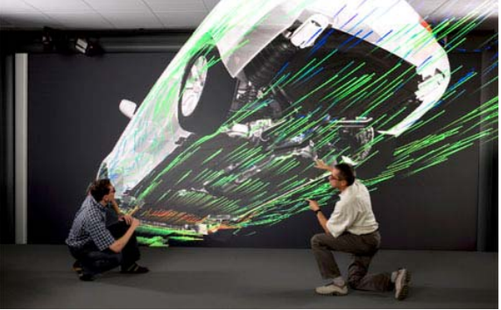

Cyber-Physical System
Why?
What?
Conclusion
Future direction
How?
http://www.real-programmer.com/interesting_things/IEEE%20SpectrumThisCarRunsOnCode.pdf
Notes:
Why FI?

Slide 3
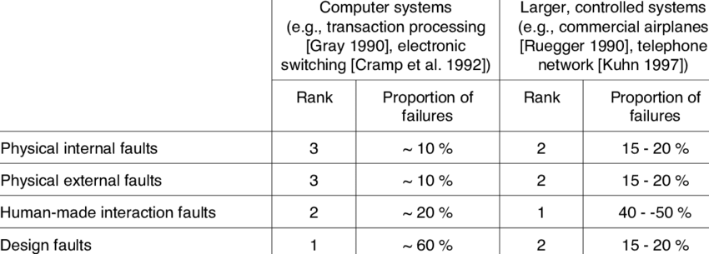
Faults and Failures
Why?
What?
Conclusion
Future direction
How?
Deswarte, Y., Creese, S., Deswarte, Y., Kursawe, K., Laprie, J.C., Powell, D., Randell, B., Riordan, J., Ryan, P., Simmonds, W., Stroud, R., Verissimo, P., Waidner, M., Wespi, A.: Conceptual Model and Architecture of MAFTIA Conceptual Model and Architecture of MAFTIA Departamento de Inform ´ Faculdade de Ciˆ. (2003).

Slide 4
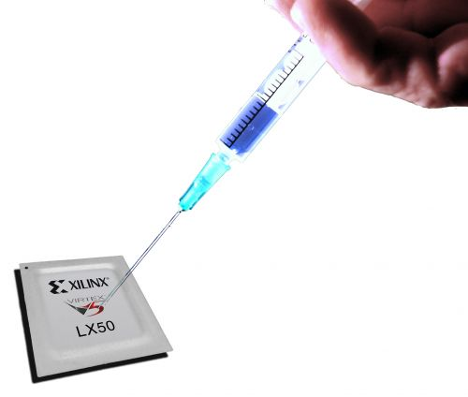
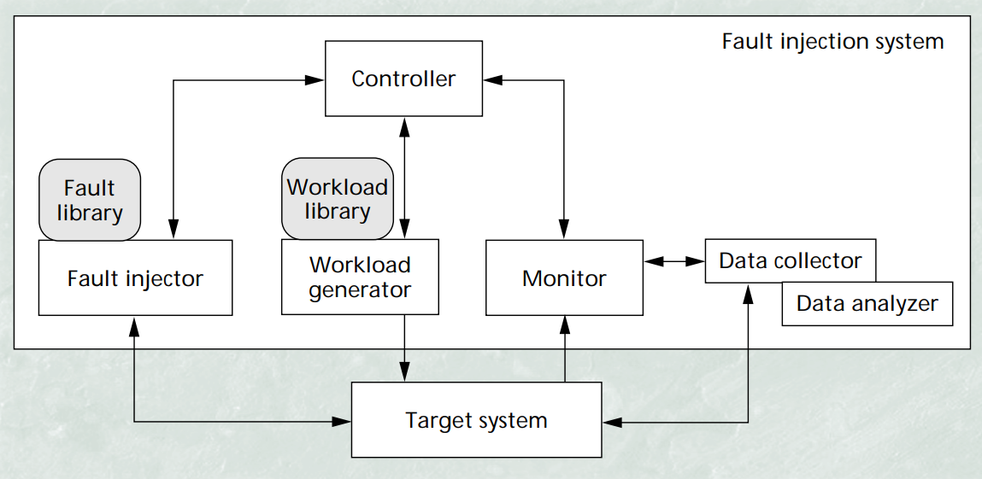
Fault Injection
Why?
What?
Conclusion
Future direction
How?
FARM model:
the set of Faults to be injected,
the set of Activations exercised during the experiment,
the Readouts to define observers of system behavior,
the Measures dependability properties.
Fault Injection Techniques and Tools
J. Arlat, M. Aguera, L. Amat, Y. Crouzet, J.C. Fabre, J.-C. Laprie, E. Martins, D. Powell, Fault Injection for Dependability Validation: A Methodology and some Applications, IEEE Transactions on Software Engineering, Vol. 16, No. 2, February 1990, pp. 166–182
Notes:
Connect pic to farm
An effective way to characterize a fault injection environment is the FARM model. The FARM model is composed of:
Faults: the faults (and its types) to inject into the model
Activations: Input to the system + when to inject faults
Read-outs: set of outputs of the system to read-out to interpret behavior
Measures: correspond to the dependability measures obtained through fault injection.
Where: to apply change (location, abstraction/system level)
What: to inject (what should be injected/corrupted?)
Which: trigger to use (event, instruction, timeout, exception, code mutation?)
When: to inject (corresponding to type of fault)
How: often to inject
….
What to record & interpret? To what purpose?
How is the system loaded at the time of the injection
Application running and their load (work load)
System resources
Real -> realistic -> synthetic workload

Slide 5
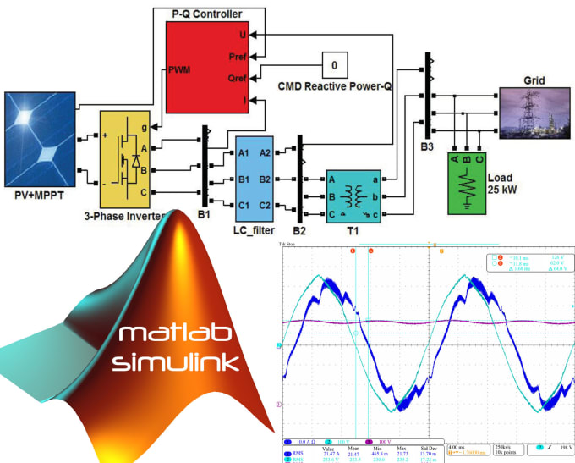
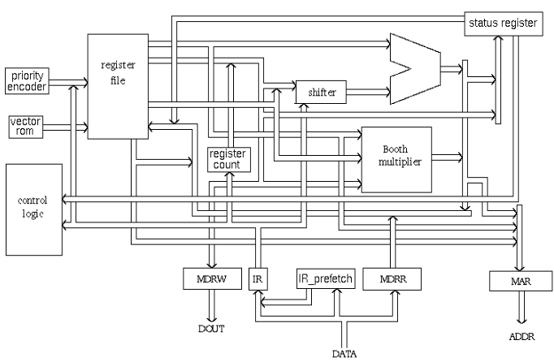
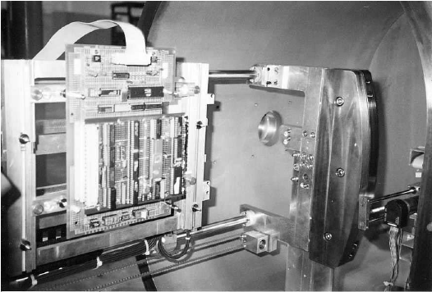
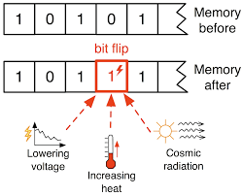
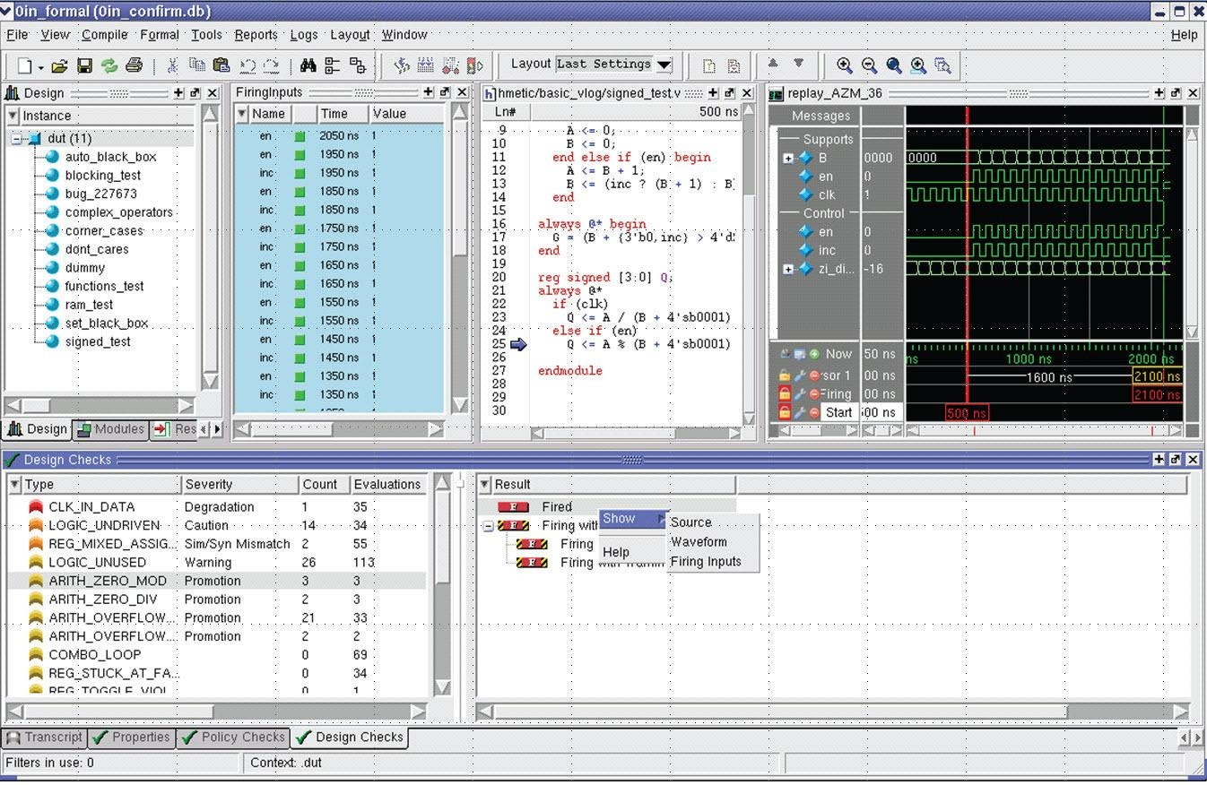
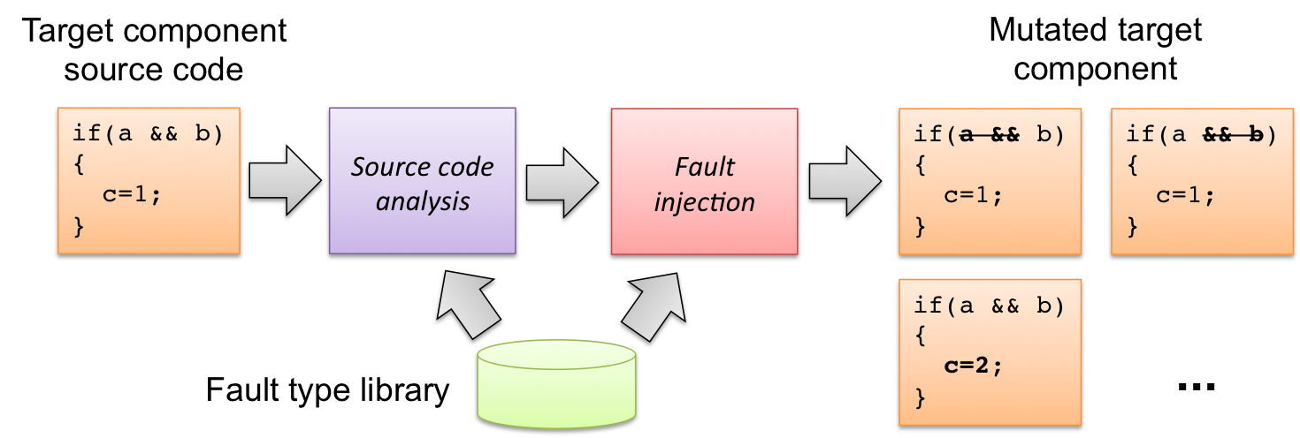
Fault Injection’s Types
Why?
What?
Conclusion
Future direction
How?
http://wpage.unina.it/roberto.natella/tools.html
Notes:
Hardware-based, software-based, simulation- based
Hybrid FI
Prototype-based, measurement-based, emulation-based, protocol-based
So it’s a time consuming, costly …. process

Slide 6
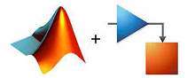
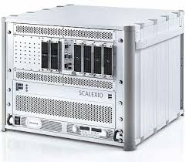
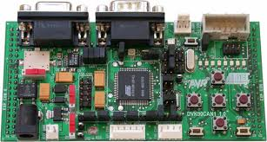
Framework
Why?
What?
Conclusion
Future direction
How?
Generative techniques: Model-Implemented Hybrid Fault Injection by explicit modelling of FARM in Simulink to setup the experiments both for
Model-in-the-Loop (MiL) and Hardware-in-the-Loop (HiL)
Control Models
Plant Models
MiL
Real-Time
System
Embedded
Target
HiL
Notes:
MiL→ reduce complexity – cost, easier
HiL→real case

Slide 7
Conclusion
Why?
What?
Conclusion
Future direction
How?
The framework automated the FI process
  MiL to simulation-based fault injection
  HiL to execution-based fault injection
  Cover wide variety of fault type
  Flexible fault injection scenario

Slide 8
Future direction
Why?
What?
Conclusion
Future direction
How?
  Complete FARM model
    Temporal Logic
  Efficient fault injection
    Increase fault coverage and speed
  Complex fault injection
  INES and aSET projects

Slide 9
Thank you for your attention

