Slide 1
Modelling Dynamic Structure Reactive Systems
Simon Van Mierlo

Slide 2
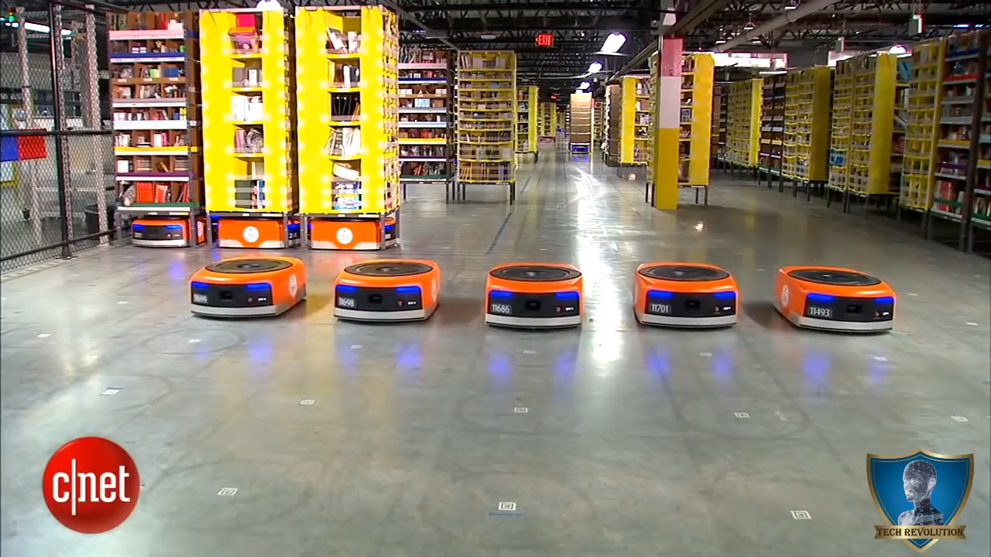
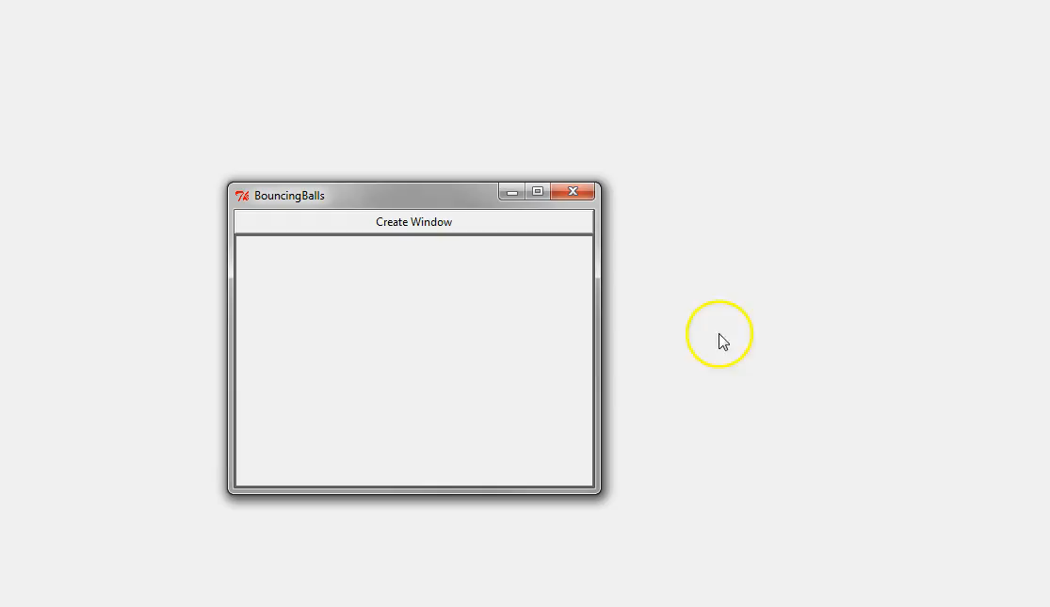
Why?
Behaviour:
Timed
Reactive
Dynamic-Structure
Independent
Adaptive
Notes:
Complex, adaptive systems often consist of autonomous agents
These agents have:
Desires
Beliefs
Intentions
Agents need to be modelled in some modelling language
Including their behaviour
And the dynamic-structure nature of the system

Slide 3
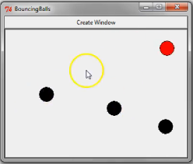
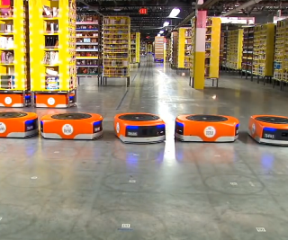
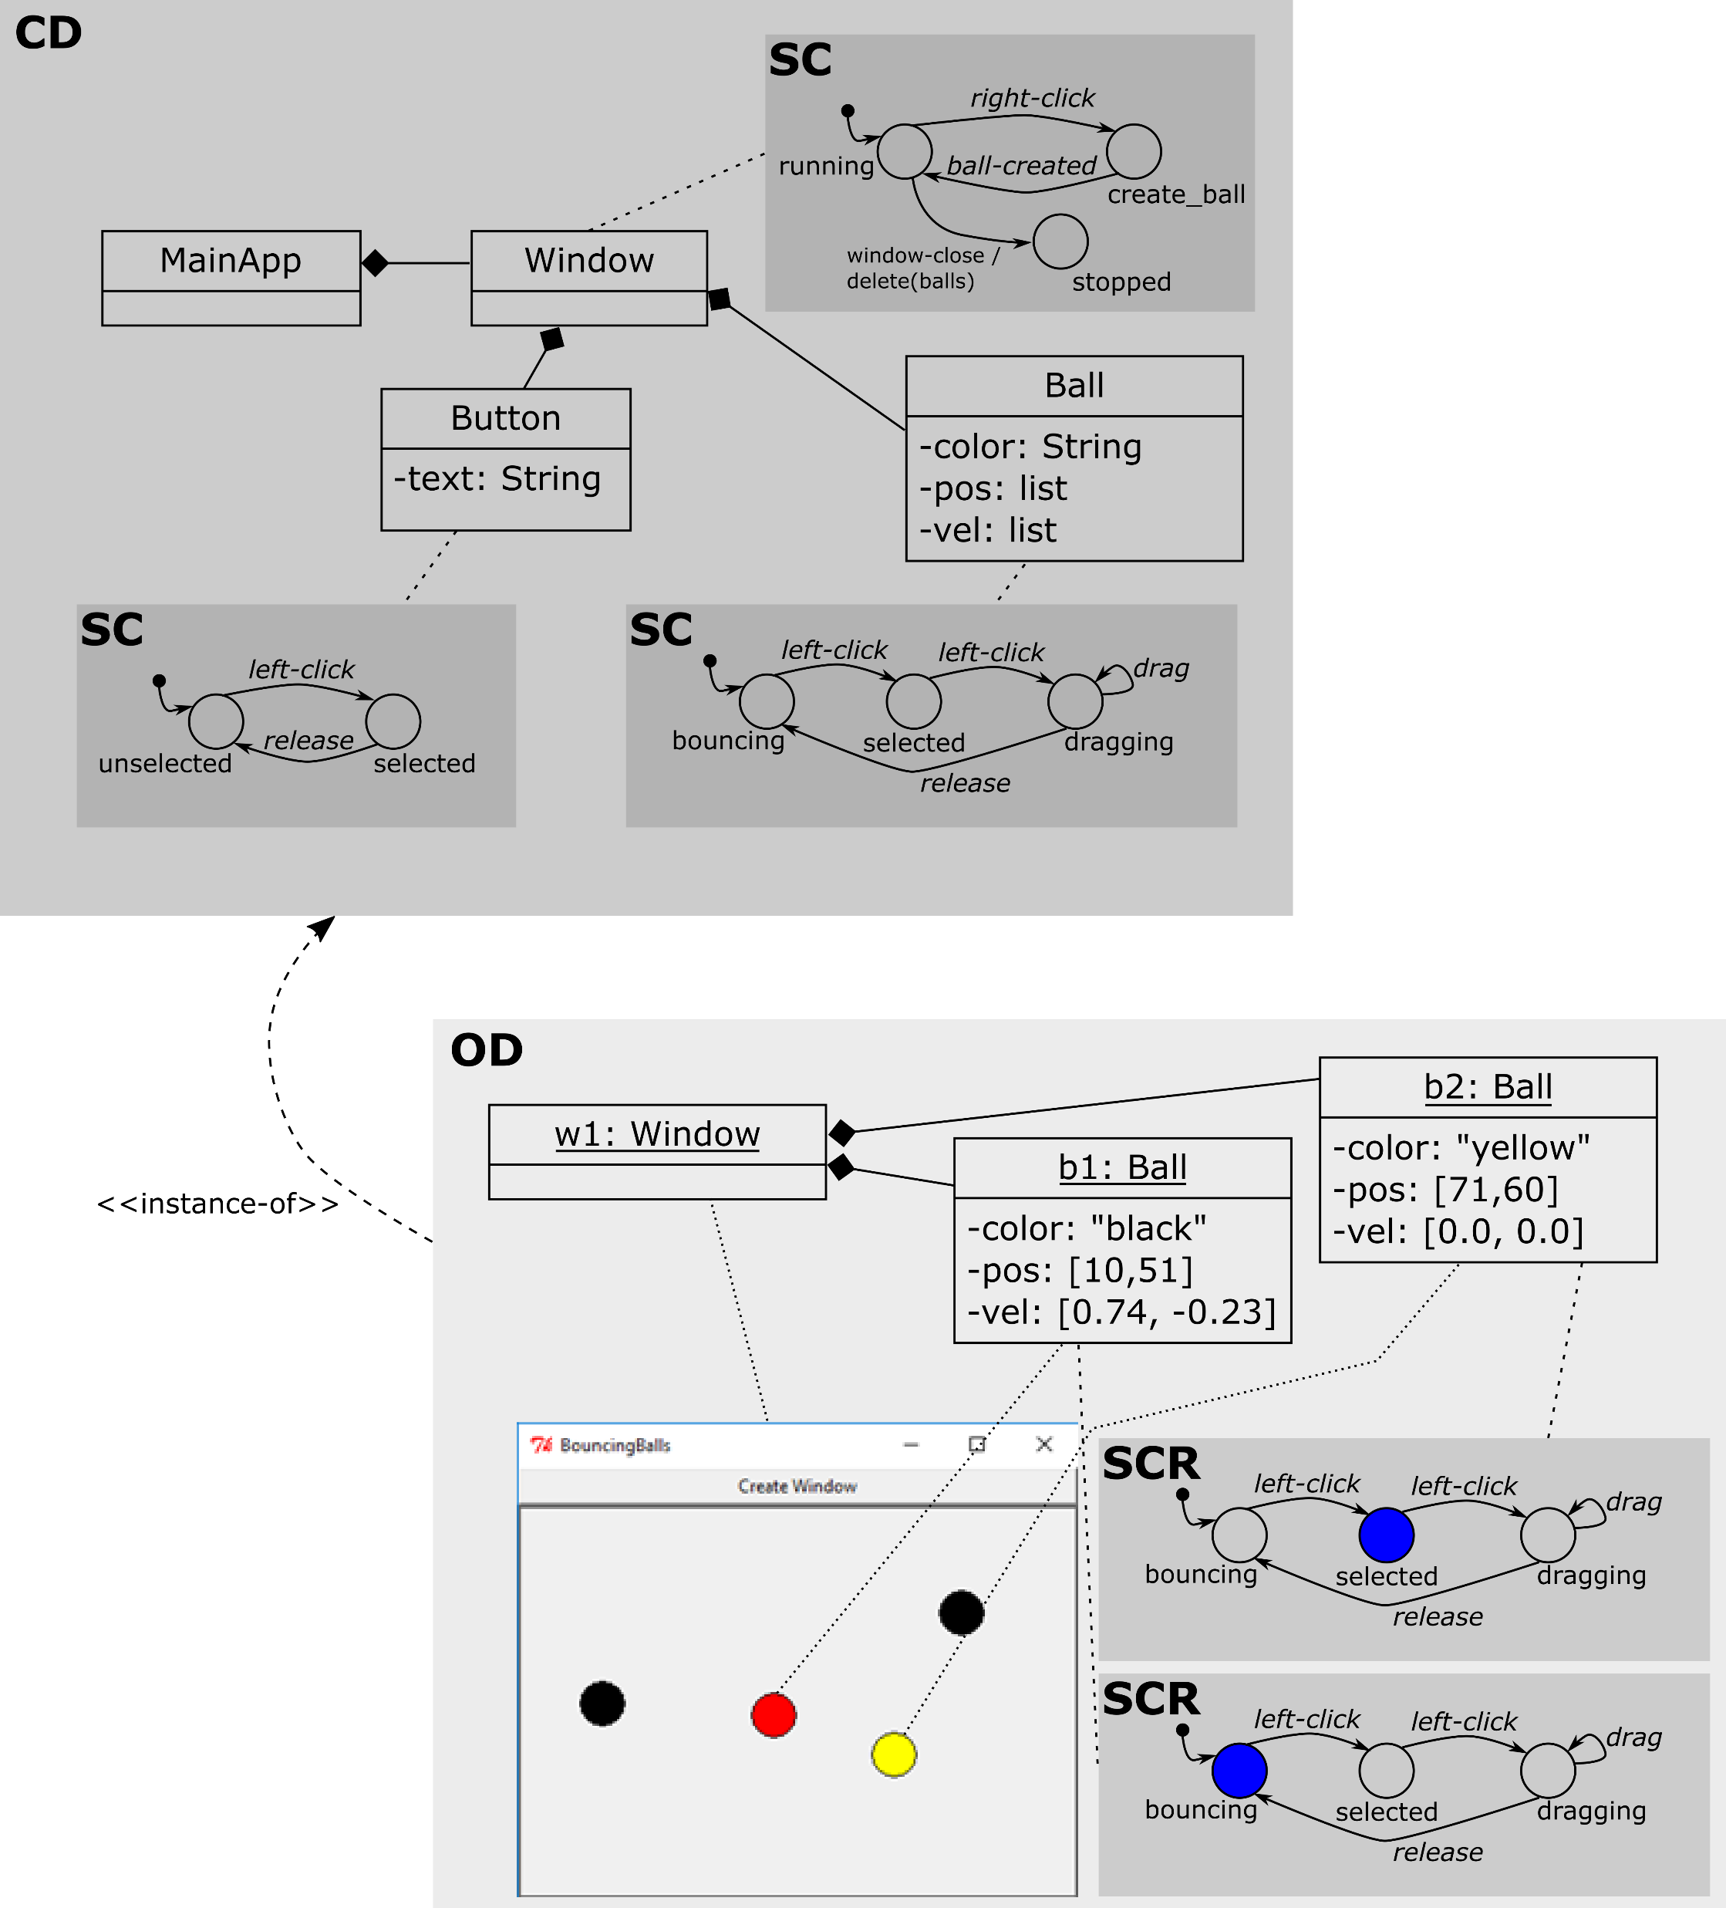
What?
Statecharts +
Class Diagrams
= SCCD
Independent Agents:
Desires
Beliefs
Intentions
Loose Couplings
Distributed Control
Notes:
SCCD
Can model dynamic-structure reactive systems (and their interactions in the form of events that are sent over channels)
Go further:
Agents need to be independent
Loose couplings
Distributed control

Slide 4

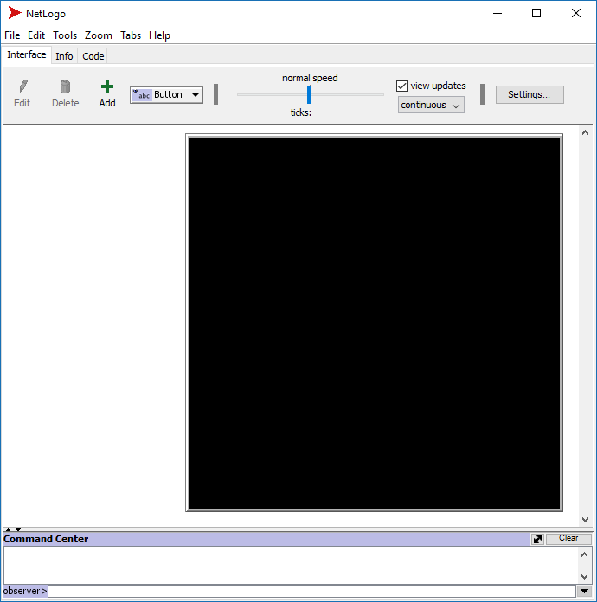


How?
SCCD
REFINE
Exceptions
Dynamic Loading
Interfaces
Subtyping
Object Referencing
Generalize Syntax + Semantics
MAS Lan.
SCCD++
Behaviour:
Timed
Reactive
Dynamic-Structure
Independent
Adaptive
Denotational Semantics
Notes:
Finish SCCD
Build language for agents on top of SCCD

Slide 5
Roadmap
Low-Hanging Fruit:
  “Fix” SCCD (-> SCXML)
  Object Behaviour Pattern
  Testing/Verification of SCCD
Master Thesis:
  Figure out MAS/BAM, syntax + semantics
  Formalize, map onto SCCD
Later:
  Deployment
  Adaptive
Notes:
2019:
Look at SCXML, extend SCCD with useful concepts
Change object behaviour pattern
(look in other presentation for more)
Later:
Figure out current MAS/BAM methods, syntax+semantics
Formalize syntax and semantics in DSL, map onto SCCD for implementation
Deployment on hardware
Adaptive stuff

