Slide 1
Modular Language Engineering
Simon Van Mierlo

Slide 2
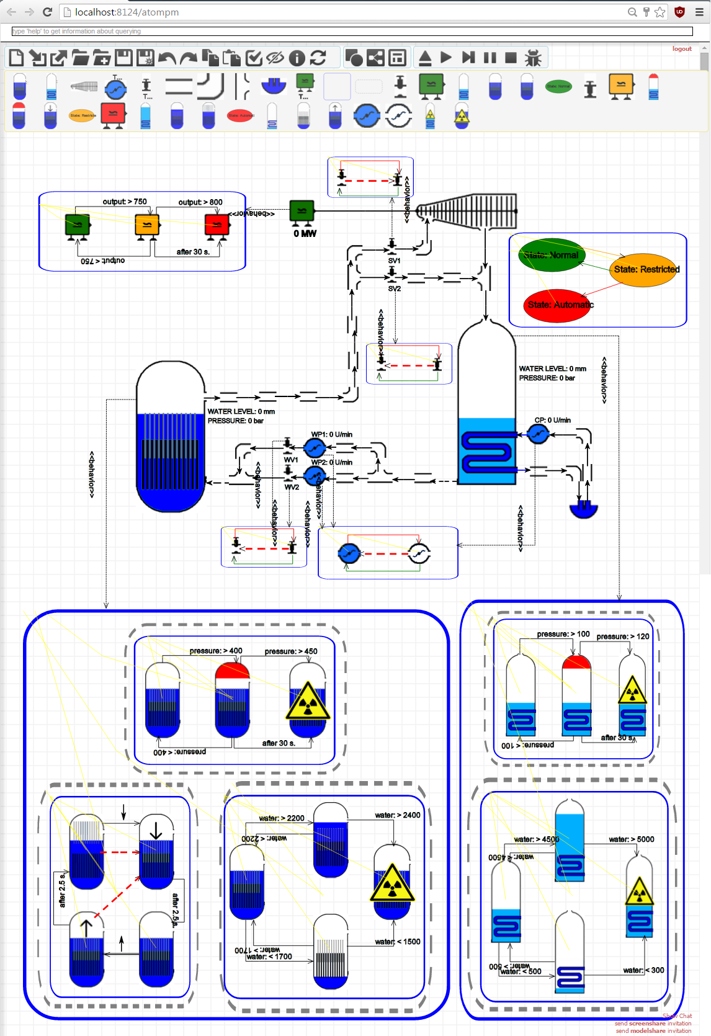
Why?
Language Engineering
Combine Existing Languages
-> possibly hybrid behaviour
Concerns:
Debugging
Testing
V&V (Properties)
Need for reuse!
Syntax
Semantics
Notes:
Combine languages
Discrete-continuous
Cross-cutting concerns
Debugging
Currently done ad-hoc

Slide 3

What?
DSL
Syntax
Semantics
Concerns (Debugging, Testing, etc.)
Monolithic -> Modularization
Language Fragment
Language Fragment
“glue”
Notes:
Method for language designers to modularly build a language

Slide 4
How?
Merged Syntax
MM_{glue}
MM₁
MM₂
SEM₁
SEM₂
SEM_{coord}
Merged Semantics

Slide 5
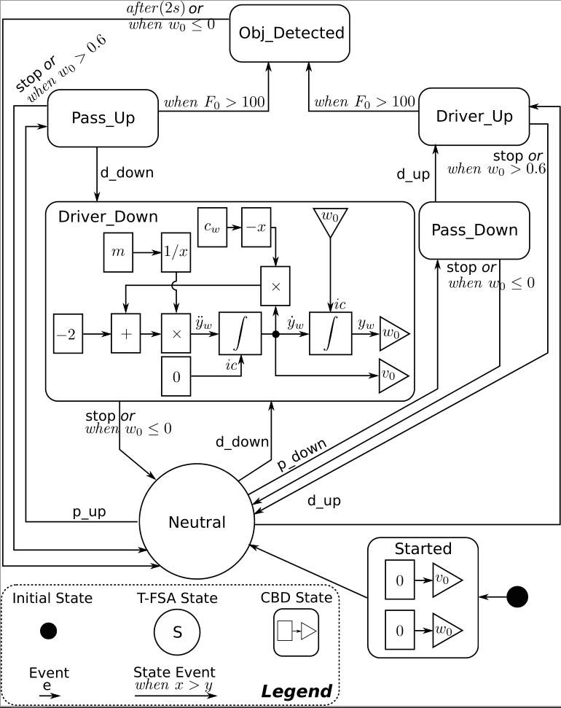
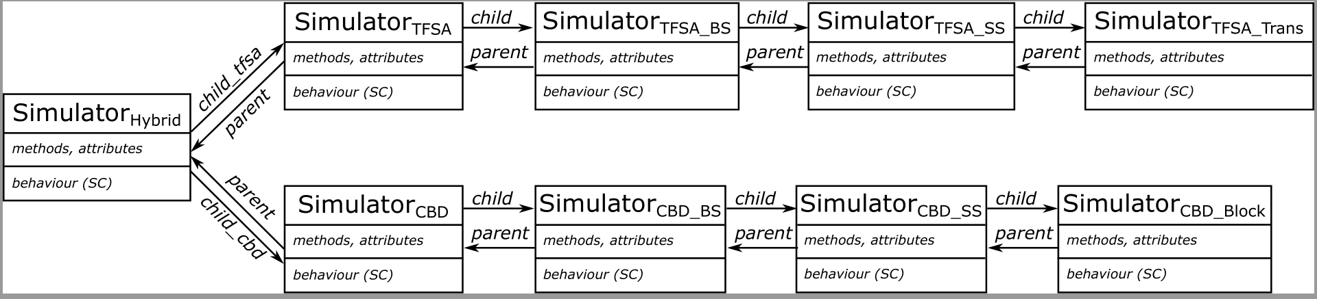
How? (Black-Box)
Hybrid TFSA-CBD Language
Notes:
Merge syntax and semantics
“Merge points”
Canonical form
“Glue”

Slide 6
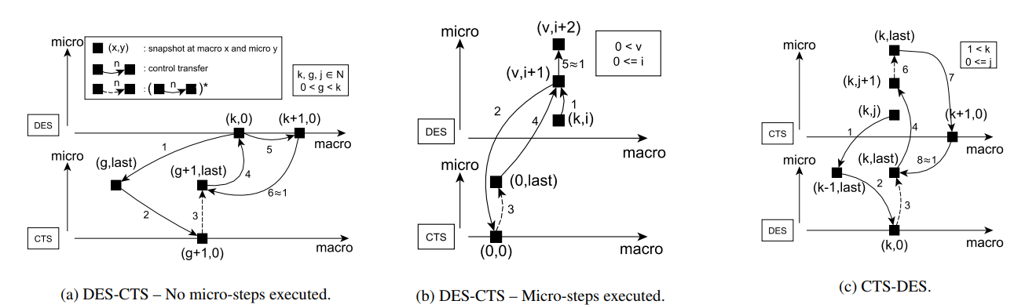
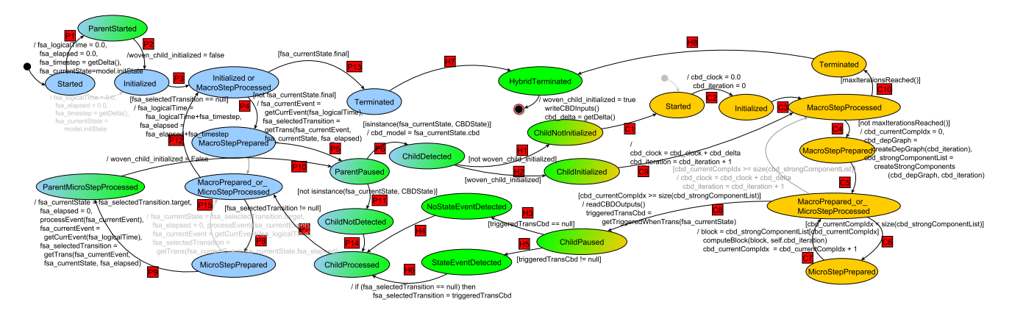
How? (White-Box)

Slide 7
Roadmap
Create language for specifying semantic interactions
Extend to “cross-cutting concerns” (debugging)
  “Glue” metamodel: extra concepts
“Fragmentize” languages to basic concepts
  Library of composable fragments
  Recompose existing languages (such as Statecharts)
Create tool support
Notes:
Current:
Canonical form shown on one example
Generalize for more language
... And towards cross-cutting concerns such as debugging

