Slide 1
Next Gen Tooling
Simon Van Mierlo

Slide 2
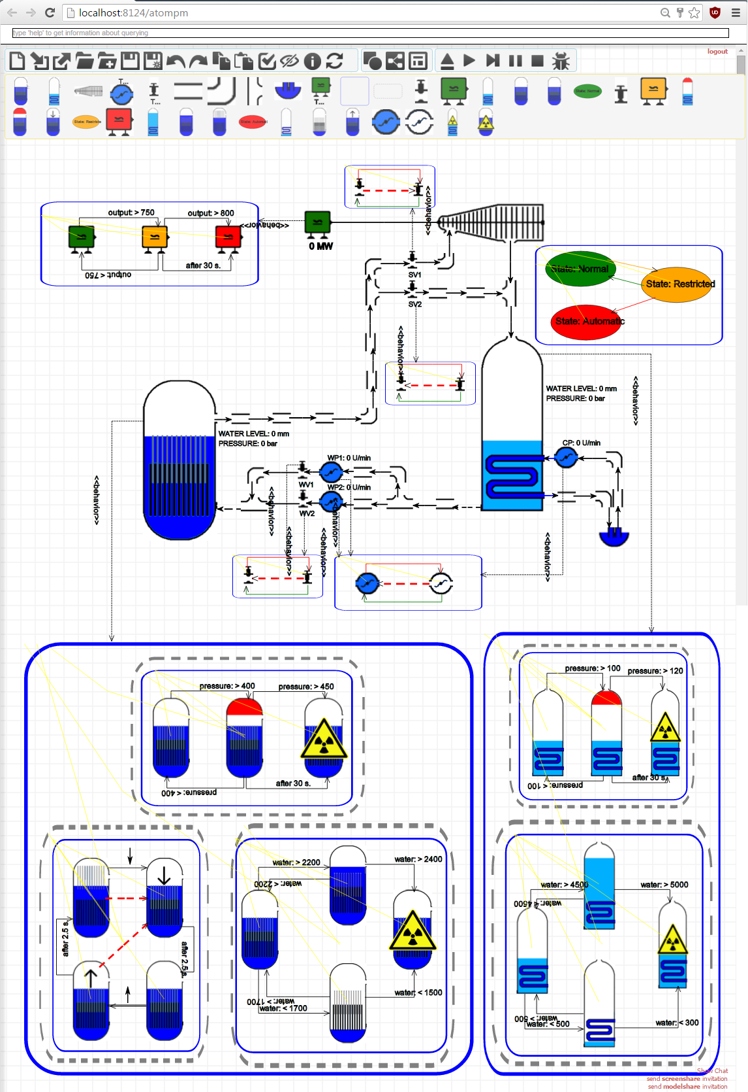
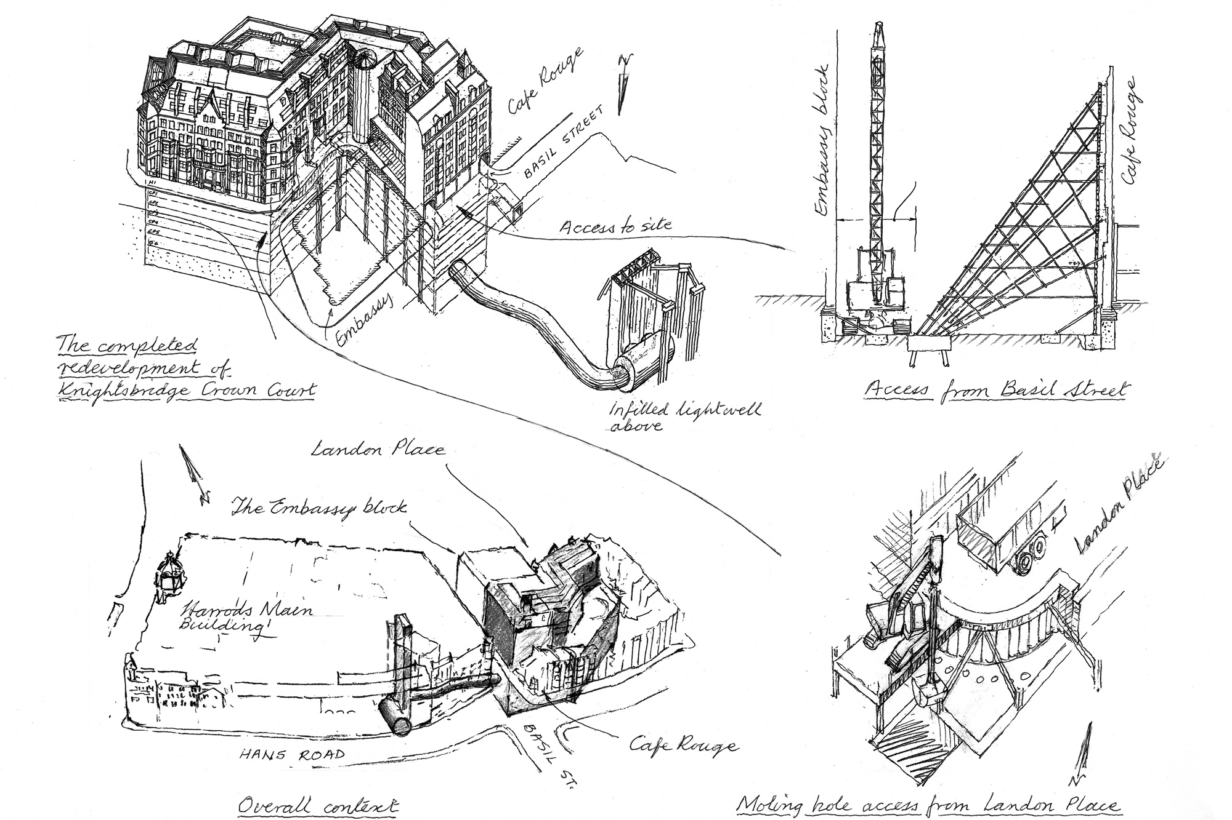
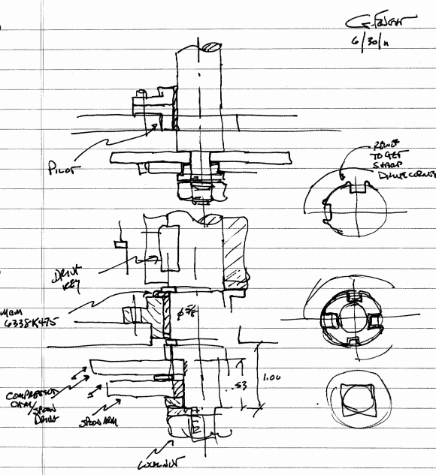
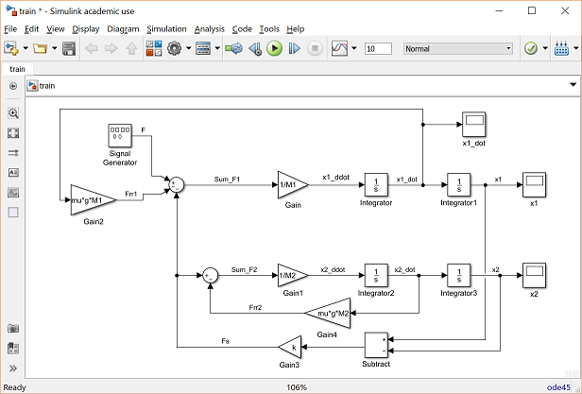
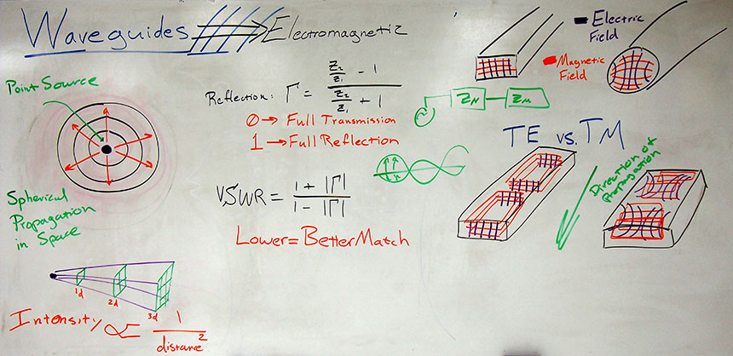
Why?
Notes:
Multi-disciplinary teams with domain experts: no formal language from the start.
People like to brainstorm before developing the system fully (ideation phase).
But later these sketches might evolve to formal models.
There is currently no tool support to fully support this process for going from a sketch to a formal model.

Slide 3
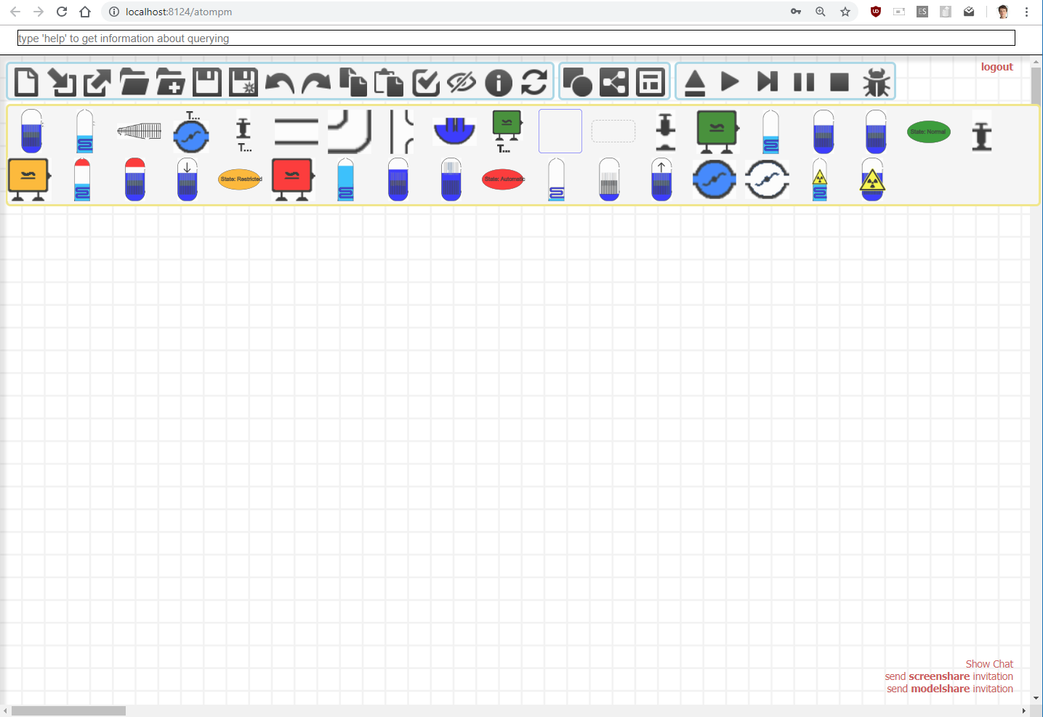

What?
SKETCHING
Multi-Disciplinary Team
BUILDING LANGUAGES FROM INSTANCES
FORMALIZE STEP BY STEP
SUGGEST TYPING FOR SKETCHES
Notes:
We will develop a flexible modelling environment that allows to:
Make early-stage sketches, completely freehand
Build up a language incrementally by giving a type to drawings
Reuse already existing languages: if a concept already exists, the tool will detect this and give suggestions for typing
BUILDING LANGUAGES FROM INSTANCES

Slide 4
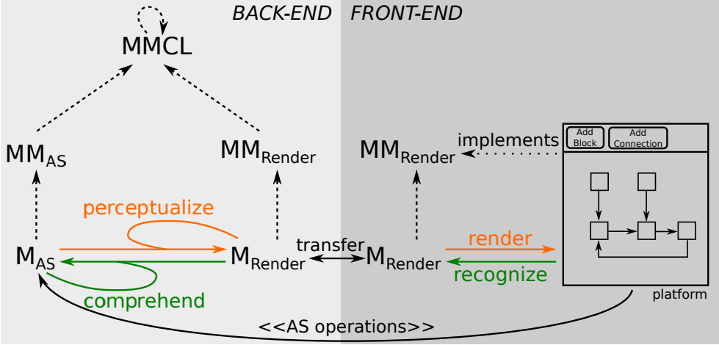
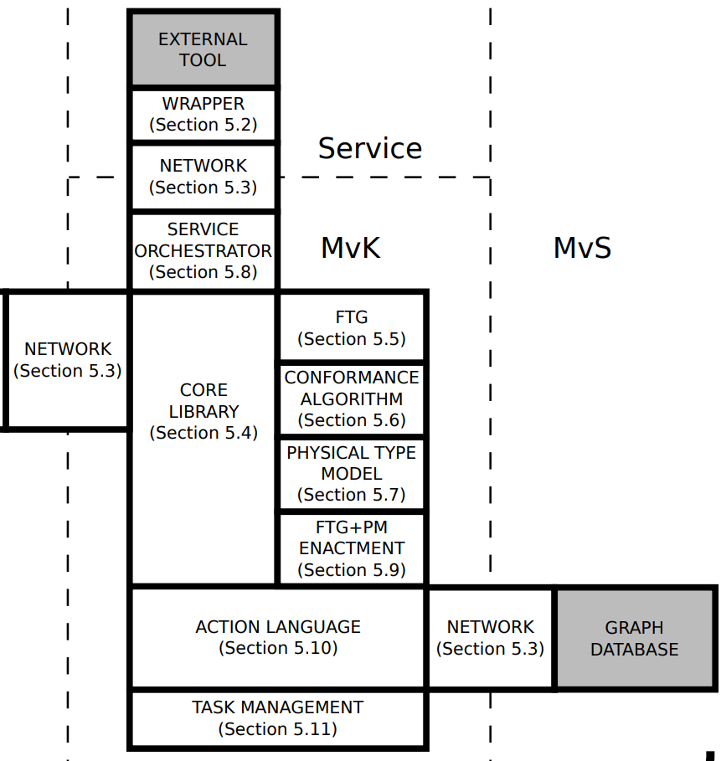
How?
Concrete Syntax
Modelverse
Sketching Environment
Generic Sketching Language
Co-Evolution
A-Posteriori Typing
Query Existing Languages
Typing Suggestions
Notes:
The implementation is based on the Modelverse
Generic sketching language
Query existing languages
A-posteriori typing to allow to change the type
Co-evolution...

Slide 5
Roadmap
Low-Hanging Fruit:
  First Prototype
Next:
  Couple to full-fledged drawing tool (Inkscape, SVGEdit, ...)
    -> model explicitly the behaviour!
  Bayesian reasoner for suggesting typings
  Implement language querying in Modelverse
  Co-Evolution
Notes:
First prototype: december 2018
Demonstrate a-posteriori typing
Next steps
Couple to full-fledged drawing tool (Inkscape, SVGEdit, ...)
Bayesian reasoner for suggesting typings
Modelverse side: querying languages

