Slide 1
Variability Modelling
Simon Van Mierlo

Slide 2
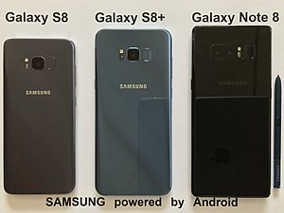
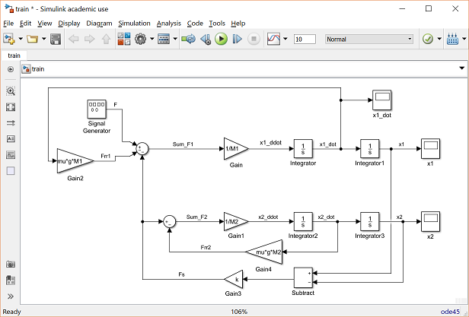
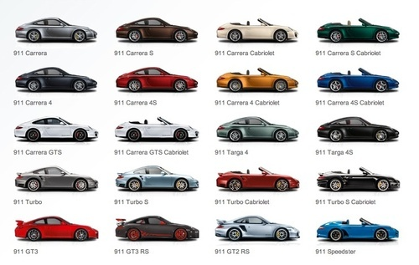
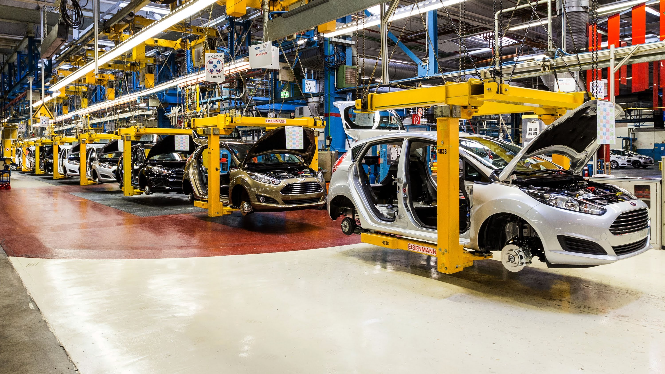
Why?
Design, V&V (Ad-Hoc)
Product Families
Manufacturing (Reconfigure)
Ultimately: lot-size one
(at cost of series production)
Notes:
Companies have lots of products that are very similar
Currently their whole development process is based on clone and own:
Design
V&V
Deployment
Testing
This is counterproductive as any changes will not propagate
We want to be able to build customized products at the cost of series products

Slide 3
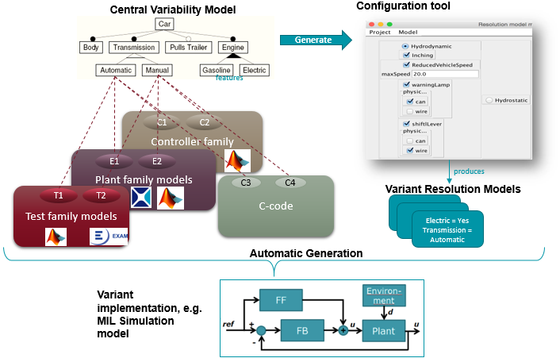
What?
Binding Times:
Model Generation
Code Generation
Compilation
Startup
Languages: Causal vs. Acausal
Tools
Notes:
We want to manage variability

Slide 4
How?
Specifying Variability:
Family modelling tool (BVR, pure::variants)
Variation Points:
Language primitives
External
Traceability between variation points and features
Link to:
Deployment (HiL)
Testing
Notes:
A method for:
Specifying variability (model)
Variation points in models
Traceability between variation points and features
Link to design, testing, deployment

Slide 5
Roadmap
Low-Hanging Fruit:
Language primitives in acausal languages (Modelica, Simscape, Amesim)
Model transformation for model generation binding time
Next:
Link to testing
Deployment (HiL)
Automatic manufacturing configuration per product
Notes:
(See FM roadmap)

