Slide 1
Deployment of Complex Real-Time Control Algorithms on Heterogeneous Embedded Hardware - A Co-Design Problem -
Yon Vanommeslaeghe

Slide 2
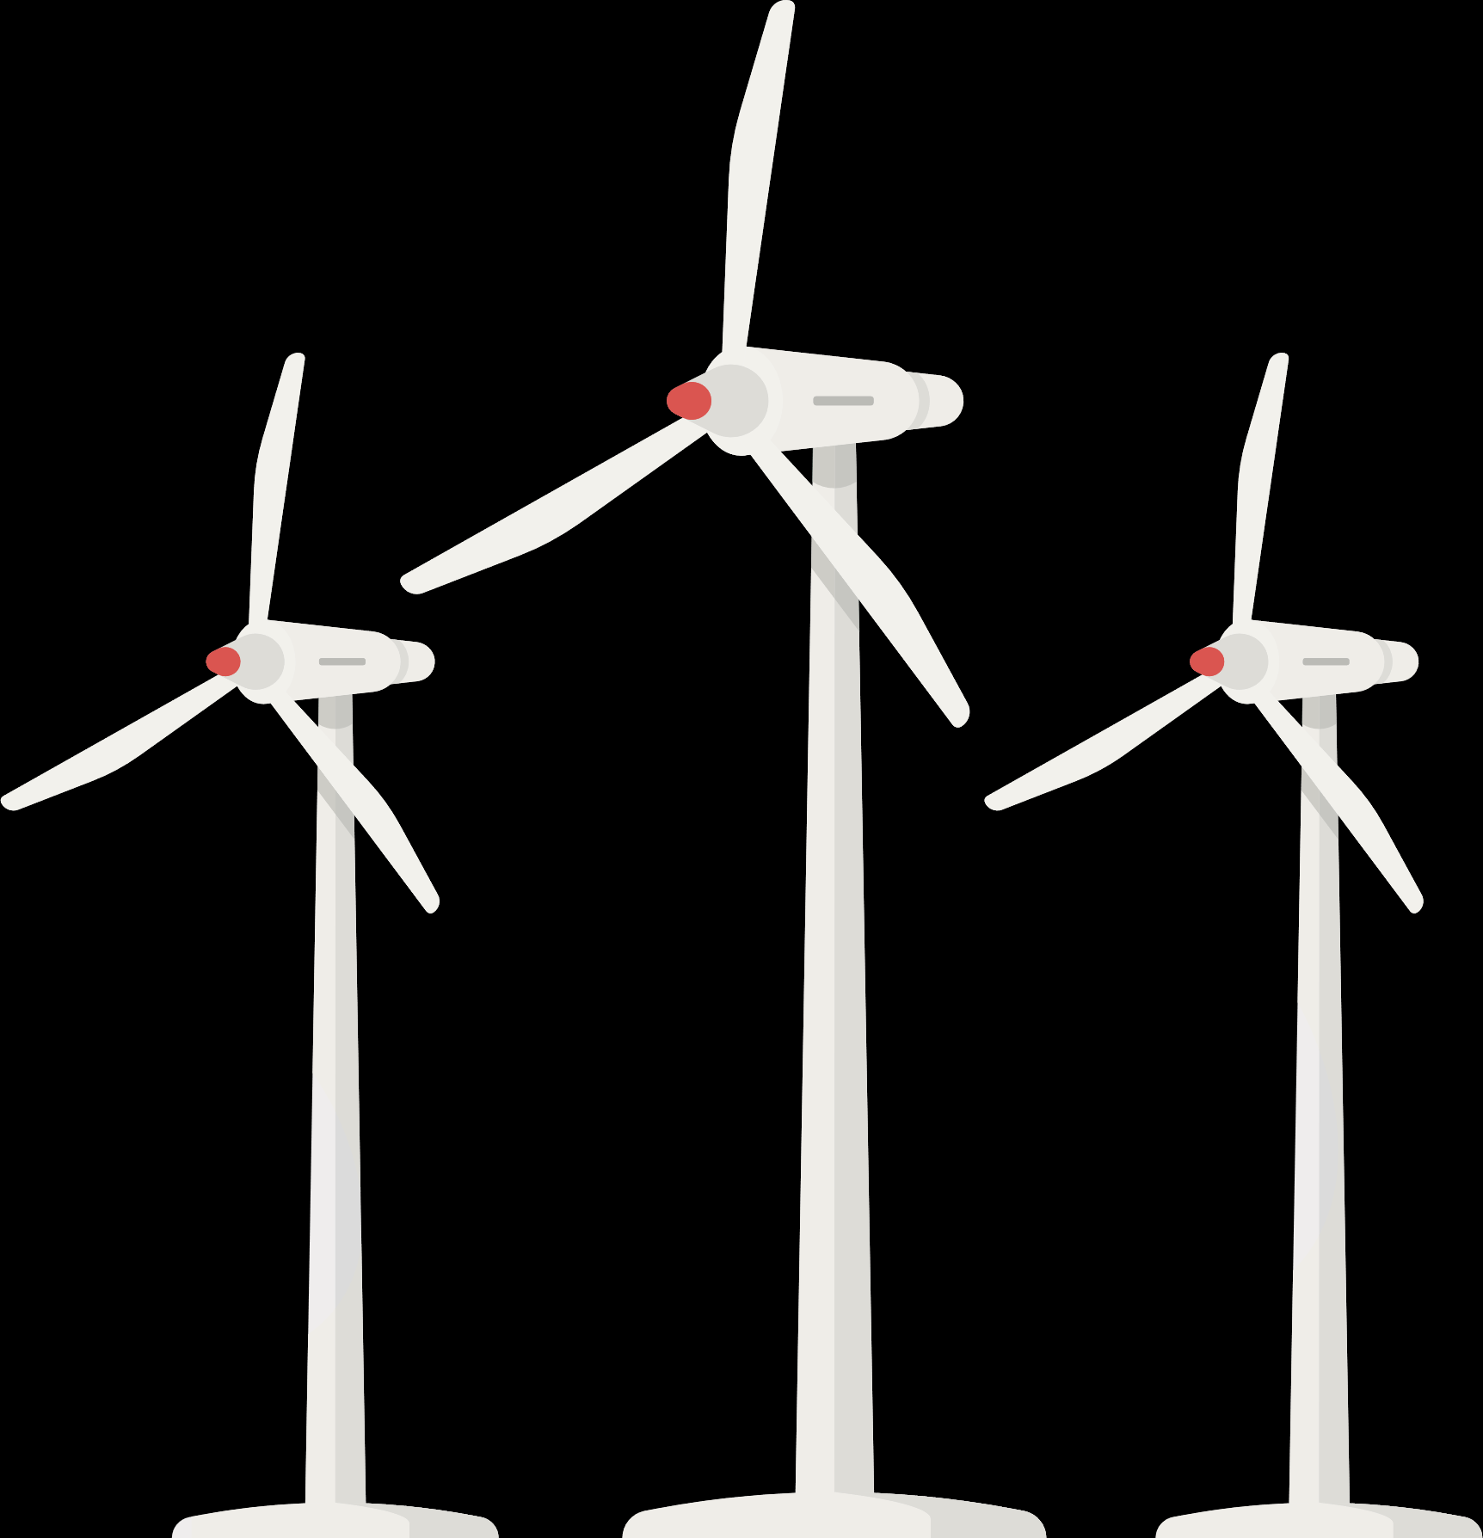
Context
Cyber-physical systems are becoming more complex.
So is the software that is meant to monitor and control them.
Illustrations by Vectorpocket, Fullvector and Freepik – Freepik.com

Slide 3
Problem
- Complex algorithms
- High numerical precision
- High frequency
- Algorithm parameters
- Complex platforms
- Multi-core
- Heterogeneous
- Limited resources
Control
Embedded
How do we find a good combination?
Icons by Eucalyp – Flaticon.com

Slide 4
Approach
Design space exploration

Slide 5
Companies in Flanders
Belgium with Provinces - Single Color by FreeVectorMaps.com

Slide 6
Questions?
Illustrations by Vectorpocket, Fullvector and Freepik – Freepik.com

